Slide 1
码农学习小组
Week 01

Slide 2
码农面试一般过程
投简历 / 内推
Recruiter寒暄
电话面试 1-3 轮
Onsite面试 一整天

Slide 3
码农面试问题分类
基础知识
CS基础知识- Max Integer, Max Unsigned Integer, K, M, G, T.
操作系统知识 – 虚拟内存，进程与线程
网络基础 – TCP vs UDP, HTTP
Design Pattern
算法 Algorithm
面向对象的设计 OOD
系统设计 System Design
难度
比重

Slide 4
目标
立足九章
刷会Leetcode Easy to Medium
分享经验、树立信心

Slide 5
时间复杂度和空间复杂度 BUD优化 – Bottleneck Unnecessary Duplicated
Two Sum
[2, 0, 8, 3, 4, 9, 5, 1] target=5
[2, 3], [0, 5], [4, 1]
Brute force
Sort
HashMap / HashSet
 | Time | Extra Space
Brute force | O(n^2) | O(1)
Sort | O(nlgn) | O(1)
HashSet | O(n) | O(n)

Slide 6
九章算法第二节 二分查找 – Binary Search
什么是Binary Search？
前提条件？
时间复杂度？
The master theorem
T(n) = aT(n/b) + f(n)
T(n) = T(n/2) + O(1) → O(lgn)
T(n) = T(n/2) + O(n) → O(nlgn)

Slide 7
二分查找模板 – 九章vs传统
int start = 0, end = nums.length - 1;
while (start + 1 < end) {
int mid = start + (end - start) / 2;
if (nums[mid] < target) {
start = mid;
} else {
end = mid;
}
}
if (nums[start] == target) {
return start;
}
if (nums[end] == target) {
return end;
}
return -1;
int start = 0, end = nums.length - 1;
while (start < end) {
int mid = start + (end - start) / 2;
if (nums[mid] == target) {
return mid;
}
else if (nums[mid] < target) {
start = mid + 1;
} else {
end = mid - 1;
}
}
return -1;

Slide 8
Example – Search for first or last target
1，1，1，2，2，2，3，3
int start = 0, end = nums.length - 1;
while (start + 1 < end) {
int mid = start + (end - start) / 2;
if (nums[mid] < target) {
start = mid;
} else {
end = mid;
}
}
if (nums[start] == target) {
return start;
}
if (nums[end] == target) {
return end;
}
return -1;
int start = 0, end = nums.length - 1;
while (start + 1 < end) {
int mid = start + (end - start) / 2;
if (nums[mid] <= target) {
start = mid;
} else {
end = mid;
}
}
if (nums[start] == target) {
return start;
}
if (nums[end] == target) {
return end;
}
return -1;

Slide 9
九章算法第三节 – Binary Tree & Divide and Conquer
什么是Binary Tree？
Balanced Binary Tree
Complete Binary Tree
Full Binary Tree
Binary Search Tree
什么是Divide and Conquer
举例？
时间复杂度？
第二大类解题思路

Slide 10
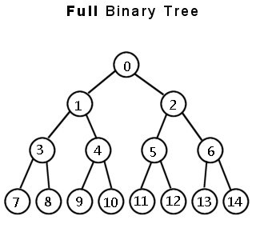
二叉树的重要性质
高度为h的Full Binary Tree, 节点数n=？
2⁰ + 2¹ + … + 2^{(h-1)} = 2^{h} – 1 = n
节点数为n的Full Binary Tree，高度是？
Lg(n)
任意一层的节点数与其上所有节点数的关系？
多1个
父节点与子节点的序号关系？
left_son = p * 2 + 1; right_son = p * 2 + 2;
p = (son – 1) / 2;

Slide 11
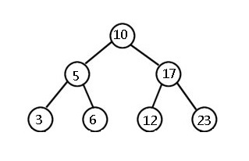
二叉树的遍历
深度优先DFS，广度优先BFS
顺序In-order，先序Pre-order，后序Post-order
层序Level-order

Slide 12
Binary Tree DFS recursive traverse 通用模板
In-order
[?] traverse (TreeNode root) {
if (root == null) // base case
return something;
[?] l = traverse(root.left);
do something with root;
[?] r = traverse(root.right);
return something base on l and r;
}
Pre-order
[?] traverse (TreeNode root) {
if (root == null) // base case
return something;
do something with root;
[?] l = traverse(root.left);
[?] r = traverse(root.right);
return something base on l and r;
}

Slide 13
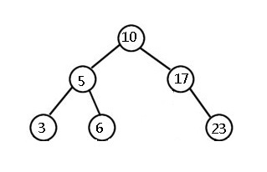
Binary Tree BFS iterative traverse 通用模板
Level-order
List<Integer> traverse (TreeNode root) {
Queue<Integer> queue = new LinkedList<>();
List<Integer> result = new ArrayList<>();
queue.add(root);
while (!queue.isEmpty()) {
TreeNode node = queue.poll();
result.add(node.val);
if (node.left != null)
queue.add(node.left);
if (node.right != null)
queue.add(node.right);
}
return result;
}

Slide 14
Binary Search Tree
Pre-order
boolean traverse (TreeNode root, int target) {
if (root == null) // base case
return false;
int value = root.val;
if (value == target)
return true;
else if (value > target)
return traverse(root.left);
else
return traverse(root.right);
}
查找一个元素
用哪个模板？
如何修改这个模板？
时间复杂度？
插入一个元素
删除一个元素

Slide 15
Questions?

Slide 16
Homework!
https://leetcode.com/problems/first-bad-version/
https://leetcode.com/problems/search-for-a-range/
https://leetcode.com/problems/find-peak-element/
https://leetcode.com/problems/search-insert-position/
https://leetcode.com/problems/search-in-rotated-sorted-array/
https://leetcode.com/problems/search-in-rotated-sorted-array-ii/
https://leetcode.com/problems/balanced-binary-tree/
https://leetcode.com/problems/same-tree/
https://leetcode.com/problems/binary-tree-paths/
https://leetcode.com/problems/lowest-common-ancestor-of-a-binary-search-tree/
https://leetcode.com/problems/count-complete-tree-nodes/
https://leetcode.com/problems/validate-binary-search-tree/

