Slide 1
Programmer’s Study Group
Week 08

Slide 2

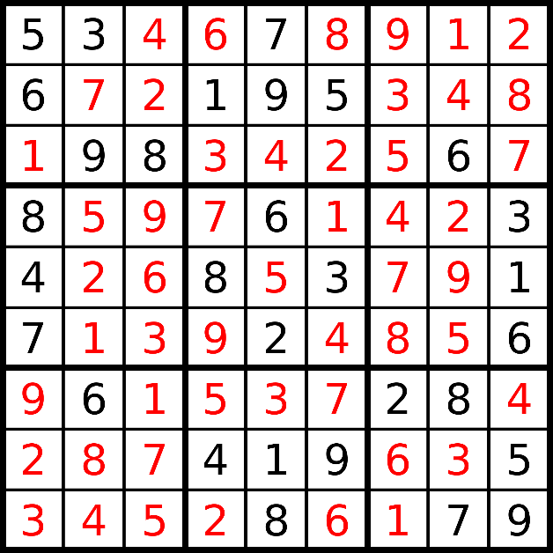
Backtracking – 回溯
Backtracking is a general algorithm for finding all (or some) solutions to some computational problems, notably constraint satisfaction problems, that incrementally builds candidates to the solutions, and abandons each partial candidate c(“backtracks”) as soon as it determines that c cannot possibly be completed to a valid solution. - Wikipedia

Slide 3
Example – Subsets
Given a set of distinct integers, nums, return all possible subsets. Note: Elements in a subset must be in non-descending order. The solution set must not contain duplicate subsets.
If nums = [1,2,3], a solution is: [ [], [1], [1,2], [1,2,3], [1,3], [2], [2,3], [3] ]
How many results?
C (n, m) = n! / (m! * (n - m)!) Ʃ C (n, i) = 2^{n} https://en.wikipedia.org/wiki/Pascal%27s_triangle
[]
[1]
[2]
[3]
[1, 2]
[1, 3]
[2, 3]
[1, 2, 3]

Slide 4
List<List<Integer>> result = null;
private void helper(int[] nums, List<Integer> subset, int left, int pos) {
result.add(new ArrayList<Integer>(subset));
if (left == 0) return;
for (int i = pos; i < nums.length; i++) {
subset.add(nums[i]);
helper(nums, subset, left - 1, i + 1);
subset.remove(subset.size() - 1);
}
}
public List<List<Integer>> subsets(int[] nums) {
result = new ArrayList<List<Integer>>();
if (nums == null) return result;
int len = nums.length;
if (len == 0) return result;
Arrays.sort(nums);
helper(nums, new ArrayList<Integer>(), len, 0);
return result;
}
When add result?
When return?
For loop conditions
Recursion parameters

Slide 5
Example – Subsets II
Given a set of distinct integers that might contain duplicates, nums, return all possible subsets. Note: Elements in a subset must be in non-descending order. The solution set must not contain duplicate subsets.
If nums = [1, 2, 2], a solution is:
[ [], [1], [1,2], [1,2,2], [2], [2,2] ]
[]
[1]
[2]
[2]
[1, 2]
[1, 2]
[2, 2]
[1, 2, 2]

Slide 6
List<List<Integer>> result = null;
private void helper(int[] nums, List<Integer> subset, int left, int pos) {
result.add(new ArrayList<Integer>(subset));
if (left == 0) return;
for (int i = pos; i < nums.length; i++) {
if (i != pos && nums[i] == nums[i - 1]) continue;
subset.add(nums[i]);
helper(nums, subset, left - 1, i + 1);
subset.remove(subset.size() - 1);
}
}
public List<List<Integer>> subsetsWithDup(int[] nums) {
result = new ArrayList<List<Integer>>();
if (nums == null) return result;
int n = nums.length;
if (n == 0) return result;
Arrays.sort(nums);
helper(nums, new ArrayList<Integer>(), n, 0);
return result;
}
Avoid duplication

Slide 7
Example – Permutations
Given a collection of distinct numbers, return all possible permutations.
If nums = [1,2,3], a solution is: [ [1,2,3], [1,3,2], [2,1,3], [2,3,1], [3,1,2], [3,2,1] ]
How many results?
P (n, n) = n!
[]
[1]
[2]
[3]
[1, 2]
[1, 3]
[2, 1]
…
[1, 2, 3]
[1, 3, 2]
[2, 1, 3]
…

Slide 8
List<List<Integer>> result;
private void helper(int[] nums, ArrayList<Integer> current, int left,
HashSet<Integer> used) {
if (left == 0) {
result.add(new ArrayList<Integer>(current));
return;
}
for (int i = 0; i < nums.length; i++) {
if (used.contains(i)) continue;
current.add(nums[i]);
used.add(i);
helper(nums, current, left - 1, used);
current.remove(current.size() - 1);
used.remove(i);
}
}
public List<List<Integer>> permute(int[] nums) {
result = new ArrayList<List<Integer>>();
if (nums == null || nums.length == 0) return result;
Arrays.sort(nums);
helper(nums, new ArrayList<Integer>(), nums.length, new HashSet<Integer>());
return result;
}

Slide 9
Example – Combinations
Given two integers n and k, return all possible combinations of k numbers out of 1 ... n.
If n = 4 and k = 2, a solution is: [ [1,2], [1,3], [1,4], [2,3], [2,4], [3,4] ]
How many results?
C (n, k) = n! / (k! * (n – k)!)
[]
[1]
[2]
[3]
[4]
[1, 2]
[1, 3]
[1, 4]
…

Slide 10
private List<List<Integer>> result = null;
private void combineHelper(List<Integer> subset, int n, int start, int left) {
if (left == 0) {
result.add(new ArrayList<Integer>(subset));
return;
}
for (int i = start; i <= n; i++) {
subset.add(i);
combineHelper(subset, n, i + 1, left - 1);
subset.remove(subset.size() - 1);
}
}
public List<List<Integer>> combine(int n, int k) {
result = new ArrayList<List<Integer>>();
if (n == 0 || k == 0 || k > n) return result;
combineHelper(new ArrayList<Integer>(), n, 1, k);
return result;
}

Slide 11
Example – Combination Sum
Given a set of candidate numbers (C) and a target number (T), find all unique combinations in C where the candidate numbers sums to T. The same repeated number may be chosen from C unlimited number of times. The solution set must not contain duplicate combinations.
Given candidate set [2,3,6,7] and target 7, a solution is: [ [7], [2, 2, 3] ]

Slide 12
private void helper(int[] candidates, int current, int target, int start,
List<Integer> history, List<List<Integer>> result) {
if (current == target) {
List<Integer> r = new ArrayList<>(history);
result.add(r);
return;
}
for (int i = start; i < candidates.length; i++) {
if (current + candidates[i] > target) break;
history.add(candidates[i]);
helper(candidates, current + candidates[i], target, i, history, result);
history.remove(history.size() - 1);
}
}
public List<List<Integer>> combinationSum(int[] candidates, int target) {
List<List<Integer>> result = new ArrayList<List<Integer>>();
if (candidates == null) return result;
int len = candidates.length;
if (len == 0) return result;
Arrays.sort(candidates);
helper(candidates, 0, target, 0, new ArrayList<Integer>(), result);
return result;
}

Slide 13
Backtracking template
List<List<Integer>> result;
private void helper(int[] nums, List<Integer> current, int left, int start [, Set<Integer> used]) {
[result.add(new ArrayList<>(current));]
if (left == 0) {
[result.add(new ArrayList<>(current));]
return;
}
for (int i = start [0]; i < nums.length; i++) {
if (...) continue;
current.add(num[i]);
[used.add(i)];
helper(nums, current, left - 1, i [+ 1] [, used]);
current.remove(current.size() - 1);
[used.remove(i)];
}
}
public combination/subset/permutation(int[] nums) {
result = new ArrayList<List<Integer>>();
Arrays.sort(nums);
helper(nums, new ArrayList<Integer>(), left, pos [, new HashSet<Integer>()]);
return result;
}

Slide 14
Common data structures
Linear Data Structure
Linked List
Queue
Stack
HashMap
Tree Data Structure
Binary Search Tree
Heap
Trie *
Segment Tree *
Red-black Tree, AVL Tree *

Slide 15
Operations
Data Structure | In | Out | Peek | Find
Queue O(n) | add(), offer() O(1) | poll() O(1) | peek() O(1) | contains() O(n)
Stack O(n) | push() O(1) | pop() O(1) | peek() O(1) | contains() O(n)
HashMap O(x * n) | put() O(1) | remove() O(1) | - | containsKey() O(1)
BST O(n) | - O(lgn) | - O(lgn) | - | - O(lgn)
Heap – PQ O(n) | add() O(lgn) | poll() O(lgn) | peek() O(1) | contains() O(lgn)

Slide 16
Queue
First In First Out – FIFO
Normally used as cache / buffer
BFS
Topological sort

Slide 17
Stack
Last In First Out – LIFO
Normally used to assist interpretation
Iterative traverse
Evaluation
Semantic tree *

Slide 18
Example – Evaluate Reverse Polish Notation
Evaluate the value of an arithmetic expression in Reverse Polish Notation. Valid operators are +, -, *, /. Each operand may be an integer or another expression.
Example: ["2", "1", "+", "3", "*"] -> ((2 + 1) * 3) -> 9 ["4", "13", "5", "/", "+"] -> (4 + (13 / 5)) -> 6

Slide 19
public int evalRPN(String[] tokens) {
Stack<Integer> stack = new Stack<Integer>();
for (int i = 0; i < tokens.length; i++) {
if (tokens[i].equals("+") || tokens[i].equals("-") ||
tokens[i].equals("*") || tokens[i].equals("/"))
stack.push(calc(stack, tokens[i]));
else
stack.push(Integer.valueOf(tokens[i]));
}
return stack.pop();
}
public int calc(Stack<Integer> st, String op) {
int j = st.pop();
int i = st.pop();
if (op.equals("+")) return i + j;
if (op.equals("-")) return i - j;
if (op.equals("*")) return i * j;
if (op.equals("/")) return i / j;
return 0;
}

Slide 20
Hash - Set, Map, Table
Quickly (O(1)) find if the element / key exists
Hash function. Java built-in Object.hashCode()
Location: hashCode % size
Collison handling
Open Addressing
Linear probing
Quadratic Probing
Double hashing
Separate Chain
Minor differences between HashMap and HashTable

Slide 21
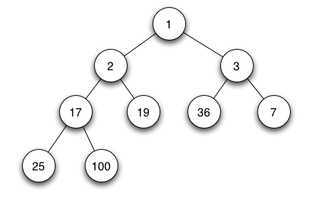
Heap
Quickly (O(1)) find the Min or Max element of a set
Characteristics – Min Heap
Root is the Min element
Any parent is less than both of its left and right child.
Internal operations
Heapify (O(n))
Shift-up (O(lgn))
Shift-down (O(lgn))
Java implementation – PriorityQueue

Slide 22
Heapify
5
1
3
1
5
6
6
8
8
1
3

Slide 23
Remove
1
7
5
5
7
6
8
7

Slide 24
Insert
1
5
2
3
8
2
5
7
6
9
2
8

Slide 25
Example - Kth Largest Element in an Array
Find the kth largest element in an unsorted array. Note that it is the kth largest element in the sorted order, not the kth distinct element.
Given [3,2,1,5,6,4] and k = 2, return 5.
Brute force
Sort: O(nlgn)
Using heap: O(nlgk)
Quick select: O(n)

Slide 26
public int findKthLargest(int[] nums, int k) {
// Min heap
Queue<Integer> pq = new PriorityQueue<>();
for (int i = 0; i < k; i++)
pq.add(nums[i]);
for (int i = k; i < nums.length; i++) {
if (nums[i] > pq.peek()) {
pq.poll();
pq.add(nums[i]);
}
}
return pq.peek();
}

Slide 27
Homework!
https://leetcode.com/problems/letter-combinations-of-a-phone-number/
https://leetcode.com/problems/generate-parentheses/
https://leetcode.com/problems/permutations-ii/
https://leetcode.com/problems/combination-sum-ii/
https://leetcode.com/problems/combination-sum-iii/
https://leetcode.com/problems/word-search/
https://leetcode.com/problems/valid-parentheses/
https://leetcode.com/problems/simplify-path/
https://leetcode.com/problems/min-stack/
https://leetcode.com/problems/happy-number/
https://leetcode.com/problems/anagrams/
https://leetcode.com/problems/top-k-frequent-elements/

