Slide 1
Programmer’s Study Group
Week 09

Slide 2
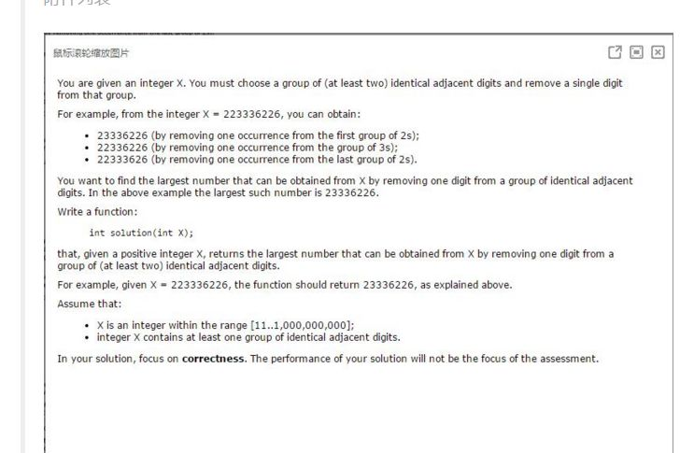
Google OA

Slide 3
public int solution(int x) {
String str = "" + x;
int index = -1;
int i = 0;
while (i < str.length()) {
int j = i + 1;
if (j < str.length() && str.charAt(i) != str.charAt(j)) {
i++;
continue;
}
while (j < str.length() && str.charAt(i) == str.charAt(j)) {
index = j;
j++;
}
if (j < str.length() && str.charAt(index) < str.charAt(j)) {
// find the result
break;
}
i = j;
}
String result = str.substring(0, index) + str.substring(index + 1);
return Integer.parseInt(result);
}

Slide 4
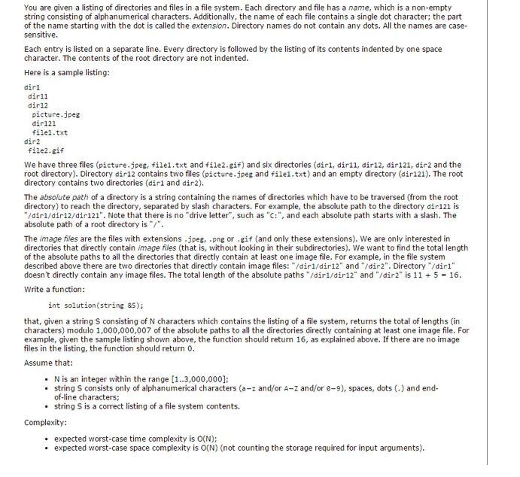

Slide 5
public int isSolution2(String input) {
if (input == null || input.length() < 1) {
return 0;
}
String[] lines = input.split("\n");
Stack<String> stack = new Stack<>();
Set<String> used = new HashSet<>();
String parent = "";
int result = 0;
for (int i = 0; i < lines.length; i++) {
int indent = countSpace(lines[i]);
String fileName = lines[i].substring(indent);
while (stack.size() > indent) { // find the right parent
String dir = stack.pop();
parent = parent.substring(0, parent.length() - dir.length() - 1);
}
if (isImage(fileName) && !used.contains(parent)) {
if (parent.length() > 0) {
result += parent.length();
}
else {
result += 1; // the root directory
}
used.add(parent);
}
stack.push(fileName);
parent += "/" + fileName; // with an "/"
}
return result;
}

Slide 6
Homework 4
https://leetcode.com/problems/letter-combinations-of-a-phone-number/
https://leetcode.com/problems/generate-parentheses/
https://leetcode.com/problems/permutations-ii/
https://leetcode.com/problems/combination-sum-ii/
https://leetcode.com/problems/combination-sum-iii/
https://leetcode.com/problems/word-search/
https://leetcode.com/problems/valid-parentheses/
https://leetcode.com/problems/simplify-path/
https://leetcode.com/problems/min-stack/
https://leetcode.com/problems/happy-number/
https://leetcode.com/problems/anagrams/
https://leetcode.com/problems/top-k-frequent-elements/

