Slide 1
Clustering Individuals using GraphX
Shawn Conner
MSDS696 - Project

Slide 2
About me
Lead developer at fortune 500 marketing company
Background in working with Big Data
Oracle – 18 years
Hadoop – 4 years
Java/Scala developer working with Spark
Working on masters in Data Science

Slide 3
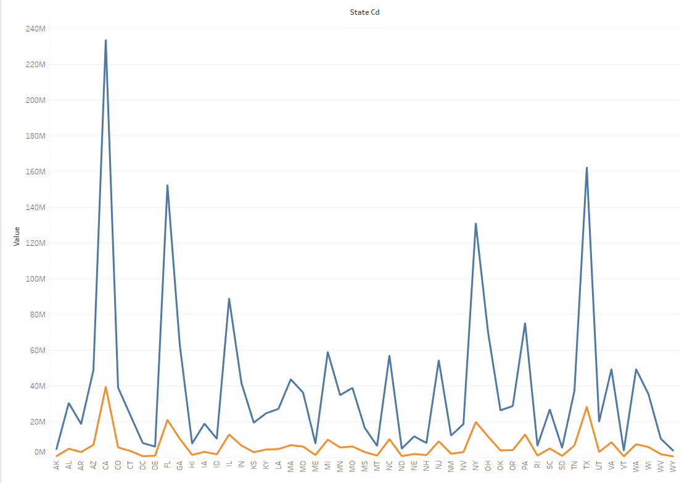

Why This Project
Currently my company has received over 2 Billion different individuals
US population 18 and over is ~ 252 million
Other companies in the industry have similar issues

Slide 4
Project overview
Create clusters of individuals that are the same person
Using Spark and GraphX
Processing on Hadoop cluster
Tools
Scala for programming
Tableau for Graphs
Spark on Hive for queries

Slide 5
Previous practicum
Created two models to identify if individuals are same person
Random Forest
Logistic Regression
Output was pairs of individuals
Flag indicating same person
Performed data analysis on raw data
Performed cleansing on data
Removed bad names, addresses and emails
Initially grouped individuals by first name and last name to reduce number of permutations.

Slide 6
My Process
Data
EDA
Data cleansing
GraphX
Results analysis

Slide 7
DATA
Output of Random Forest
Individual 1 – Id identifying person 1
Individual 2 - Id identifying person 2
Same person flag
0 – Not same person
1 – Same person
Output of Logistic Regression
Individual 1 – Id identifying person 1
Individual 2 - Id identifying person 2
Same person flag
0 – Not same person
1 – Same person
Distinct individual id file – Used for vertex

Slide 8
EDA
Model input: 23,863,565,578
Model output: 23,863,565,578
Records marked as Same person: 7,586,424,791
Number of initial clusters: 1,186,419,757
Average users in initial clusters: 6.39
Notes:
- Didn’t drop and email or phone due to reg ex. Data coming in for these was already clean

Slide 9
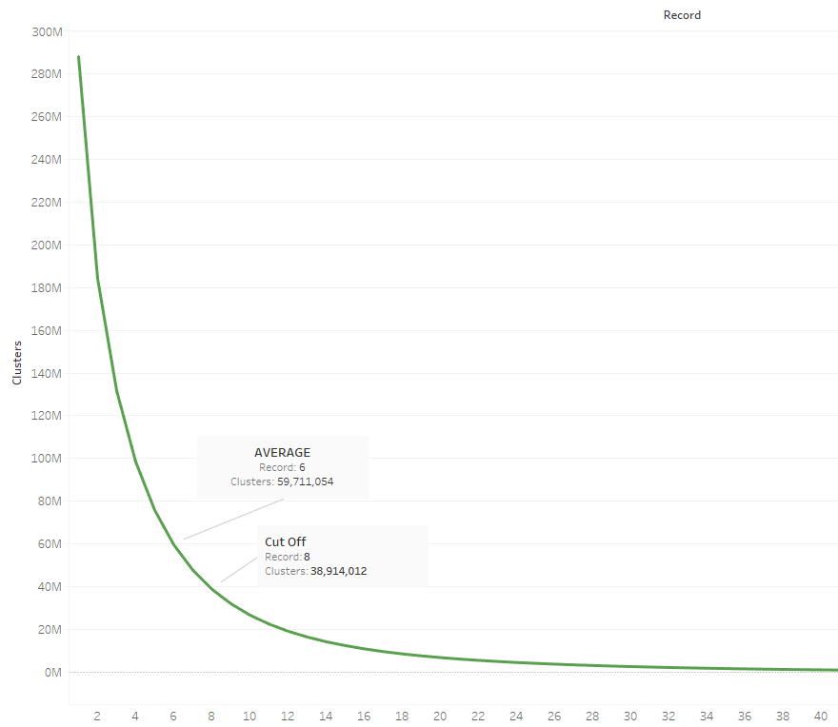
Cluster size graph
At 8 graph drops off
Clusters of 9 or larger start to look off
Average is around 6
Notes:
- Didn’t drop and email or phone due to reg ex. Data coming in for these was already clean

Slide 10
Data Cleansing
Raw data was already cleansed
Reviewed initial clusters
Looked to see if individuals looked to be same person
Compared to other clustering sources
For GraphX input I cut off at 8
We have 8X number of individuals
At 9 to 10 individuals data started to look off
Want to be conservative in clustering.
The clusters will grow when processed by GraphX
Notes:
- Didn’t drop and email or phone due to reg ex. Data coming in for these was already clean

Slide 11
GraphX
Inputs
cleansed model output
Distinct individual ids
Output
Clusters
Cluster id – minimum individual id
List of individuals in cluster
Preparation
Put minimum id for each pair in first position.
Confirmed that each pair only appeared once in file
Notes:
- Didn’t drop and email or phone due to reg ex. Data coming in for these was already clean

Slide 12
GraphX Results
Final number of clusters: 741 mm
Clusters with 1 person: 288 mm
Average size of clusters larger then 1: 4.4
Reduced number of individuals down to 741 mm using clustering
Some of the clusters are bad

Slide 13
Next Steps
For this analysis only used one model
Would like to try initial clustering on other attributes
Phone
Email
Would like to add multiple edges to each pair in the graph
Want to use multiple inputs to produce confidence score for each match

