Slide 1
DEMOShark
Approve an invoice
Find a checked invoice by its number, open it and approve it, so its payment can be scheduled.
App: Paydesk
Language: English
Version 1.0.0
Verified 2026-11-13
6 of 6 steps passed
Notes:
Find a checked invoice by its number, open it and approve it, so its payment can be scheduled.

Slide 2
At a glance
1
Open Paydesk on the invoices screen.
2
Type the invoice number.
3
Select Search. The invoice appears in the list.
4
Select the invoice number to open it.
5
Select Approve.
6
Check the supplier and the amount, then select Confirm.
Approve an invoice · paydesk-approve-invoice
DEMOShark

Slide 3
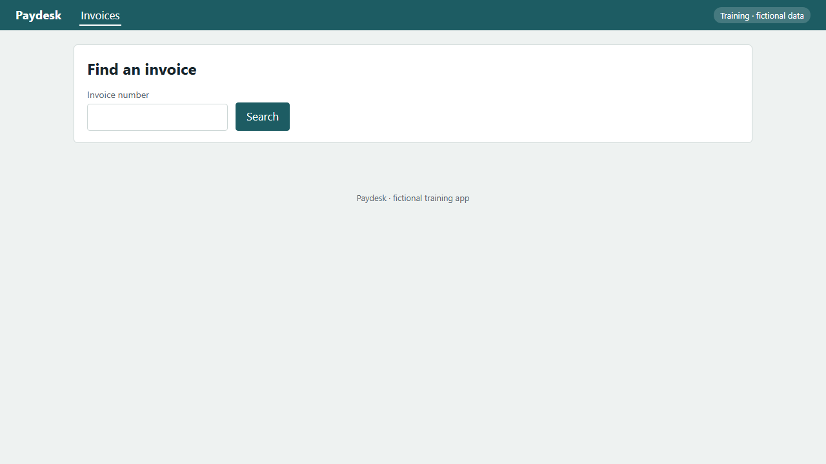
STEP 1 OF 6
Open Paydesk on the invoices screen.
WHAT YOU SHOULD SEE
The Find an invoice screen opens.
IN THE VIDEO
00:00
PASS
Approve an invoice · paydesk-approve-invoice · S1
DEMOShark
Notes:
Open Paydesk on the invoices screen.
The Find an invoice screen opens.

Slide 4
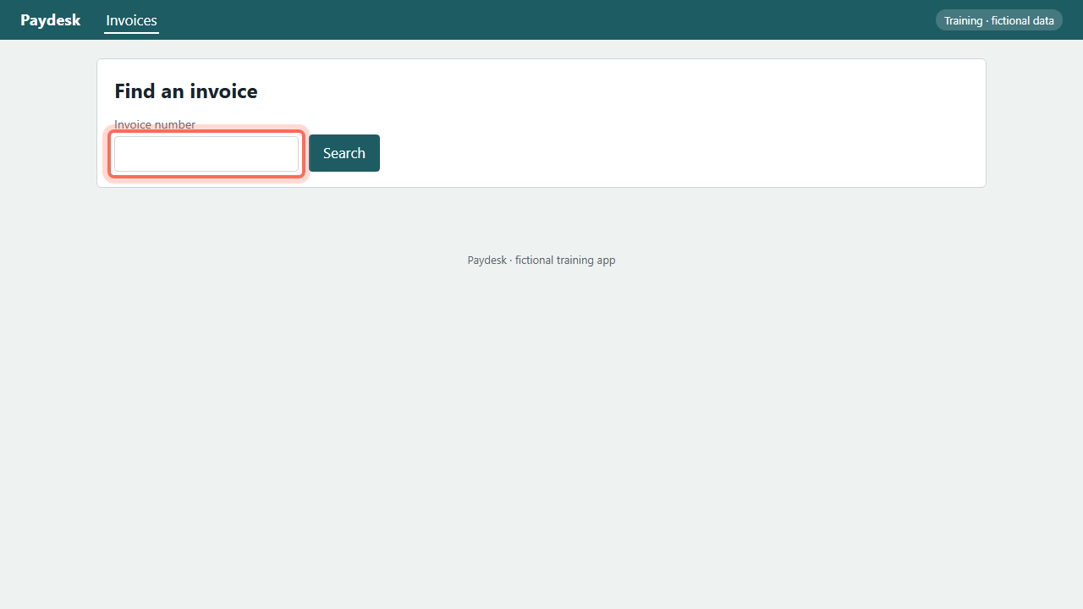
STEP 2 OF 6
Type the invoice number.
WHAT YOU SHOULD SEE
The number is in the Invoice number box.
IN THE VIDEO
00:03
PASS
Approve an invoice · paydesk-approve-invoice · S2
DEMOShark
Notes:
Type the invoice number.
The number is in the Invoice number box.

Slide 5
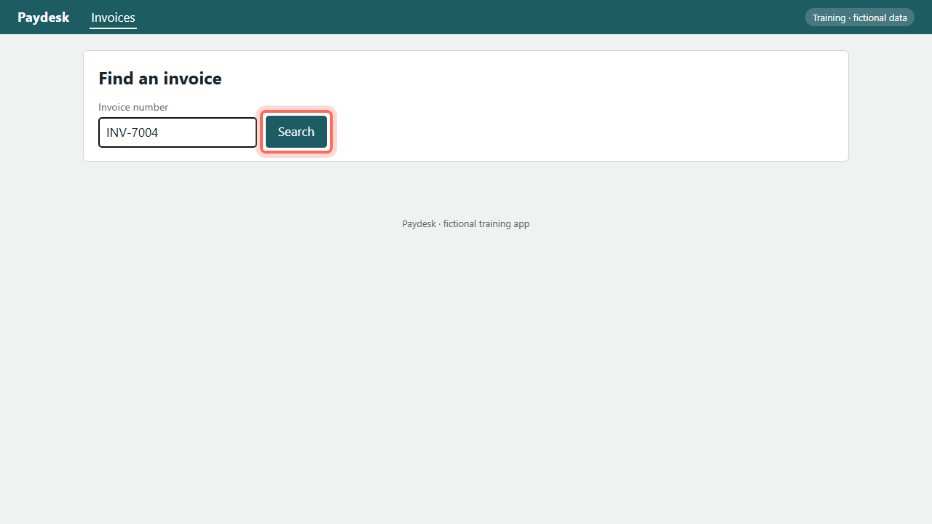
STEP 3 OF 6
Select Search. The invoice appears in the list.
WHAT YOU SHOULD SEE
The invoice is listed.
IN THE VIDEO
00:06
PASS
Approve an invoice · paydesk-approve-invoice · S3
DEMOShark
Notes:
Select Search. The invoice appears in the list.
The invoice is listed.

Slide 6
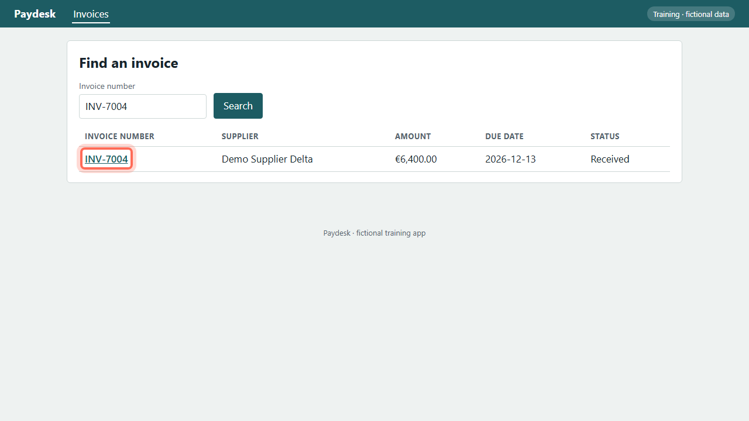
STEP 4 OF 6
Select the invoice number to open it.
WHAT YOU SHOULD SEE
The invoice details open.
IN THE VIDEO
00:10
PASS
Approve an invoice · paydesk-approve-invoice · S4
DEMOShark
Notes:
Select the invoice number to open it.
The invoice details open.

Slide 7
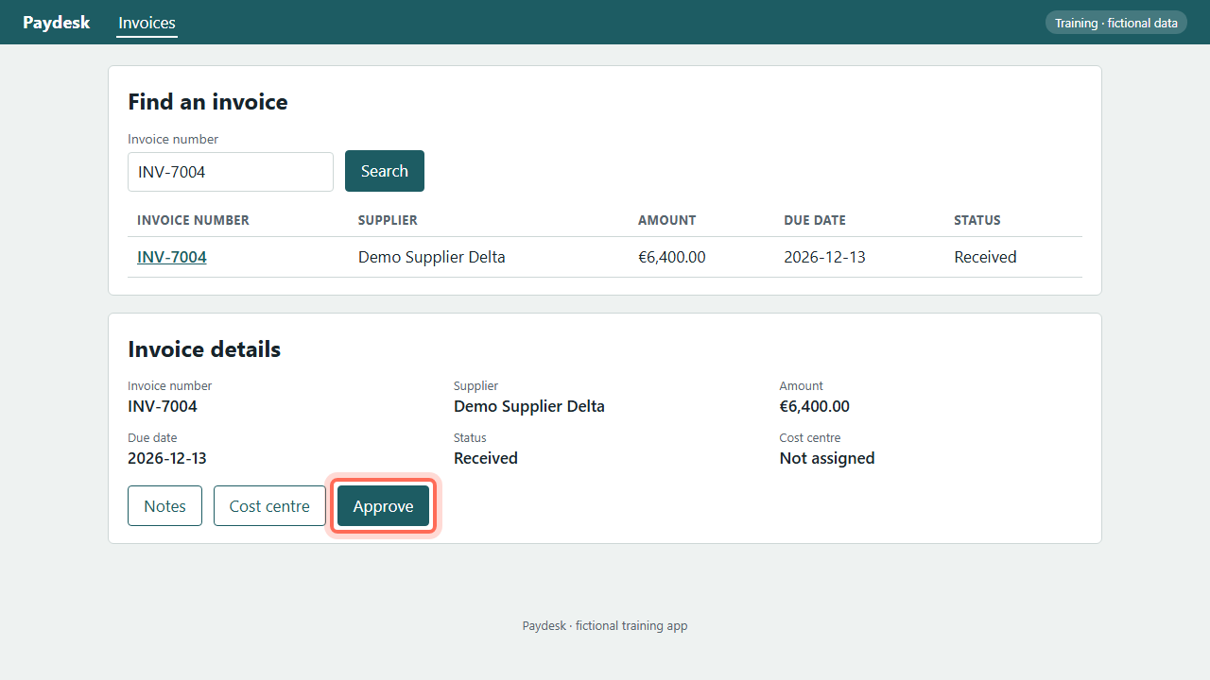
STEP 5 OF 6
Select Approve.
WHAT YOU SHOULD SEE
The Approve invoice window opens.
IN THE VIDEO
00:13
PASS
Approve an invoice · paydesk-approve-invoice · S5
DEMOShark
Notes:
Select Approve.
The Approve invoice window opens.

Slide 8
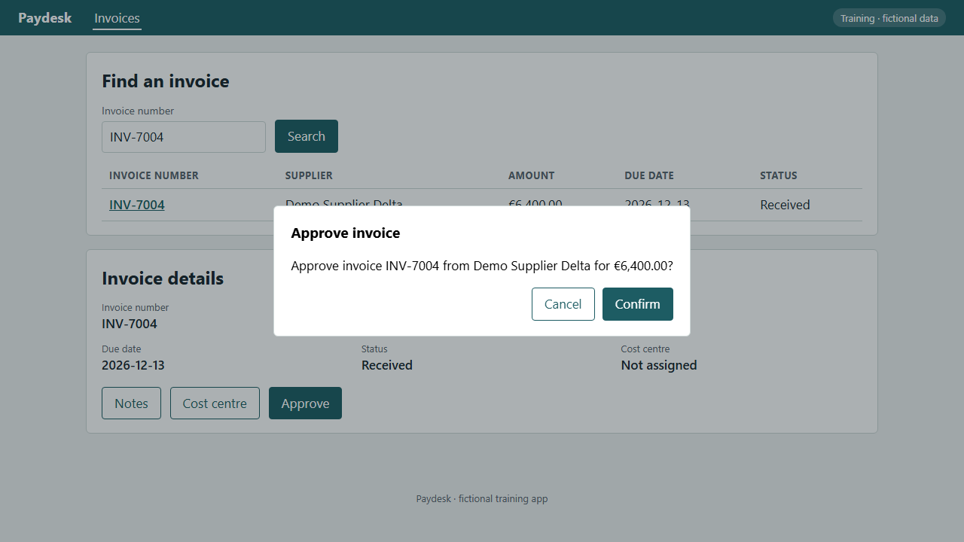
STEP 6 OF 6
Check the supplier and the amount, then select Confirm.
WHAT YOU SHOULD SEE
Paydesk confirms that the invoice is approved.
IN THE VIDEO
00:16
PASS
Approve an invoice · paydesk-approve-invoice · S6
DEMOShark
Notes:
Check the supplier and the amount, then select Confirm.
Paydesk confirms that the invoice is approved.

Slide 9
Verified run
Steps |  | Result | In the video
S1 | Open Paydesk on the invoices screen. | pass | 00:00
S2 | Type the invoice number. | pass | 00:03
S3 | Select Search. The invoice appears in the list. | pass | 00:06
S4 | Select the invoice number to open it. | pass | 00:10
S5 | Select Approve. | pass | 00:13
S6 | Check the supplier and the amount, then select Confirm. | pass | 00:16
Data check | invoice.status = approved | pass
Data check | invoice.approved_by = demo.manager | pass
Generated by DEMOShark from specs/paydesk-approve-invoice.yaml
Approve an invoice · paydesk-approve-invoice
DEMOShark

