Slide 1
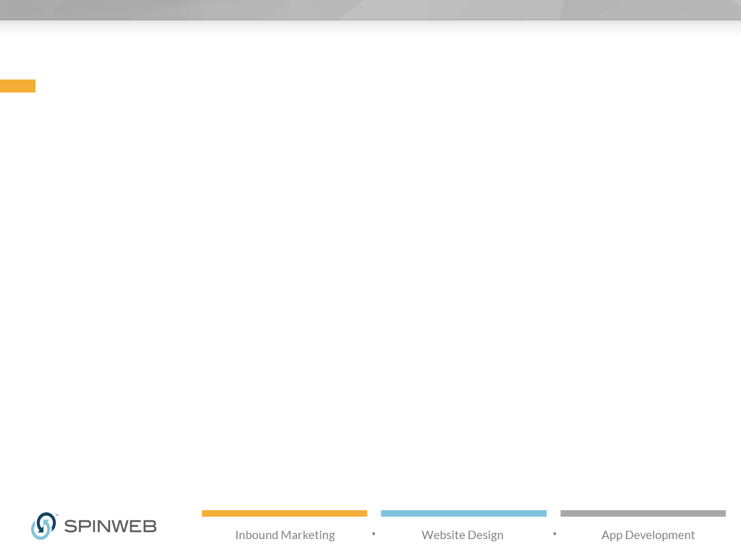

Welcome to
YOUR COMPANY’S
Monthly Review
Agenda:
1. Monthly Progress Review
2. Monthly Performance Report
3. Discussion Items
PRESENTED BY: YOUR COMPANY’S Marketing Team
You Logo Here

Slide 2
Progress Report
List your progress and deliverables for the month here
For example:
Completed and launched the new case study
Created and tested the new email campaign
Created new Facebook cover photo
Monthly webinar and blog posts
Continued social campaigns
You Logo Here

Slide 3
Upcoming Projects
List your upcoming projects here
For example:
Next month’s ebook: “Title of Ebook”
Launching the new website!
You Logo Here

Slide 4
Visits: Monthly Trend
Use your marketing software to create charts that show overall website visit trends, like this one.
You Logo Here

Slide 5
Leads: Monthly Trend
Use your marketing software to create charts that show monthly leads. These screenshots are from HubSpot and show sources in different colors (organic traffic=green, social media=teal, etc)
You Logo Here

Slide 6
Leads: Landing Pages
Show visit and download stats for your offer landing pages (pages that have a form to capture new leads).
You Logo Here

Slide 7
Blog Performance
Compare previous month’s blog performance to make sure your blog content is effectively capturing
your audience’s attention.
You Logo Here

Slide 8
Blog Performance
Add a second blog performance slide to show:
Top posts by view (overall)
Top posts for the previous month
Number of blog subscribers
You Logo Here

Slide 9
Special Campaign
If you have any extra campaigns or content, like a podcast or a TV show, show those stats here.
You Logo Here

Slide 10
Followers
Quick view of social media followers, to take the pulse of your social presence. Some reporting tools
include interesting benchmarks that compare your organization to a “landscape average.”
You Logo Here

Slide 11
Twitter
Include screenshots of your top Twitter posts for the month, or other metrics like sponsored content campaign results.
You Logo Here

Slide 12
Facebook
Include screenshots of your top Facebook posts for the month, or other metrics like boosted posts or ad campaign results.
You Logo Here

Slide 13
LinkedIn
Include screenshots of your top LinkedIn posts for the month, or other metrics like sponsored content.
You Logo Here

Slide 14
Google+
Include screenshots of your most engaging Google+ posts for the month.
Add more slides if you have more social media channels to report on.
You Logo Here

Slide 15
Facebook Advertising
You Logo Here

Slide 16
Twitter Advertising
You Logo Here

Slide 17
LinkedIn Advertising
You Logo Here

