Slide 1


Monthly Marketing Report
{Company Name}
Your Name
Today’s Date

Slide 2
Table of Contents
Why use this template? ....................................................................... 2
Monthly Highlights Template ............................................................. 5
Monthly Trends Graphs ...................................................................... 7
Top Campaigns Slide .......................................................................... 18
Rate This Content ............................................................................... 20

Slide 3
Why use this template?
Here's a challenge for all you marketers who are on top of your game: How do you make sure your marketing team is taken seriously within your own company?
The first step should be to publish a thorough and quantitative monthly report on your marketing team's impact. However, marketing managers often struggle to show their impact. But there's no need to struggle. Today, it's simple to collect the data you need to show how your marketing investments are generating revenue for your business. You just have to pull together the right reports – and that’s what this customizable template will provide!
We’ll walk you through a series of slides that highlight important metrics you should be reporting to the rest of the business. To customize the graphs and understand the numbers, simply refer to the excel document included with your download of this template!

Slide 4
First Thing’s First: Month Highlights
Your C-Suite is busy. But that doesn’t mean they should ignore your thorough reporting. While a marketing executive will be invested in your full report, you’ll want to provide a summary of the metrics to help:
  Keep an easy reference for monthly performance.
  Show off your team’s work to executives who want to do a quick scan.
The following slide will emphasize key metrics to include in this summary, and where you can find their respective place in the associated excel spreadsheet.
We’ll then provide an example of how this would look!

Slide 5
[Month] Highlights
Total Marketing reach grew X%
(Cell O9, Reach Tab)
Overall website visits up X%
(Cell O14, Visits Tab)
Generated X new leads, up X%
(Cell M13 & O13, Leads Tab)
Marketing brought in X customers, up X%
(Cell M13 & Cell O13, Customers Tab)
  X% of all customers closed
  (Cell M18, Customers Tab)
  Note: Add additional metrics as needed.

Slide 6
December Highlights (Example)
Total Marketing reach grew 13%
Overall website visits up 7%
  Organic search traffic up 10%
Generated 545 new leads in December, up 9%
  Organic search leads up 13%
Marketing brought in 48 customers, up 20%
  96% of all customers closed
  Lead-to-Customer % up 10%

Slide 7
Use Graphs to Display Trends
While a highlights summary is helpful, you want to show your team the overall trends occurring in various parts of your marketing. This will help provide:
  Historical context into your growth and fall patterns.
  Help you pinpoint which campaigns are hurting or helping you.
  Monitor trends that can be used in future strategy meetings.
The following eight slides will highlight eight different metrics to include in your report. You can customize each by, as already mentioned, looking to the excel spreadsheet.

Slide 8
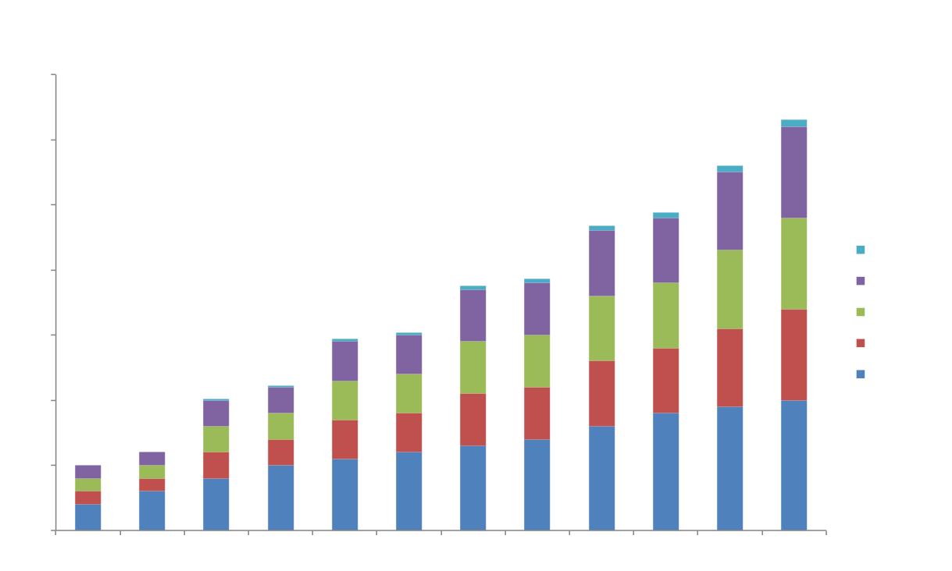
Marketing Reach

Slide 9
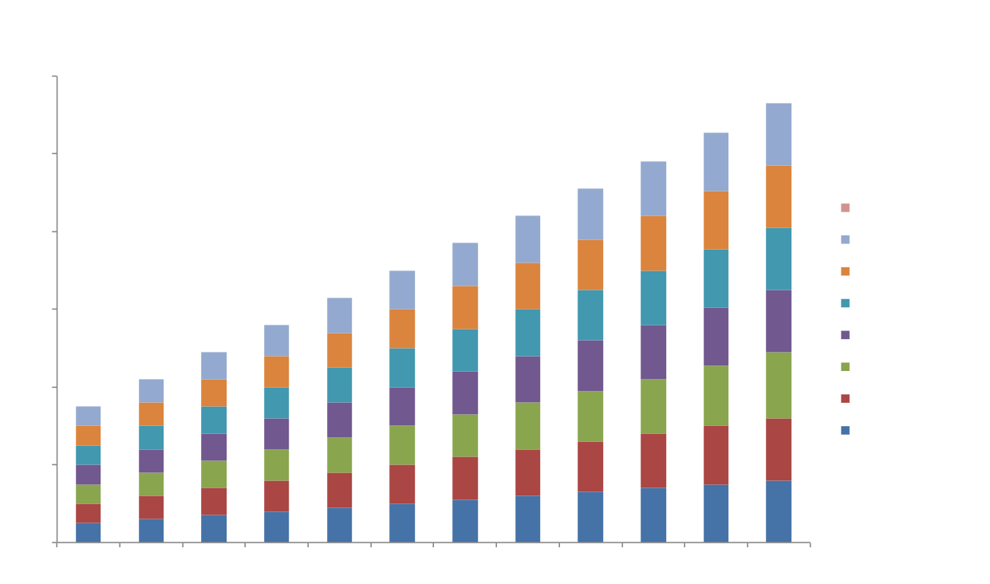
Website Visits

Slide 10
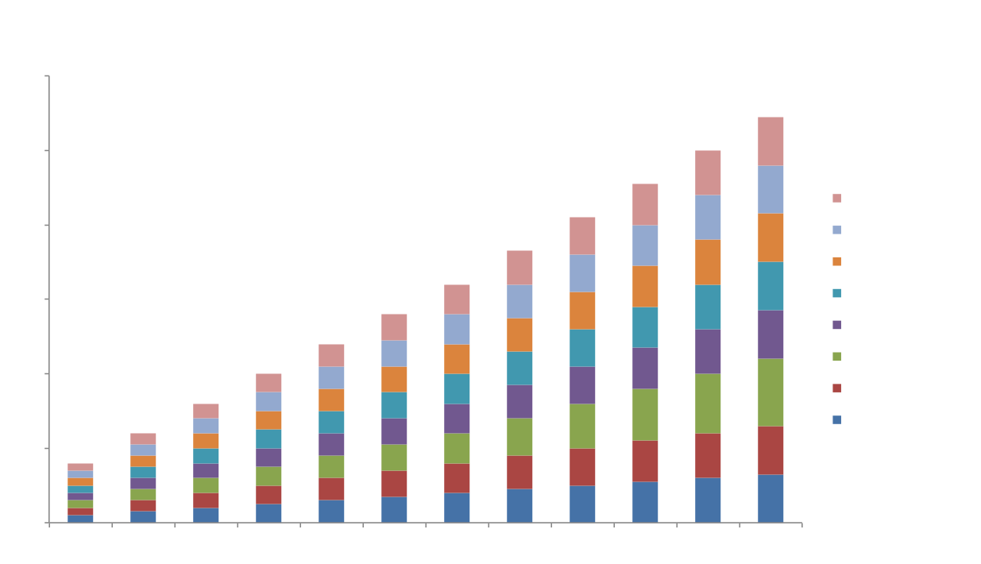
Leads Generated by Marketing

Slide 11
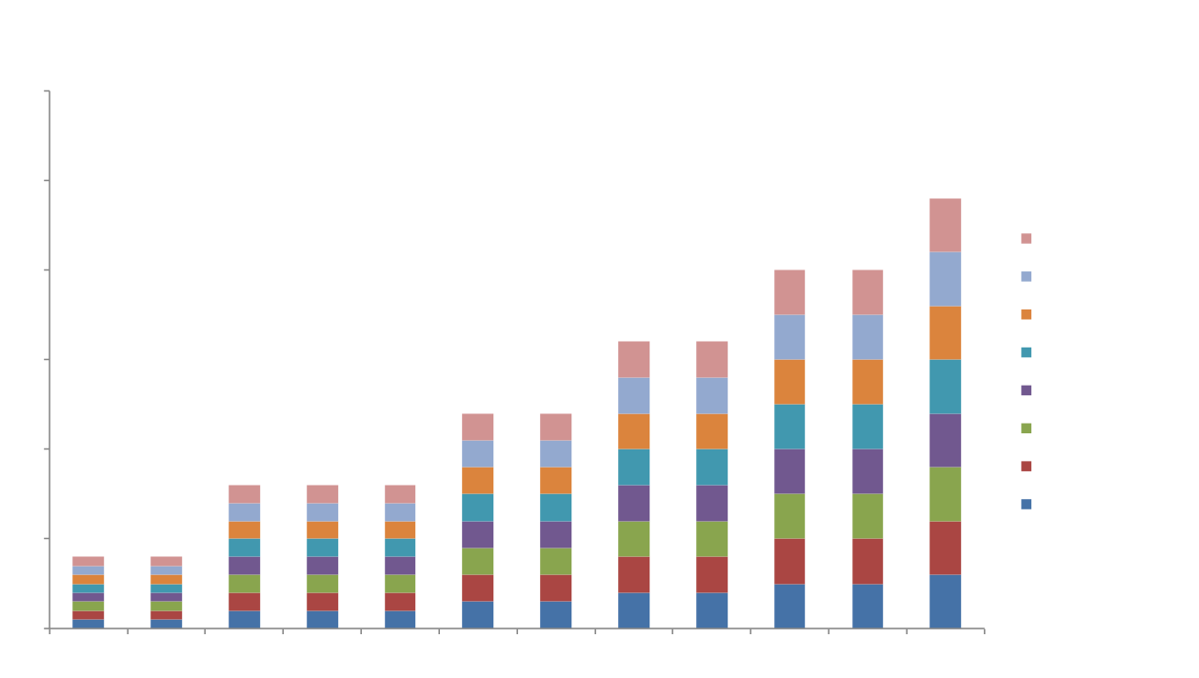
New Customers by Source

Slide 12
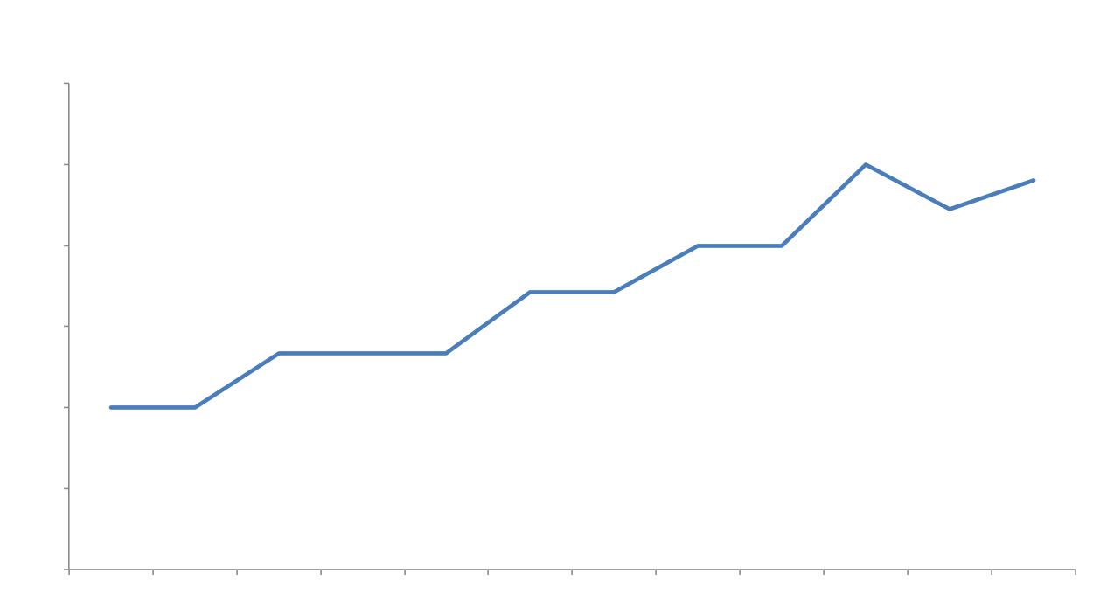
Customers Sourced by Marketing

Slide 13
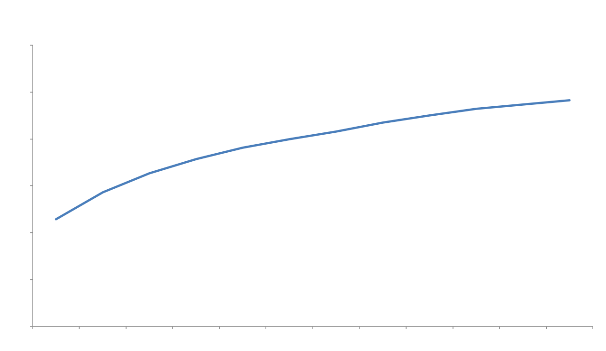
Visit to Lead Performance

Slide 14
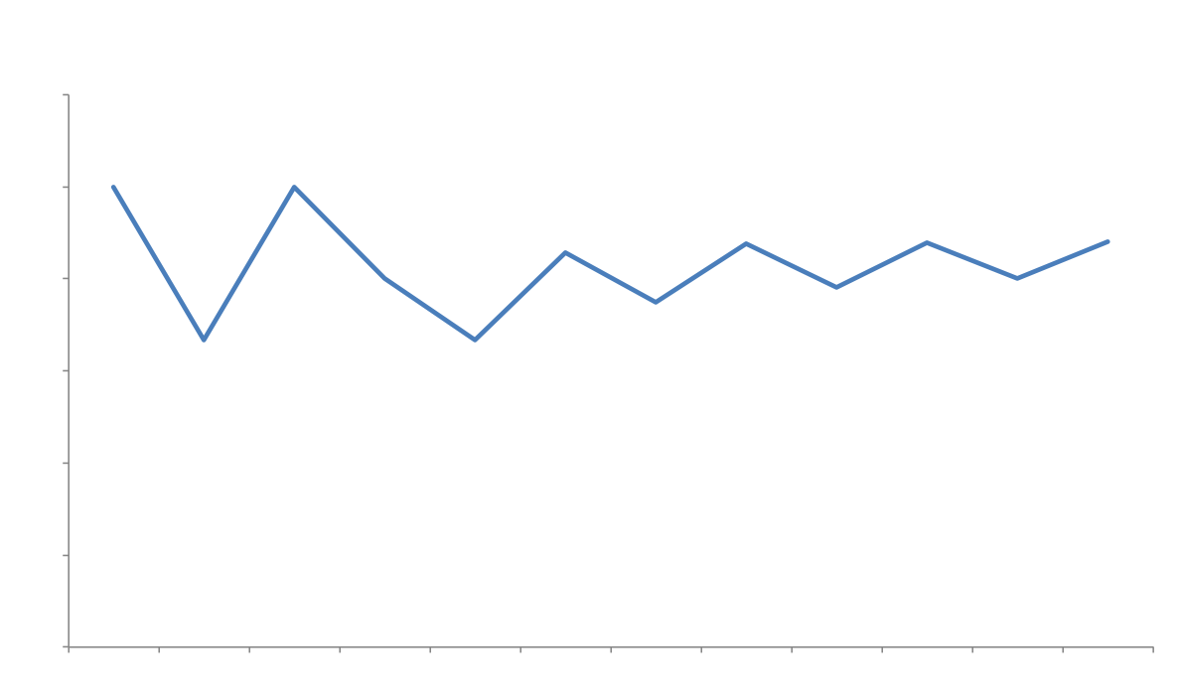
Lead to Customer Performance

Slide 15
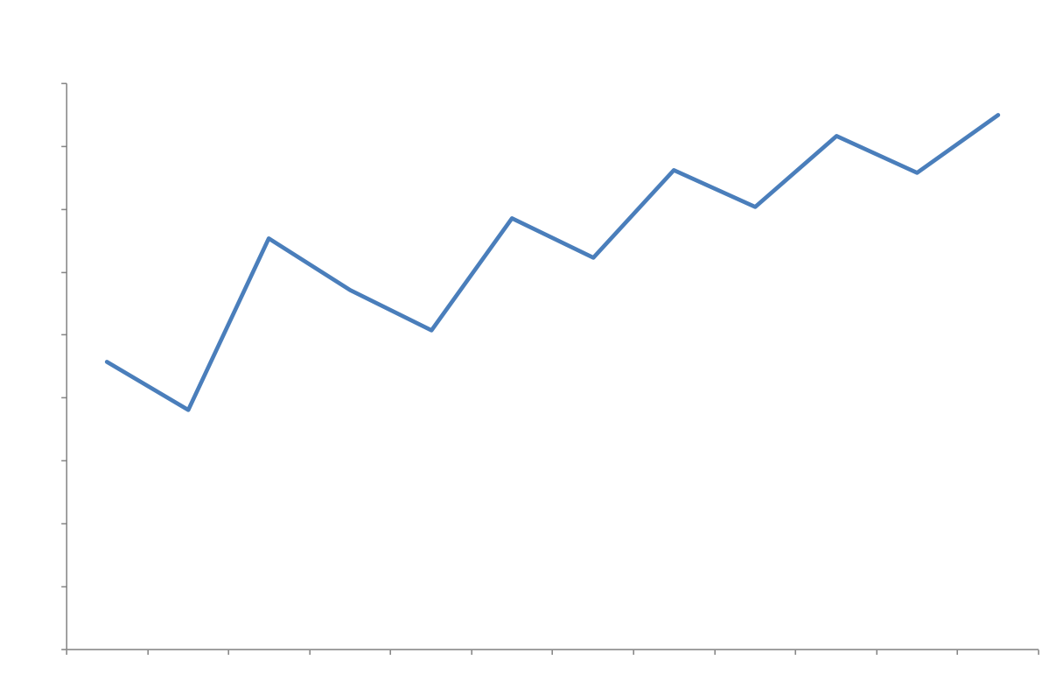
Visit to Customer Performance

Slide 16
Point Out Top Campaigns
Your team works on many campaigns that ultimately help drive the trends shown in the previous graphs. Use this last slide to call out the specific campaigns that helped drive your success.
For a larger team, this is an opportunity to call out folks who may have worked particularly hard to help meet a specific goal with their campaign. This will also help you show the importance of specific campaigns your team put energy behind.
We’ll show an example of how this looks as well!

Slide 17
Top Marketing Campaigns
Campaign A: X Leads
Campaign B: X Leads
Campaign C: X Leads

Slide 18
Top Marketing Campaigns (Example)
Industry Trends Ebook: 225 leads
Free Sales Assessment: 75 leads
Product Launch Webinar: 50 leads

Slide 19
Next Steps
Now that you have this template, dedicate time to actually using it every month. Your metrics matter. Your team’s impact matters.
We hope the slides presented in this template will help you share the value of your team to the rest of the company.
Good luck!

Slide 21

RATE THIS CONTENT & HELP HUBSPOT IMPROVE.
HubSpot believes in creating content for you (not for us), so we’d like to hear what you thought of these templates! Submit a 1-10 rating in a matter of seconds by clicking here. Your feedback goes directly to our content team.
SUBMIT RATING:
http://bitly.com/MktgReportTemplateNPS

