Slide 1
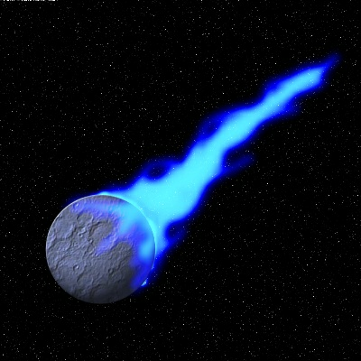
METEOR

Slide 2
meteor is…
like rails for front-end-heavy apps
awesome at moving data between server/javascript/dom
really big

Slide 3
introducing… DUBSTEXT
http://dubstext.meteor.com/
http://github.com/shawndrost/dubstext

Slide 4
template rerendering: how does it work?

Slide 5
functions have data dependencies

Slide 6
3 steps

Slide 7
1. ‘Context’ objects wrap a data-dependent function and manage a global variable, ‘Context.current’.
https://github.com/meteor/meteor/blob/v0.3.7/packages/deps/deps.js#L18
https://github.com/meteor/meteor/blob/v0.3.7/packages/liveui/liveui.js#L19

Slide 8
2. data sources grab a copy of Context.current when they’re accessed

Slide 9
3. when data sources change, they re-invoke all dependent contexts

Slide 10
questions?

