Slide 1
AI Bootcamp Project 2 Group 2 Shawn Feils & Chelsey Hay

Slide 2
AGENDA
Research Question
Approach
Results
Future Considerations
Resources

Slide 3
Research Question

Slide 4
Research Question
Can we use machine learning to predict the variance of a stock price using news reporting sentiments?
A strong hypothesis is that the model will allow us to predict the magnitude and direction of variance based on sentiment (regression)
A weak hypothesis is that the model will allow us to predict the direction of variance based on sentiment (classification)

Slide 5
Approach

Slide 6
Data Retrieval & Clean up
DATA RETRIEVAL
Alpha Vantage We accessed Alpha Vantage using an API Gathered historical daily closing prices on stocks within the S&P 500 Gathered all news articles published for the stocks in 2023 (some stocks did not have data) Retrieved relevance scores for every stock listed in the news articles & exported into CSV files for each stock Retrieved sentiment scores for every stock listed in the article & exported into CSV files for each stock
S&P 500 Accessed the S&P 500 to download a CSV with all S&P 500 stock ticker information
CLEAN UP
Stocks Exported all data into individual CSV files Created a data frame Added a percent change from prior day and prior week for historical stock prices Grouped each stock by time period (pre-market, intra-day, after-market) Created a pivot to combine the time period data into one data frame
News Articles Exported all data into individual CSV files Reduced the news article data to focus on just the stock we were analyzing (some articles reference multiple stocks) Created a data frame Created a relevance weighted sentiment score for the articles Added zeros (0) for stocks that did not have news data for that day to ensure all days remained in the analysis Combined the stock & news article files
6

Slide 7
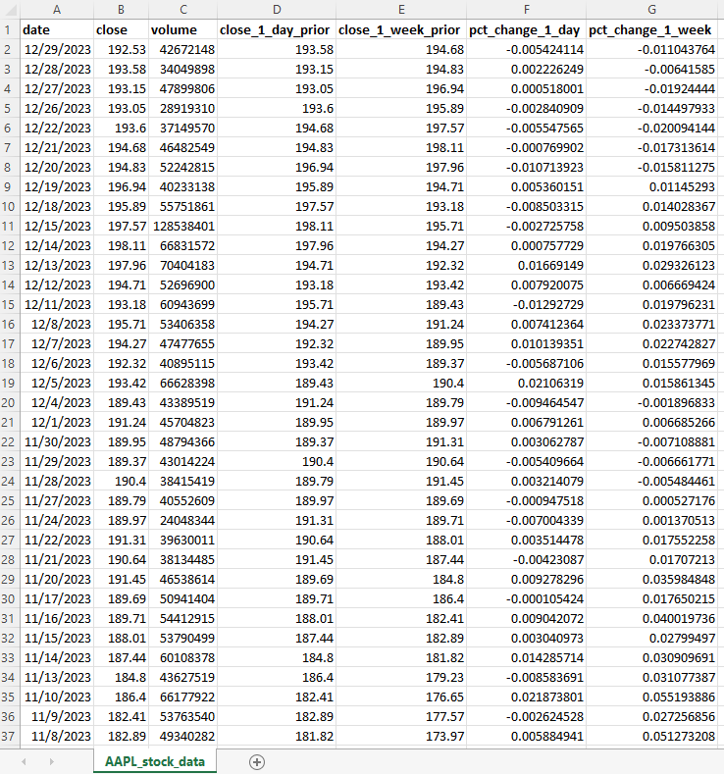
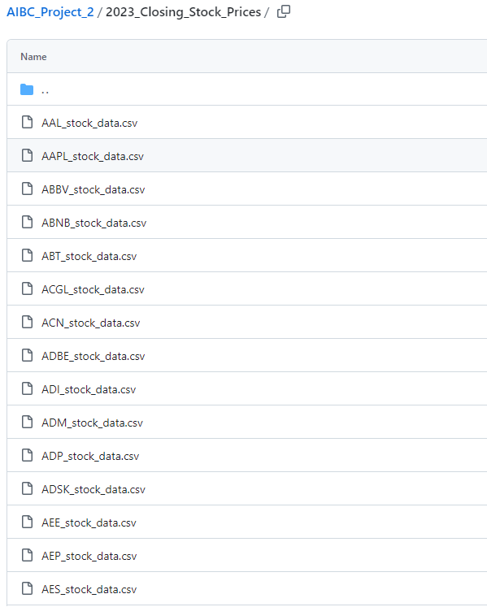
Data Retrieval & Clean up Stock Prices

Slide 8
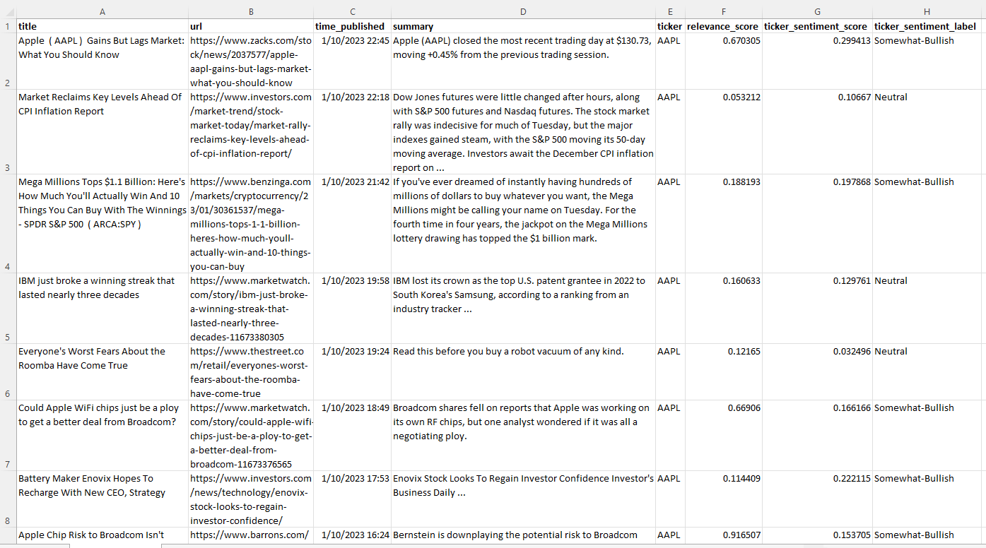
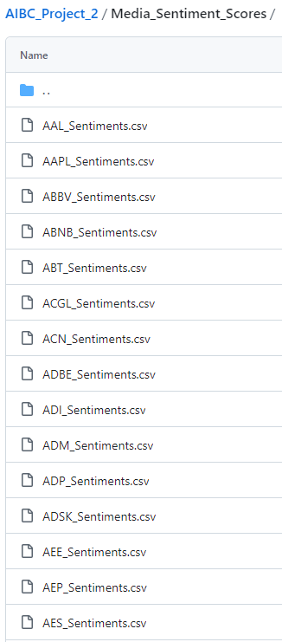
Data Retrieval & Clean up Sentiment

Slide 9
Results

Slide 10
Methodology
Random Forest Regression – modeling the strong hypothesis
Random Forest Classifier – modeling the weak hypothesis

Slide 11
MODELS
 |  | Performance |  | Methodologies |  |  |  |  | Data Inclusions
 |  | Training Score | Testing Score | RF - R | RF - C | Bin # | Label Encoded | One-Hot Encoded | Volume | Weekly Price Change | Year | Month | Date | Weekday | Raw Sentiment Score | Relevance Weighted Sentiment Scores | Sector | Industry
Strong Hypothesis | Model 1 | 0.919 | 0.390
 | Model 2 | 0.862 | -0.012
 | Model 3 | 0.675 | -0.026
Weak Hypothesis | Model 4 | 1.000 | 0.580 |  |  | 4
 | Model 5 | 1.000 | 0.437 |  |  | 4
 | Model 6 | 0.837 | 0.446 |  |  | 4
 | Model 7 | 1.000 | 0.729 |  |  | 2
 | Model 8 | 1.000 | 0.737 |  |  | 2
 | Model 9 | 1.000 | 0.742 |  |  | 2
 | Model 10 | 0.958 | 0.742 |  |  | 2
 | Model 11 | 0.874 | 0.576 |  |  | 2
 | Model 12 | 0.846 | 0.574 |  |  | 2
✔
✔
✔
✔
✔
✔
✔
✔
✔
✔
✔
✔
✔
✔
✔
✔
✔
✔
✔
✔
✔
✔
✔
✔
✔
✔
✔
✔
✔
✔
✔
✔
✔
✔
✔
✔
✔
✔
✔
✔
✔
✔
✔
✔
✔
✔
✔
✔
✔
✔
✔
✔
✔
✔
✔
✔
✔
✔
✔
✔
✔
✔
✔
✔
✔
✔
✔
✔
✔
✔
✔
✔
✔
✔
✔
✔
✔
✔
✔
✔
✔
✔
✔
✔
✔
✔
✔
✔
✔
✔
✔
✔
✔
✔
✔
✔
✔
✔
✔
✔
✔
✔
✔
✔
✔
✔
✔
✔
✔
✔
✔
✔
✔
✔
✔
✔
✔
✔
✔
✔

Slide 12
MODELS
 |  | Performance |  | Methodologies |  |  |  |  | Data Inclusions
 |  | Training Score | Testing Score | RF - R | RF - C | Bin # | Label Encoded | One-Hot Encoded | Volume | Weekly Price Change | Year | Month | Date | Weekday | Raw Sentiment Score | Relevance Weighted Sentiment Scores | Sector | Industry
Strong Hypothesis | Model 1 | 0.919 | 0.390
 | Model 2 | 0.862 | -0.012
 | Model 3 | 0.675 | -0.026
Weak Hypothesis | Model 4 | 1.000 | 0.580 |  |  | 4
 | Model 5 | 1.000 | 0.437 |  |  | 4
 | Model 6 | 0.837 | 0.446 |  |  | 4
 | Model 7 | 1.000 | 0.729 |  |  | 2
 | Model 8 | 1.000 | 0.737 |  |  | 2
 | Model 9 | 1.000 | 0.742 |  |  | 2
 | Model 10 | 0.958 | 0.742 |  |  | 2
 | Model 11 | 0.874 | 0.576 |  |  | 2
 | Model 12 | 0.846 | 0.574 |  |  | 2
✔
✔
✔
✔
✔
✔
✔
✔
✔
✔
✔
✔
On the regression model, performance degrades as Weekly Price Change and Volume are removed.
✔
✔
✔
✔
✔
✔
✔
✔
✔
✔
✔
✔
✔
✔
✔
✔
✔
✔
✔
✔
✔
✔
✔
✔
✔
✔
✔
✔
✔
✔
✔
The same is not true (or as strongly true) on the classification model.
✔
✔
✔
✔
✔
✔
✔
✔
✔
✔
✔
✔
✔
✔
✔
✔
✔
✔
✔
✔
✔
✔
✔
✔
✔
✔
✔
✔
✔
✔
✔
✔
✔
✔
✔
✔
✔
✔
✔
✔
✔
✔
✔
✔
✔
✔
✔
✔
✔
✔
✔
✔
✔
✔
✔
✔
✔
✔
✔
✔
✔
✔
✔
✔
✔
✔
✔
✔
✔
✔
✔
✔
✔
✔
✔
✔
✔

Slide 13
MODELS
 |  | Performance |  | Methodologies |  |  |  |  | Data Inclusions
 |  | Training Score | Testing Score | RF - R | RF - C | Bin # | Label Encoded | One-Hot Encoded | Daily Volume | Weekly Price Change | Year | Month | Date | Weekday | Raw Sentiment Score | Relevance Weighted Sentiment Scores | Sector | Industry
Strong Hypothesis | Model 1 | 0.919 | 0.390
 | Model 2 | 0.862 | -0.012
 | Model 3 | 0.675 | -0.026
Weak Hypothesis | Model 4 | 1.000 | 0.580 |  |  | 4
 | Model 5 | 1.000 | 0.437 |  |  | 4
 | Model 6 | 0.837 | 0.446 |  |  | 4
 | Model 7 | 1.000 | 0.729 |  |  | 2
 | Model 8 | 1.000 | 0.737 |  |  | 2
 | Model 9 | 1.000 | 0.742 |  |  | 2
 | Model 10 | 0.958 | 0.742 |  |  | 2
 | Model 11 | 0.874 | 0.576 |  |  | 2
 | Model 12 | 0.846 | 0.574 |  |  | 2
✔
✔
✔
✔
✔
✔
✔
✔
✔
✔
✔
✔
✔
✔
✔
✔
✔
✔
✔
✔
✔
✔
✔
✔
✔
✔
✔
✔
✔
✔
✔
✔
✔
✔
✔
✔
✔
✔
✔
✔
✔
✔
✔
Volume, as utilized in this model, is problematic and drives overfitting.
✔
✔
✔
✔
✔
✔
✔
✔
✔
✔
✔
✔
✔
✔
✔
✔
✔
✔
✔
✔
✔
✔
✔
✔
✔
✔
✔
✔
✔
✔
✔
✔
✔
✔
✔
✔
✔
✔
✔
✔
✔
✔
✔
✔
✔
✔
✔
✔
✔
✔
✔
✔
✔
✔
✔
✔
✔
✔
✔
✔
✔
✔
✔
✔
✔
✔
✔
✔
✔
✔
✔
✔
✔
✔
✔
✔
✔

Slide 14
MODELS
 |  | Performance |  | Methodologies |  |  |  |  | Data Inclusions
 |  | Training Score | Testing Score | RF - R | RF - C | Bin # | Label Encoded | One-Hot Encoded | Daily Volume | Weekly Price Change | Year | Month | Date | Weekday | Raw Sentiment Score | Relevance Weighted Sentiment Scores | Sector | Industry
Strong Hypothesis | Model 1 | 0.919 | 0.390
 | Model 2 | 0.862 | -0.012
 | Model 3 | 0.675 | -0.026
Weak Hypothesis | Model 4 | 1.000 | 0.580 |  |  | 4
 | Model 5 | 1.000 | 0.437 |  |  | 4
 | Model 6 | 0.837 | 0.446 |  |  | 4
 | Model 7 | 1.000 | 0.729 |  |  | 2
 | Model 8 | 1.000 | 0.737 |  |  | 2
 | Model 9 | 1.000 | 0.742 |  |  | 2
 | Model 10 | 0.958 | 0.742 |  |  | 2
 | Model 11 | 0.874 | 0.576 |  |  | 2
 | Model 12 | 0.846 | 0.574 |  |  | 2
✔
✔
✔
✔
✔
✔
✔
✔
✔
✔
✔
✔
✔
✔
✔
✔
✔
✔
✔
✔
✔
✔
✔
✔
✔
✔
✔
✔
✔
✔
✔
✔
✔
✔
✔
✔
✔
✔
✔
✔
✔
✔
✔
Binary binning (UP/DOWN) classifies more successfully than a 4-bin approach (DOWN+/DOWN/UP/UP+).
✔
✔
✔
✔
✔
✔
✔
✔
✔
✔
✔
✔
✔
✔
✔
✔
✔
✔
✔
✔
✔
✔
✔
✔
✔
✔
✔
✔
✔
✔
✔
✔
✔
✔
✔
✔
✔
✔
✔
✔
✔
✔
✔
✔
✔
✔
✔
✔
✔
✔
✔
✔
✔
✔
✔
✔
✔
✔
✔
✔
✔
✔
✔
✔
✔
✔
✔
✔
✔
✔
✔
✔
✔
✔
✔
✔
✔

Slide 15
MODELS
 |  | Performance |  | Methodologies |  |  |  |  | Data Inclusions
 |  | Training Score | Testing Score | RF - R | RF - C | Bin # | Label Encoded | One-Hot Encoded | Daily Volume | Weekly Price Change | Year | Month | Date | Weekday | Raw Sentiment Score | Relevance Weighted Sentiment Scores | Sector | Industry
Strong Hypothesis | Model 1 | 0.919 | 0.390
 | Model 2 | 0.862 | -0.012
 | Model 3 | 0.675 | -0.026
Weak Hypothesis | Model 4 | 1.000 | 0.580 |  |  | 4
 | Model 5 | 1.000 | 0.437 |  |  | 4
 | Model 6 | 0.837 | 0.446 |  |  | 4
 | Model 7 | 1.000 | 0.729 |  |  | 2
 | Model 8 | 1.000 | 0.737 |  |  | 2
 | Model 9 | 1.000 | 0.742 |  |  | 2
 | Model 10 | 0.958 | 0.742 |  |  | 2
 | Model 11 | 0.874 | 0.576 |  |  | 2
 | Model 12 | 0.846 | 0.574 |  |  | 2
✔
✔
✔
✔
✔
✔
✔
✔
✔
✔
✔
✔
✔
✔
✔
✔
✔
✔
✔
✔
✔
✔
✔
✔
✔
✔
✔
✔
✔
✔
✔
✔
✔
✔
✔
✔
✔
✔
✔
✔
✔
✔
✔
✔
✔
✔
✔
✔
✔
✔
✔
✔
✔
✔
✔
✔
✔
✔
✔
✔
✔
✔
✔
✔
✔
✔
✔
✔
✔
✔
✔
✔
✔
✔
✔
✔
Label encoding was a mistake (the values are categorical not ordinal), and One-Hot encoding improves the model, even while removing the Weekly Price Change.
✔
✔
✔
✔
✔
✔
✔
✔
✔
✔
✔
✔
✔
✔
✔
✔
✔
✔
✔
✔
✔
✔
✔
✔
✔
✔
✔
✔
✔
✔
✔
✔
✔
✔
✔
✔
✔
✔
✔
✔
✔
✔
✔
✔

Slide 16
MODELS
 |  | Performance |  | Methodologies |  |  |  |  | Data Inclusions
 |  | Training Score | Testing Score | RF - R | RF - C | Bin # | Label Encoded | One-Hot Encoded | Daily Volume | Weekly Price Change | Year | Month | Date | Weekday | Raw Sentiment Score | Relevance Weighted Sentiment Scores | Sector | Industry
Strong Hypothesis | Model 1 | 0.919 | 0.390
 | Model 2 | 0.862 | -0.012
 | Model 3 | 0.675 | -0.026
Weak Hypothesis | Model 4 | 1.000 | 0.580 |  |  | 4
 | Model 5 | 1.000 | 0.437 |  |  | 4
 | Model 6 | 0.837 | 0.446 |  |  | 4
 | Model 7 | 1.000 | 0.729 |  |  | 2
 | Model 8 | 1.000 | 0.737 |  |  | 2
 | Model 9 | 1.000 | 0.742 |  |  | 2
 | Model 10 | 0.958 | 0.742 |  |  | 2
 | Model 11 | 0.874 | 0.576 |  |  | 2
 | Model 12 | 0.846 | 0.574 |  |  | 2
✔
✔
✔
✔
✔
✔
✔
✔
✔
✔
✔
✔
✔
✔
✔
✔
✔
✔
✔
✔
✔
✔
✔
✔
✔
✔
✔
✔
✔
✔
✔
✔
✔
✔
✔
✔
✔
✔
✔
✔
✔
✔
✔
Relevance Weighted Sentiment Scores alone are more valuable in the model than both scores.
✔
✔
✔
✔
✔
✔
✔
✔
✔
✔
✔
✔
✔
✔
✔
✔
✔
✔
✔
✔
✔
✔
✔
✔
✔
✔
✔
✔
✔
✔
✔
✔
✔
✔
✔
✔
✔
✔
✔
✔
✔
✔
✔
✔
✔
✔
✔
✔
✔
✔
✔
✔
✔
✔
✔
✔
✔
✔
✔
✔
✔
✔
✔
✔
✔
✔
✔
✔
✔
✔
✔
✔
✔
✔
✔
✔
✔

Slide 17
MODELS
 |  | Performance |  | Methodologies |  |  |  |  | Data Inclusions
 |  | Training Score | Testing Score | RF - R | RF - C | Bin # | Label Encoded | One-Hot Encoded | Daily Volume | Weekly Price Change | Year | Month | Date | Weekday | Raw Sentiment Score | Relevance Weighted Sentiment Scores | Sector | Industry
Strong Hypothesis | Model 1 | 0.919 | 0.390
 | Model 2 | 0.862 | -0.012
 | Model 3 | 0.675 | -0.026
Weak Hypothesis | Model 4 | 1.000 | 0.580 |  |  | 4
 | Model 5 | 1.000 | 0.437 |  |  | 4
 | Model 6 | 0.837 | 0.446 |  |  | 4
 | Model 7 | 1.000 | 0.729 |  |  | 2
 | Model 8 | 1.000 | 0.737 |  |  | 2
 | Model 9 | 1.000 | 0.742 |  |  | 2
 | Model 10 | 0.958 | 0.742 |  |  | 2
 | Model 11 | 0.874 | 0.576 |  |  | 2
 | Model 12 | 0.846 | 0.574 |  |  | 2
✔
✔
✔
✔
✔
✔
✔
✔
✔
✔
✔
✔
✔
✔
✔
✔
✔
✔
✔
✔
✔
✔
✔
✔
✔
✔
✔
✔
✔
✔
✔
✔
✔
✔
✔
✔
✔
✔
✔
✔
✔
✔
✔
✔
✔
✔
✔
✔
✔
✔
✔
✔
✔
✔
✔
✔
✔
✔
✔
✔
✔
✔
✔
✔
✔
✔
✔
✔
✔
✔
✔
✔
✔
✔
✔
✔
Sector and Industry, combined, are relevant to the model.
✔
✔
✔
✔
✔
✔
✔
✔
✔
✔
✔
✔
✔
✔
✔
✔
✔
✔
✔
✔
✔
✔
✔
✔
✔
✔
✔
✔
✔
✔
✔
✔
✔
✔
✔
✔
✔
✔
✔
✔
✔
✔
✔
✔

Slide 18
MODELS
 |  | Performance |  | Methodologies |  |  |  |  | Data Inclusions
 |  | Training Score | Testing Score | RF - R | RF - C | Bin # | Label Encoded | One-Hot Encoded | Daily Volume | Weekly Price Change | Year | Month | Date | Weekday | Raw Sentiment Score | Relevance Weighted Sentiment Scores | Sector | Industry
Strong Hypothesis | Model 1 | 0.919 | 0.390
 | Model 2 | 0.862 | -0.012
 | Model 3 | 0.675 | -0.026
Weak Hypothesis | Model 4 | 1.000 | 0.580 |  |  | 4
 | Model 5 | 1.000 | 0.437 |  |  | 4
 | Model 6 | 0.837 | 0.446 |  |  | 4
 | Model 7 | 1.000 | 0.729 |  |  | 2
 | Model 8 | 1.000 | 0.737 |  |  | 2
 | Model 9 | 1.000 | 0.742 |  |  | 2
 | Model 10 | 0.958 | 0.742 |  |  | 2
 | Model 11 | 0.874 | 0.576 |  |  | 2
 | Model 12 | 0.846 | 0.574 |  |  | 2
✔
✔
✔
✔
✔
✔
✔
✔
✔
✔
✔
✔
✔
✔
✔
✔
✔
✔
✔
✔
✔
✔
✔
✔
✔
✔
✔
✔
✔
✔
✔
✔
✔
✔
✔
✔
✔
✔
✔
✔
✔
✔
✔
✔
✔
✔
✔
✔
✔
✔
✔
✔
✔
✔
✔
✔
✔
✔
✔
✔
✔
✔
✔
✔
✔
✔
✔
✔
✔
✔
✔
✔
✔
✔
✔
✔
✔
✔
✔
✔
✔
✔
✔
✔
✔
✔
✔
✔
✔
✔
✔
✔
✔
✔
✔
✔
✔
✔
✔
✔
✔
✔
✔
✔
✔
✔
✔
✔
✔
✔
✔
✔
✔
✔
✔
✔
✔
✔
✔
✔

Slide 19
Future Considerations

Slide 20
Future Considerations
Volume and prior period price changes are relevant – can prior day/week volume and prior week (excluding current day) price changes be incorporated?
The model didn’t include specific stocks – can tickers be included to identify company/media relationships that are unique (i.e. Apple, Microsoft, Facebook, Amazon, Tesla, etc.)?
We did not run the 4-bin models with any variation in the bin ranges – is there an opportunity to optimize the bin range and achieve similar model performance to the binary bin models while gaining higher fidelity in the price change prediction?

Slide 21
Resources
Alpha Vantage API was used to retrieve stock candles (open, high, low, close, and volumes) - https://www.alphavantage.co/
S&P 500 Stock Data was retrieved from the S&P Global Website - https://www.spglobal.com/spdji/en/indices/equity/sp-500/#data

Slide 22
THANK YOU
Shawn Feils & Chelsey Hay

