Slide 1
AI Bootcamp Project 2 Group 2 Shawn Feils & Chelsey Hay

Slide 2
AGENDA
Research Question
Approach
Results
Future Considerations
Resources

Slide 3
Research Question

Slide 4
Research Question
Can we use machine learning to predict the variance of a stock price using news reporting sentiments?
A strong hypothesis is that the model will allow us to predict the magnitude and direction of variance based on sentiment (regression)
A weak hypothesis is that the model will allow us to predict the direction of variance based on sentiment (classification)

Slide 5
Approach

Slide 6
Data Retrieval & Clean up
DATA RETRIEVAL
Alpha Vantage We accessed Alpha Advantage using an API Gathered historical daily closing prices on stocks within the S&P 500 Gathered all news articles published for the stocks in 2023 (some stocks did not have data) Retrieved relevance scores for every stock listed in the news articles & exported into CSV files for each stock Retrieved sentiment scores for every stock listed in the article & exported into CSV files for each stock
S&P 500 Accessed the S&P 500 to download a CSV with all S&P 500 stock ticker information
CLEAN UP
Stocks Exported all data into individual files Created a data frame Added a percent change from prior day and prior week for historical stock prices Grouped each stock by time period (pre-market, intra-day, after-market) Created a pivot to combine the time period data into one data frame
News Articles Exported all data into individual files Reduced the news article data to focus on just the stock we were analyzing (some articles reference multiple stocks) Created a data frame Created a relevance weighted sentiment score for the articles Added zeros (0) for stocks that did not have news data for that day to ensure all days remained in the analysis Combined the stock & news article files
6

Slide 7
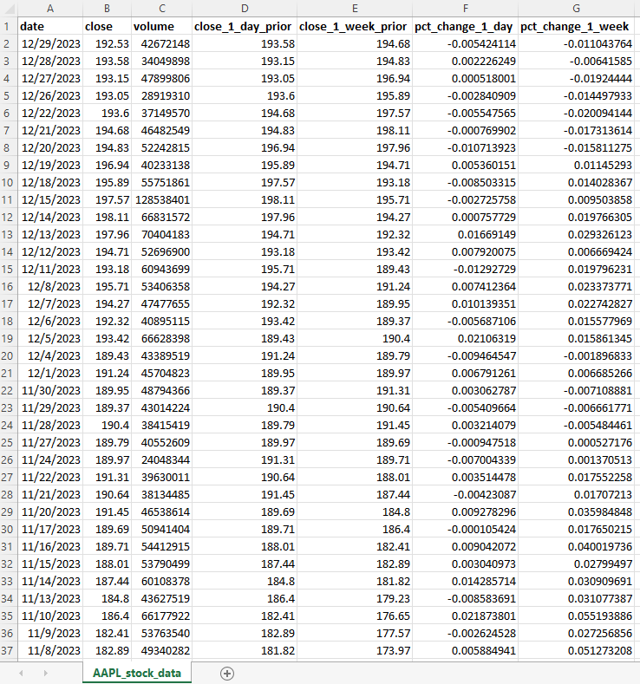
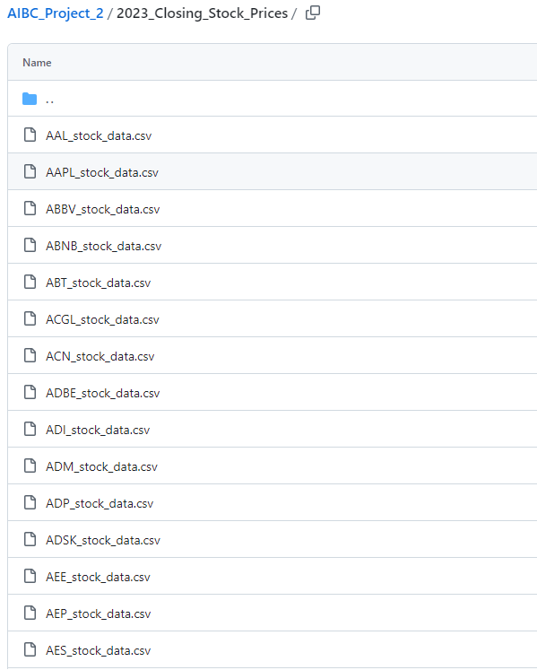
Data Retrieval & Clean up Stock Prices

Slide 8
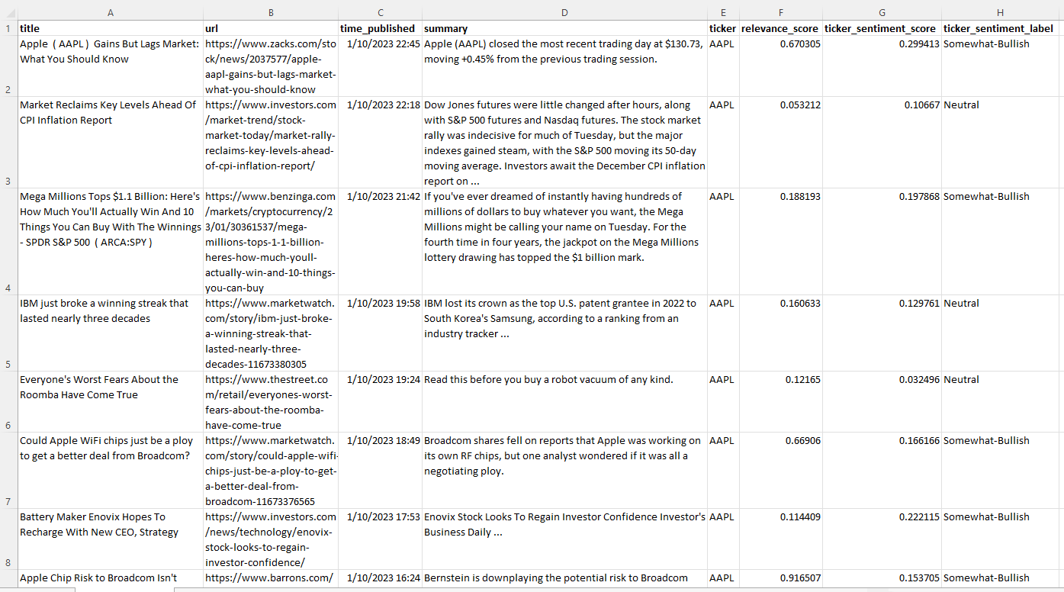
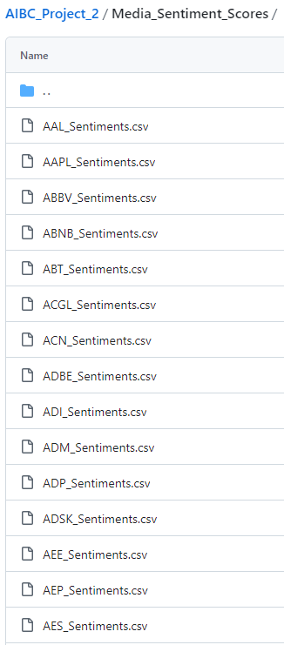
Data Retrieval & Clean up Sentiment

Slide 9
Results

Slide 10
Methodology
Random Forest
Support Vector Machines (SVMs)

Slide 11
Future Considerations

Slide 12
Future Considerations

Slide 13
Resources

Slide 14
THANK YOU
Shawn Feils & Chelsey Hay

