Slide 1
Handwriting Recognition Using a Neural Network
AI Boot Camp Final Project
Team Members: Shawn Feils & Chelsey Hay

Slide 2
Project Overview
Project Purpose / Description
The intent of the project was to build a neural network that could convert the project team’s handwriting into text.
Handwriting recognition programs typically perform poorly at recognizing the team’s handwriting and the team sees an opportunity to improve upon the existing handwriting recognition approaches.

Slide 3
Project Overview
Goals/Problem to be solved
Build a working handwriting recognition model using MNIST
Expand the approach to build a working handwriting recognition model using EMNIST
Fine-tune the EMNIST model using the team’s handwriting

Slide 4
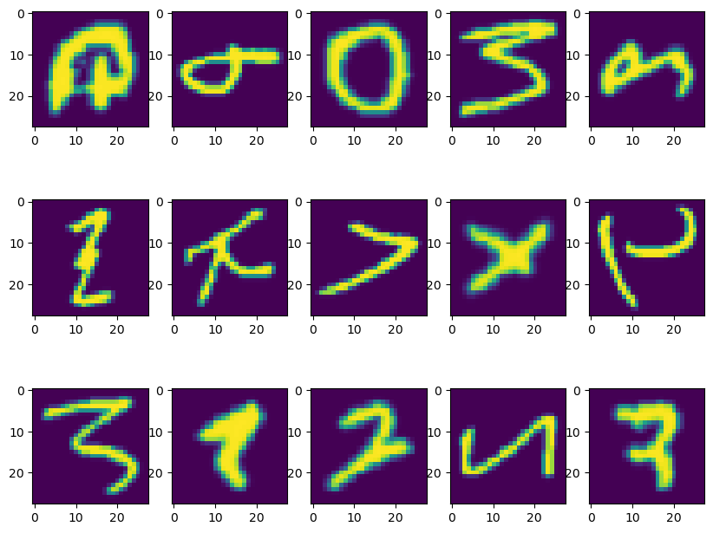
Project Overview
Overview of data collection, cleanup and exploration process
Model 1: MNIST
The training and testing data for the MNIST model are included in the TensorFlow data sets
Models 2: EMNIST Letters
The training and testing data for the EMNIST Letters model are included in the TensorFlow data sets
Models 3-8: EMNIST ByClass
The training and testing data for the EMNIST ByClass model are included in the TensorFlow data sets
Model 9: EMNIST Letters
The training and testing data for the final EMNIST Letters model were downloaded and read as CSVs
The shape of each data set was taken, as well as a visual inspection of a selection of training data images. Prediction images were photographed, uploaded, sized, and inverted.

Slide 5
Project Overview
Approach taken to achieve goals
The first goal was to build a working handwriting model using MNIST and a simple neural network using TensorFlow.
From the successful MNIST model, the team looked to build on the approach to incorporate handwritten letters in addition to digits.
The team cycled between EMNIST Letters and EMNIST ByClass (letters & numbers) and moved from a simple neural network to a convolutional neural network to improve the accuracy. Additional attempts were made to augment the training data set by making random changes to the source images (ie. rotations, etc.), increasing the layers in the neural network and running additional epochs. A Keras Tuner was utilized to optimize the neural network hyperparameters.
Lastly, a public version of the EMNIST with a high-accuracy modeling approach was adapted from Kaggle.

Slide 6
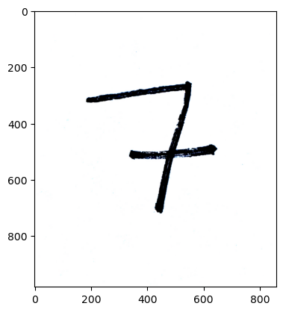
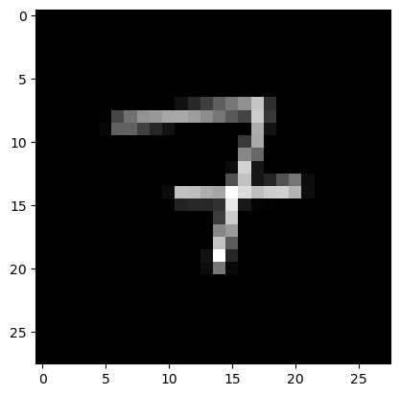

MNIST Model | Summary | Accuracy | Validation Accuracy
Model 1 | 4-layers | 97.43% | 97.50%
Result/Conclusion 1
Provide a summary of the results with the supporting visualization(s)
The results of the initial MNIST model were promising.

Slide 7
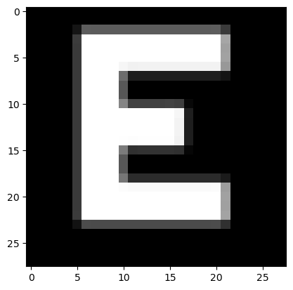
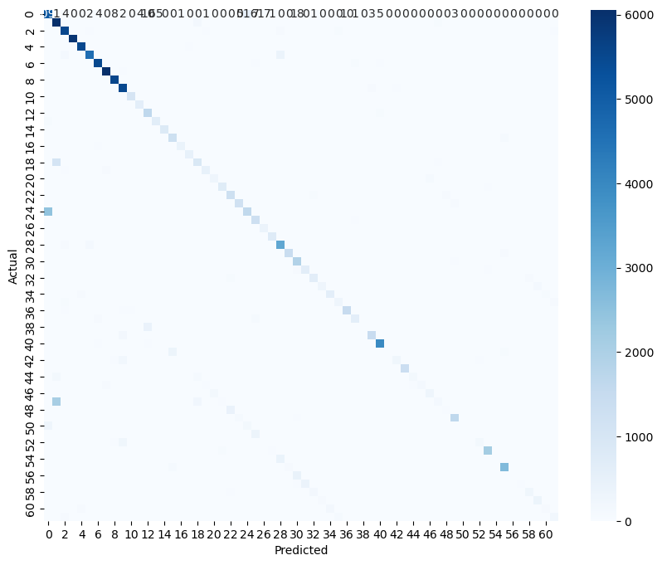
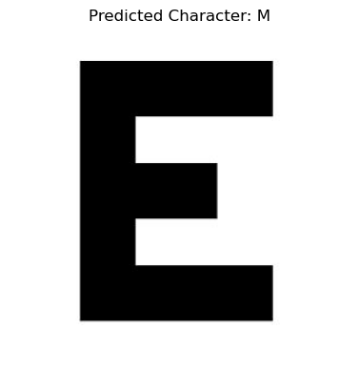

Result/Conclusion 2
Provide a summary of the results with the supporting visualization(s)
Models 3-7 attempted to utilize the same approach as the MNIST, however trained on the EMNIST ByClass data set. Training results seemed sufficient; predictions were erroneous.
EMNIST Models* | Summary | Accuracy | Validation Accuracy
Model 3 | 4-layers | 80.13% | 82.19%
Model 4 | CNN – 9-layers | 85.56% | 86.11%
Model 5 | CNN – 9-layers, with training augmentations | 81.43% | 83.96%
Model 6 | CNN – 9-layers, with training augmentations and 15 epochs | 81.35% | 83.62%
Model 7 | CNN – 11-layers, with training augmentations | 85.15% | 85.50%
* Model 2 was abandoned for EMNIST ByClass; Model 8 was abandoned due to the 25+ hour and counting run time of the Keras Tuner

Slide 8
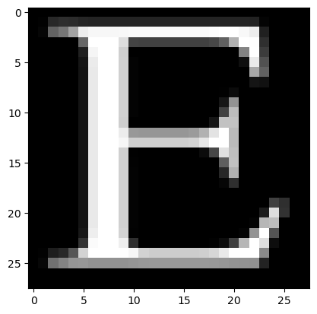
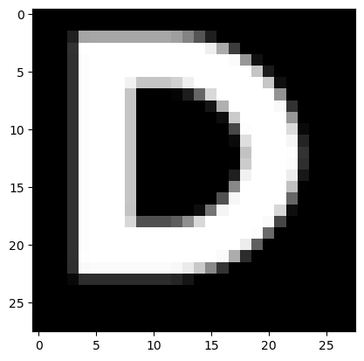
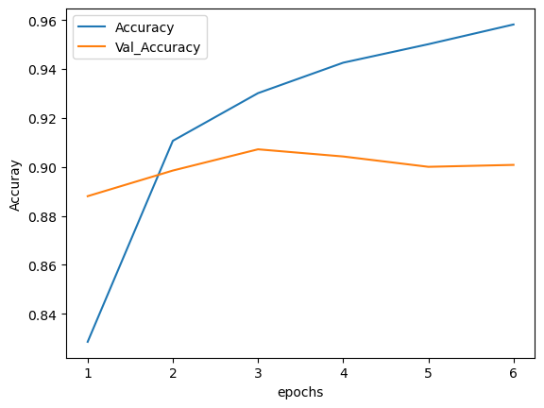
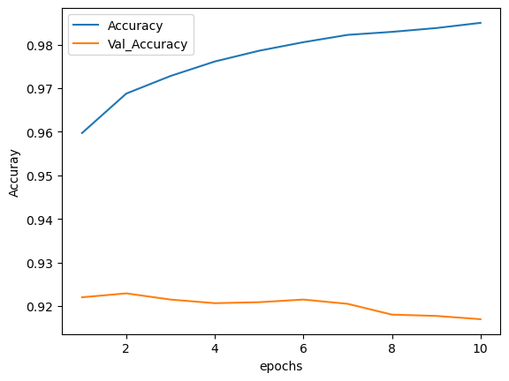
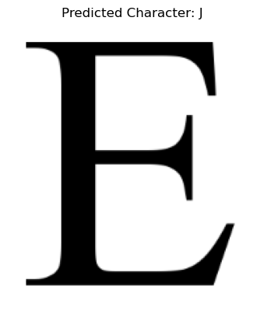





MNIST Model | Summary | Accuracy | Validation Accuracy
Model 9 | CNN – 6-layers | 98.53% | 91.70%
Result/Conclusion 3
Provide a summary of the results with the supporting data
The initial goal of building a model that could predict the team’s handwriting was abandoned in preference for a model that could predict any handwriting. A high performing data set and modelling approach was selected from Kaggle. Accuracy was high and the modelling approach well validated, however successful predictions remain elusive.

Slide 9
FIRST: The success with the original MNIST model indicates that the method of preprocessing the images – both for the training and prediction data sets – was successful. The team was able to hand write digits, photograph and upload the images, and then process the image and predict the digit.
Summary
SECOND: The complete failure to successfully predict a single letter across an series of models of increasing accuracy suggests that there is an error, perhaps in the classification.

Slide 10
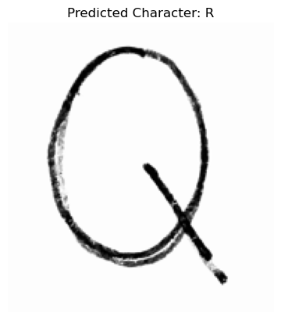
Despite the high accuracy of the models, prediction failed every time.
Tuning of the CNN and re-running the model took many hours of development and processing.
The Keras Tuner ran 18 different models over 25+ hours and the approach had to be abandoned so that additional approaches could be pursued.
Predictions were consistent, yet incorrect, and efforts to improve the model and troubleshoot the predictions were unsuccessful.
Problems Encountered
← Both the letter R, apparently →

Slide 11
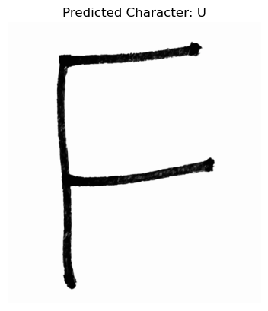
Summarize any additional questions that surfaced, what your group might research next if more time was available, or share a plan for future development.
Troubleshooting centered on these recommendations, which were attempted:
Generate a Confusion Matrix
Visualize Misclassified Images
Adjust Model Complexity
Experiment with Preprocessing
Experiment with CNN Model Architecture and Hyperparameter Choices
Additional troubleshooting approaches could be to:
Expand evaluation metrics beyond accuracy to include F1-score, precision, and recall for a more comprehensive assessment of model performance.
Review the labels and classes to ensure consistency
Future development would include:
Incorporating the team’s handwriting into the training data of a successful model
Incorporating an OCR app to convert long form handwriting into processable images
Future Considerations

