Slide 1
Scope Programming
Big Data at Microsoft
Alan Tan
2015/05/18
http://aka.ms/Cosmos

Slide 2
Microsoft Confidential

Slide 3
The Scope Language

Slide 4
Scope Is the Cosmos Query Language
Inspired by SQL
Developers familiar with SQL will find it easy to start using Scope
Amazing .NET Integration
Embed C# code in Scope and use libraries in .NET Assemblies
Incredible extensibility
Scope Tutorial
Scope Tutorial http://aka.ms/ScopeTutorial
Structured Computations Optimized for Parallel Execution

Slide 5
Remember
Scope is not SQL
There are differences in syntax, convention, and idioms
Notable Differences
Scope keywords are case sensitive. MUST be all upper case.
Expressions are C# expressions
String literals are C# string literals
No Sub-queries
Cosmos is not a relational database
Cosmos takes advantage of relational concepts
No concept of a catalog, tables, etc.

Slide 6
Scope Language Feature Set
Basics
SELECT FROM WHERE HAVING
C# Expression Syntax
Embed C# code in Scope Script
Re-use .NET Libraries
User-Defined Operators (UDOs)
Extractors - Custom readers of unstructured data
Outputters - Custom writers for unstructured data
Processors - Custom transforms of rows
Combiners - Custom JOINs
Reducers - More advanced Aggregation of rows
Custom Aggregators
Aggregations
GROUP BY
SUM, COUNT, MAX, MIN, …
Custom Aggregators
Windowing Functions (OVER Clause)
Reusing Scope Code
Views
Modules
Views – Reading Data
Functions – Transforming Data
Procedures – Writing Data
Dynamics – Scope code created at compile time via C#
Functions, Views, Procedures
Data Partitioning
Structured Streams
SteamSets

Slide 7
Executing Scope Scripts

Slide 8
How Do You Run These Scripts?
Two Options
In-Cluster Execution
Upload your data to your virtual cluster
Submit a Scope Job
Local Execution
Keep your data on your machine
Run a script locally

Slide 9
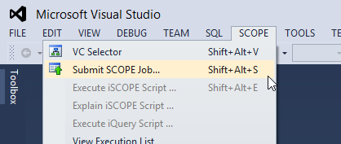
In-Cluster Execution
Cosmos PowerShell
Import-Module Cosmos
Submit-CosmosScopeJob d:\myscript.script vc://cosmos08/sandbox
scope.exe (found in the ScopeSDK)
scope.exe submit –i d:\myscript.script –vc vc://cosmos08/sandbox
Scope Studio

Slide 10
Local Execution
Cosmos PowerShell
Invoke-ScopeRun d:\myscript.script
Use scope.exe found in the ScopeSDK
scope.exe run –i d:\myscript.script
Use Scope Studio
Just type in a script and hit Start

Slide 11
A Practical Walkthrough of the Basics

Slide 12
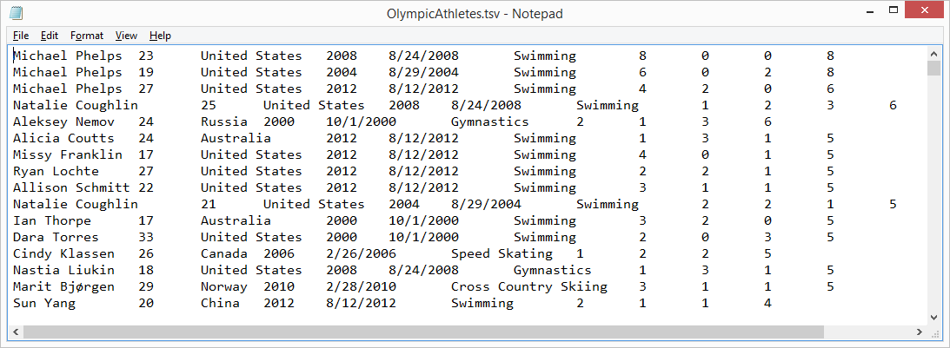
Sample Data Set: Olympic Gold Medals
Source: Tableau Software sample data sets. Converted to a text file (tsv)
About 8.5K rows.
No Header Row!
The Schema:
Athlete
Age
Country
Year
Closing Ceremony Date
Sport
Gold Medals
Silver Medals
Bronze Medals
Total Medals

Slide 13
athletes =
EXTRACT
Athlete: string,
Age: string,
Country: string,
Year: string,
ClosingCeremonyDate: string,
Sport: string,
GoldMedals: string,
SilverMedals: string,
BronzeMedals: string,
TotalMedals: string
FROM "/my/OlympicAthletes.tsv"
USING DefaultTextExtractor();
OUTPUT athletes
TO "/my/Output/output.tsv"
USING DefaultTextOutputter();
First Task: Read and Write
Notes:
First focus on getting on just reading and writing the data as strings

Slide 14
athletes =
EXTRACT
Athlete: string,
Age: int,
Country: string,
Year: int,
ClosingCeremonyDate: datetime,
Sport: string,
GoldMedals: int,
SilverMedals: int,
BronzeMedals: int,
TotalMedals: int
FROM @"/my/OlympicAthletes.tsv"
USING DefaultTextExtractor();
OUTPUT athletes
TO @"/my/Output/output.tsv"
USING DefaultTextOutputter();
Now Extract the Correct Types
Types introduced here
string
int
datetime
This is when you discover whether you are missing fields
or if the fields have malformed data

Slide 15
Data Types
Native
User Defined
Category | Data type | Nullable Data type
Miscellaneous | bool Guid datetime byte[] | bool? Guid? datetime?
Numeric | byte sbyte int uint long ulong float double decimal short ushort | byte? sbyte? int? uint? long? ulong? float? double? decimal? short? ushort?
Text | char string | char?
Complex | MAP<k,v> ARRAY<v>
// Example
public class UrlList
{
public List<string> Items;
private static char [] sepchars = new char[] {','};
public UrlList(string s)
{
this.Items = new List<string>(s.Split(sepchars));
}
public string Serialize()
{
return string.Join(";", this.Items);
}
}
a = SELECT new UrlList(urls) As Urls
FROM searchlog;

Slide 16
Extraction Errors

Slide 17
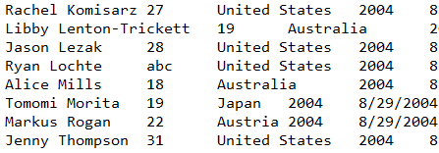
What If We Have a Bad Value?

Slide 18
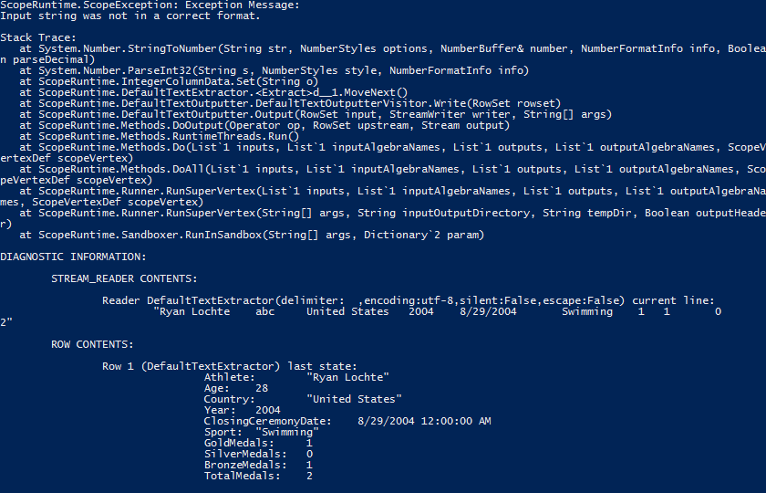
Extraction Will Fail

Slide 19
Views

Slide 20
Avoid Repetition: Use VIEWs
athletes =
EXTRACT
Athlete: string,
Age: int,
Country: string,
Year: int,
ClosingCeremonyDate: datetime,
Sport: string,
GoldMedals: int,
SilverMedals: int,
BronzeMedals: int,
TotalMedals: int
FROM @"/my/OlympicAthletes.tsv"
USING DefaultTextExtractor();
OUTPUT athletes
TO "/my/Output/output.tsv"
USING DefaultTextOutputter();
How can we avoid writing this same EXTRACT statement over and over?
VIEWs encapsulate input data.

Slide 21
CREATE VIEW SearchLog
SCHEMA (
Athlete: string,
Age: int,
Country: string,
Year: int,
ClosingCeremonyDate: DateTime,
Sport: string,
GoldMedals: int,
SilverMedals: int,
BronzeMedals: int,
TotalMedals: int
)
AS BEGIN
athletes =
EXTRACT
Athlete: string,
Age: int,
Country: string,
Year: int,
ClosingCeremonyDate: DateTime,
Sport: string,
GoldMedals: int,
SilverMedals: int,
BronzeMedals: int,
TotalMedals: int
FROM "/my/OlympicAthletes.tsv"
USING DefaultTextExtractor();
END;
Save this as a file called
OlympicAthletes.view.
CREATE VIEW name
SCHEMA (schema)
AS BEGIN
extract
END

Slide 22
Consuming the View
athletes = VIEW “/my/OlympicAthletes.view";
OUTPUT athletes
TO "/my/Output/output.tsv"
USING DefaultTextOutputter();
rowset = VIEW path;
Notes:
Always use Scope VIEWs to make your scripts smaller and more maintainable

Slide 23
SELECT … FROM… WHERE … HAVING

Slide 24
Projection & Filtering
data =
SELECT Athlete, Year, TotalMedals
FROM athletes
WHERE Year==2008;
data =
SELECT *
FROM athletes
WHERE Year==2008;
Select the columns you want
Or pick them all
On choose specific rows from the input

Slide 25
HAVING & WHERE
data =
SELECT Athlete, Year, ClosingCeremonyDate.Month AS ClosingMonth
FROM athletes
WHERE (Year==2008 OR Year==2006) AND ClosingMonth==2;
data =
SELECT Athlete, Year, ClosingCeremonyDate.Month AS ClosingMonth
FROM athletes
WHERE Year==2008 OR Year==2006
HAVING ClosingMonth==2;
Compilation Error
This works
WHERE filters input rows
HAVING filters output rows
Input rows
SELECT *
FROM input
WHERE (cond1)
HAVING (cond2);
Output rows

Slide 26
MISC
data =
SELECT DISTINCT Athlete, Year
FROM athletes;
data =
SELECT TOP 5 *
FROM athletes
ORDER BY Athlete;
Find Unique Records
Get the first 5 records ordered by Athelete.

Slide 27
Using .NET Code

Slide 28
C# Blocks
athletes = VIEW @"OlympicAthletes.view";
data =
SELECT MyHelper.Normalize(Athlete) AS Athlete, Year, TotalMedals
FROM athletes;
OUTPUT data
TO "/my/Output/output.tsv"
USING DefaultTextOutputter();
#CS
public static class MyHelper
{
public static string Normalize(string s)
{
return s.ToUpper();
}
}
#ENDCS
CS Blocks let us keep C# code in the script that we can use later.
Great for helper methods.
Scope Studio makes it even easier with support for a “code-behind” C# file.

Slide 29
References
REFERENCE @“MyHelper.dll";
data =
SELECT MyHelper.Normalize(Athlete) AS Athlete, Year, TotalMedals
FROM athletes;
You can reuse code in .NET assemblies.
// In a separate DLL
public static class MyHelper
{
public static string Normalize(string s)
{
return s.ToUpper();
}
}
The following DLLs are always available. You do not need REFERENCE them:
mscorlib.dll
System.dll
System.Core.dll
System.Data.dll

Slide 30
Aggregations

Slide 31
Aggregations
data =
SELECT Country, SUM(TotalMedals) AS Medals
FROM athletes
GROUP BY Country;
How many medals were earned by each country?
Built-in Aggregations
ARGMAX
AVG
COUNT
COUNTIF
ANY_VALUE aka FIRST
LAST
MAX
MIN
SUM
VAR *
STDEV *
ARRAY_AGG
MAP_AGG
LIST

Slide 32
Custom Aggregators
data =
SELECT Country, MySUM(TotalMedals) AS Medals
FROM athletes
GROUP BY Country;
class MySUM: Aggregate1<double, double>
{
double sum = 0;
public override void Initialize() { sum = 0; }
public override void Add(double y) { sum += y; }
public override double Finalize() { return sum; }
}

Slide 33
Combining Data

Slide 34

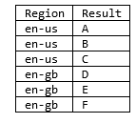
Converting Columns to Rows
rs1 =
SELECT
Region,
Urls
FROM searchlog;
rs2 =
SELECT
Region,
SplitUrls AS Result
FROM rs1
CROSS APPLY Urls.Split(';') AS SplitUrls;
CROSS APPLY

Slide 35
Converting Rows to Columns
rs1 =
SELECT
Region,
Urls
FROM searchlog;
rs2 =
SELECT
Region,
SplitUrls AS Url
FROM rs1
CROSS APPLY Urls.Split(';') AS SplitUrls;
rs3 =
SELECT
Region,
string.Join(";" , ARRAY_AGG(Url) ) AS Urls
FROM rs2
GROUP BY Region;
ARRAY_AGG
LIST
MAP_AGG

Slide 36
Set Operations
data1 = … some rows;
data2 = … some rows;
merged =
(SELECT * FROM data1)
UNION ALL
(SELECT * FROM data2);
UNION ALL
UNION DISTINCT
INTERSECT ALL
INTERSECT DISTINCT
EXCEPT DISTINCT
SELECT DISTINCT

Slide 37
Joins
rs_inner =
SELECT
employees.DepID AS EmpDepId, departments.DepID ,
employees.EmpName,
departments.DepName
FROM employees
INNER JOIN
departments ON employees.DepID == departments.DepID;
INNER JOIN
OUTER JOIN
LEFT OUTER JOIN
RIGHT OUTER JOIN
FULL OUTER JOIN
CROSS JOIN
SEMIJOIN
LEFT SEMIJOIN
RIGHT SEMIJOIN

Slide 38
COMBINERS
RS2 =
COMBINE left WITH right
ON left.X == right.X
USING MyCombiner()
PRODUCE A,B,C,D;
Advanced Technique

Slide 39
Parameters

Slide 40
Internal Parameters
#DECLARE TargetYear int = 2008;
data =
SELECT Athlete, Year, TotalMedals
FROM athletes
WHERE Year==@TargetYear;
#DECLARE a string = @"Hello World";
#DECLARE b int = 10;
#DECLARE c bool = true;
#DECLARE d double = 1.0;
#DECLARE date0 DateTime = DateTime.Parse("2010/03/31");
The #DECLARE preprocessor instruction
#DECLARE name type = expression;
To use the value: @name

Slide 41
You Can Use Expressions in #DECLARE
#DECLARE str1 string = @"Hello World";
Literal values
#DECLARE str2 string = "BEGIN" + @str1 + "END";
Simple Expressions
#DECLARE str3 string = string.Format("BEGIN{0}END", @str1 );
Compose parameters
#DECLARE myName string = MyHelper.GetMyName();
But you CAN NOT call your own C# methods

Slide 42
External Parameters
athletes = VIEW @"OlympicAthletes.view";
data =
SELECT Athlete, Year, TotalMedals
FROM athletes
WHERE Year==@@TargetYear@@;
OUTPUT data
TO @"/my/CosmosSamples/CosmosUniversity/Output/output.tsv"
USING DefaultTextOutputter();
The value is NOT in the script.
The value is provided by the USER when the script is SUBMITTED.
To use the value: @@name@@

Slide 43
Passing External Parameters
a = VIEW @@view@@;
OUTPUT a TO SSTREAM @"/my/output.ss";
Submitting with Cosmos PowerShell
$params = @{ view="/my/Colors.view" }
$job = Submit-CosmosScopeJob d:\test.script vc://cosmos08/sandbox -Parameters $params
scope.exe
scope.exe submit -i d:\test.script -vc vc://cosmos08/sandbox -params view=\"/my/Colors.view\"
Scope Studio
Right click on script file and select “Set Parameters”

Slide 44
StreamSets

Slide 45
User tend to organize their streams by name.
// Modern Syntax
Rs1 =
EXTRACT col1:string, col2:int
FROM STREAMSET @“\my\Input\"
PATTERN “log_%Y_%m_%d.txt"
RANGE __date = ["2013-10-03", "2013-10-07"]
USING DefaultTextExtractor();
// Legacy Syntax
Rs1 =
EXTRACT col1:string, col2:int
FROM @“\my\Input\log_%Y_%m_%d?date=2013-10-03...2013-10-07"
USING DefaultTextExtractor();
log_2013_10_01.txt
log_2013_10_02.txt
log_2013_10_03.txt
log_2013_10_04.txt
log_2013_10_05.txt
log_2013_10_06.txt
log_2013_10_07.txt
log_2013_10_08.txt
log_2013_10_09.txt
log_2013_10_10.txt
log_2013_10_11.txt
log_2013_10_12.txt

Slide 46
What if one of the files is missing?
log_2013_10_01.txt
log_2013_10_02.txt
log_2013_10_03.txt
log_2013_10_04.txt
log_2013_10_05.txt
log_2013_10_06.txt
log_2013_10_07.txt
log_2013_10_08.txt
log_2013_10_09.txt
log_2013_10_10.txt
log_2013_10_11.txt
log_2013_10_12.txt
// Modern Syntax
Rs1 =
EXTRACT col1:string, col2:int
FROM SPARSE STREAMSET @“\my\Input\"
PATTERN “log_%Y_%m_%d.txt"
RANGE __date = ["2013-10-03", "2013-10-07"]
USING DefaultTextExtractor();
// Legacy Syntax
Rs1 =
EXTRACT col1:string, col2:int
FROM @“\my\Input\log_%Y_%m_%d?date=2013-10-03...2013-10-07&sparsestreamset=true"
USING DefaultTextExtractor();

Slide 47
Windowing Functions

Slide 48
Windowing Functions (as defined by ANSI SQL) were added to Scope to support common Analytic Scenarios in a reliable and highly efficient manner.
A Windowing Function is a function whose value is computed from multiple rows (the window defined by the OVER clause) instead of just the current row.
Common Analytic Scenarios
TOP N in a GROUP
Generating unique IDs for Rows
Calculating Percentiles
Moving Averages
Reporting aggregate functions such as SUM or AVG
Ranking functions like DENSE_RANK, ROW_NUMBER, NTILE, and RANK
Analytic functions such as cumulative distribution, or accesses data from a previous row in the same result set without the use of a self-join
Cumulative aggregate functions
Moving aggregate functions

Slide 49
User-Defined Operators

Slide 50
User-Defined Operators UDOs are the most powerful way of extending scope.
rs1 = SELECT Market, Results
FROM searchlog;
rs2 = PROCESS rs1
PRODUCE Market, Results
USING CopyProcessor;
Extractors
Outputters
Processors
Reducers
Combiners
Aggregators

Slide 51
public class CopyProcessor : ScopeRuntime.Processor
{
public override Schema Produces( string[] requested_columns,
string[] args,
Schema input_schema)
{
var output_schema = input_schema.CloneWithSource();
return output_schema;
}
public override IEnumerable<Row> Process(
RowSet input_rowset,
Row output_row,
string[] args)
{
foreach (Row input_row in input_rowset.Rows)
{
input_row.CopyTo(output_row);
yield return output_row;
}
}
}
The simplest processer – it just copies the input to the output

Slide 52
public class MyProcessor : Processor
{
public override Schema Produces(
string[] requested_columns,
string[] args,
Schema input_schema)
{
var output_schema = input_schema.Clone();
var newcol = new ColumnInfo("Market2", typeof(string));
output_schema.Add(newcol);
return output_schema;
}
public override IEnumerable<Row> Process(
RowSet input_rowset,
Row output_row,
string[] args)
{
foreach (Row input_row in input_rowset.Rows)
{
input_row.CopyTo(output_row);
string market = input_row[0].String;
output_row[2].Set( "FOO" + market );
yield return output_row;
}
}
}
This adds a column called Market2
The value of Market2 is “Foo” + Market

Slide 53
Use native Scope constructs before UDOs
A pure Scope gives the best performance and reliability
The #1 cause of failures and performance problems use using C# code un UDOs instead of native Scope features

Slide 54
Questions?

