Slide 1
Quantum Liquid Neural Networks
for ODE / PDE Solving & Forecasting
A pre-registered, falsifiable benchmark against matched classical baselines
Shawn Gibford · Anja Hribljan Advisor update — July 2026
target venue: PRX Quantum
Notes:
Frame: we built a rigorous benchmark asking whether quantum liquid networks beat matched classical models on differential-equation tasks. The honest answer is no under our pre-registered hypothesis — and that null, plus the mechanism story behind it, is the paper.

Slide 2
The research question
Do quantum PINNs hold a regime-dependent advantage — better on smooth/periodic dynamics than on broadband/chaotic dynamics?
Theory motivation: data-reuploading circuits are truncated Fourier series (Schuld 2021) → built-in bias toward smooth, low-frequency functions
Field problem: most QML papers compare against under-tuned classical baselines (Bowles, Ahmed & Schuld 2024)
Our answer: pre-register the hypothesis, lock the decision rule, tune BOTH sides, then let the data decide
9
5
quantum model families
classical baselines
8
405+
ODE / PDE systems
training cells, 0 errors
22
pre-registration amendments — every choice disclosed
Bowles, Ahmed, Schuld (2024) “Better than classical? The subtle art of benchmarking QML models,” arXiv:2403.07059
Notes:
The field's credibility problem is baseline fairness. Our design contribution is procedural: pre-registration + symmetric tuning + mechanical verification of every number.

Slide 3
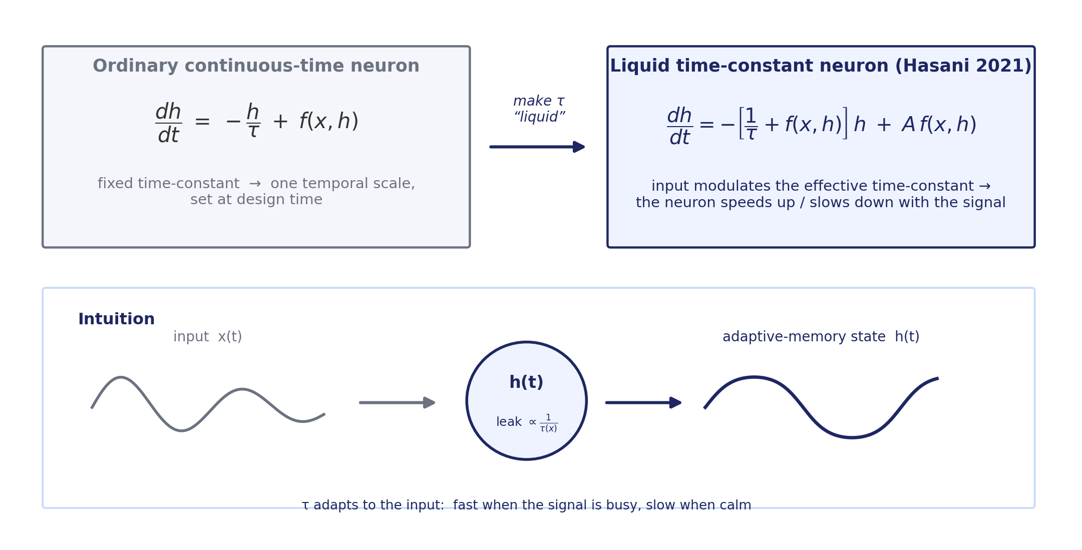
Background: what is a Liquid Neural Network?
MIT (Hasani et al., AAAI 2021): neurons are tiny ODEs
The time-constant τ is modulated by the input — the network’s memory adapts to the signal (“liquid”)
Inspired by C. elegans neurons (302 neurons, complex behavior)
Strong on time-series; the basis of MIT’s autonomous-driving NCPs
Diagram: ours, after Hasani et al. 2021 (arXiv:2006.04439). dh/dt = −[1/τ + f(x,h)]h + A·f(x,h)
Notes:
One-liner for advisor: an RNN whose neurons are little leaky ODEs where the leak rate itself listens to the input. That input-dependent time constant is the whole trick.

Slide 4
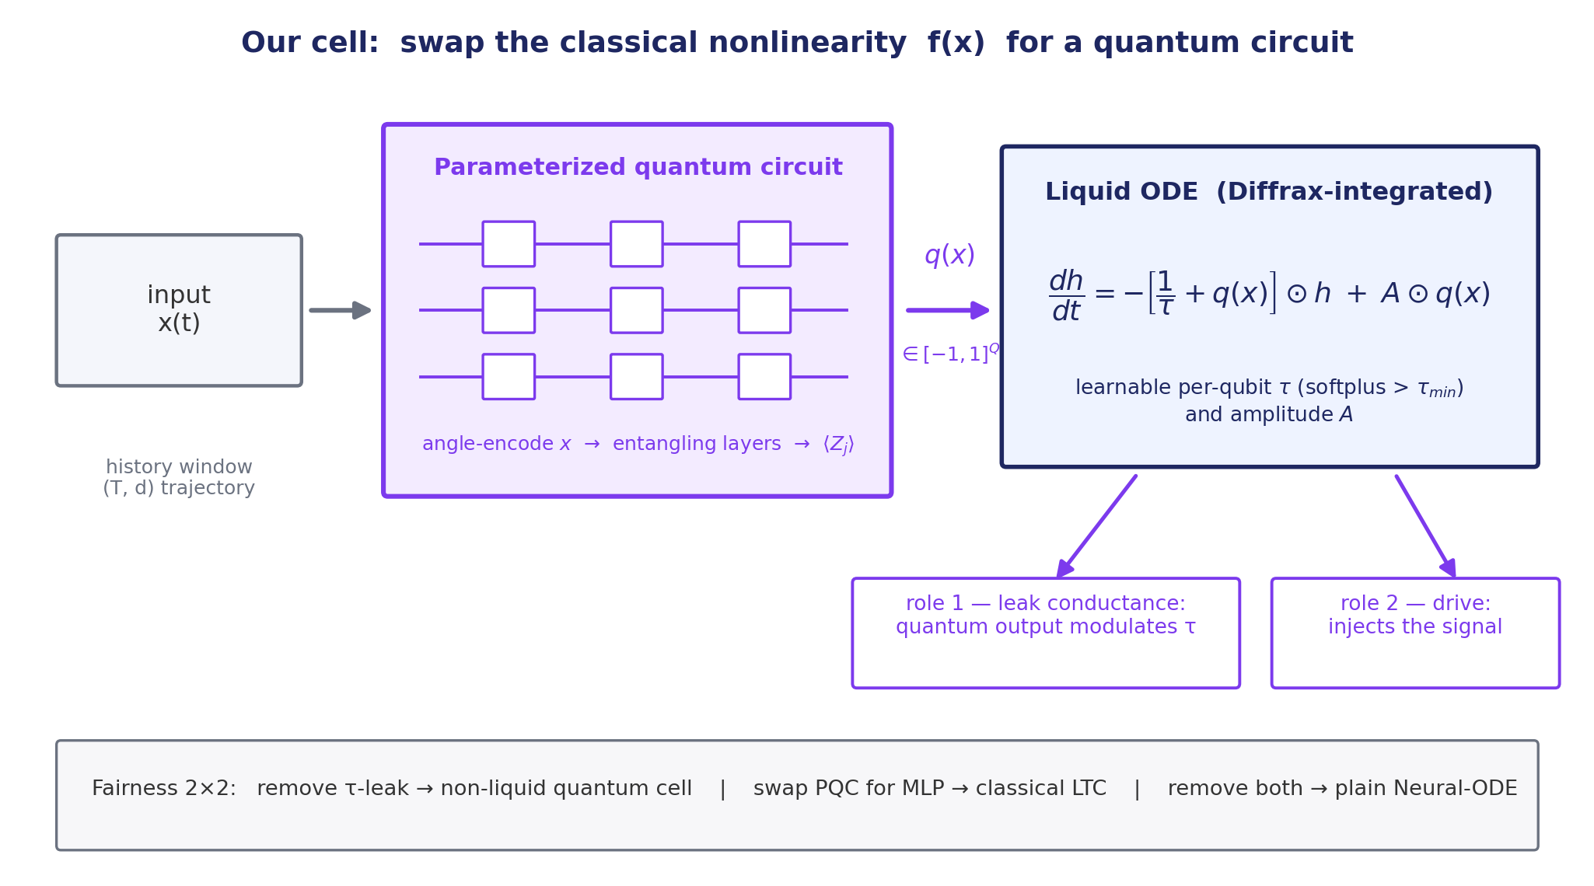
Where the “quantum” goes in our model
We replace the classical nonlinearity f(x) with a parameterized quantum circuit
PauliZ readout q(x) plays BOTH liquid roles: leak conductance and drive
τ and amplitude A stay classical and learnable
Every piece is separable → clean ablations (next slides)
Solver task uses the same circuits as PINN function approximators (no ODE cell; fairness is PINN-vs-PINN there).
Notes:
Key architectural point: the quantum circuit is the encoder inside the liquid cell. Because tau, A, and the circuit are separable, we can knock each out independently — that gives us the 2x2 fairness matrix that became the paper's mechanistic centerpiece.

Slide 5
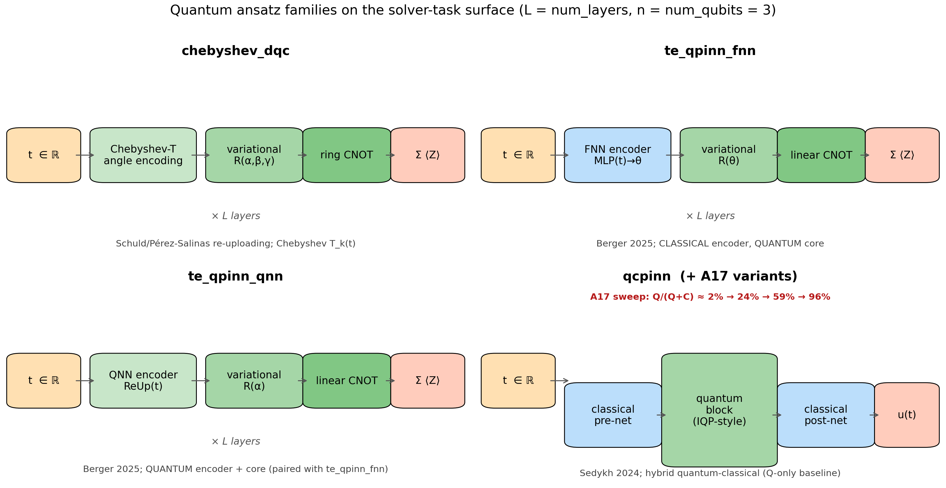
The model zoo — every quantum family vs every baseline
Quantum (solver): chebyshev_dqc, te_qpinn_fnn, te_qpinn_qnn, qcpinn (+2D ports)
Quantum (forecaster): data-reuploading, hardware-efficient, strongly-entangling, rf_qrc + non-liquid ablations
Classical: PINN, Neural-ODE, classical LTC, plain MLP, known-structure skyline
All capacity-matched; all-to-all head-to-head in the paper
Every family implemented against its published spec; faithfulness manifest in refs/CIRCUIT_SPECS.md.
Notes:
Emphasize completeness: 9 quantum families and 5 classical baselines, everything head-to-head — the all-to-all tables are in the paper body, not buried in a supplement.

Slide 6
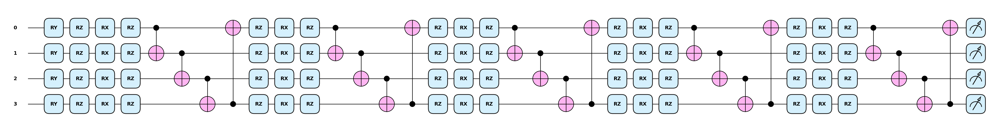
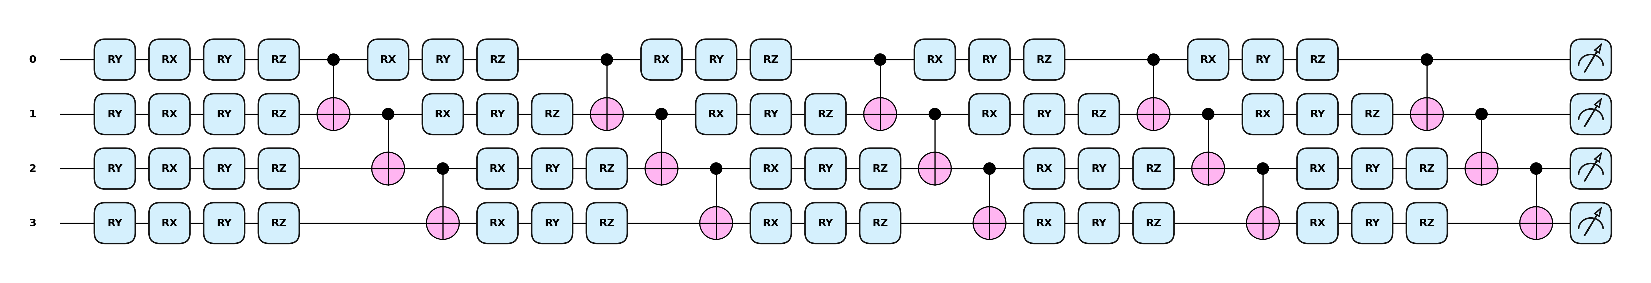
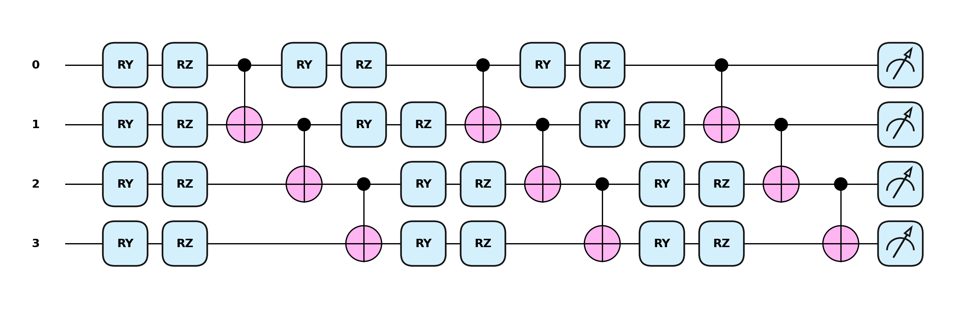
The solver circuits — printed from the code (PennyLane)
chebyshev_dqc — Chebyshev tower RY(2(j+1)·arccos x) → 5× [RZ·RX·RZ + ring CNOT] → ⟨Σ Zj⟩ (n=4, L=5)
te_qpinn_fnn — classical MLP φ(t) → RY(φk·t) embed → 5× HEA [RX·RY·RZ + CNOT chain] → ⟨Σ Zj⟩ (n=4, L=5)
te_qpinn_qnn — stage 1: quantum embedding (K=3) → αk = π·⟨Zk⟩ …
… stage 2: RY(αk) re-encode → 5× HEA → ⟨Σ Zj⟩
→
Notes:
These are not schematics — each strip is the actual PennyLane circuit object used in training, rendered with qml.draw_mpl at the gate-matched paper configuration (4 qubits, 5 variational layers). Chebyshev encodes time through an arccos feature tower; the two te_qpinn variants differ only in whether the embedding angles come from a classical MLP or a second quantum circuit.

Slide 7
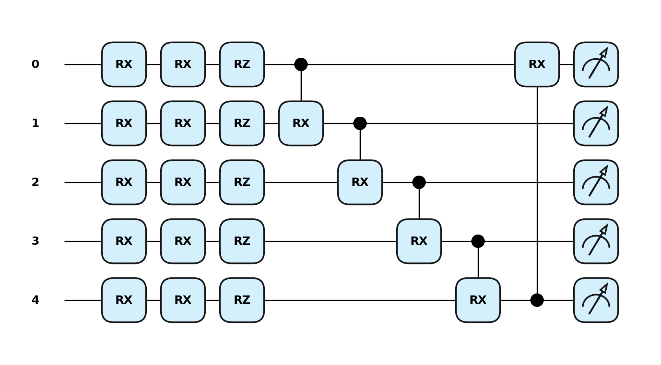
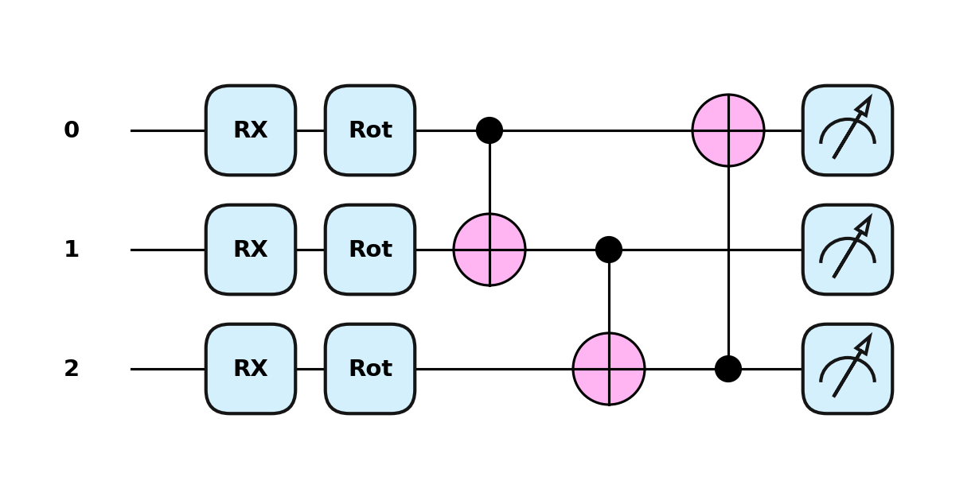
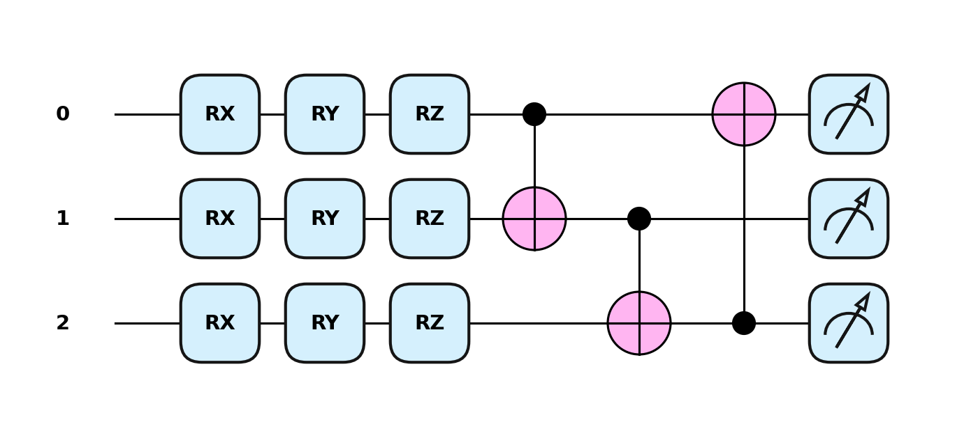
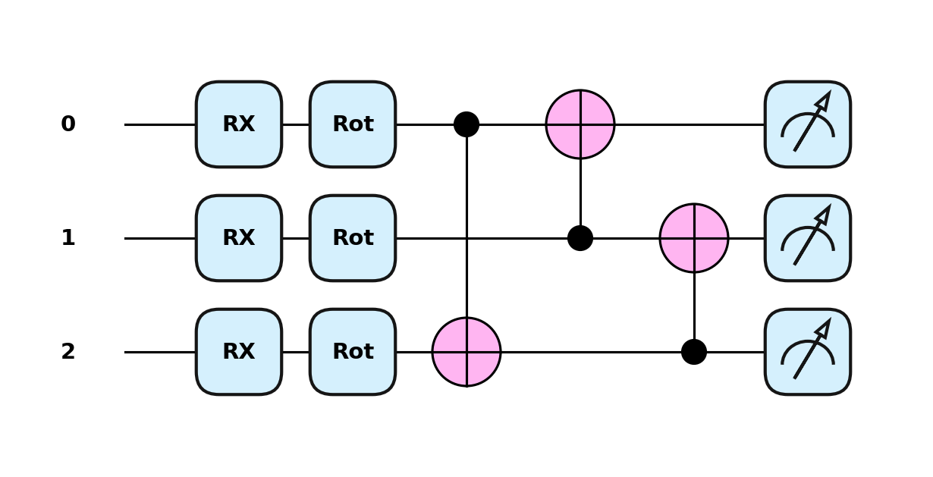
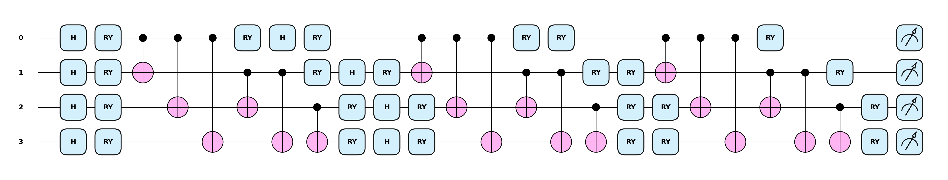
Forecaster + hybrid circuits — printed from the code
qcpinn — quantum block (n=5, Cascade, L=1)
data_reuploading (n=3, L=1)
hardware_efficient (n=3, L=1)
strongly_entangling (n=3, L=1, long-range CNOT)
rf_qrc — fixed random-feature reservoir (n=4): double feature map Φ,Φ → frozen V(α) → full 2ⁿ probability readout
Every diagram on these two slides is generated by qml.draw_mpl on the exact circuit objects the training runs execute — zero hand-drawing.
Notes:
qcpinn sandwiches this 5-qubit cascade between two classical 50-unit MLPs — the A17 sweep moves the parameter budget between those pieces. rf_qrc is the odd one out: nothing in the circuit is trained; a frozen random circuit produces a 16-dimensional probability vector and only a ridge regression readout is fit. strongly_entangling's long-range CNOT range is what un-aliased it from data_reuploading in amendment A16.

Slide 8
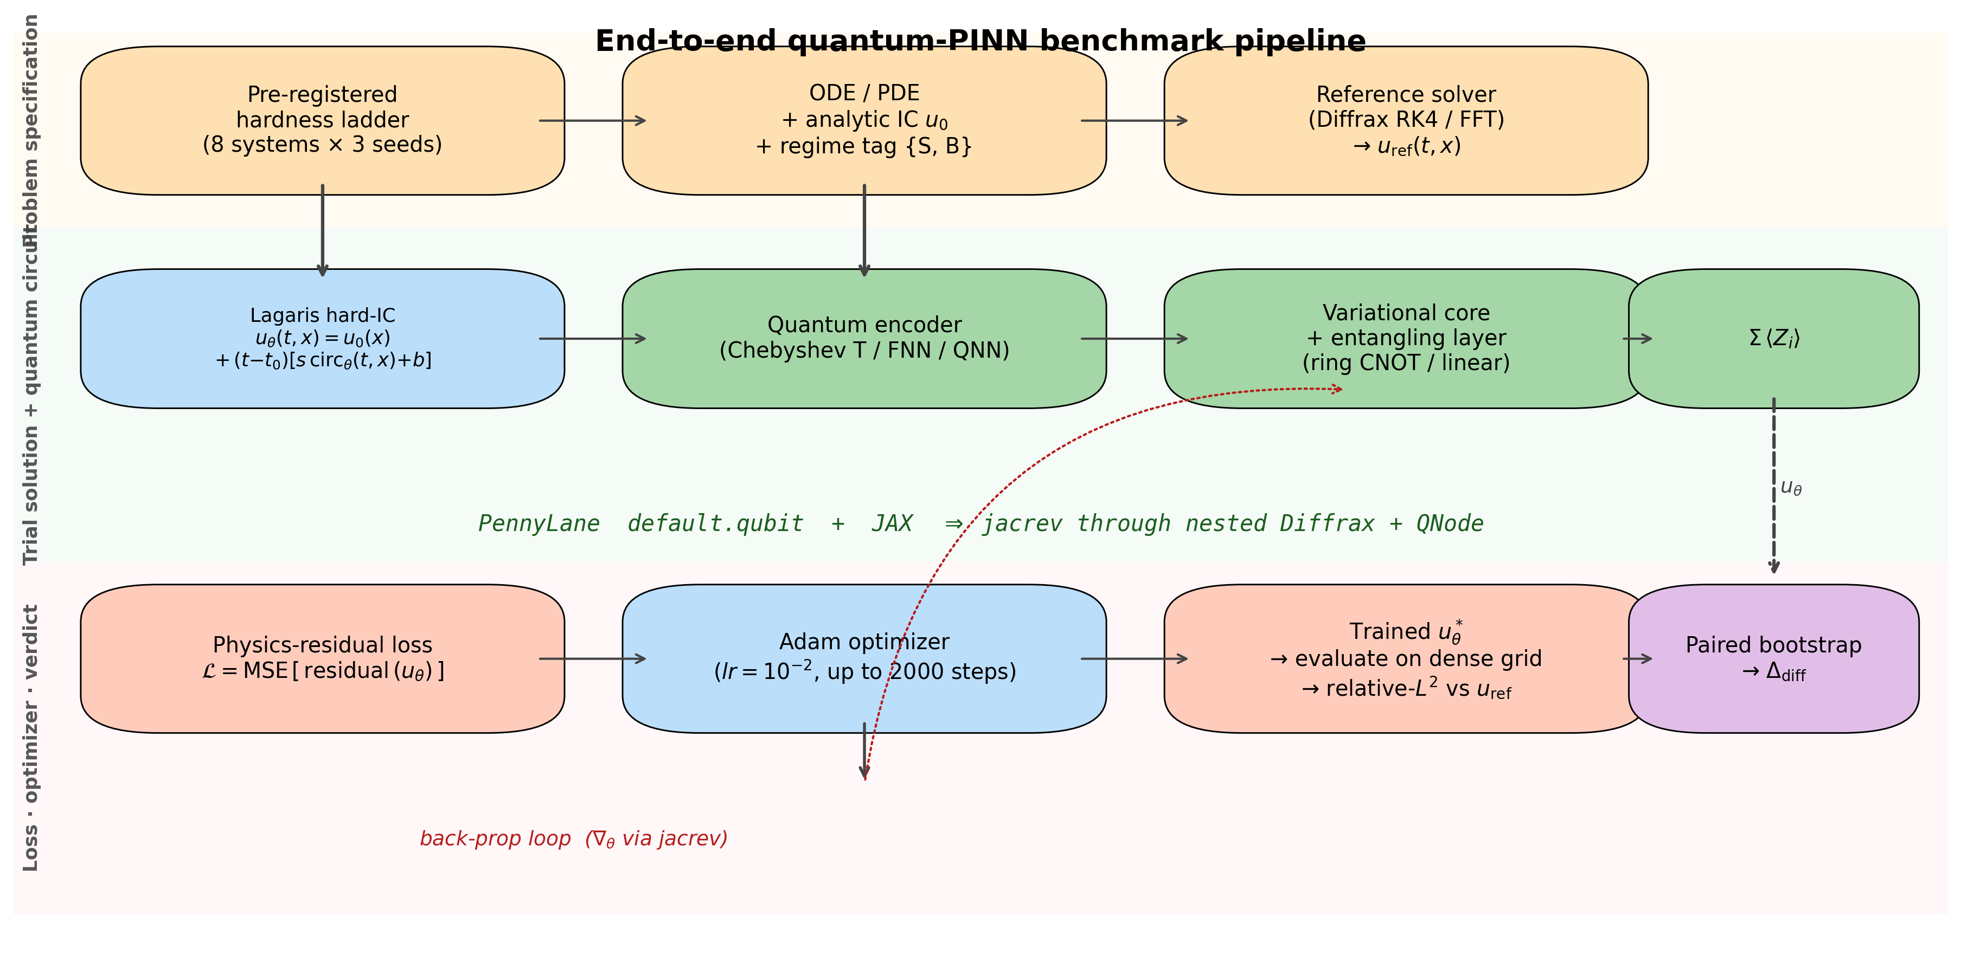
Pre-registered methodology (the Bowles–Schuld checklist)
Hypothesis + decision rule locked BEFORE results
Matched parameter budgets & training steps
Symmetric HPO — both sides tuned
Paired-bootstrap 95% CI (n=10,000)
Underfit + skyline guards
22 amendments — every deviation disclosed
verify_paper_integrity.py gates EVERY cited number
Decision rule (pre-reg §7): CONFIRMED iff 95% CI of Δ_smooth − Δ_broad excludes 0 positively on the solver task.
Notes:
If they remember one slide, this one: the verdict was mechanically determined by a locked rule, and a script re-verifies every number in the paper from committed result files. A reviewer can clone and check.

Slide 9
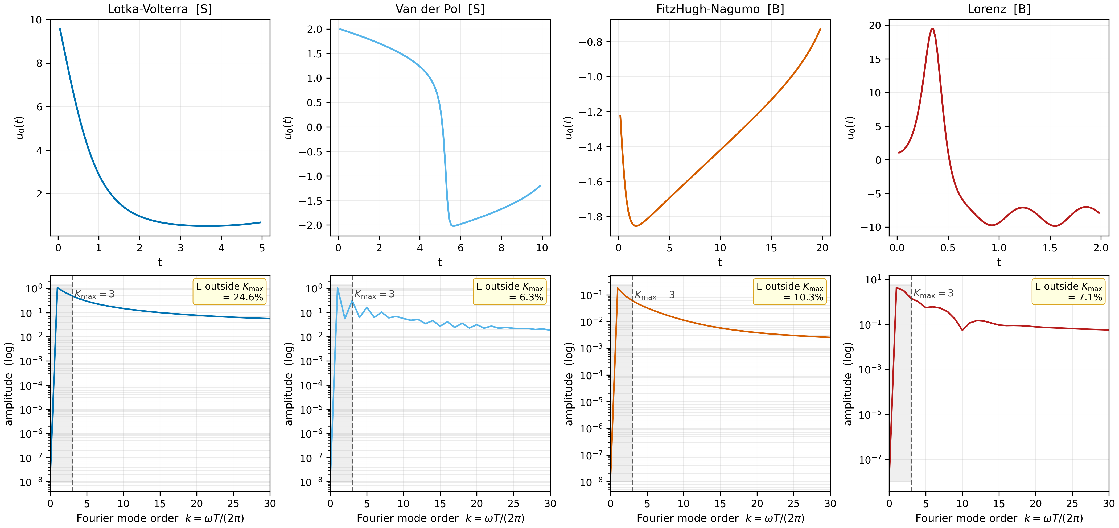
The hardness ladder — 8 systems, 2 regimes
SMOOTH / PERIODIC:
Lotka-Volterra · Van der Pol · Heat · Burgers (smooth)
BROADBAND / MULTISCALE:
Lorenz · FitzHugh-Nagumo · Allen-Cahn · Burgers (shock)
Spectra measured, not asserted — PSD of each reference solution
3 seeds per cell; Kuramoto (12-D) + KdV running on Anvil now
Regime tags bound in code and asserted against the pre-registration.
Notes:
The regime split IS the hypothesis: quantum should win the top row and lose the bottom row if the Fourier-bias story is right.

Slide 10
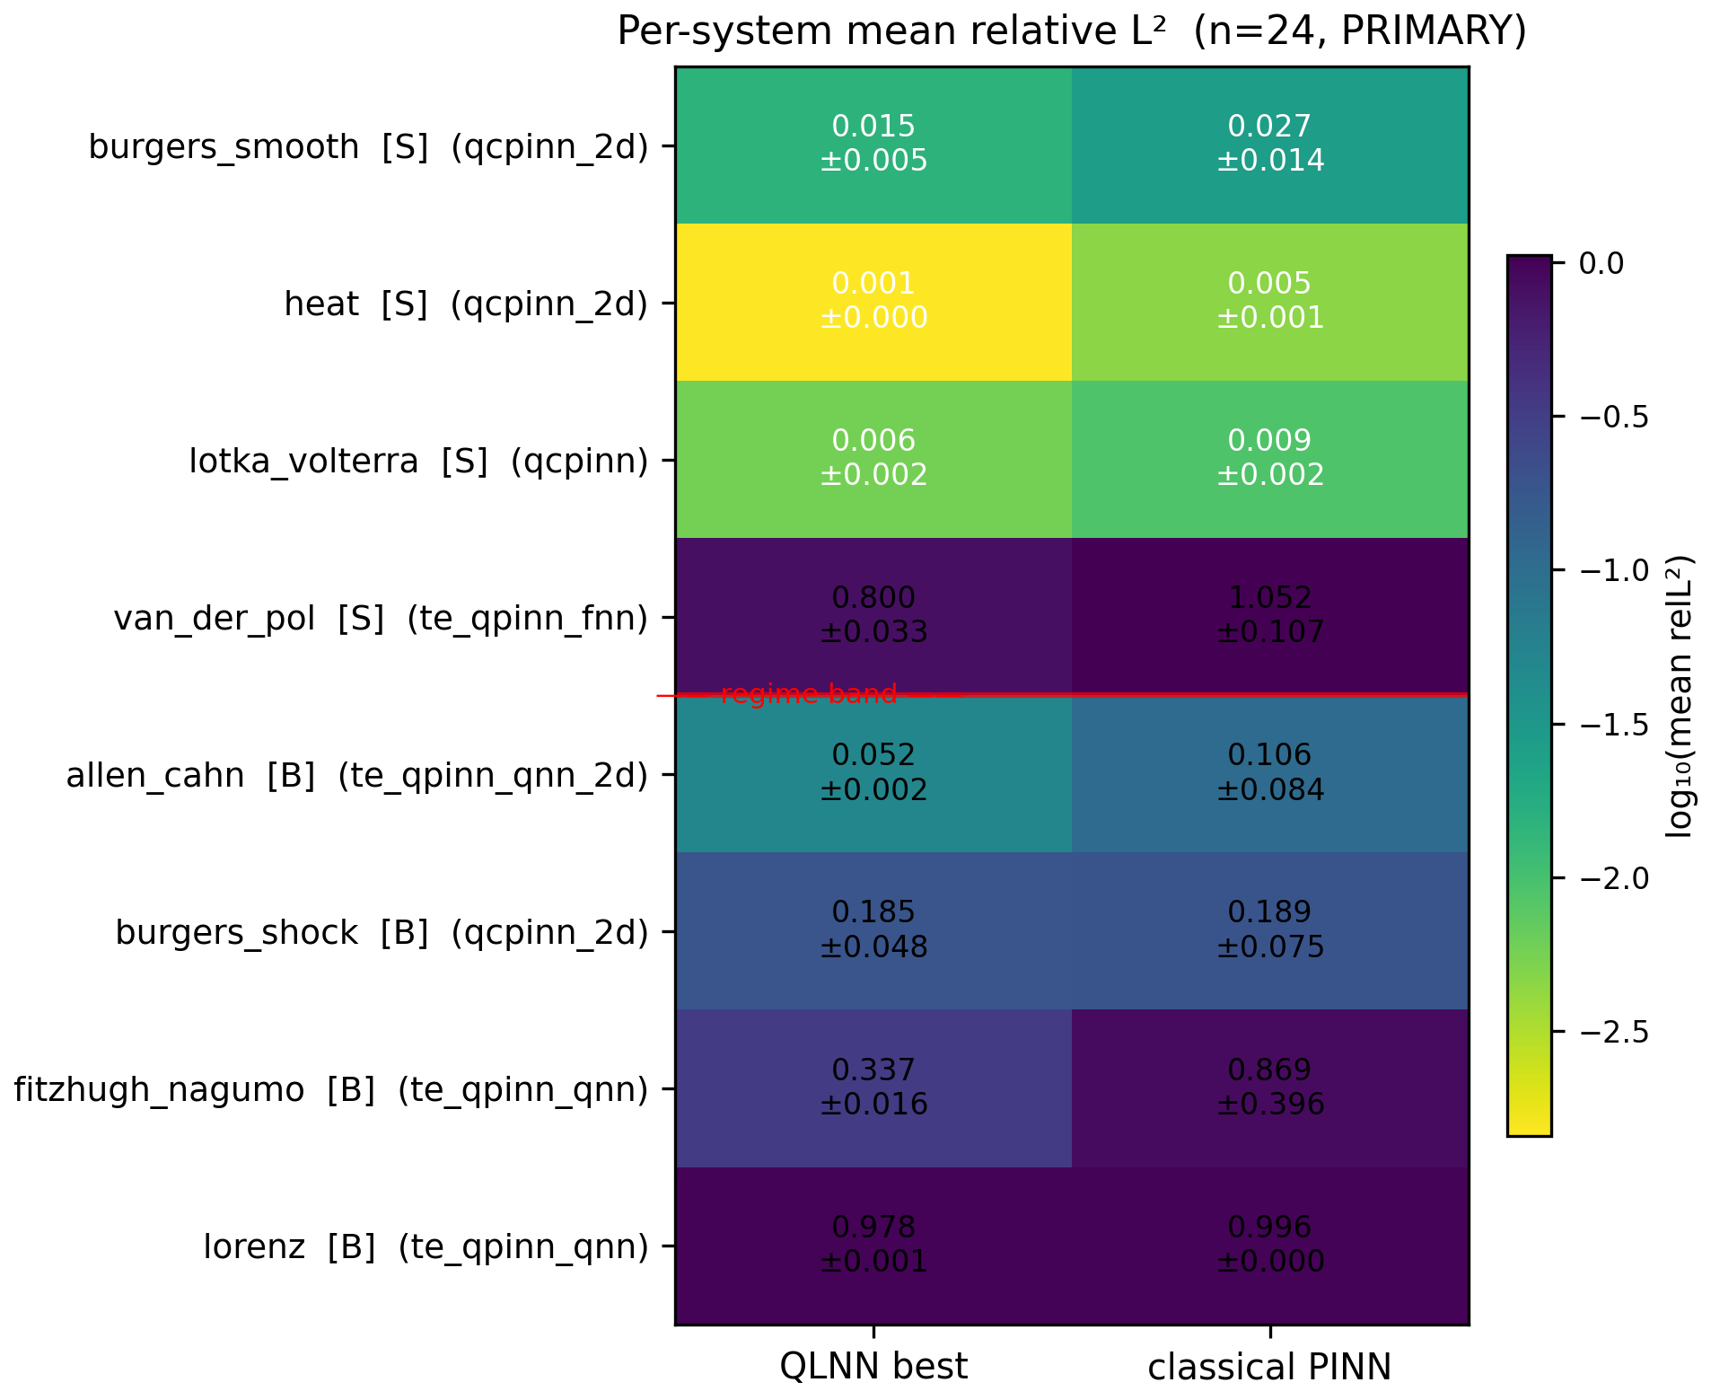
Solver task: per-system results (n = 24 cells)
Quantum wins the easy smooth systems (LV, Heat) — but so does everything; margins are small
te_qpinn_qnn is the clear broadband story: best-in-class on FitzHugh-Nagumo AND Allen-Cahn
chebyshev family confirmed smooth-only (fails shocks & fronts)
Lorenz: every model collapses to predict-zero — a shared-failure datapoint
24×
2.5×
tighter seed std-dev: te_qpinn_qnn vs cPINN on FHN
lower mean error on FHN (0 classical params)
Full all-to-all per-cell table in paper §3; every value integrity-gated.
Notes:
The FHN result is the positive finding that survives everything: a purely quantum cell that is dramatically more stable across seeds than its classical twin on stiff fast-slow dynamics.

Slide 11
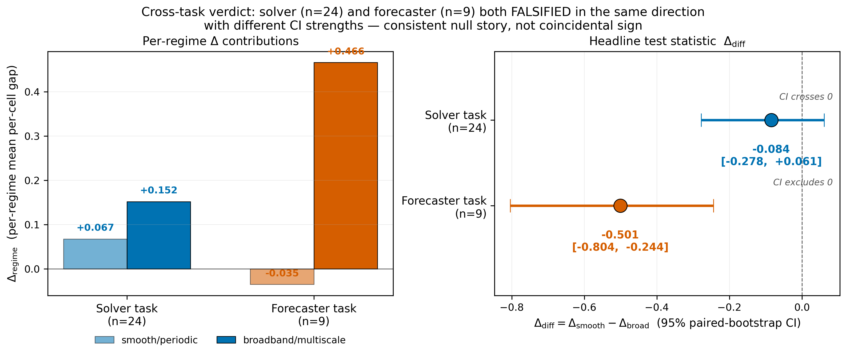
The pre-registered verdicts: H1 is FALSIFIED — on both tasks
−0.084
SOLVER Δdiff (n=24)
CI [−0.278, +0.061]
−0.501
FORECASTER Δdiff (n=9)
CI [−0.804, −0.244]
Every sensitivity point agrees: expanding n, tuning both sides, adding systems — the predicted smooth-side advantage never appears
Forecaster CI excludes zero NEGATIVELY — the trend points the opposite way from the hypothesis
“Published as a rigorous mechanistic null” — the outcome class our pre-registration explicitly planned for.
Notes:
Deliver plainly: the hypothesis failed, at every sample size and tuning level we could build. That consistency is what makes the null credible rather than disappointing.

Slide 12
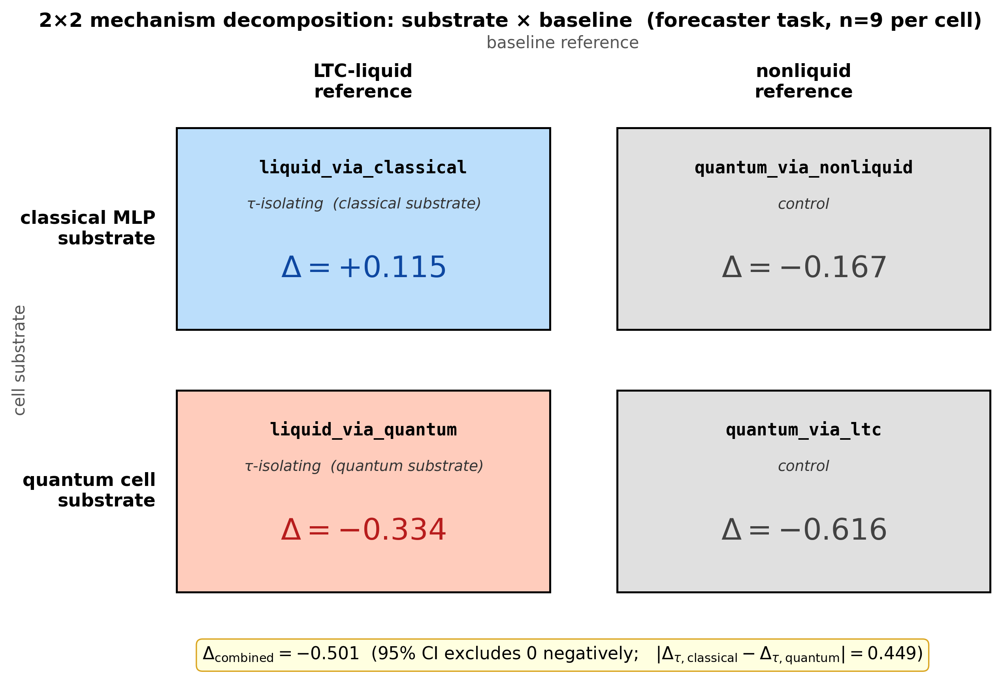
Whose fault is it? The complete fairness 2×2
We built all four corners: {classical, quantum} × {liquid τ, non-liquid}
Δ_combined = Δ_quantum + Δ_liquid — the algebraic identity holds per-cell EXACTLY, along two independent paths
Quantum-isolated contribution: −0.616, CI excludes 0 → the quantum circuit is the source of the underperformance
The liquid-τ machinery is NOT the problem
Ablations: classical LTC (P7.10) and non-liquid quantum cell (P7.11) complete the square.
Notes:
This is the review-proofing slide: nobody can say we conflated the liquid trick with the quantum trick — we separated them experimentally and the arithmetic closes exactly.

Slide 13
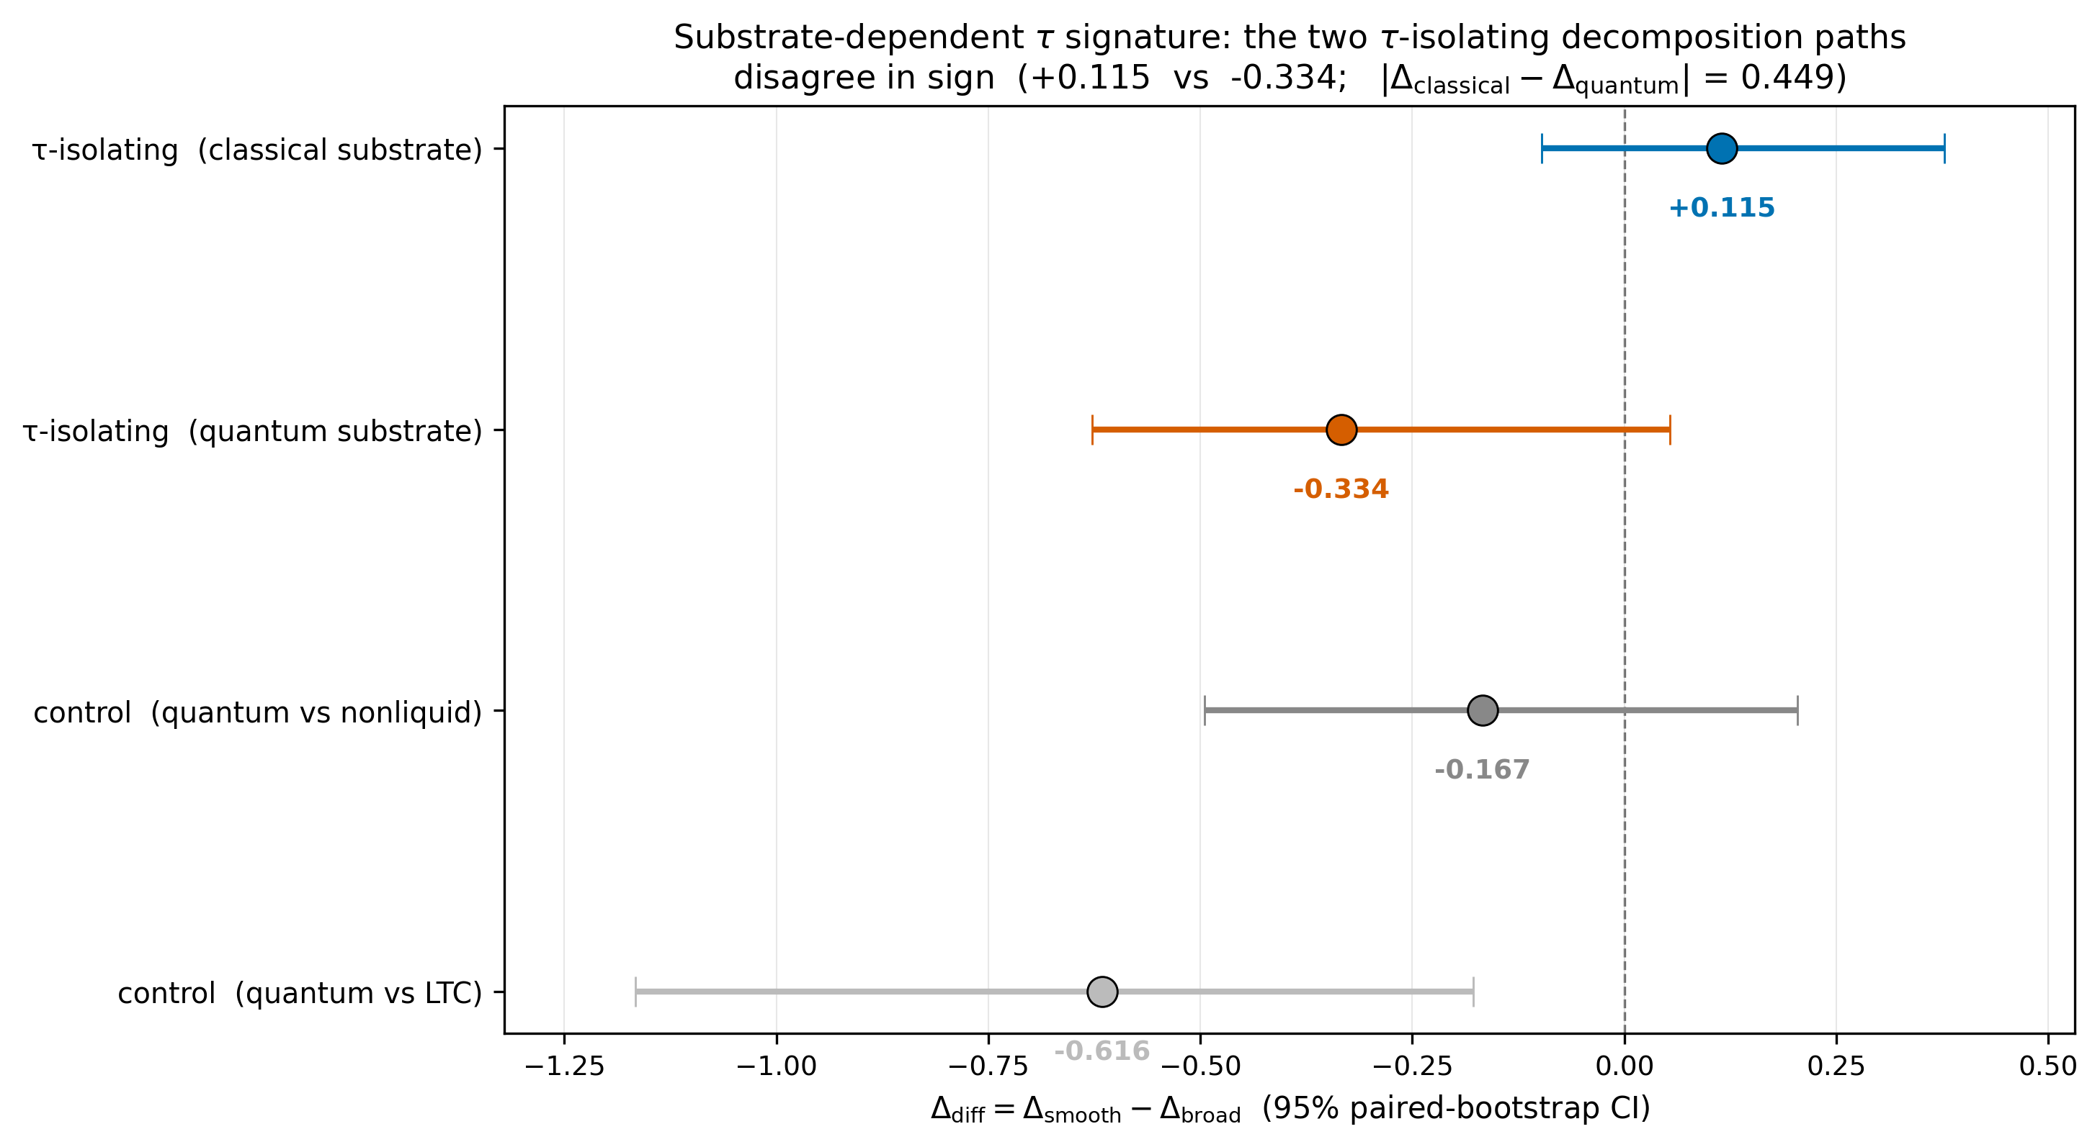
The surprise: liquid τ is substrate-dependent
+0.115
τ added to a CLASSICAL cell → smooth-favoring (matches the original hypothesis!)
−0.334
τ added to the QUANTUM cell → broadband-favoring (sign flips)
Identical τ machinery, opposite effect depending on what it wraps — measured along two independent ablation paths
The classical-side direction is the ONLY measurement in the whole program matching the Schuld-Fourier prediction
This interaction effect is the seed of the follow-up paper (theory derivation deferred to Tier-4 work).
Notes:
If the advisor asks 'so what did we learn?': the liquid mechanism carries the hypothesized inductive bias, but coupling it to a quantum encoder inverts it. That's a genuinely new observation and the strongest hook for follow-up funding.

Slide 14
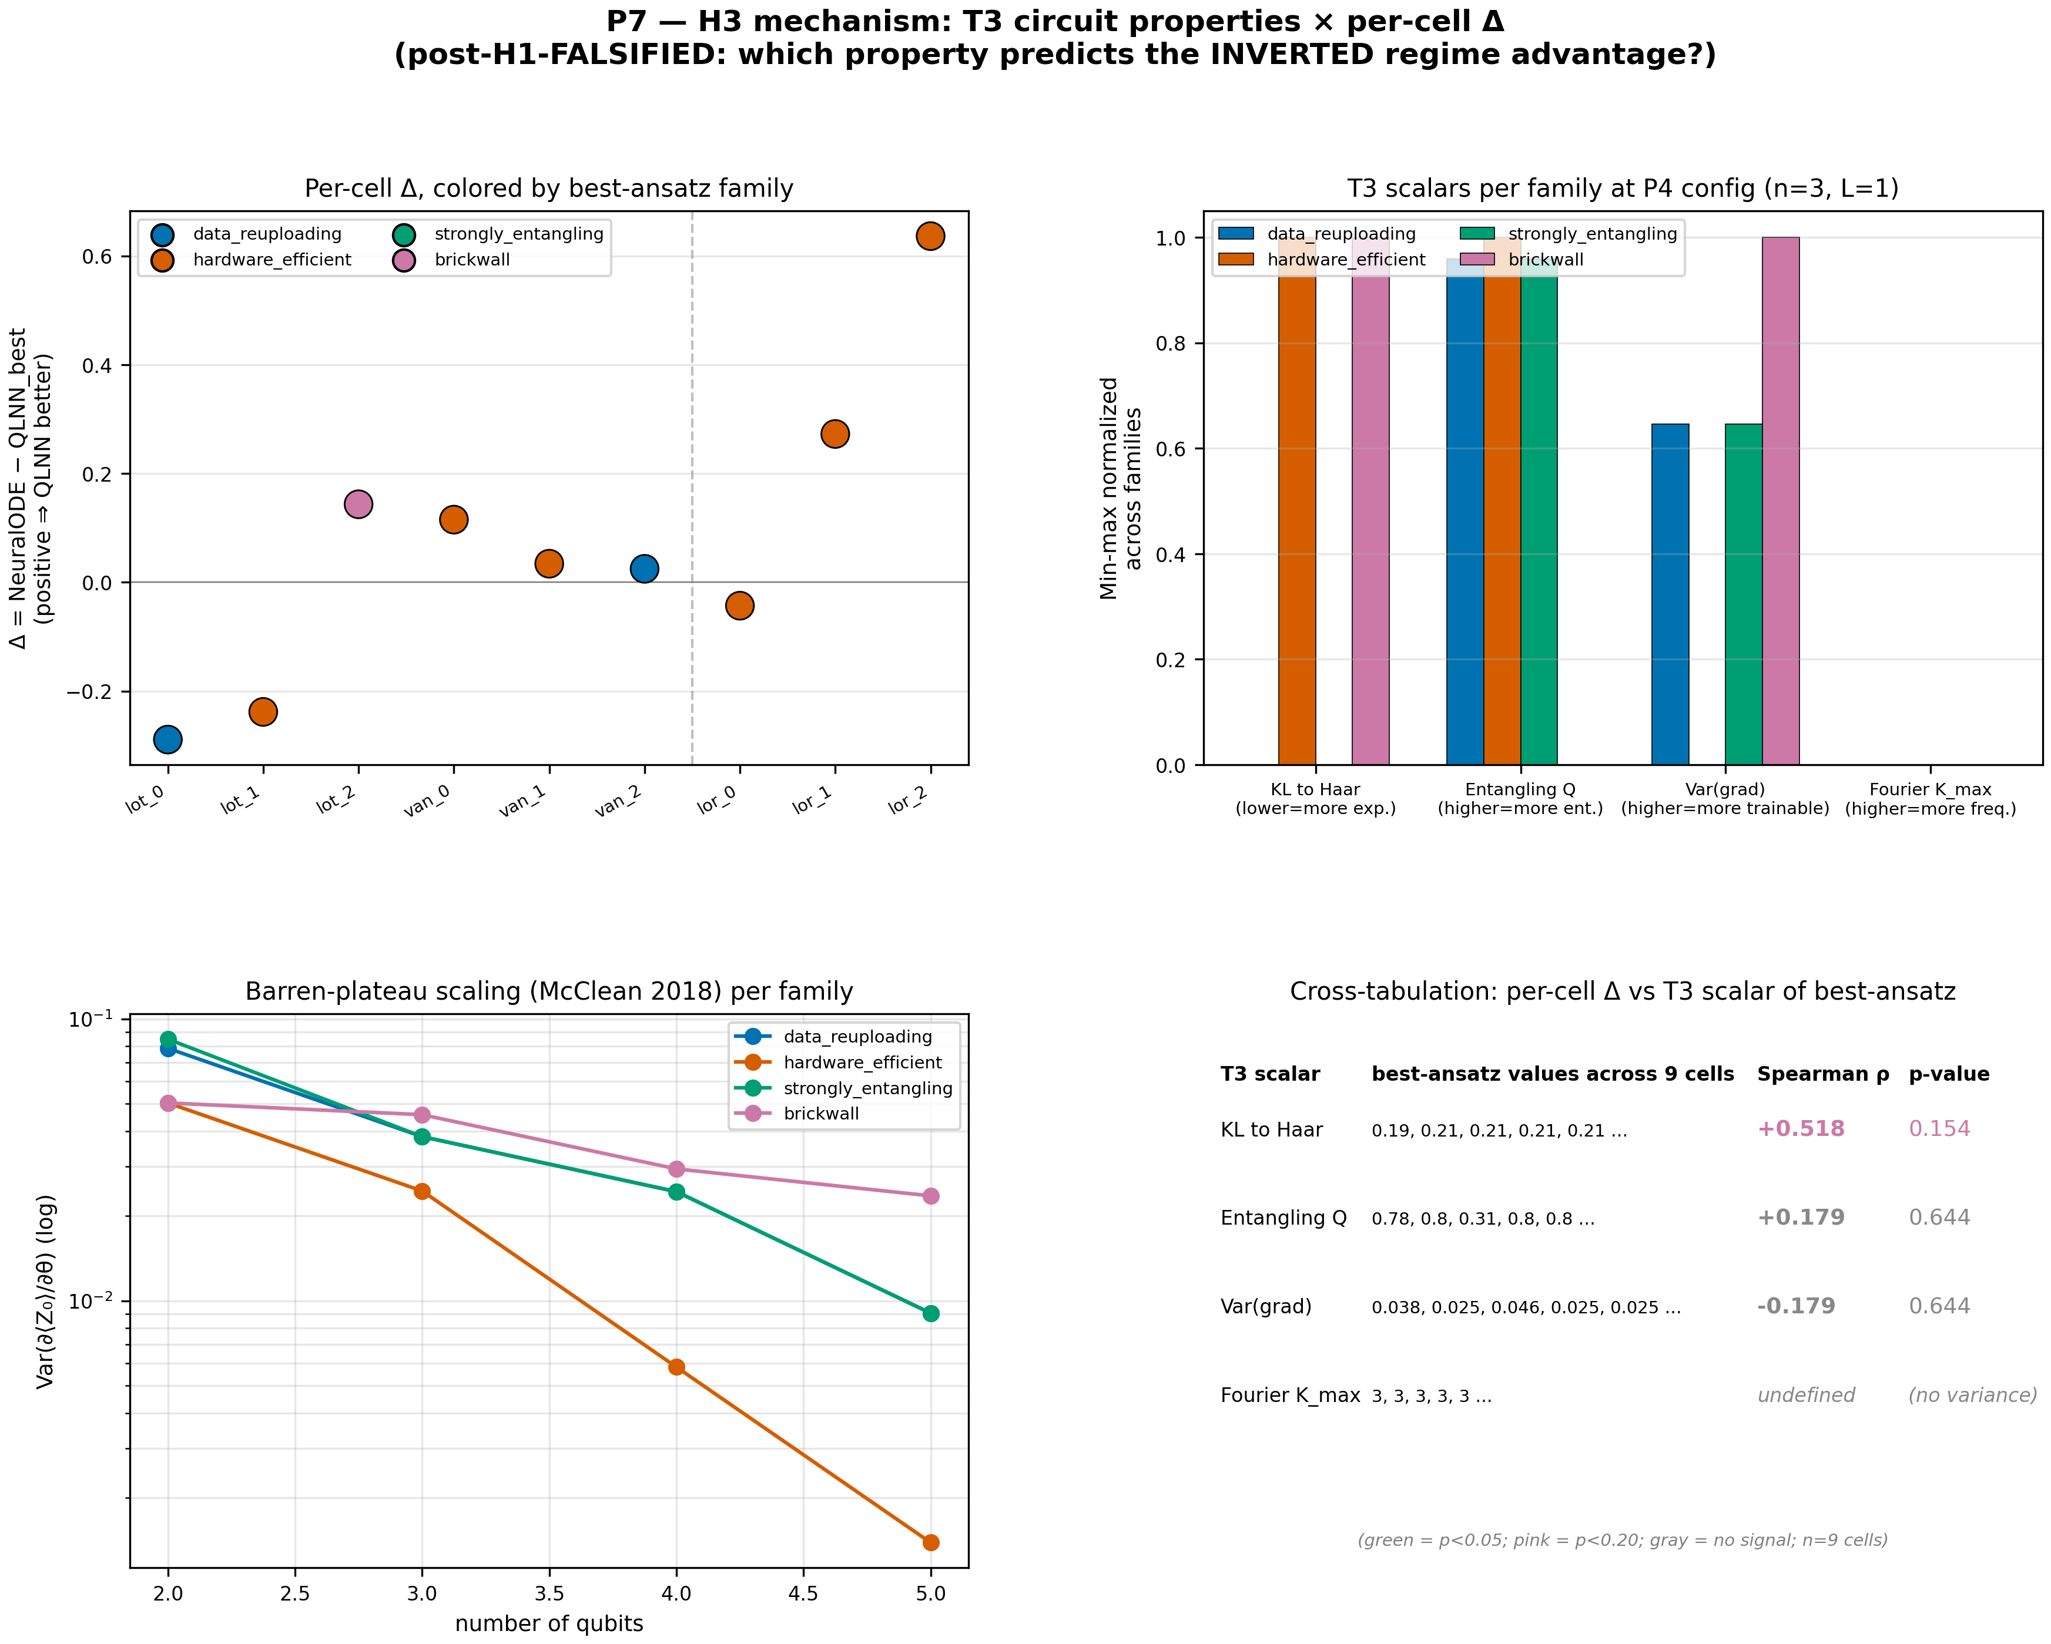
Rigor receipts — why this survives review
36 pp
22
37
508
paper + supplement, built from source
pre-reg amendments (A1–A22), all disclosed
verified bibliography entries, 22 woven citations
tests green + integrity gate exit-0
5-reviewer adversarial audit already run internally; every critical finding remediated (4-tier plan)
Every number in the paper is machine-checked against committed result JSONs — reviewers can clone & re-verify
Mechanism cross-check (left): expressivity (KL-to-Haar) is the only trainability scalar with a sign-stable trend vs per-cell Δ (ρ = +0.518, LOO-robust)
Open-source: github.com/shawngibford/qlnn — tagged releases v0.1 → v1.2
Notes:
Position this as de-risked: internal adversarial review already happened; the remaining risk is venue fit, not correctness.

Slide 15
Where we are & what we need
DONE — paper v1.2 (peer-review-hardened), all local experiments, SLURM pipeline
IN FLIGHT — Anvil Phase C: 222-cell audit re-run matrix (Kuramoto + KdV completion, uniform budgets, qcpinn attribution, forecaster refresh) — ~1 day wall-clock remaining
NEXT — Phase D verdict refresh → final paper numbers → arXiv preprint + PRX Quantum submission
Asks for you
Sign-off on the falsification framing (rigorous null + mechanism finding)
Venue check: PRX Quantum first, or Quantum / PR Research as the faster path?
Co-author review pass on the 36-page draft (2 weeks?)
Notes:
End on the decision points: framing sign-off, venue, and a review timeline. Everything else is executing.

