Slide 1


Lean Overview

Slide 2
What Is Waste?
Waste is “anything other than the minimum amount of equipment, materials, parts, space, and worker’s time which are
absolutely essential to add value to the product.”
—Shoichiro Toyoda
President, Toyota

Slide 3
Lean = Eliminating the 8 Wastes
Typically 95% of Total Lead Time is
Non-Value Added!!!
RUN
TIME
Order Processing, Transport, Storage, Waiting, Rework,
Machine Setup, Inspection, Machine Breakdowns, etc...
TOTAL LEAD TIME
LEAN FOCUS:
Reducing Total True Lead Time

Slide 4
Lean = Eliminating the 8 Wastes
Defects
Overproduction
Waiting
Non Value-added Processing
Transportation of Part/Materials/Tooling
Inventory in Excess
Motion in Excess
Employees that are underutilized

Slide 5
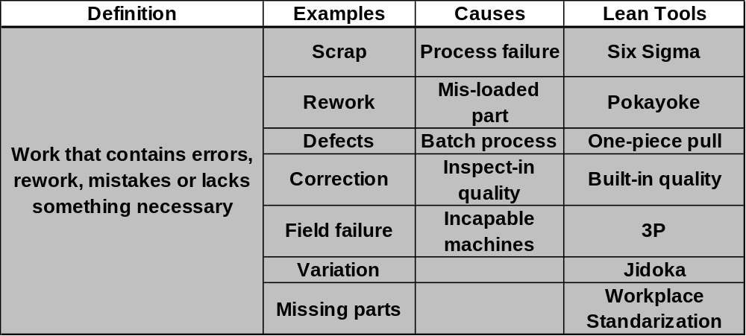
Defects
Notes:
3P stands for Product, Process and People, It is a kaizen like product & process event.

Slide 6
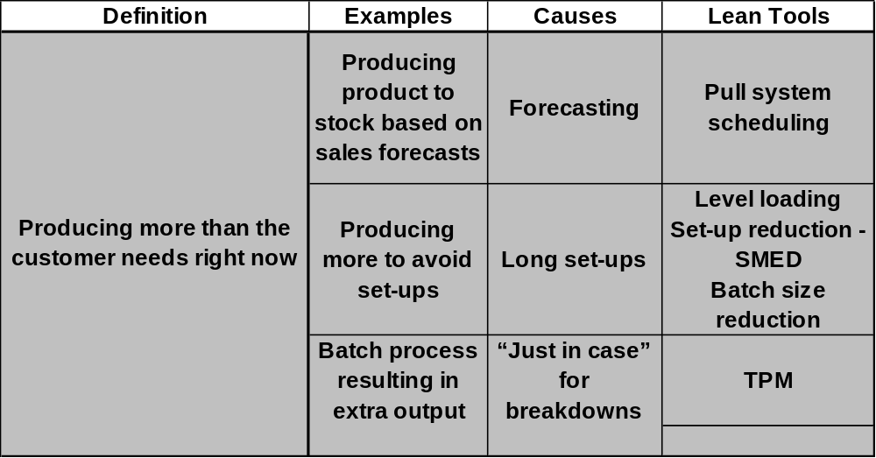
Overproduction

Slide 7
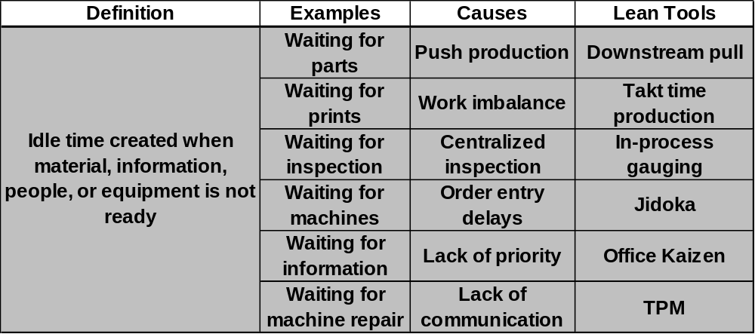
Waiting
Notes:
Jidoka is the transferring of human knowledge to automated machinery so machines are able to detect a single defective part and immediately stopping themselves while asking for help. This concept was pioneered by Sakichi Toyoda at the turn of the 20th century when he invented automated looms that stopped instantly when a single thread broke.

Slide 8
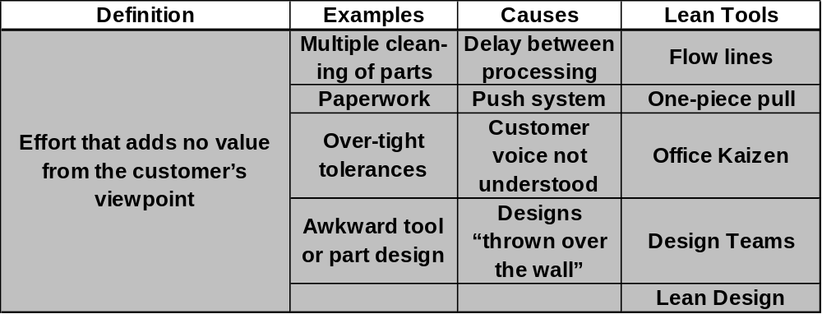
Non Value-added Processing

Slide 9
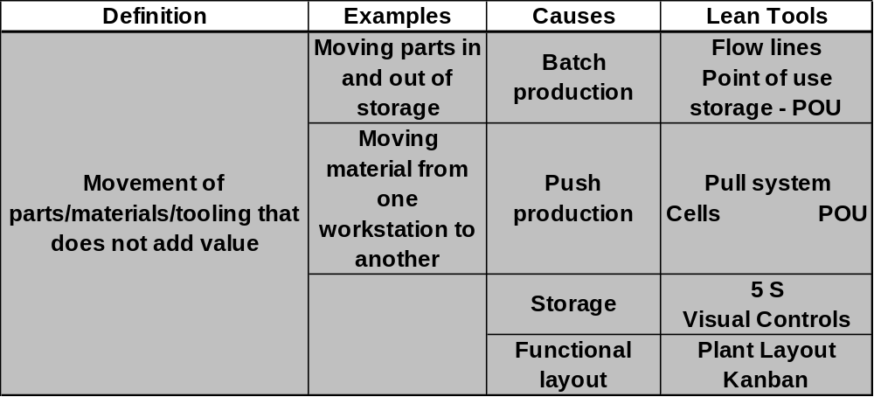
Transportation of Part/Materials/Tooling

Slide 10
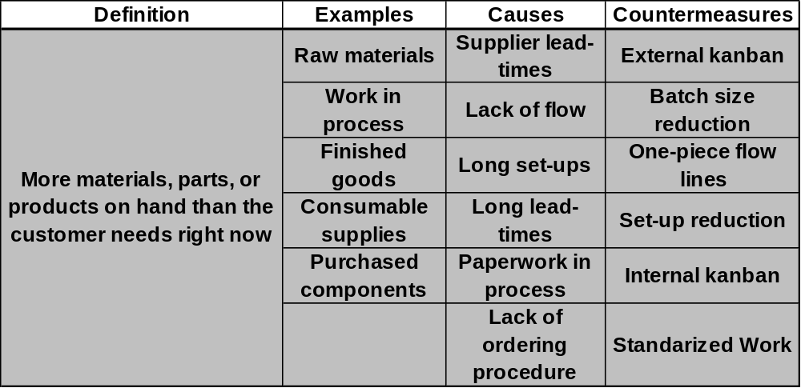
Inventory in Excess

Slide 11
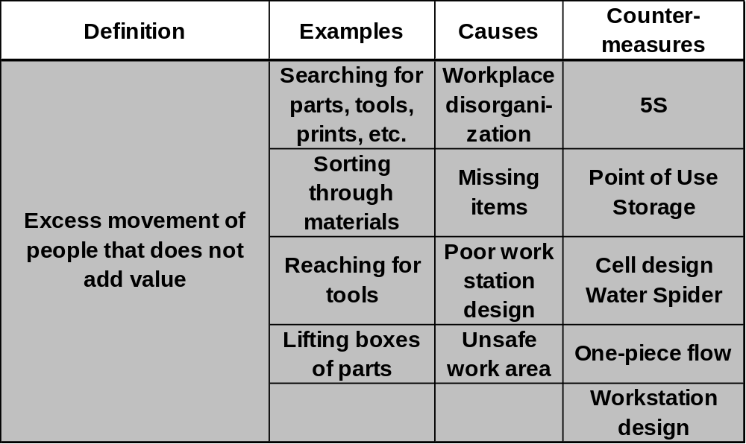
Motion in Excess

Slide 12
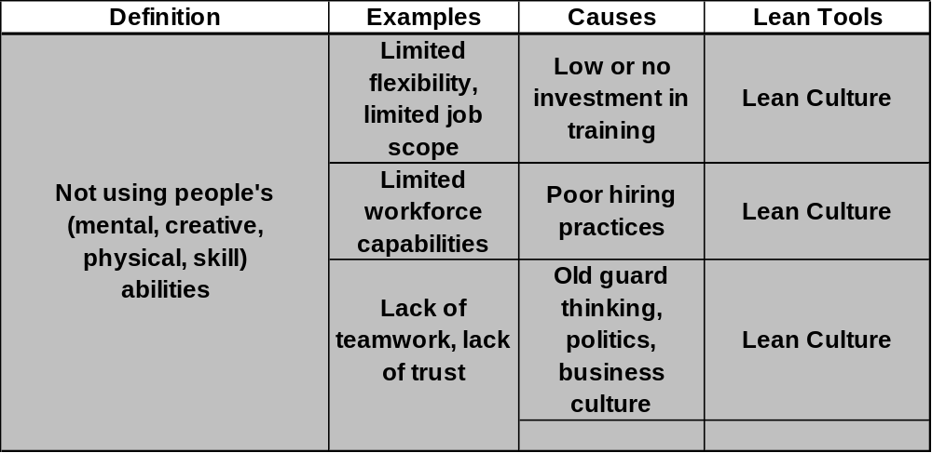
Employees that are underutilized

Slide 13
Strategic Lean Focus:
“Find Whole New Ways of
Completing a Job with a Focus on
Reducing Total True Lead Time (MCT)”

Slide 14
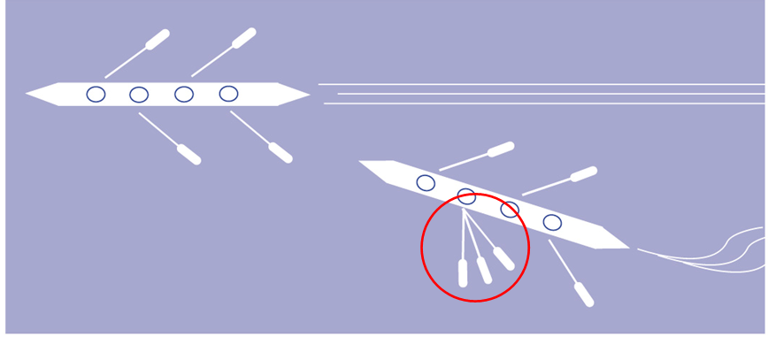
Individual Efficiency vs.
System Efficiency

Slide 15
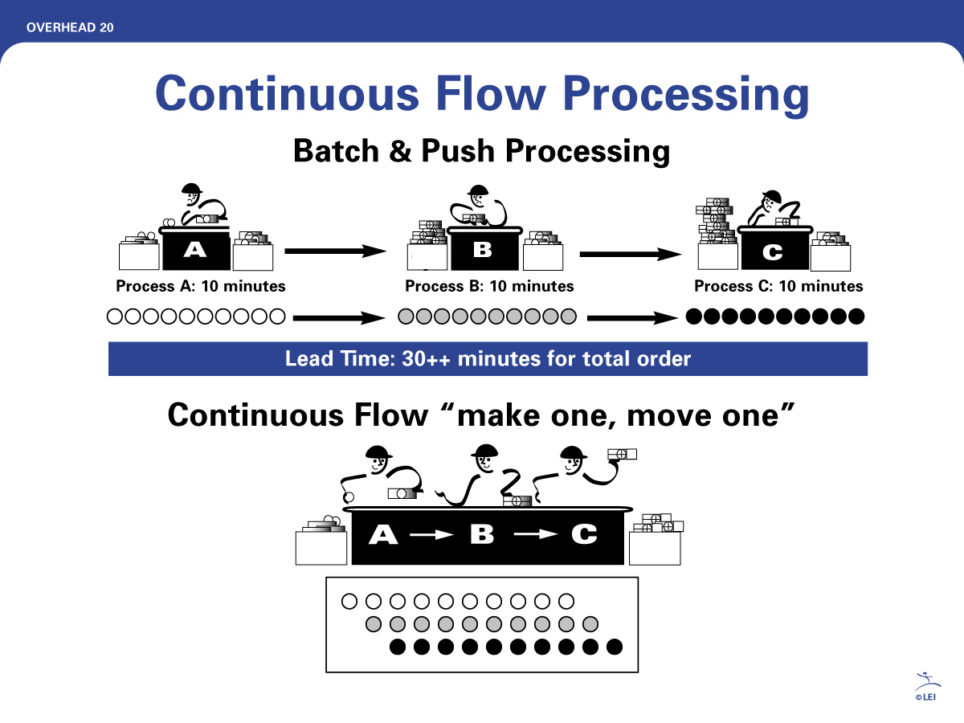


Slide 16


The Effect of Batch Sizes
Large batch sizes increase the lead time of all the products behind it.
Smaller Batch sizes:
- Increase flexibility
- Reduce overall lead times
- Reduces waste and cost caused by extended lead times

Slide 17
Lean Building Blocks
Continuous Improvement
Pull/Kanban
Cellular/Flow
TPM
Quality at Source
POUS
Quick Changeover
Standardized Work
Batch Reduction
Teams
5S System
Visual
Plant Layout
Value
Stream
Mapping

