Slide 1
Time-based Continuous Improvement:
Enterprise-Wide Systematic
Lead Time Reduction

Slide 2
Time-Based Continue Improvement Culture
Discussion Points
Speed as a Framework to Drive Continuous Improvement
Common misconceptions
Tools to find Whole New Ways of Completing a Job
Measuring and Understanding the Cost of Long Lead times

Slide 3
“People say time is money….
But I say that time is
a heckuvalot more money
than most people realize!”
Dr. Rajan Suri, Executive Director
Center for Quick Response Manufacturing
UW-Madison
Notes:
Speed is not only a performance advantage; it’s a key to greater profitability.
You’ll be receiving Rajan’s new book, It’s About Time. Written for Manufacturing Executives to provide a framework for exploiting the competitive advantage of driving true lead time reduction through the entire enterprise.
- VP representing National Oilwell Varco. Division in Orange, CA. Started Lean implementation several years ago. CEO wanted to shut plant down. Why? High labor wages. Bought time. Results? Best of 27 plants. Highest productivity and lowest cost of production of all 37 plants. Why? Focus on implementing lean techniques to drive lead time reduction in the entire enterprise.
Chuck Gates, RenewAire, Based in Madison, WI
Produce Energy Recovery Venalators Over 12,000 options.
Reduced Lead times 60-90%
140% revenue increase and total number of employees 73%

Slide 4
Waste Driven by Long True Lead Times
Expediting: Management Time, Production Disruption, Freight
Overtime cost
Inventory- Both WIP and Finished Goods. Holding Costs and Space.
Obsolescence
High Scrap caused by Late detection of Defects
Order cancellations or loss of sales to competition
Sales time devoted to expediting or explaining delays
Notes:
Think for a moment about all the additional cost that is driven by long lead times:
ALL these wastes increase costs, tie up capacity, etc.
By applying a focus on reducing lead time using lean methodologies, DOMESTIC Suppliers can exploit one of their key competitive advantages… PROXIMITY… to the fullest.

Slide 5
Three Common Misconceptions
In Order to Reduce Lead Times…
3. We need to place great emphasize on “on-time delivery”
performance for each department.
Leads to pushing out due dates as a “buffer”, extending lead times.
Instead, emphasize lead time reduction.
2. We need to keep our machines and people busy at all times.
Creates extended lead times (e.g. supermarket, highway)
Instead, strategically plan for spare capacity.
1. Everyone will have to work harder, faster, and longer.
Not about working harder in the current system.
Instead, find whole new ways of completing a job,
with a primary focus on reducing Lead time.

Slide 6
Delivery Dilemma:
Problem of Pushing Out the Due Date
What actually happens
variation
Planned Schedule
Key Points:
The longer the time, the greater the variation.
Extending promise dates adds variation and cost.
Driving MCT reduction reduces variation and cost.
time

Slide 7


The Effect of Batch Sizes
Large batch sizes increases the lead time of all the products behind it.
Smaller Batch sizes:
- Increase flexibility
- Reduce overall lead times
- Reduces waste and cost caused by extended lead times

Slide 8


Strategic Capacity or The Order Ambulance
Without strategic spare capacity,
the unexpected always becomes an Emergency.
Spare Capacity = Strategically planning for the unexpected

Slide 9
Focus: “Find Whole New Ways of Completing a Job with a Focus on Reducing Total True Lead Time (MCT)”
1. Organization: Cellular Production
    Dedicate Product Cells for High Volume Products
    Can be a Common Resource Grouping in low volume settings* (More info next slide)
2. Ownership: Cell-based Teams
    Planning and scheduling the cell’s jobs and resources
    Production and Office Functions
3. Skills: Cross-Trained
    Skills needed to perform processes in their cell
4. Mindset: MCT (True Lead Time) reduction
    MCT = Quality Delivery and Cost
    When MCT is reduced, performance and cost improves as a result.

Slide 10
Common Resource Grouping Cells- Overview
Elements:
Dedicated, Collocated, Multifunctional Resources
Complete a Sequence of Operations
Flexible Sequencing Managed by Cell-Team
Job B
Start
Vertical Mill
Job A
Start
Horizontal
Mill
Lathe 1
Finish
Lathe 2
Drill Press
Finish
Debur

Slide 11
Measuring True Lead Time
Manufacturing Critical-path Time (MCT)
“The typical amount of calendar time from when a customer creates an order, through the critical-path, until the first piece of that order is delivered to the customer.”
Key Elements
    Measures Calendar Time (customer point of view)
    Build from Scratch (FIFO, non-expedited)
    Tracks First Piece through the Critical-path

Slide 12






MCT…Why is it Important?
High Scores in: | SHORT MCT | LONG MCT
Quality | Robust Processes; Built-in Quality | Inspection, Scrap, and Rework
On Time Delivery | Flexible, Lean Manufacturing | Stockpile of Finished Goods
Competitive Pricing | Low Production Cost; Reduced waste
Notes:
Short True Lead times are a strategic advantage.
Everybody has decent quality, delivery and cost or they won’t be in business.
The question is how do you meet those performance requirements.
Driving lead time reduction allows you to meet these performance requirements in a way that is healthy for your business.

Slide 13
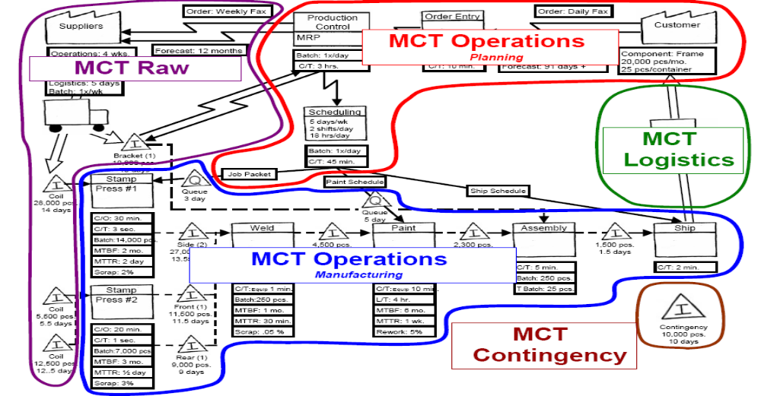
The MCT and Value Stream Map
“Each loop represents a certain amount of calendar time. All of these together make up your MCT measurement.”
Notes:
1) After completing the Current state VSM, show MCT Presentation. Transition from VSM to building the MCT Map by breaking it down into loops and relating it to a calendar. Analogy: People on a diet identify their start weight. Think of MCT like a scale in Calendar days. We’re going to drop our current state VSM onto a Calendar and see “how much it weighs”. Furthermore, where is the “fat” located? Where are the improvement opportunities?

Slide 14
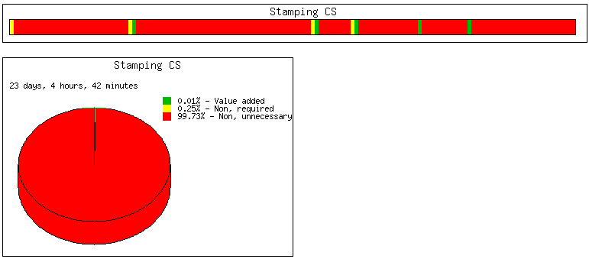
MCT Map – Current State
Total Elapsed Time: 40 Days
Order Entry
5 days
Component Fab
12 days
Weld 1 & 2
6 days
Assemble
9 days
Pack and Ship
8 days
Value Chart
MCT _{Total} = 40 days
Value Add
Non Value Add but required
0.01%
Value Add
Non Value Add
0.25%
Non-Value Add Necessary
99.73%
Non-Value Add Unnecessary
Notes:
Shown here is the collective Process Map (PM) discerned from the Value Stream Map.
The Value Chart, a visual representation of the processes value composition, displays each slice as a percentage of the total of each value:
Value Add – green
Non-Value Add Necessary – yellow
Non-Value Add Unnecessary – red
The Manufacturing Critical-path Time is defined by the critical path flow, which is: 23 day

Slide 15
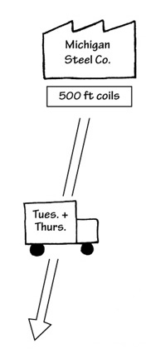
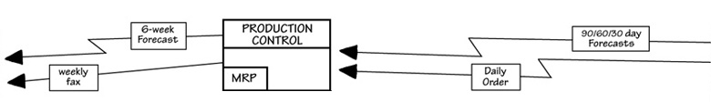
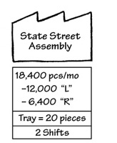

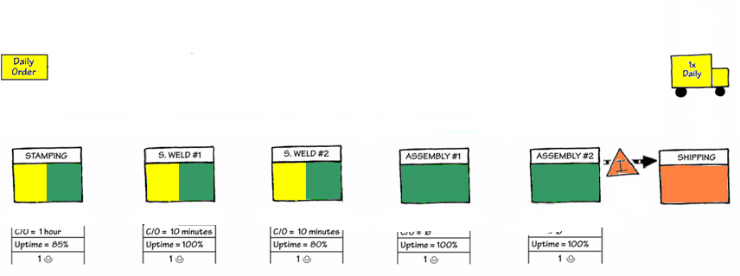




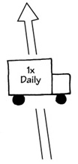
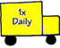






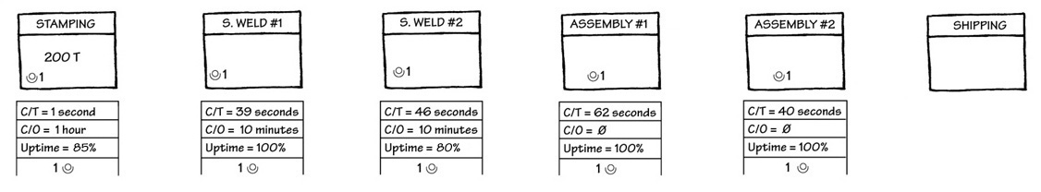














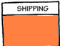

Value Stream Mapping with MCT – Current State
MCT Map

Slide 16

Cost Based Focus vs. Time-Based Focus
Cost Based Focus:
Improving Utilization and Efficiency
Order Entry
5 days
Component Fab
12 days
Weld 1 & 2
6 days
Assemble
9 days
Pack and Ship
8 days
Total Elapsed Time: 40 Days
TIME-BASED FOCUS:
Reducing Total True Lead Time

Slide 17
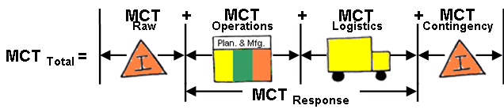
Manufacturing Critical-path Time Application:
  Improvement strategy:
    MCT _{Total}
        Measures total value stream in Calendar Days
  Order fulfillment planning strategy:
    MCT _{Response}
        Subset of MCT Total
        Eliminates Raw Inventory and Finished Goods Inventory from MCT Total
        Measures Flexibility of Operations
Notes:
From a practical sense, it is useful to understand the applications of MCT.
MCT Total (d

