Slide 1
IMDC
Swarm Exploration

Slide 2
Goals
Explore a bounded area completely.
Collect environmental data of the bounded area to visualize plantation feasibility.
Pick up loose fruits in the plantation.

Slide 3
Assumptions
The bounded space is a square area.
Loose fruits are found around oil palm plants.

Slide 4
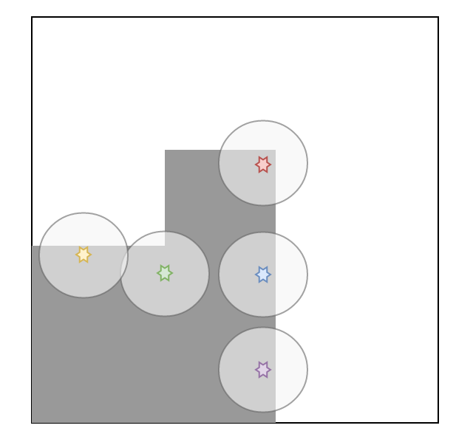
Algorithm

Slide 5
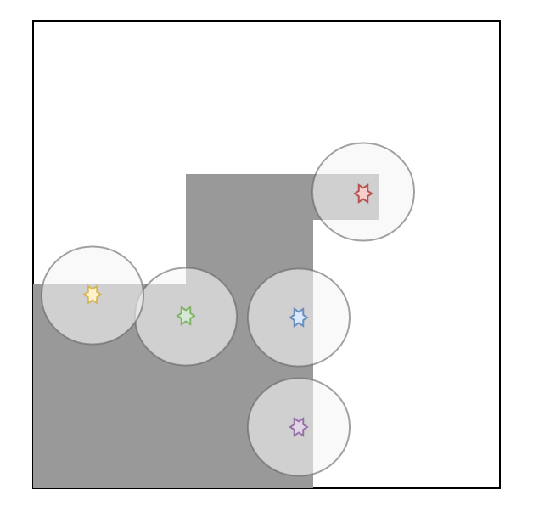

Slide 6
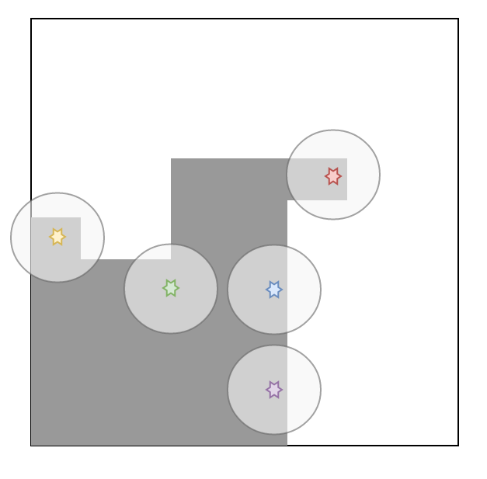

Slide 7
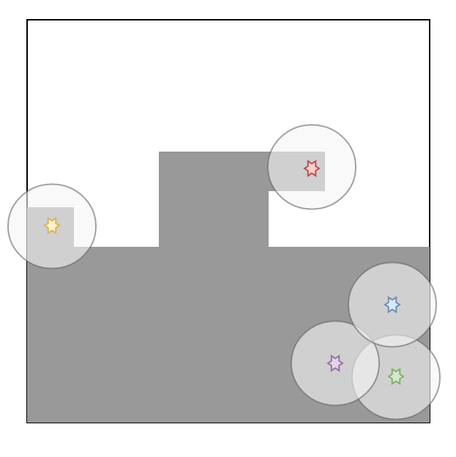

Slide 8
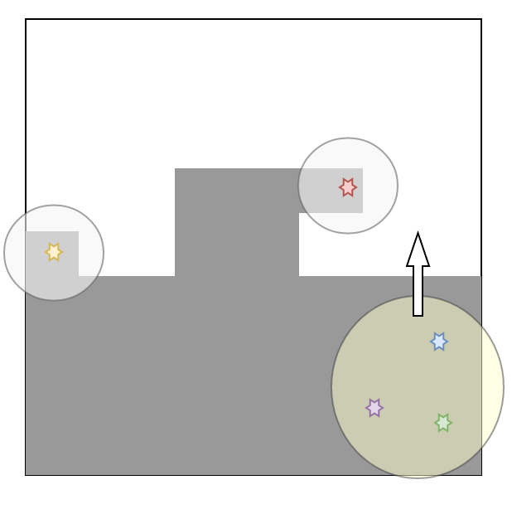
Flocking

Slide 9
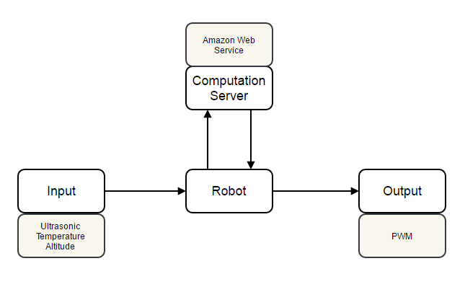
System

Slide 10
Progress
Completed
In progress
Hardware
PWM
Ultrasonic
Algorithm
Flocking mechanism
Coverage mechanism
Server setup
AWS Lambda
AWS API Gateway
Hardware
Altitude and Temperature
Robot base
Algorithm
Work distribution
Evaluation method
Server setup
DynamoDB

Slide 11
Features
HTTP requests
PWM
GPIO
Encoder
Ultrasonic sensor
I2C
Altitude and temperature

Slide 12
Problems
Optimization
Gets slower per iteration
Current: check every single coordinate

