Slide 1

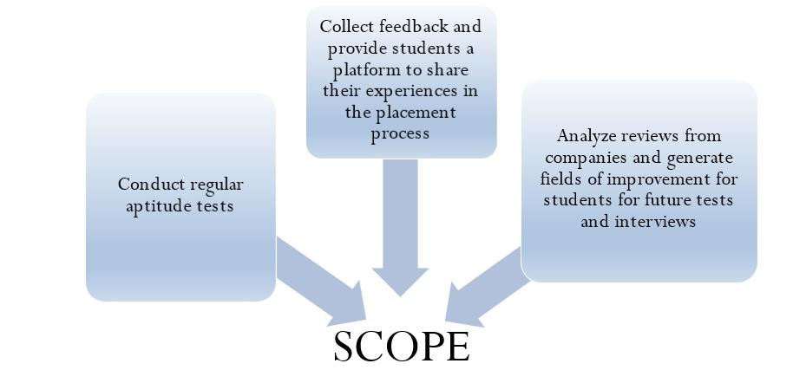
Automated Training and Placement By - Shawn Gonsalves, Hrishikesh Parab, Hammiliton David
Project Guide Dr Sunil Surve
Department of Computer Engineering, FRCRCE, Bandra, Mumbai,
Affiliated to Mumbai university
Introduction
Results
The increasing advantage of automated systems makes it necessary for educational infrastructures like colleges to move all manual processes onto a functional online system.
Placement Activity takes an important role since students join reputed college not only for better education but also for campus recruitment
The training and placement cells in most colleges lack a fully automated system which can manage and process data in an efficient manner.
The development of such a system has become necessary since the number of applicants for recruitment is increasing every year and the means of storing the data generated in this process has become primitive.
Objectives
Students can upload their resume by using the template provided in the application and also update it on regular basis.
Company representatives can access required information entered by students.
The administrator can manage the data generated in the process as well as produce the required list of results of online tests.
Given below are the results discovered for our system.
1 .User can login only if the id and password are correct and the user is a part of the organization.
2 .Students can upload their resumes and the admin can view them by accessing Firebase.
3 .Student can take tests and receive notifications only if the user is signed in.
4 .Students can view the results of tests that the admin posts on the application.
5 .Users can use the sentiment analysis feature of the application to determine recruiter’s opinion about their performance in the placement process.
Figure 2: Block diagram
Figure 3: SENTIMENT ANALYSIS
student
Online
Training
&
Placement System
Web Server
Student’s feedback
Methods
Admin/
TPO
Database
Pre-processing
The above mentioned problems can be solved using a web based android application running on a web server that not only automates the training and placement process but also conducts aptitude tests online and analyzes company based reviews to discover fields for improvement.
The system will use natural language processing and sentiment analysis technique to determine fields of improvement for students based on reviews from companies Automated Training and Placement System consists of modules like Student, Administrator and Company. This system will be used by students to download resume templates and upload their details.
Administrator of the system will upload questions based on different categories and the student can choose which test they want to take. The proposed system can be used to conduct aptitude tests .The system will also provide a forum for the company to post their feedback about the students appearing for interview. The system will analyze this feedback using natural language processing and sentiment analysis and determine fields of improvement for the students.
.
Automated SMS And Email
System
Opinion world
identification
company
Sentimentword
Database
Assign polarity scores
Calculate total sentiment score
Calculate total sentiment score
Show the opinion result
Conclusions
The project is aimed at developing a fully functional android application that will serve the purpose of automation of the training and placement process in an institute. For our system, we describe the back-end of how data flows in the whole software and how the database is implemented.
We also define architectural design and data flow of the project, along with the algorithms required for implementation which include natural language processing and sentiment analysis. We analyzed the hardware and software requirements which has helped us in achieving an efficient design for this particular system.
Bibliography
[1] Khin Zezawar Aung, Nyein Nyein Myo, “Sentiment Analysis of Student’s Comment Using Lexicon Based Approach”, IEEE ICIS, Volume-4, Issue-17, May2017.
[2] Farhana Siddiqui , “An Automated training and Placement System” Dept.of Computer Engineering ,M.H.Saboo Siddik College of Engineering ,Mumbai,India.
Figure 1: Scope

