Slide 1
AUTOMATED TRAINING AND PLACEMENT
Members :- 1. Shawn Gonsalves - 7632
2. Hrishikesh Parab - 7658
3. Hamilton David - 8098
Fr.Conceicao Rodrigues College Of Engineering

Slide 2
Index
Title & Introduction.
Problem definition & Proposed solution.
Scope of the Project.
Literature Survey.
Requirements.

Slide 3
INTRODUCTION
The increasing advantage of automated systems make it necessary for educational infrastructures like colleges to move all manual processes onto a functional online system.
2. Placement Activity takes an important role since students join reputed college not only for better education but also for campus recruitment
.
The training and placement cells in most colleges lack a fully automated system which can manage and process data in an efficient manner.
4. The development of such a system has become necessary since the number of applicants for recruitment is increasing every year and the means of storing the data generated in this process has become primitive.

Slide 4
INTRODUCTION
Training and placement is the program conducted within educational institutes to provide jobs to students pursuing or in the stage of completing the programme.
In this programme, industries visit the colleges to select students depending on their ability to work, capability, focus and aim.
Measures are taken by the TPO cell to equip students with necessary technical and behavioral competencies. This is achieved through rigorous and meticulously developed academic curriculum and by bringing the proper alignment with intense Industry Institute Interaction that help students to potentially build the desirable competencies.

Slide 5
Literature Cited
Khin Zezawar Aung, Nyein Nyein Myo, “Sentiment Analysis of Student’s Comment Using Lexicon Based Approach”, IEEE ICIS, Volume-4, Issue-17, May 2017.
Priyanka Hajare, Priyanka Khandave, Shital Adhav, Swati Pimpale, Prof. Anagha Kulkarni, “Implementation of Online Placement System”, International Journal of Emerging Research in Management & Technology, ISSN: 2278-9359, Volume-5, Issue-1, January 2016.
Farhana Siddiqui “An Automated Training and Placement System”

Slide 6
LITERATURE SURVEY
NAME | PAPER | REVIEW | CITED
Priyanka Hajare, Priyanka Khandave, Shital Adhav, Swati Pimpale, Prof. Anagha Kulkarni | “Implementation of Online Placement System” | The motivation for this endeavor originates from the need of a computerized system to eliminate the cost and effort required to manage paper documents in the college. | January 2016

Slide 7
LITERATURE SURVEY
Name | paper | Review | Cited
Khin Zezawar Aung, Nyein Nyein Myo | “Sentiment Analysis of Student’s Comment Using Lexicon Based Approach” | Students’ feedback can be analyzed using lexicon based approach to identify the students’positive or negative attitude. A database of English sentiment words is created as a lexical source to get the polarity of words. | May 2017

Slide 8
LITERATURE SURVEY
Name | Paper | Review | Cited
Farhana Siddiqui | “An Automated Training and Placement System” | A TaP system provides module like Student (Current Student/Alumni), Administrator (TPO/ TnP Staff/Departmental Staff), Company and Forum. Such systems aid colleges to practice full IT deployment and fast access procedures in placement related activities. | 2017

Slide 9
Problem definition & Proposed solution
Placement activity takes an important role since students join college for not only better education but also for campus recruitment.
There is a growing need of automation of such process since number of students applying for placements is large and overhead of manual tests and analysis is huge.
Emails need to be replaced with automatic notifications and resumes should be validated. Entire test process must be online. Students and companies need a platform to post their reviews. All data generated during these processes must be properly maintained and can later be used for analysis.

Slide 10
Motivation
The above mentioned problems can be solved using a web based android application running on a web server. All automation processes can be integrated within the same application.
Considering the fact that the number of applicants for recruitment is increasing every year, an Automated System becomes essential to meet the demand.
In Training & Placement Automation System, the organization need not worry about innumerable copies of each document, instead the system will enable a greener and less paper intensive approach to placements. This system uses several programming and database management techniques to ease the work involved in this process.

Slide 11
Problem definition & Proposed solution
We propose to develop a system that not only automates the training and placement process but also conducts aptitude tests online and analyzes company-based reviews to discover fields for improvement.
The system also provides a platform for students to share their experiences in interviews to help other students get and insight about the recruitment process.
All data generated will be managed in the database and can later be used for analysis.

Slide 12
Objectives
Automated Training and Placement is an application to facilitate students to register, search and apply for
jobs and by accessing information about past interviews of students who are already placed.
Students will be able to upload their information in the form of a resume by using the template provided
in the application and also update it on regular basis.
Company representatives can access required information entered by students.
The administrator can manage the data generated in the process as well as produce the required list of results of online tests.

Slide 13
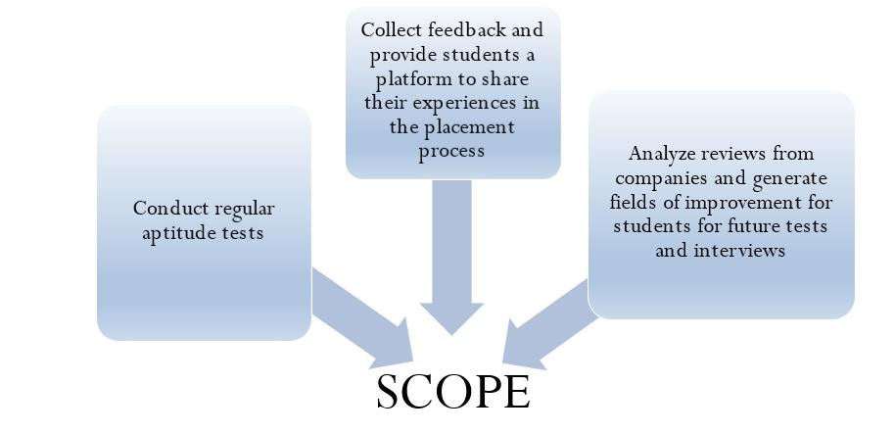

Slide 14
Scope of the Project
The motivation to Develop an Automated system stems from the need of a Computerized system to eliminate cost and effort required to manage paper documents in the college
Resume templates can be used to upload students details in a structured manner so that it can be easily extracted whenever necessary.
Companies can post reviews and comments about the campus and the students

Slide 15
The admin can conduct regular aptitude tests based on company requirements to prepare the students for different rounds of interviews.
The test questions can be modified as per requirements by the admin of the system.
Feedback from students who are placed in a company can be collected describing their experiences in personal interviews.
Students appearing for the interview in the future can refer to them to prepare better and increase their chances of doing well in the interview.

Slide 16
Proposed Architecture Of System
SENTIMENT ANALYSIS
Create API using Google Cloud NLP
Enter feedback or review in the text field
Get results of Sentiment Analysis in terms of Salience, Score and Magnitude
Develop page using Android Studio

Slide 17
APTITUDE TESTS
Input questions and answers in MCQ format
Generate Result
SENTIMENTAL ANALYSIS
Google NLP
Polarities
Unstructured Text
Create categories

Slide 18
REQUIREMENTS
Hardware Requirements
Memory of 4 GB RAM or more.
Intel i3 Processor or higher
Software Requirements
Android Development Tool
Android SDK tools
Java SE JDK
Windows 7 Operating System or higher
Database technologies: SQLite, Firebase

Slide 19
TECHNOLOGIES TO BE USED
Natural Language processing is a field of computer science and Artificial Intelligence concerned with the interaction between computers and human (natural) language.
2. Sentiment Analysis (also known as opinion mining or emotion AI) refers to the use of Natural Language Processing (NLP),text analysis to systematically identify and extract subjective information.
3. Sentiment Analysis in our system show Positivity or Negativity of the reviews and comments from Company about students.
4. It also points out the extent of importance of specific words that appear frequently in reviews

