Slide 1
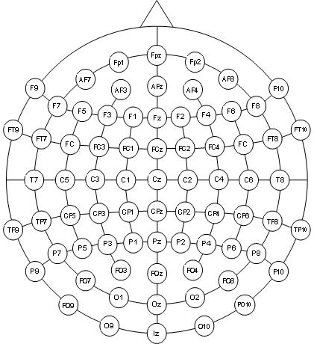
Lead pairs (channels) defined in hb montages #23

