Slide 1



PREDICTING THE COVID-19 MORTALITY RATE
20MIS1063 SARVESHWARAN B
20MIS1075 SHASHANK D
20MIS1173 JEGADEESH D

Slide 2




ABSTRACT
The COVID-19 pandemic has caused widespread devastation, affecting millions and causing countless deaths.
Accurate prediction of patient mortality is crucial for effective disease management and resource allocation, especially in hard-hit areas.
Machine learning and big data analytics have proven significant in addressing the pandemic in healthcare, public health, and policy-making.
Insights from predictions help policymakers and healthcare providers make informed decisions to mitigate the pandemic's impact.

Slide 3
ABSTRACT
Time series models are vital for predicting:
COVID-19 patient fatality rates
Number of deaths caused by the virus
Cumulative vaccinated population over time
These forecasts support:
Public health planning
Resource management
Effective vaccination program implementation

Slide 4
INTRODUCTION
The COVID-19 pandemic has had a devastating global impact, affecting millions and causing hundreds of thousands of deaths
Accurately predicting COVID-19 mortality is crucial for effective disease management and resource allocation
Machine learning and big data analytics have shown potential in combating the pandemic across various sectors

Slide 5
INTRODUCTION
Time series models can predict COVID-19 fatality rates, deaths, and cumulative vaccinations
These predictions aid in public health planning, resource management, and vaccination program implementation
Predictions help policymakers and healthcare providers make informed decisions to mitigate the pandemic's impact

Slide 6
RELATED WORK
1. Padilla, L., Fygenson, R., Castro, S. C., & Bertini, E. (2023). Multiple Forecast Visualizations (MFVs): Trade-offs in Trust and Performance in Multiple COVID-19 Forecast Visualizations. IEEE transactions on visualization and computer graphics, 29(1), 12–22. https://doi.org/10.1109/TVCG.2022.3209457
The paper examines the impact of different line chart visualizations on trust and prediction accuracy in COVID-19 mortality forecasts through three studies involving 1,299 participants.
It tested various designs by altering the number of forecasts shown, colour schemes, and the inclusion of 95% confidence intervals. Results showed that trust increased with the number of forecasts but plateaued after 6-9 forecasts.
Interestingly, while 95% confidence intervals were trusted, they often led to inaccurate predictions. Participants trusted both simple and detailed visualizations.

Slide 7
2.Alafif, T., Etaiwi, A., Hawsawi, Y., Alrefaei, A., Albassam, A., & Althobaiti, H. (2022). DISCOVID: discovering patterns of COVID-19 infection from recovered patients: a case study in Saudi Arabia. International journal of information technology : an official journal of Bharati Vidyapeeth's Institute of Computer Applications and Management, 14(6), 2825–2838. https://doi.org/10.1007/s41870-022-00973-2
The paper studies COVID-19 infection patterns to help health providers understand what affects infections. Data was collected by hand from recovered patients in Saudi Arabia and analyzed using the Association Rules Apriori (ARA) algorithm.
This method found strong, reliable patterns in the data.
These patterns give important insights into how the virus spreads, helping improve pandemic management

Slide 8
3.N. Braig, A. Benz, S. Voth, J. Breitenbach and R. Buettner, "Machine Learning Techniques for Sentiment Analysis of COVID-19-Related Twitter Data," in IEEE Access, vol. 11, pp. 14778-14803, 2023, doi: 10.1109/ACCESS.2023.3242234
The paper looks at how sentiment analysis on Twitter can reveal public opinion during the COVID-19 pandemic.
By reviewing 40 papers published from October 2019 to January 2022, the authors evaluated different machine learning techniques for analyzing tweets.
They found that ensemble models, especially fine-tuned BERT and RoBERTa models, were the most accurate for classifying COVID-19-related tweets.

Slide 9
REQUIREMENT SPECIFICATION
Software specification
Language: Python
Distributed Computing Framework: Apache Spark
Data Handling: Large-scale data processing, real-time streaming, machine learning, graph processing
Environment Setup: PySpark: Python API for Apache Spark.
Hardware specification
RAM : 16GB
Processor: Ryzen 7
Storage: 512 GB SSD
Graphics: NVIDIA 1650Ti

Slide 10
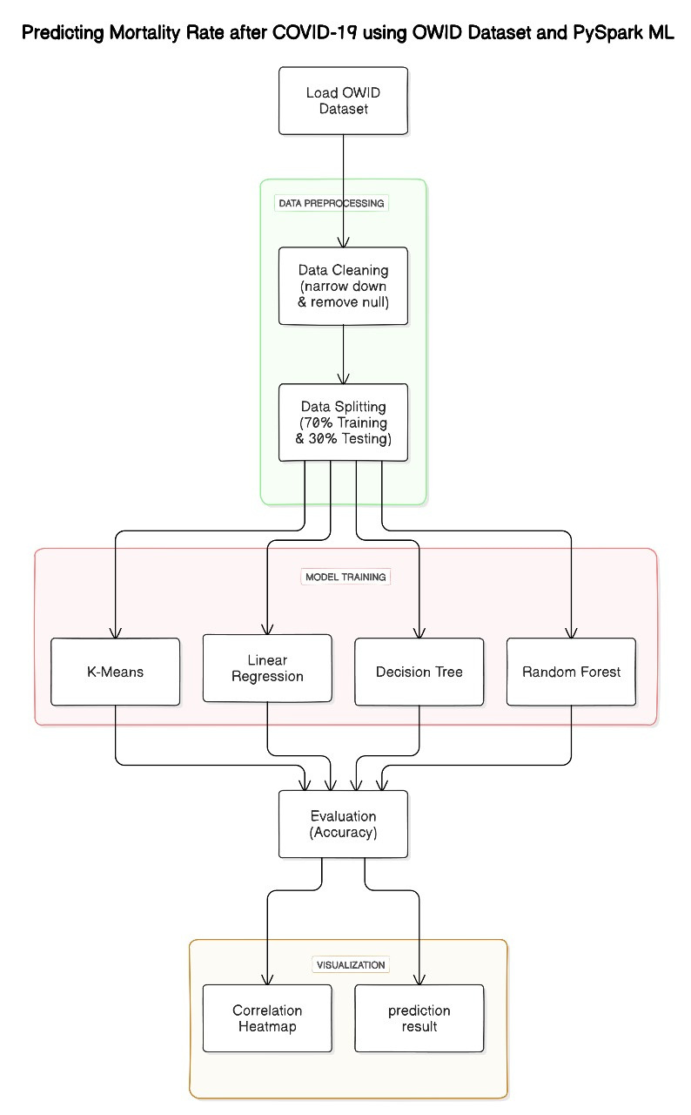
PROPOSED ARCHITECTURE

Slide 11
First step , loading the OWID covid dataset
Now preprocess the data by cleaning sorting and standardizing the data format and removing the null values and using imputer functions
After preprocessing the data is split into training and testing samples in the ratio of 70:30
Now the models (Linear regression, Decision Tree and Random Forest) are trained
The Performance is assed using performace metrics such AS MAE,MSE,R2,RMSE
Now the best model in terms of score is used to predict the result for the test data

Slide 12
DATASET DESCRIPTION
The dataset provides detailed COVID-19 data for India, spanning 1,390 records and containing 67 columns. Key columns include:
Date and Location Information: iso_code, continent, location, date
Case and Death Statistics: total_cases, new_cases, new_cases_smoothed, total_deaths, new_deaths, new_deaths_smoothed
Per Million Statistics: total_cases_per_million, new_cases_per_million, new_cases_smoothed_per_million, total_deaths_per_million, new_deaths_per_million, new_deaths_smoothed_per_million
Healthcare Data: icu_patients, icu_patients_per_million, hosp_patients, hosp_patients_per_million

Slide 13
DATASET DESCRIPTION
Vaccination Data: total_vaccinations, people_vaccinated, people_fully_vaccinated, new_vaccinations, total_boosters
Testing Data: total_tests, new_tests, positive_rate, tests_per_case
Other Indicators: reproduction_rate, stringency_index, population
Certain columns have a significant number of missing values, such as ICU and hospital patients data. The dataset includes additional demographic and health system indicators like life_expectancy, human_development_index, and population.

Slide 14
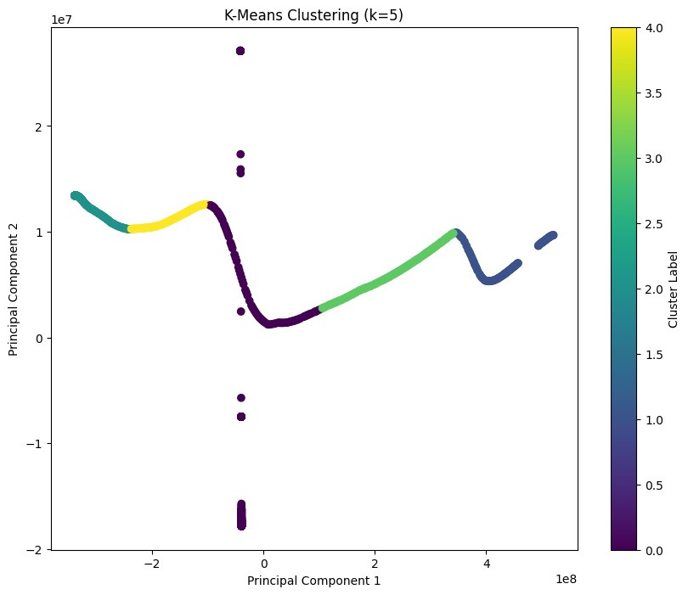
VISUALIZATION
K-means Clustering

Slide 15
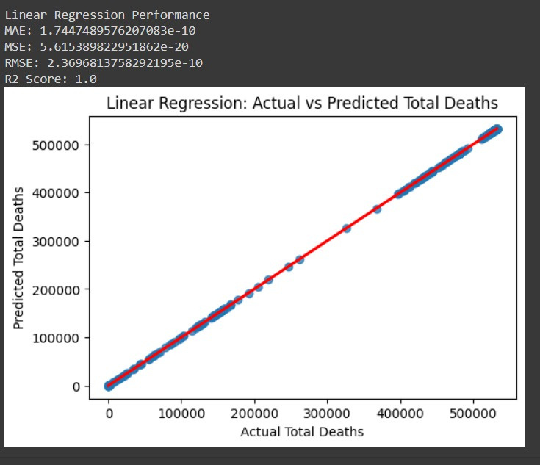
SAMPLE OUTPUT OBTAINED
Linear
Regression

Slide 16
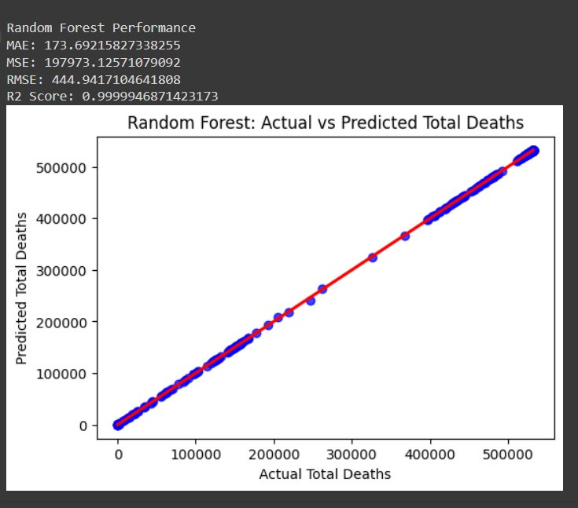
SAMPLE OUTPUT OBTAINED
Random
Forest

Slide 17
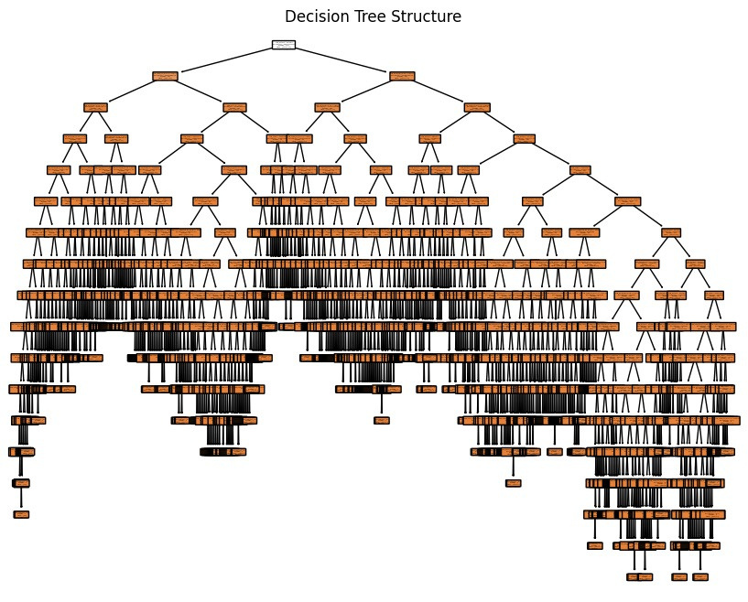
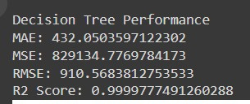
SAMPLE OUTPUT OBTAINED
Decision
Tree

Slide 18
EVALUATION METRICS
Mean Absolute Error (MAE)
Measures the average magnitude of the errors between predicted and actual values.
Represents the average absolute difference between predicted and actual values.
Mean Squared Error (MSE)
Measures the average of the squares of the errors between predicted and actual values.
Squares the differences between predicted and actual values to emphasize larger errors.
.

Slide 19
EVALUATION METRICS
Root Mean Squared Error (RMSE)
The square root of MSE.
Provides a measure of the average magnitude of the errors in the same units as the predicted and actual values.
R-squared (Coefficient of Determination)
Indicates how well the regression predictions approximate the real data points.
Measures the proportion of the variance in the dependent variable that is predictable from the independent variables.

Slide 20
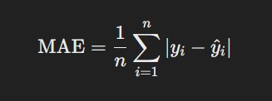
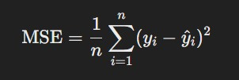
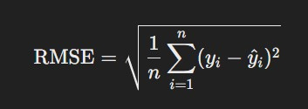
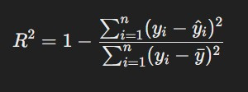
EVALUATION METRICS

Slide 21
RESULT
Metric | Linear Regression | Random Forest | Decision Tree
MAE | 0.117 | 0.006 | 0.007
MSE | 0.051 | 0.004 | 0.007
RMSE | 0.227 | 0.064 | 0.084
R2 Score | 0.098 | 0.927 | 0.874

Slide 22
Among the three models evaluated, the Random Forest model emerges as the most accurate and reliable for the given dataset. It exhibits the lowest error metrics (MAE, MSE, and RMSE) and a very high R² score, indicating its exceptional ability to capture nearly all the variability in the data with minimal errors. This makes it the best choice for predicting outcomes in this context.
The Decision Tree model also shows good performance with low error metrics and a strong R² score. While it is slightly less precise than the Random Forest model, it still provides a high level of accuracy and reliability, making it a viable alternative.
The Linear Regression model struggles significantly with higher error metrics and a low R² score, indicating poor fit and limited explanatory power. This model is not suitable for the given dataset due to its inability to accurately predict the outcomes and capture the variability in the data.

Slide 23
CONCLUSION
The COVID-19 pandemic has significantly impacted millions globally, making accurate mortality predictions crucial for effective disease management and resource allocation. Leveraging machine learning and big data analytics has shown potential in combating the pandemic across healthcare, public health, and policy-making sectors.
This study uses PySpark, a Python API for Apache Spark, to predict COVID-19 mortality rates using the OWID dataset and various machine learning algorithms. PySpark's features include large-scale data processing, integration with Python, and rich libraries for SQL, machine learning, graph processing, and streaming data.

Slide 24
CONCLUSION
The study evaluates several machine learning models, including K-means Clustering, Linear Regression, Random Forest, and Decision Tree, using metrics such as Mean Absolute Error (MAE), Mean Squared Error (MSE), Root Mean Squared Error (RMSE), and R-squared (R²).
The Random Forest model outperforms Linear Regression and Decision Tree, having the lowest MAE, MSE, and RMSE, and the highest R² score, indicating it is the best-performing algorithm for predicting COVID-19 mortality.

Slide 25
REFERENCES
Padilla, L., Fygenson, R., Castro, S. C., & Bertini, E. (2023). Multiple Forecast Visualizations (MFVs): Trade-offs in Trust and Performance in Multiple COVID-19 Forecast Visualizations. IEEE transactions on visualization and computer graphics, 29(1), 12–22. https://doi.org/10.1109/TVCG.2022.3209457
S. Dash, C. Chakraborty, S. K. Giri, S. K. Pani and J. Frnda, "BIFM: Big-Data Driven Intelligent Forecasting Model for COVID-19," in IEEE Access, vol. 9, pp. 97505-97517, 2021, doi: 10.1109/ACCESS.2021.3094658.

Slide 26
REFERENCES
N. Braig, A. Benz, S. Voth, J. Breitenbach and R. Buettner, "Machine Learning Techniques for Sentiment Analysis of COVID-19-Related Twitter Data," in IEEE Access, vol. 11, pp. 14778-14803, 2023, doi: 10.1109/ACCESS.2023.3242234
V. K. Gupta, A. Gupta, D. Kumar and A. Sardana, "Prediction of COVID-19 confirmed, death, and cured cases in India using random forest model," in Big Data Mining and Analytics, vol. 4, no. 2, pp. 116-123, June 2021, doi: 10.26599/BDMA.2020.9020016.

Slide 27
REFERENCES
Alafif, T., Etaiwi, A., Hawsawi, Y., Alrefaei, A., Albassam, A., & Althobaiti, H. (2022). DISCOVID: discovering patterns of COVID-19 infection from recovered patients: a case study in Saudi Arabia. International journal of information technology : an official journal of Bharati Vidyapeeth's Institute of Computer Applications and Management, 14(6), 2825–2838. https://doi.org/10.1007/s41870-022-00973-2

