Slide 1
Web Search: Engines and Directories
Effective Searching Methods

Slide 2

Summary
Understanding effective search ideas.
Understanding Boolean operators.
Understanding wild cards.
Understanding phrase and proximity searching.

Slide 3
Effective Searching Methods
Searching the Web can be a monumental task. However, just because it’s a monumental task does not mean users should not search the Web! There are plenty of tips and concepts to make searching easy and effective.

Slide 4
Boolean Operators
Boolean – A logical combinational system that represents symbolically relationships between entities. Logical operators include AND, OR, and NOT. These operators are considered stopwords.

Slide 5

Boolean Operators
Stopwords – words ignored by search engines because they are too common in search results.
Examples: a, the, to, for, an, that, or, and.

Slide 6
Boolean Operators
AND – This special stopword is used in a search with two or more words. This operator tells an engine that all words must appear in the search results.
Example: Atlanta AND Augusta
Google, by default, does not need a user to use the AND operator. Google automatically uses the AND operator in searching.

Slide 7
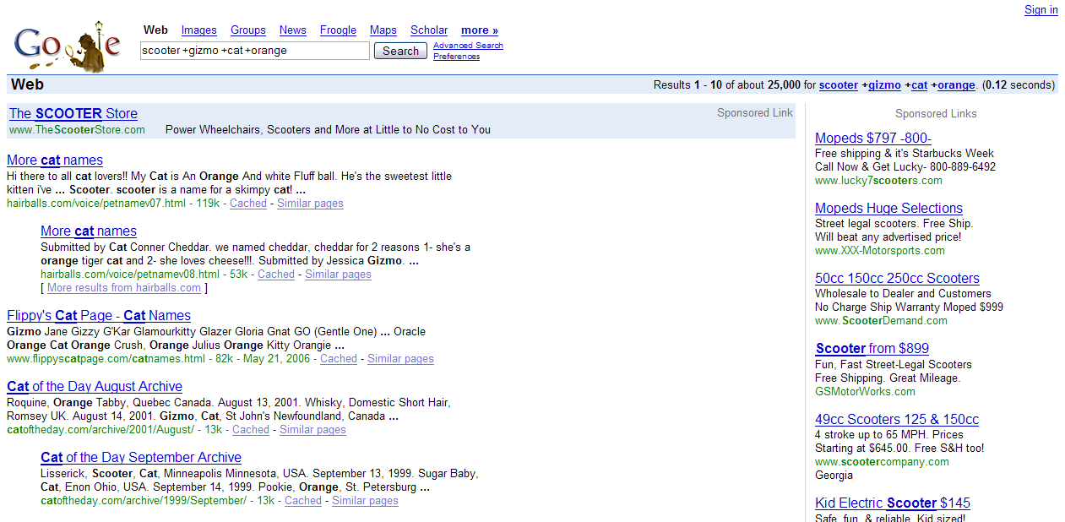
Boolean Operators
With some search engines, a plus sign in front of a search word acts as the same as AND.

Slide 8
Boolean Operators
OR – Boolean operator used in a search to return results containing any of the words in a query.
Example: Karl OR Richard

Slide 9
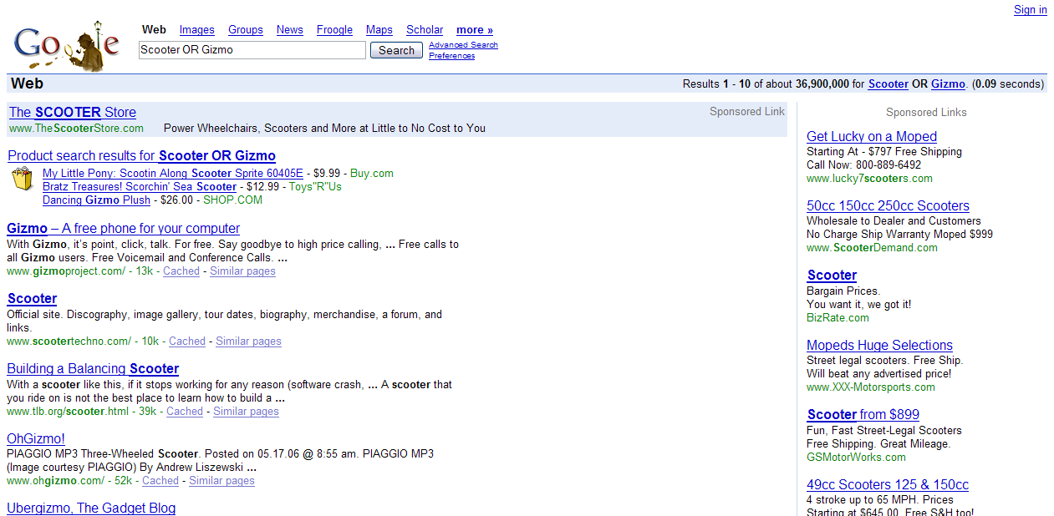
Boolean Operators
OR search

Slide 10
Boolean Operators
In the search example, the user wants all results featuring either the word gizmo or scooter in the text.
Notice the Google logo. This is a example of a special Google logo. This logo is for celebrating Sir Arthur Conan Doyle’s birthday.

Slide 11
Boolean Operators
NOT – The third major Boolean operator used in a search to exclude certain words from a search.
Example: Armstrong NOT Lance

Slide 12
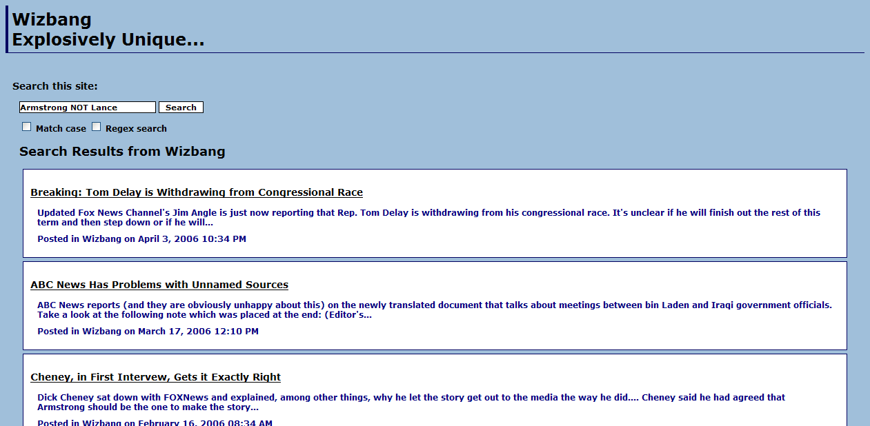
Boolean Operators
NOT search

Slide 13
Boolean Operators
In the search example, notice that the name Lance does not appear in any of the results.
Google and Yahoo, however, do not use the NOT operator in searching the Web. Instead, to exclude a word, a user needs to place a minus (-) sign in front of the word to exclude:
Example: Armstrong -Lance

Slide 14
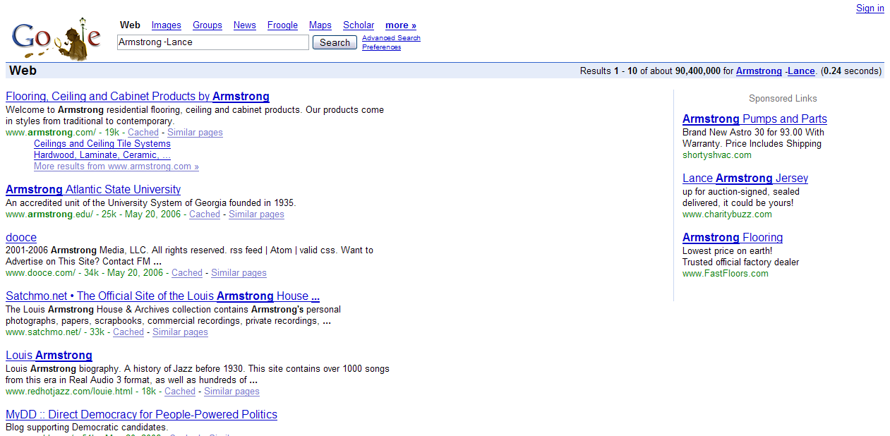
Boolean Operators
Again, notice the name Lance does not appear in any of the results.

Slide 15
Wildcards
Wildcards – Wildcards are characters used to represent an unknown or unpredictable search factor. Wildcards vary from system to system. Check the system’s requirement for which wildcards it supports.

Slide 16
Wildcards
There are there popular wildcards commonly used in search engine systems. They are:
  Dollar sign ($)
  Question mark (?)
  Asterisk (*)

Slide 17
Wildcards
Dollar sign ($) – This character represents an optional single character.
  Example: Hono$r
  This will find Honor and Honour.

Slide 18
Wildcards
Question mark (?) – This character represents a required single character.
  Example: medic???
  This will find medicate and medicine.

Slide 19

Wildcards
Asterisk ($) – This character represents an optional multi-character wildcard.
    Example: Brit*
    This will find, as a few examples, Britain, British, Brittany, and Britney.
  The asterisk is also known as a truncation symbol.

Slide 20
Wildcards
Google allows wildcard searches, but only uses asterisk to represent whole words (truncation), not portions of words. Google refers to this as “stemming technology.”
Check your search engine of choice on its policy of wildcards.

Slide 21
Phrase Searching
Quotation marks are helpful in queries. These marks are used to denote phrases. Engines, like Google, will search for the exact phrase, instead of the words separately. This is known as phrase searching.

Slide 22
Proximity Searching
In addition to Boolean and wildcard searches, proximity searching can also help strengthen the search results. Proximity searching include using quotation marks and the NEAR stopword.

Slide 23
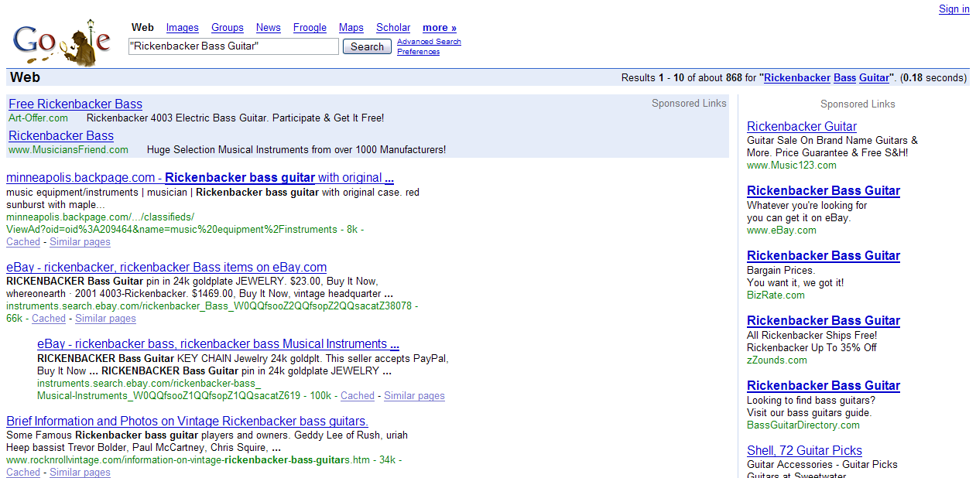
Proximity Searching
An example of using quotation marks

Slide 24
Proximity Searching
The NEAR stopword is used by some search engines, like AltaVista.com, to find two or more words in close proximity to each other in a document. The proximity range for engines that use this method is usually about ten words. Not all engines support the NEAR feature.

Slide 25
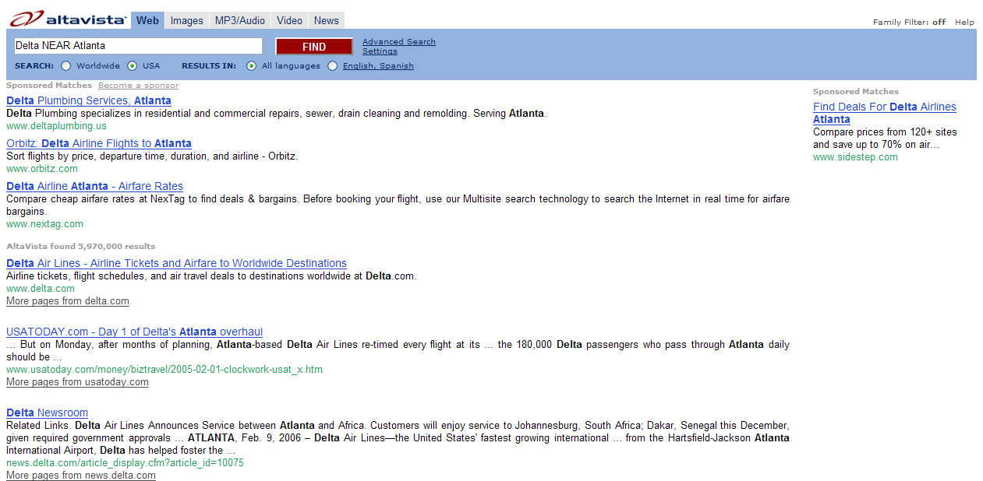
Proximity Searching
An example of using the NEAR stopword.

Slide 26
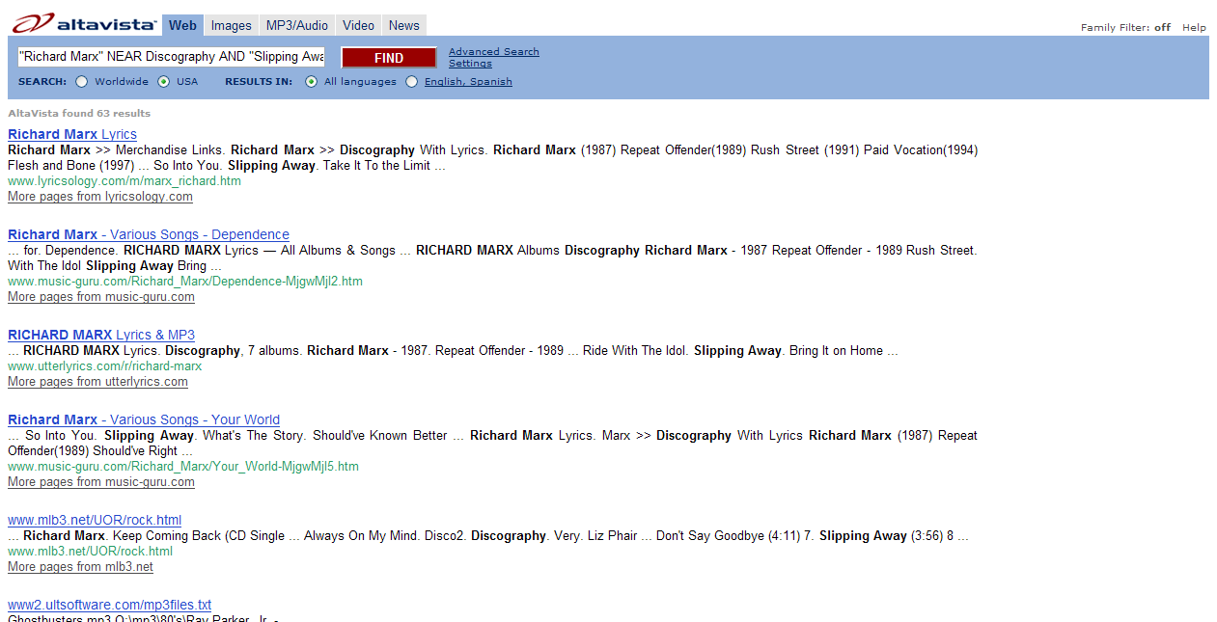
Combinations
Also, a combination of these methods can be used together to further refine a search.

Slide 27
Summary
Understanding effective search ideas.
Understanding Boolean operators.
Understanding wild cards.
Understanding phrase and proximity searching.

Slide 28
Resources
Baeza-Yates, Ricardo and Berthier Ribeiro-Neto. Modern Information Retrieval. New York, NY: Addison Wesley, 1999.
“Netscape Search: General Tips.” Netscape. 2004. 7 June 2006. <http://wp.netscape.com/escapes/search/tips_0.html>.
Poremsky, Diane. Google and Other Search Engines. Berkeley, CA: Peachpit Press, 2004.

