Slide 1
Web Search: Engines and Directories
Search Basics

Slide 2

Summary
Understanding challenges posed by Web searching.
Knowing the different types of Web searching tools.
Knowing the 2 types of search tool architectures.
Understanding the strength and weaknesses of search tools.

Slide 3

Challenges Posed by Web Searches
Data are distributed. Data are located on many computers that are interconnected. Data have no predefined topology. Also, there is no set standard of bandwidth or network reliability.
  Bandwidth – The capacity for data transfer of an electronic communications system; especially the maximum data transfer rate of such a system.

Slide 4
Challenges Posed by Web Searches
Data are volatile, due to Internet dynamics. Data change from day-to-day. A web page visible today may not be visible tomorrow.
Large volume. The exponential growth of the Web makes it hard to find the right data. Volume makes searching the Web akin to searching for a needle in a haystack!

Slide 5
Challenges Posed by Web Searches
Redundant data. Many pages are simply clones of text presented in different formats. Because of redundancy, 5 results for a term in a search may provide a person with 1 passage repeated on 5 pages.
Quality. Quality of a Web page may be poor. There in no editorial process in Web publishing. Anyone can be a web publisher.

Slide 6
Challenges Posed by Web Searches
Heterogeneous data. In addition to data being redundant, data can be presented in many languages. A person might skip valuable data simply by not understand the language used to present them.
There are also challenges of Web searching brought on the user.
  A user’s search can be too broad. This provides too much data for a certain topic.
  A user’s search can be too narrow. This limits the number of data returned for a certain topic.

Slide 7
Challenges Posed by Web Searches
One should not let such challenges prevent them from using Web searches. It is possible to over come these challenges! The key is to learn ways around the such challenges.

Slide 8
Four Main Types of Search Tools
Web search tools can be broken down into four types of tools:
Search Engine – A tool that lets a person explore databases containing the text from hundreds of million of Web pages.

Slide 9
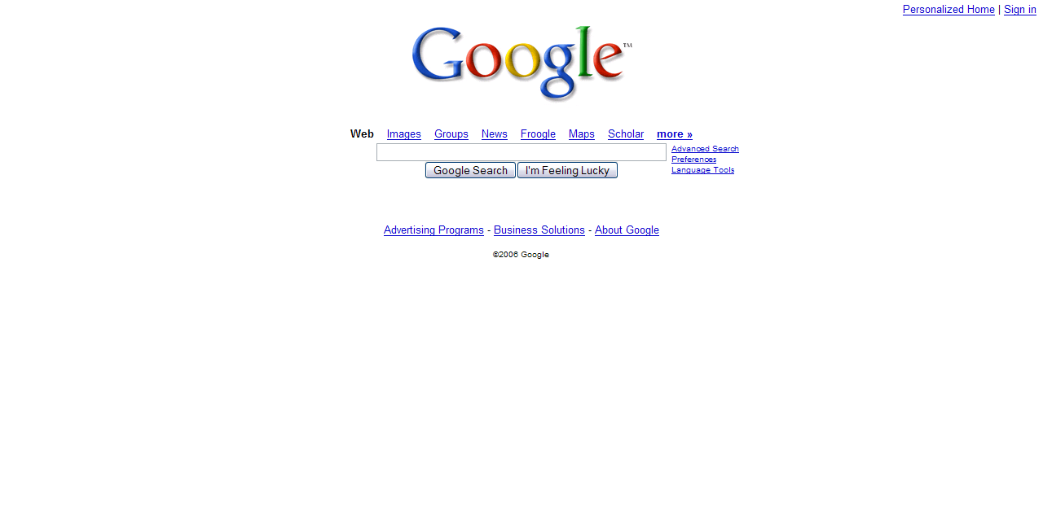
Four Main Types of Search Tools
Google (google.com)

Slide 10
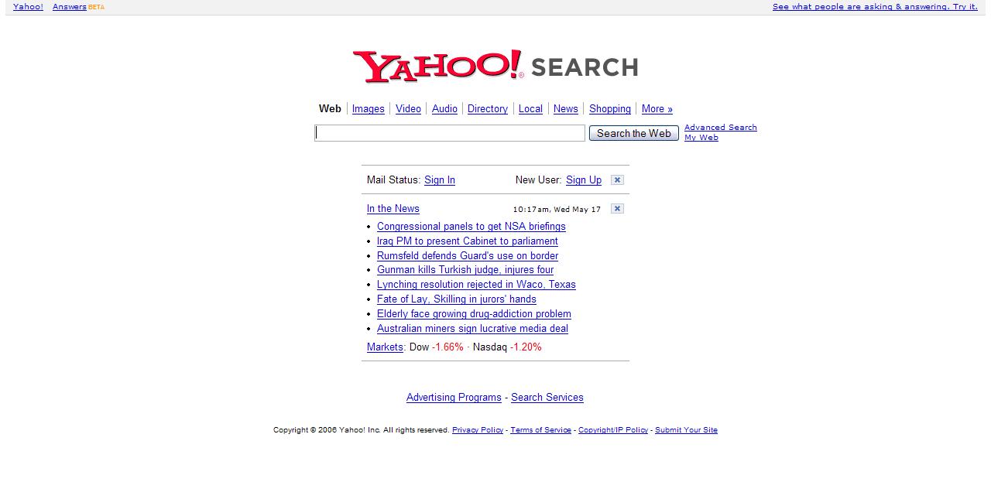
Four Main Types of Search Tools
Yahoo! Search (search.yahoo.com)

Slide 11
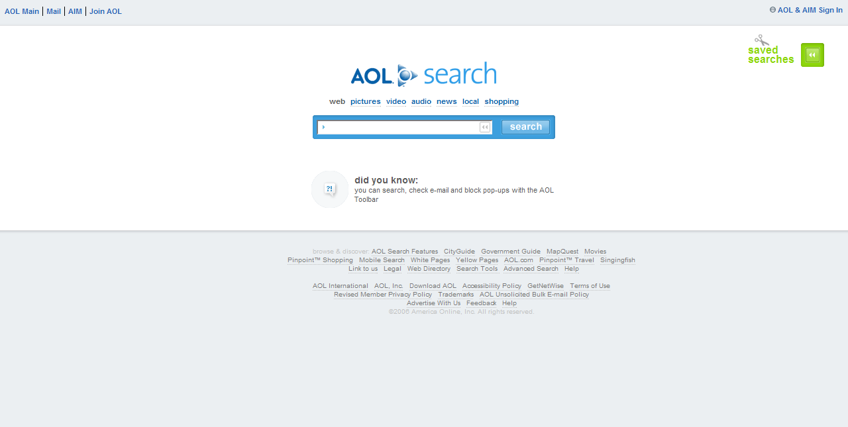
Four Main Types of Search Tools
AOL Search (search.aol.com)

Slide 12
Four Main Types of Search Tools
Topic Directory – A tool that is a human prepared directory of Web sites.

Slide 13
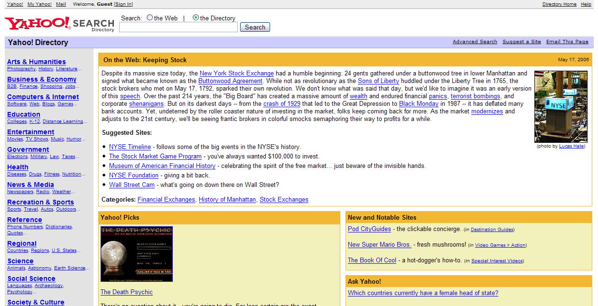
Four Main Types of Search Tools
Yahoo! Directory (dir.yahoo.com)

Slide 14
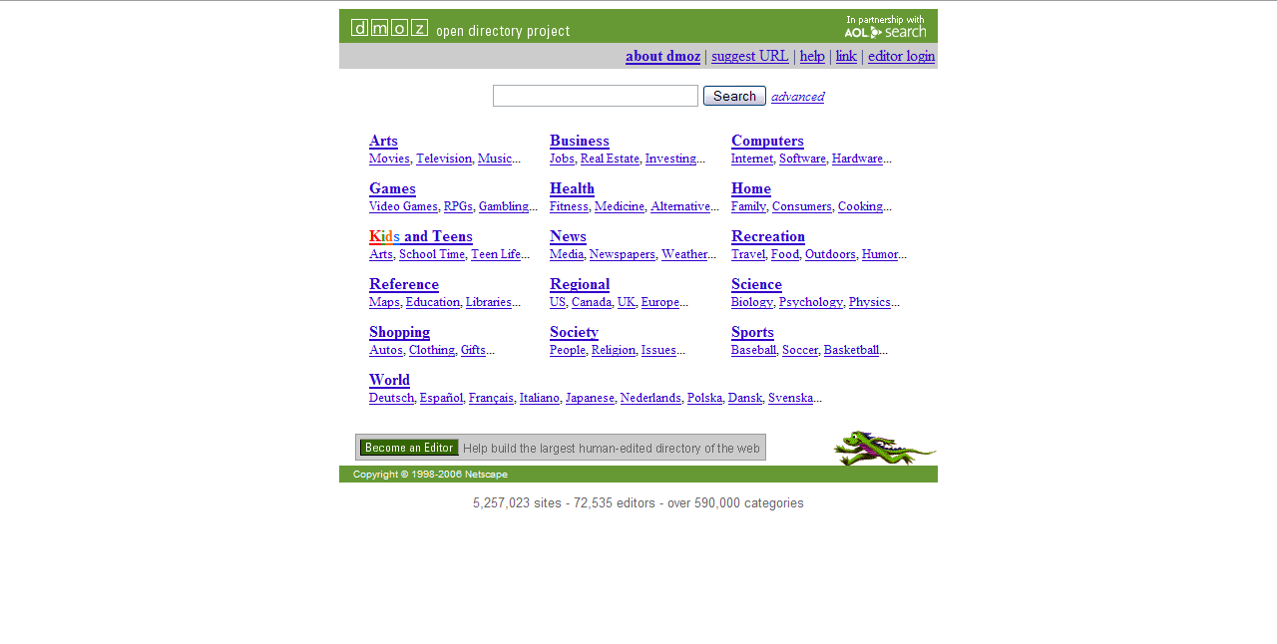
Four Main Types of Search Tools
Open Directory Project (dmoz.org)

Slide 15
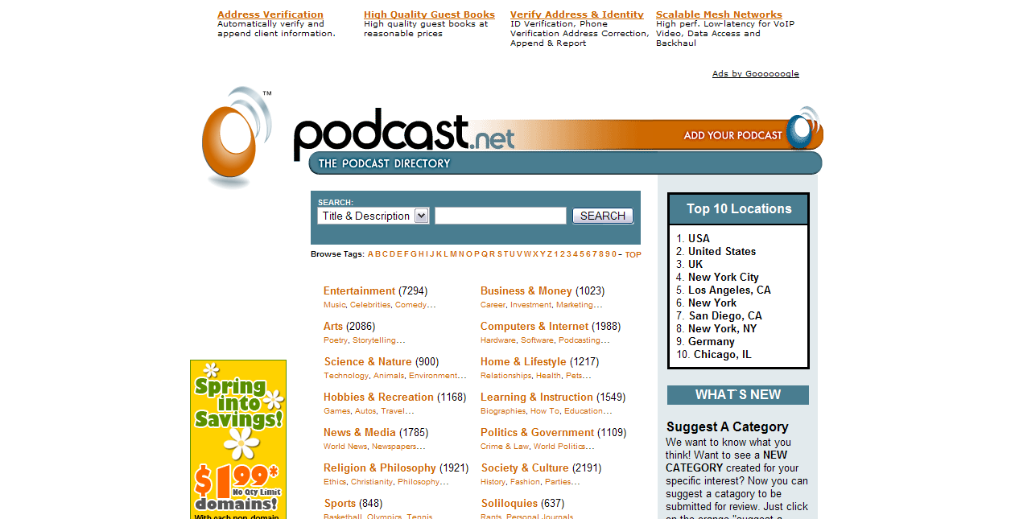
Four Main Types of Search Tools
The Podcast Directory (podcast.net)

Slide 16
Four Main Types of Search Tools
Portal – A tool that is a collection of information like search engines, news, weather, link, e.t.c, all on one page.
Many Internet service providers’ homepages can be portals to the Web.

Slide 17
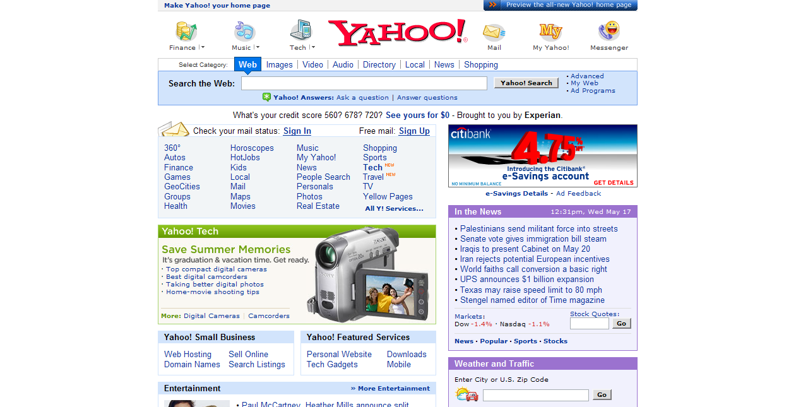
Four Main Types of Search Tools
Yahoo! (yahoo.com)

Slide 18
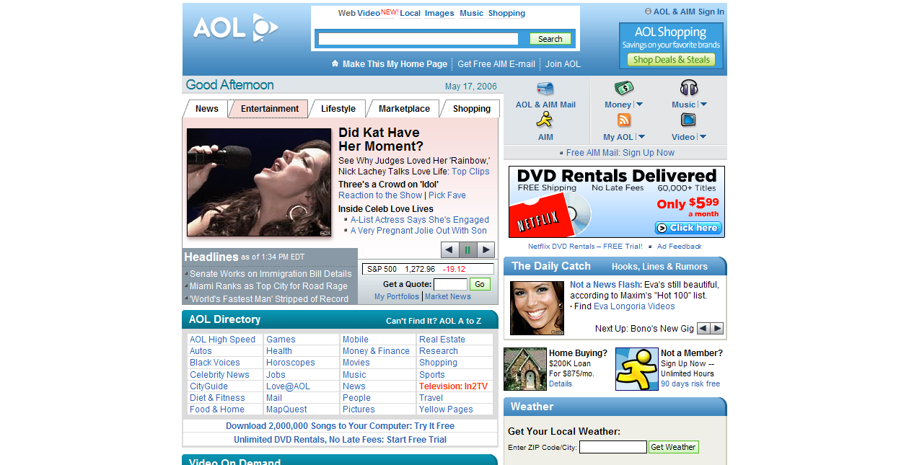
Four Main Types of Search Tools
AOL (aol.com)

Slide 19
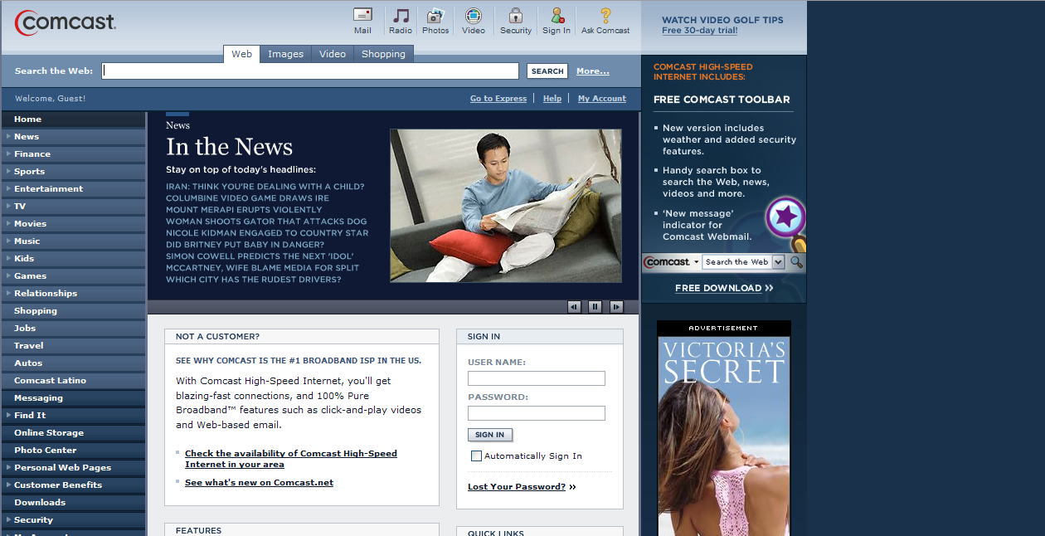
Four Main Types of Search Tools
Comcast (comcast.net)

Slide 20
Four Main Types of Search Tools
Hyperlink Engines – Engines that search the Web based on hyperlinks and the content behind the hyperlinks.
  Hyperlink – An electronic link providing direct access from one distinctively marked place in a hypertext document to another in the same or different document.
  Hypertext – A database format in which information related to that on a display can be accessed directly from the display.

Slide 21
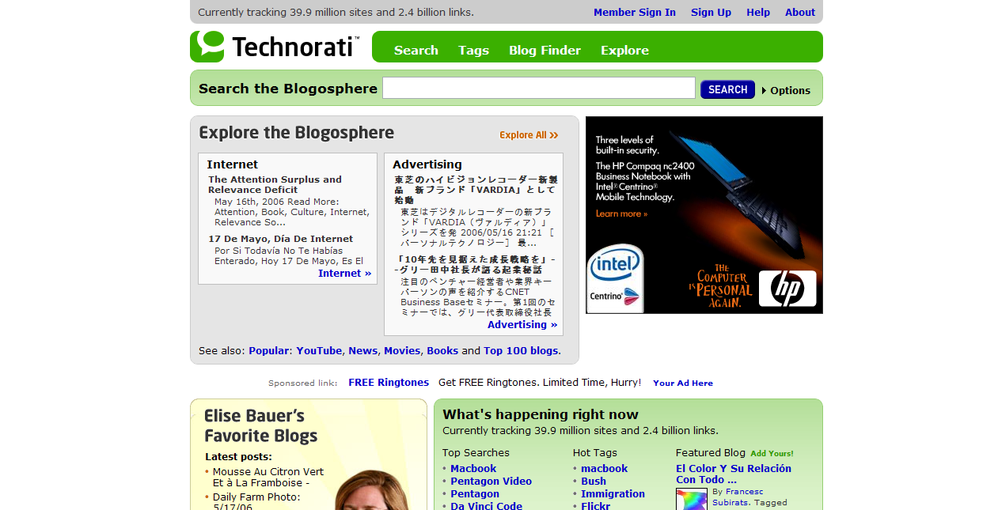
Four Main Types of Search Tools
Technorati (technorati.net)

Slide 22
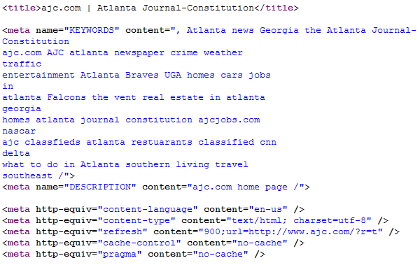
Additional Search Tools
Meta-search Tools – Tools that scan the meta tags of Webpages. Data are entered into a database based on these tags. Results are returned based on the tags.

Slide 23
Additional Search Tools
Drawback: Meta tags, like the NAME tag, can be spoofed. Some unrelated pages may show up in a search simply because the searched term appears in the meta tag.

Slide 24
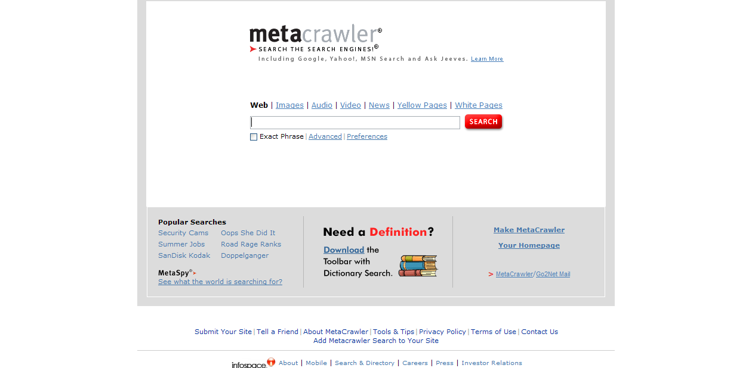
Additional Search Tools
MetaCrawler (metacrawler.com)

Slide 25
Additional Search Tools
Digital Libraries (also known as Virtual Libraries) – Libraries with resources available in a digital format. They are considered to be a complement to traditional library sources. Some digital libraries contain full text of works. Others may simply catalogue where to access texts.

Slide 26
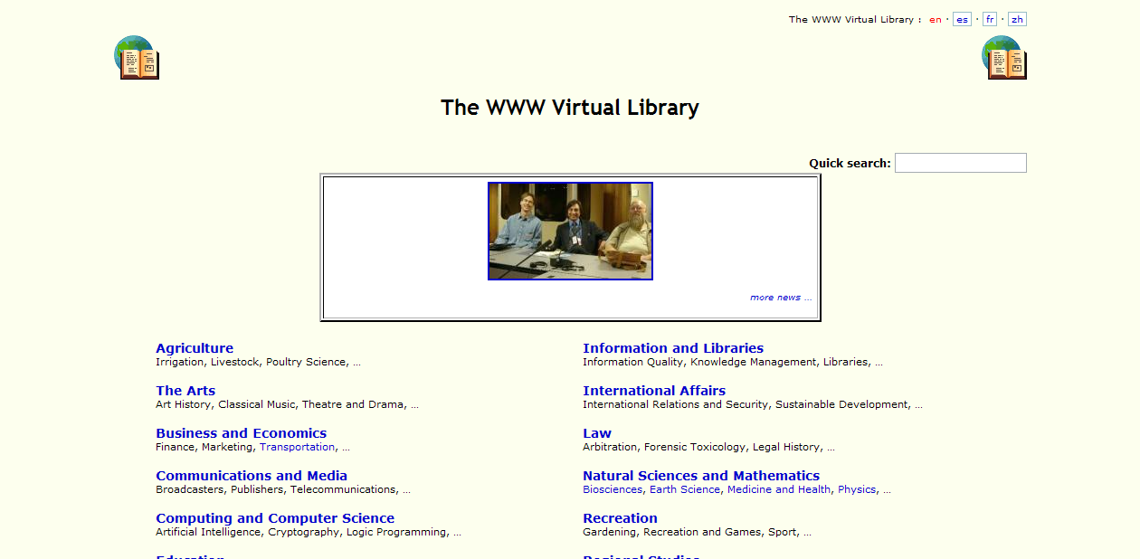
Additional Search Tools
The WWW Virtual Library (vlib.org)

Slide 27
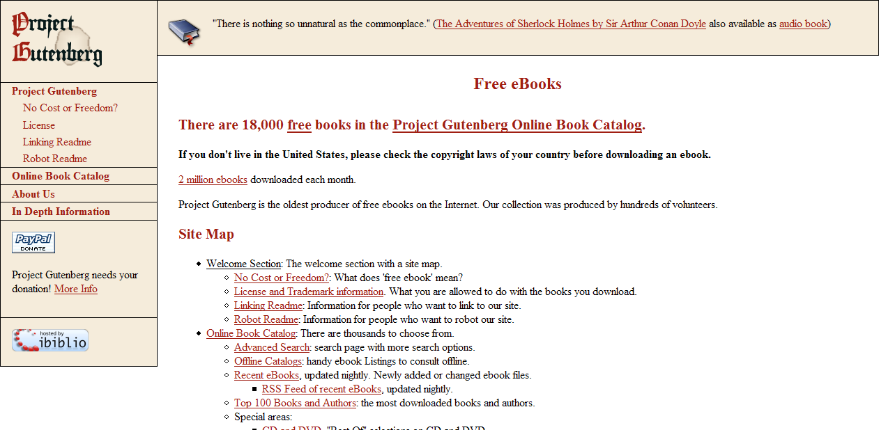
Additional Search Tools
Project Gutenberg (gutenberg.org)

Slide 28
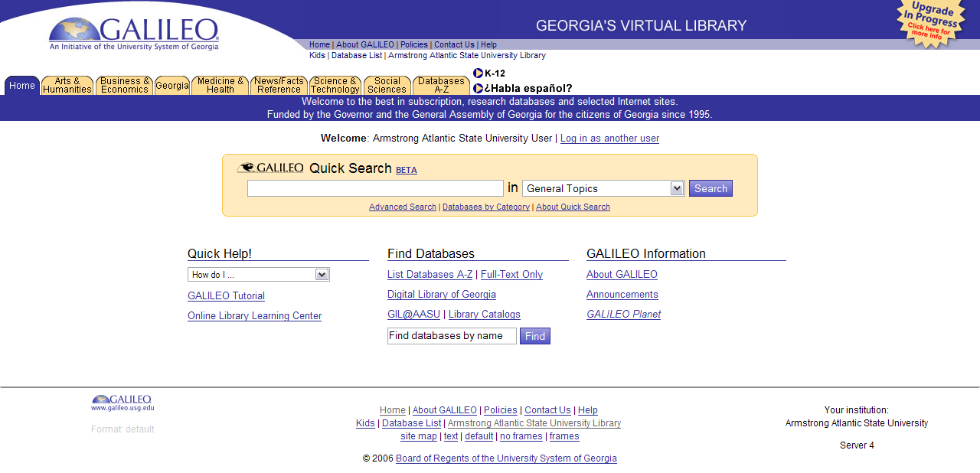
Additional Search Tools
GALILEO (galileo.usg.edu)

Slide 29
Additional Search Tools
Specialized Databases – Databases of data specifically designed to focus on one or more specific subjects.

Slide 30
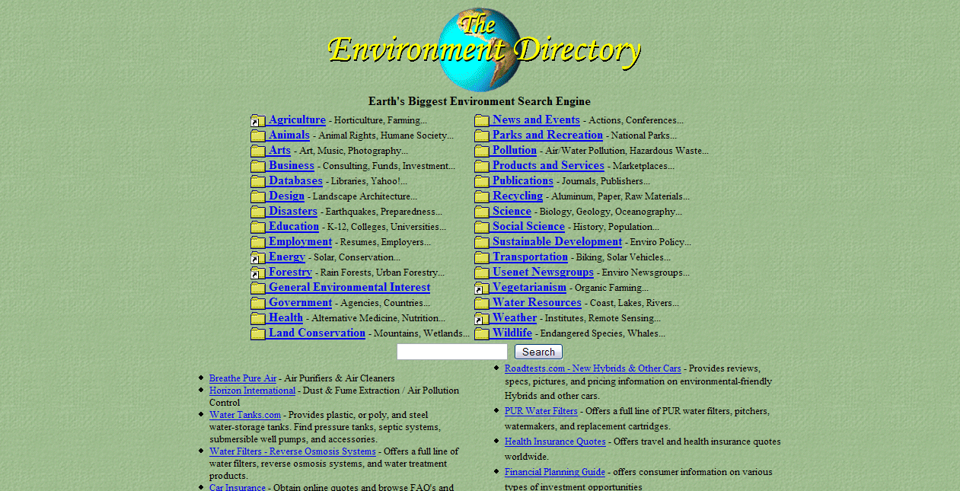
Additional Search Tools
Environment Web Directory (webdirectory.com)

Slide 31
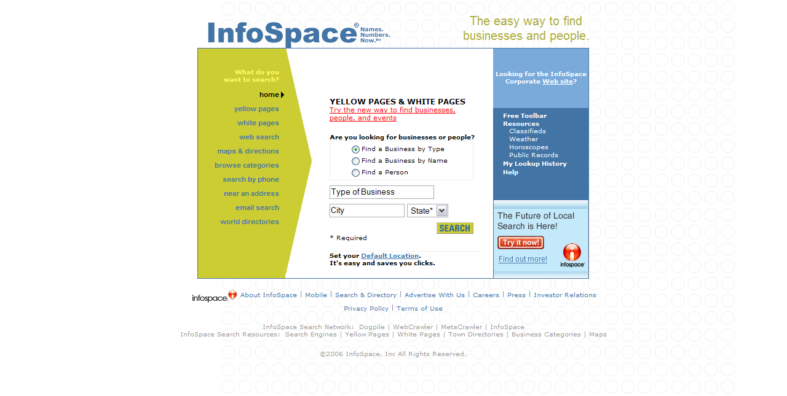
Additional Search Tools
Infospace (infospace.com)

Slide 32
Additional Search Tools
Spiders – Spiders are programs that browse the World Wide Web in an automated manner. Information is gathered by spiders for later processing and inclusion into databases, like search engines.

Slide 33
Additional Search Tools
Famous Spiders:
GoogleBot (Google)
Slurp! (Yahoo!)
Robozilla (Open Directory Project)

Slide 34
Additional Search Tools
Unfortunately, there are spiders on the Web that are used to harvest e-mail addresses on the Web. These addresses are then spammed!
  Spam - unsolicited e-mail
Be care with your e-mail address on the Web! Posting an e-mail address may lead to spam in your e-mail account.

Slide 35
Search Tool Architectures
Search engines use two types of architectures in collection and display of data.
Centralized - A centralized search engine architecture is one that runs on one computer system. This one system sends requests to remote Web servers to collect data. The system also processes the data.

Slide 36
Search Tool Architectures
Centralized Engines:
Google
Yahoo! Search
AOL Search

Slide 37
Search Tool Architectures
Distributed - Distributed engine architectures us multiple servers for computing power. One or more servers are used exclusively to either gather data or index the data.
  Distributed Engines:
  Harvest
  Majestic-12

Slide 38
Strength Of Search Tools
Search tools will usually return the most popular entries for a query. These results can be considered portals to the Web community on a particular subject.
  Query – A query is a request for information.

Slide 39
Weaknesses Of Search Tools
Some results may contain the query, but have no relation to the query. This is known as a “false positive.”
Some data may be out of date. This includes pages no longer in service and pages that haven’t been updated in years.

Slide 40
Weaknesses Of Search Tools
Dynamic pages (such as pages with the .cgi extension) may not appear in search tools.
Some listings are ranked high, not based on an algorithm, but how much a Website pays for placement in the tool (e.g Google AdWords).

Slide 41
Weaknesses Of Search Tools
Not all of the Web is covered by search tools. Some pages on a subject may never be seen by a tool.

Slide 42
Summary
Noting the challenges posed by Web searching.
Knowing the different types of Web searching tools.
Knowing the 2 types of search tool architectures.
Understanding the strength and weaknesses of search tools.

Slide 43
Resources
Baeza-Yates, Ricardo and Berthier Ribeiro-Neto. Modern Information Retrieval. New York, NY: Addison Wesley, 1999.
Chan, Ben. “24-hour Reference Service.” Chartered Institute of Library and Information Professionals. 27 May 2005. 7 June 2006. <http://www.cilip.org.uk/publications/ updatemagazine/archive/archive2005/june/chan.htm>.
McMillan, Gail. “Digital Library Definition for DLI2.” 5 Jun. 1998. 7 June 2006. <http://scholar.lib.vt.edu/DLI2/defineDL.html>.

Slide 44
Resources
Merriam-Webster Online. Merriam-Webster, Inc. 2006. 17 May 2006. <http://www.webster.com/>.
Poremsky, Diane. Google and Other Search Engines. Berkeley, CA: Peachpit Press, 2004.

