Slide 1
Thankful Missionary Baptist Church Web Site and Database Management System for Small Churches
Shawn Latta
ITEC 4390 – Senior Project
November 26, 2007

Slide 2
Abstract
Thankful Missionary Baptist Church is a small historically black church in Savannah, GA. It is located in downtown Savannah at 820 Martin Luther King Jr. Blvd, Savannah, GA 31415. Dr. Evelyn Dandy, leader of the church’s Education and Information Ministry and member of Armstrong Atlantic State University staff, wanted her church to have a Web presence. The first part of this Senior Project dealt with designing, developing, and launching a Web site for the church.
The second part of this Senior Project dealt with designing and developing a database management system for small churches. This database management system was developing in PHP and uses MySQL as is database system.

Slide 3
Motivation
Motivation for the project came from several directions. One motivation for me to agree upon the project is the fact that it would satisfy the requirements for graduation. However, the biggest factor for accepting this assignment over other projects I may have chosen to do is how it interconnects with my faith and my values. I was able to make use of skills and ideas acquired from my attendance at Catholic church and Girl Scouting. My final main motivation for this project is a very personal reason. My mother, my biggest influence, was a very spiritual person. She was active in Girl Scouting and big into helping the community. She would have encouraged me to go for this project. I did this project as a way to related to her and remember her memory.

Slide 4
Objectives
The objectives of this project were simple. My major objective was to satisfy the requirements for graduation. To reach this objective, smaller objective were developed. The objective are as follows:
  Design, develop, and launch a static Website for Thankful Missionary Baptist Church.
  Develop and write a basic manual for maintaining the Thankful Missionary Baptist Church Web site.
  Design and develop a database for storing and maintaining information related to a church’s members. This includes developing this database in the MySQL format.
  Design and develop a Web-based application, in PHP, to manipulate the MySQL database.
  Learn and/or increase my knowledge on HTML, site design, databases in general, MySQL, and PHP as I developed the tools for Thankful Missionary Baptist Church and the dynamic part of my project.

Slide 5
Significance of Project
The significance of the project was two-fold. On one end, Thankful Missionary Baptist Church needed a Web site to present information about the church to current and potential new members. Information on the church’s pastor, first lady, its ministries, its worship services, and history were presented on the site.
The other significant part of the project was the design and development of database management system. This system will allow a small church or other small organization to be able to manage information on its members, manage Sunday School roster and classes, and manage activities’ dates and rosters.

Slide 6
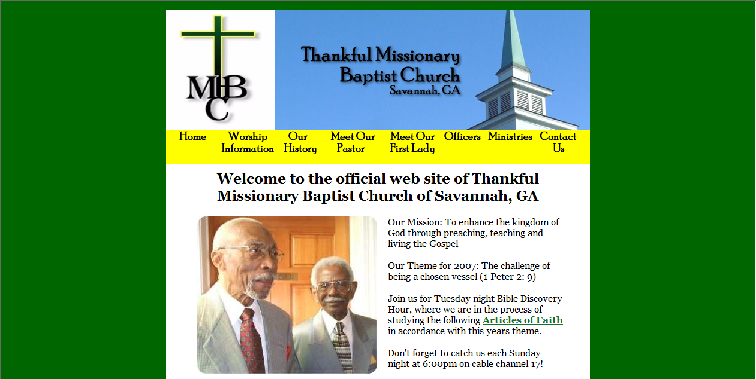
Thankful Missionary Baptist Church
http://www.thankfulbaptistsavannah.org/

Slide 7

Database Management System

Slide 8
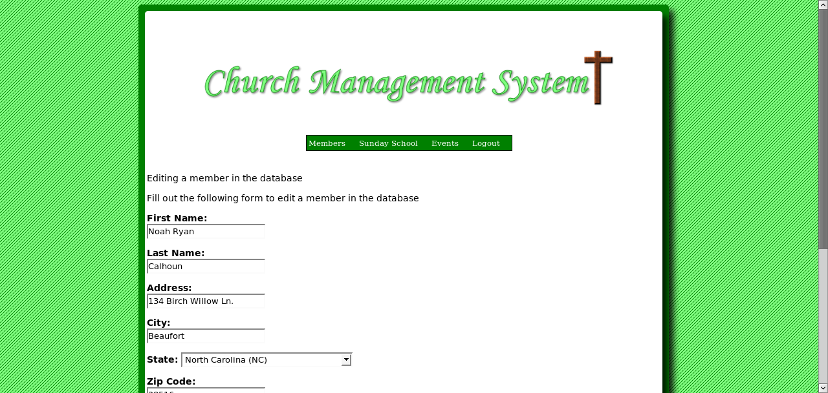
Database Management System

Slide 9
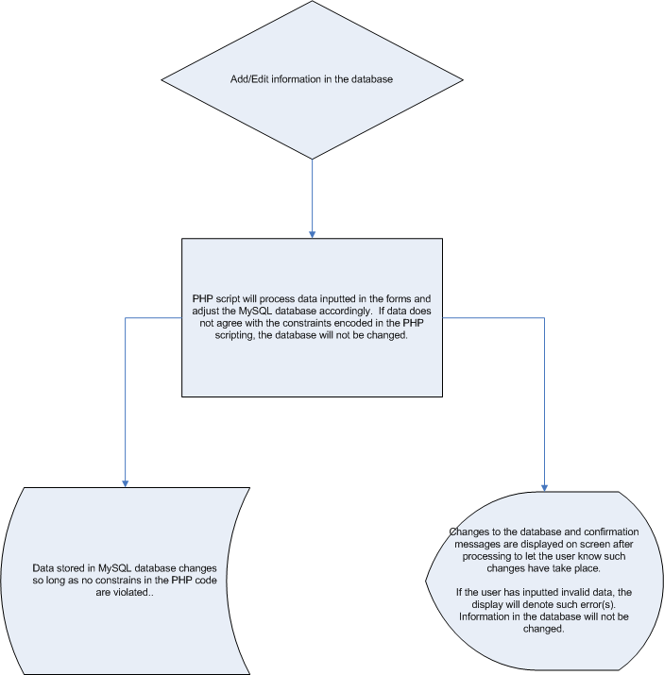
Data Flow

Slide 10
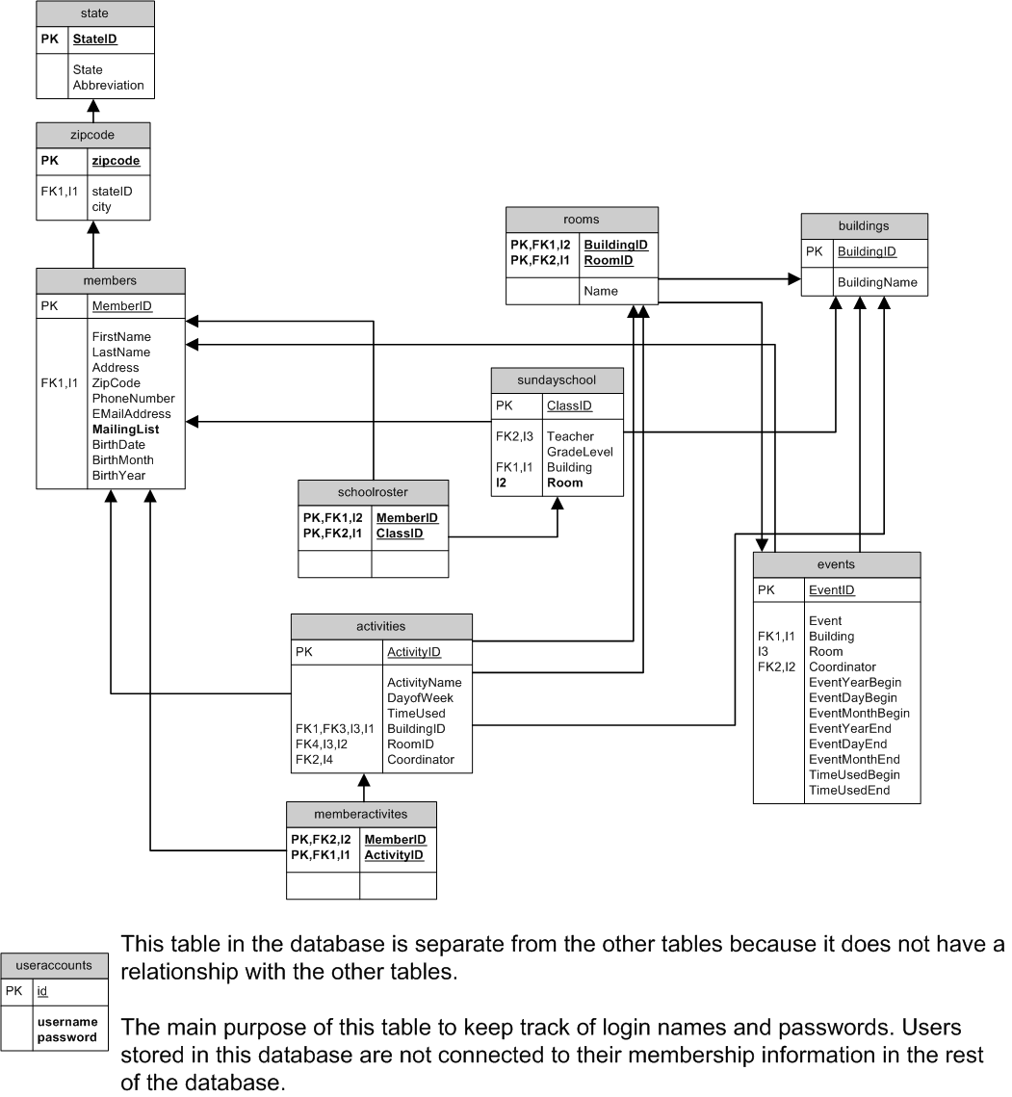
ER Diagram

Slide 11
Questions or Comments

