Slide 1
Web Search: Engines and Directories
An In-Depth Look into Three Major Search Tools

Slide 2

Summary
Understanding the history and how to use Google search.
Understanding the history and how to use Yahoo!’s directory.
Understanding how to use Yahoo!’s portal page.

Slide 3
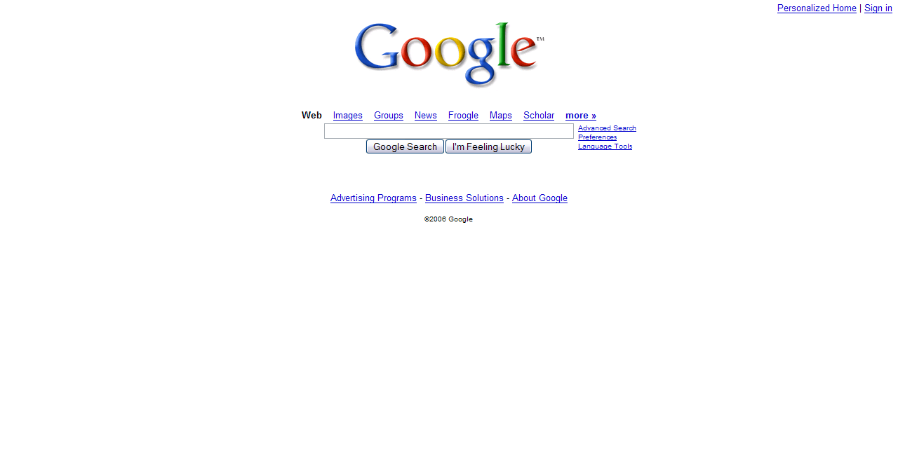
An Examination Of Google
Google is considered to be the best known search engine on the Web today.

Slide 4
History of Google
The name Google is a play on the word “googol.” Googol, coined by the nephew of mathematician Edward Kasner, is a number. How big is this number? Image a 1 followed by 100 zeros!

Slide 5
History of Google
Google was developed in 1996 by Larry Page and Sergey Brin, Stanford University graduate computer science students. The search engine was known as Back-Rub at the time.

Slide 6
History of Google
In September 1998, after finding financial backers and tweaking the technology behind the search engine, Google opened its doors as a corporation. The search engine was launched to the world in Beta form. Google search left Beta testing on September 21, 1999.

Slide 7
History of Google
Since Google was first launched, it developed into one the most popular search engines on the Web. Google has branched out into other Web markets with developing and acquiring new technologies. Google tools include Google News, Blogger, Froogle, and Google Earth.

Slide 8
History of Google
However, with all these technologies possessed by Google, Google’s main focus is searching the web!

Slide 9
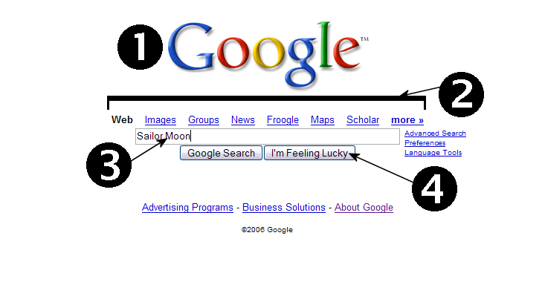
Breakdown of Google
This is a shot of the Google home page. The following slides will explain the numbers on this shot in detail.

Slide 10
Breakdown of Google
The Google logo.
It changes when Google likes to celebrate holidays and birthdays.
A small list of various Google services. In this example, services listed include Image Search and Froogle.
Textbox to place query terms in for searching. Pressing the “Google Search” button will perform the search.

Slide 11

Breakdown of Google
  Query – a request for information.
“I’m Feeling Lucky” button takes a user to the number one page, according to Google’s Page Rank System. The system is responsible for sorting how pages are ordered in a query.

Slide 12
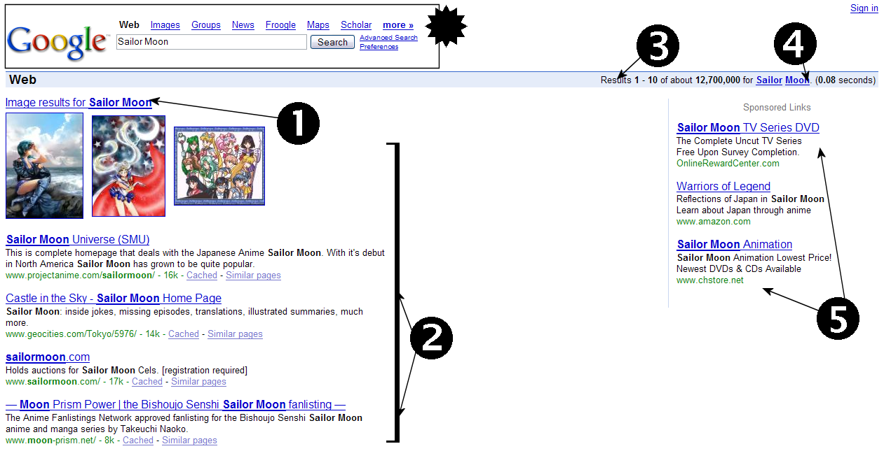
Breakdown of Google
A shot of the Google Search Results page. (Part 1)

Slide 13
Breakdown of Google
This box is the items on the front page brought over to the search results.
Image results – a query may be a popular images query, too. As in this example, a few images are displayed to show an example of the image search.
Data the matches the given query.

Slide 14
Breakdown of Google
Lists the number of results containing the query.
Hyperlinks, if underlined, to the definitions of words used in the query. If not hyperlinked, it is not a link to the definition.
Sponsored links are link that are paid to be displayed along with the query. They are mainly advertisements.

Slide 15
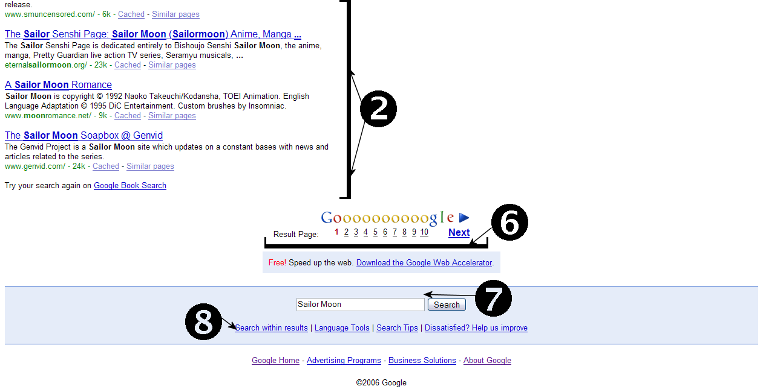
Breakdown of Google
(google.com)
A shot of the Google Search Results page. (Part 2)

Slide 16
Breakdown of Google
Data that match the given query.
The number of pages of results for the query. The next text and arrow above mean even more pages are available for the query.
A user may enter a fresh query, in addition seeing the current query.
A user may search within the current query to narrow down a search for a specific item.

Slide 17
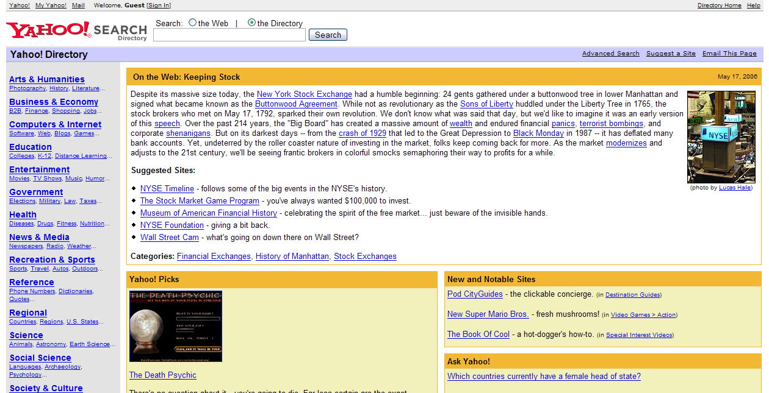
An Examination Of Yahoo! Directory
Yahoo! is one of the best known Websites in the world. According to Alexa.com, Yahoo! is ranked #1 in the world of all Internet traffic.

Slide 18
History of Yahoo!
Yahoo!, another web giant, was founded in 1994 by Stanford Electrical Engineering doctorate students David Filo and Jerry Yang. It started as a hobby to keep track of personal interests on the Internet. This system evolved into the Yahoo! Directory. In 1995, Yahoo! Incorporated was born.

Slide 19
History of Yahoo!
Yahoo!, like Google, had branched out with different Web markets tools and technology. Yahoo! Brands include the acquisitions of Broadcast.com, Launch.com (now Yahoo! Music), Geocities.com (personal home pages) and Flickr.com (photo sharing service).

Slide 20
History of Yahoo!
Even with all these services, Yahoo! is still the world’s best known Internet directory.

Slide 21
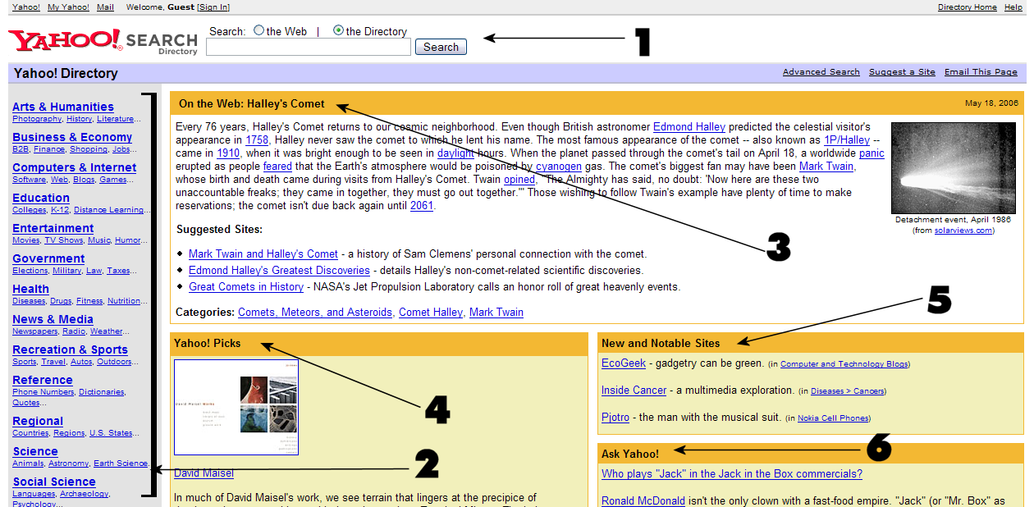
Breakdown of Yahoo! Directory
(dir.yahoo.com)
This is a shot of the Yahoo! Directory page. The following slides will explain the directory in more detail.

Slide 22
Breakdown of Yahoo! Directory
Query box for user to search the Internet or the Yahoo! Directory.
Listing of categories and subcategories of topics featured in the directory.
Subject of the day. For May 18, 2006, Yahoo! Chose to highlight Halley’s Comet. Along with a short summary of the subject, Yahoo! Suggested site with information on the subject and list categories related to the subject.

Slide 23
Breakdown of Yahoo! Directory
Yahoo! Picks – Sites and information chosen by the Yahoo! Staff.
A listing of new sites added to the directory.
Ask Yahoo! – Question of the day answered by Ask Yahoo!, Yahoo!’s question and answer service. Questions asked and answered are usually trivia questions like “Why do all U.S. radio station call letters start with the letter W?”

Slide 24
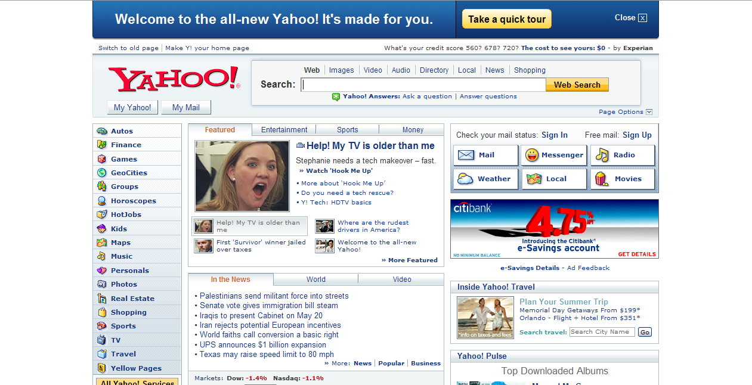
An Examination Of Yahoo! Portal
Yahoo! has morphed from a directory to offering a portal on the main Yahoo! Page. The featured screen shot is of Yahoo!’s latest portal look.

Slide 25
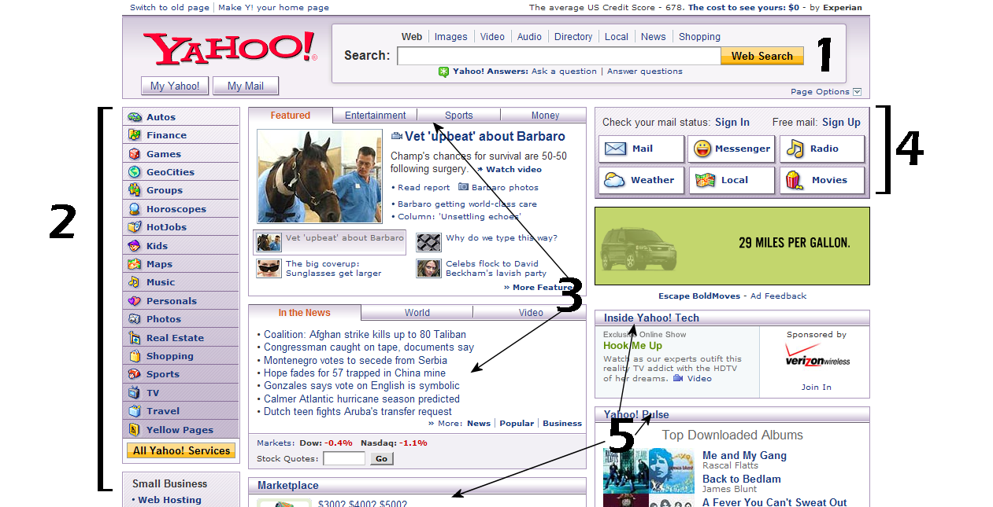
Breakdown of Yahoo! Portal
(yahoo.com)
This is a shot of the Yahoo! Portal page. The following slides will explain the directory in more detail.

Slide 26
Breakdown of Yahoo! Directory
Section for Web searching.
A small listing of all of Yahoo!’s services.
Portal information. These two sections contain tabs to the latest information in the News, Entertainment, Sports, Money, and Video sections.

Slide 27
Breakdown of Yahoo! Directory
Links to personalized Yahoo! services like mail and movie times.
Spotlights on more Yahoo! Services like Marketplace and Pulse.

Slide 28
Summary
Discussed the history and how to use Google search.
Discussed the history and how to use Yahoo!’s directory.
Discussed how to use Yahoo!’s portal page.

Slide 29
Resources
Baeza-Yates, Ricardo and Berthier Ribeiro-Neto. Modern Information Retrieval. New York, NY: Addison Wesley, 1999.
Poremsky, Diane. Google and Other Search Engines. Berkeley, CA: Peachpit Press, 2004.
“Google Milestones.” Google, Inc. Jan. 2006. 17 May 2006. <http://www.google.com/corporate/history.html>.

Slide 30
Resources
“The History of Yahoo! – How It All Started....” Yahoo! Inc. 2006. 18 May 2006. <http://yhoo.client.shareholder.com/press/history.cfm>.

