Slide 1
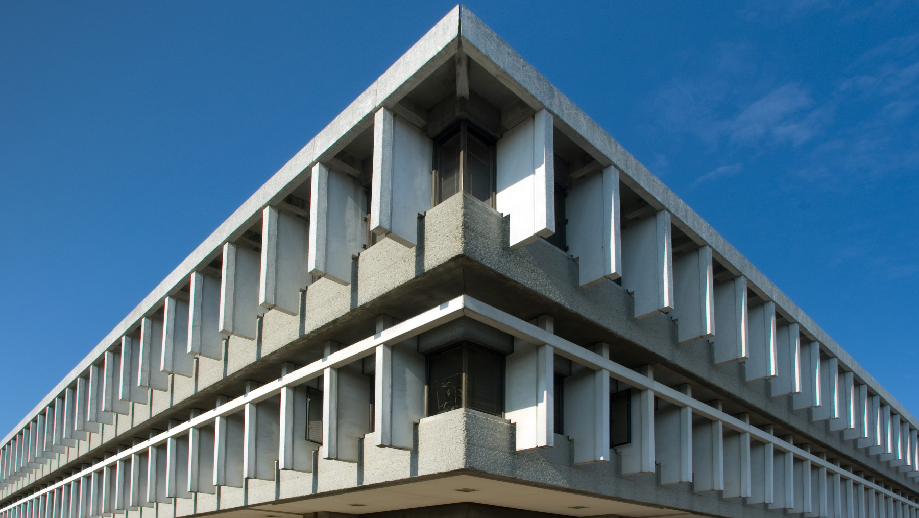

Lab Session 3
Vehicle Detection
CMPT742 - Fall 2018

Slide 2
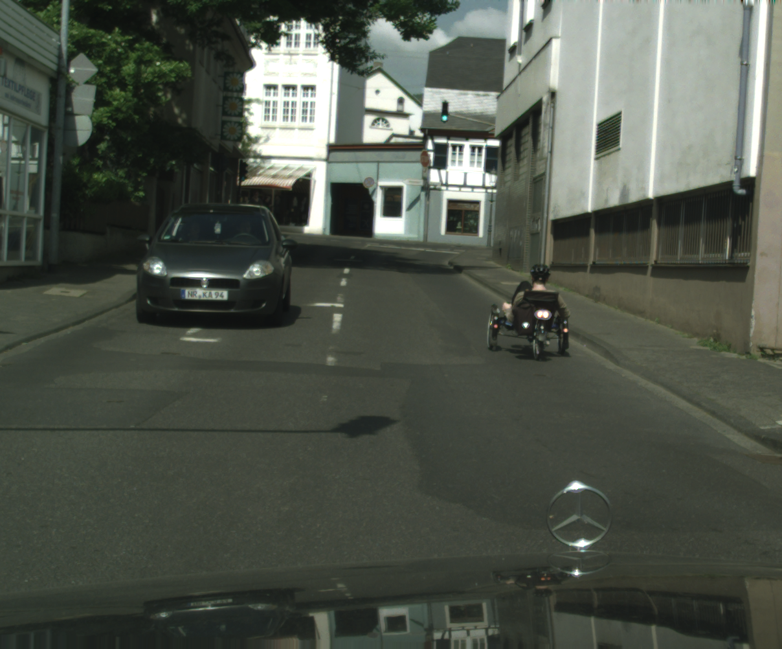
Lab Session 3: Overview
Task
input
Predicted

Slide 3
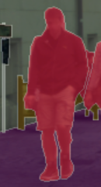
Cityscapes dataset overview
3475 annotated + 19998 extra annotated images
Class Definitions:
  Vehicle, Humans, Object etc.
Instance are segmented with polygons
  e.g.
  each instance is related to one class label

Slide 4
Prepare cityscapes dataset
1. We use extra dataset (19998 images)
2. Convert polygons to the bounding box
  Load the polygons from json, you can use python’s json lib by import json
  Compute the bounding box by finding the max and min of the polygon vertices position.
  Demo
3. Select ground-truth labels
  You can choose vehicles and human as the training positive samples, and the label index start from 1.
  Set the negative sample label to 0 important
4. Create the prior bounding box for each feature pixel
  When training, matching with the marked ground-truth bounding boxes and produce the training supervised labels.
  Detailed in following slides

Slide 5
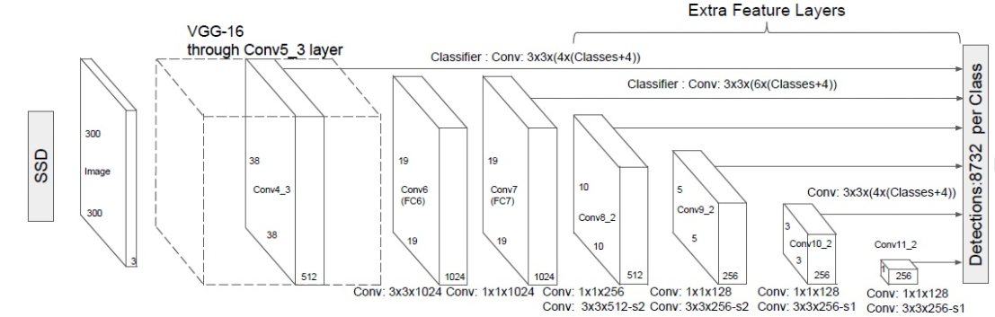
Run forward of SSD
Bounding Box Regressor and Classifier
basenet
Extra feature layers

Slide 6
Run forward of SSD
BaseNet: Originally use VGG16, but we use MobileNetV2 for fast computation
  MobileNetV2: https://arxiv.org/abs/1801.04381
  Implemented in mobilenet.py
  Load the pretrained model before training: pretrained/mobienetv2.pth
Added following additional layers:
  Extra feature extractor: Down-sampling the feature map with multiple levels, implement the sub-net self.additional_feat_extractor in ssd_net.py
  Bounding box regressor: Predicting the offset for the prior bounding, implement the sub-net self.loc_regressor in ssd_net.py
  Bounding box classifier: Predicting the confidence score for each class, implement the sub-net self.classifier in ssd_net.py

Slide 7
Run forward step by step
1. Run basenet forward from layer 0 to layer 11. Use module_util.forward_from()
2. Run bounding box regressor and classifier on the first feature layer. Refer to self.feature_to_bbbox()
4. Run bounding box regressor and classifier on second feature layer
5. Iterative forward the feature on extra layers and then run the bbox regress &classifier iteratively
3. Run basenet forward from layer 11 to layer 13.

Slide 8
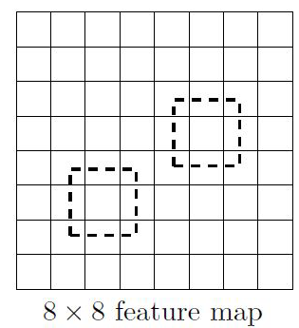
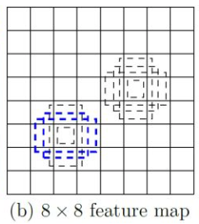
Training
1. Prepare Prior Bounding Box
  Generate preset bounding box
  Implement in generate_prior_bboxes() in bbox_helper.py
  Init the prior bounding box in dataloader, when loading the training data, matching the ground-truth bounding box with the prior defined bounding box and produce positive examples for supervised training, implement matching prior in match_priors(), see Matching strategy (SSD paper*, page 5) for reference.
6 preset bounding box with different
aspect ratio
Notes:
* Default box = prior box in paper

Slide 9



Training
2. Define the Loss function
  Hard Negative Mining: Balance the positive samples and negative samples. implemented in hard_negative_mining() in bbox_loss.py.
  Loss Function
  : Entropy loss of multi-label classification. Note the idx=0 is background (negative label).
  : regression loss of bounding box offset, the conversion (equation 2. in SSD paper) of predict box and ground-truth box are implemented in pred2real() and its inversion real2pred() in bbox_helper.py
alpha set to 1
Notes:
* Default box = prior box in paper

Slide 10
Testing
1. Normalize the classification output with F.softmax()
2. Implement NMS (Non-Maximum Suppression) for filtering out unnecessary bounding boxes and compute the best overlap bounding box for each object.
  Implement your code in NMS() in bbox_helper.py
  Tip: You can first filtering out some samples that has low probability and retain the high probability bounding box prediction, then do the NMS() to accelerate the computation.
Notes:
* Default box = prior box in paper

Slide 11
Summary: Skeleton Code Structure
bbox_helper.py
  prior bounding box (default box) generating,
  matching with ground truth box to produce training samples
  nms for filtering out unnecessary predicted bounding boxes
bbox_loss.py
  Hard Negative Mining reduce the mount of negative samples and balance the positive and the negative set.
  Multibox loss measures the matched boxes and labels with predicted ones.
cityscape_dataset.py
  Init Prior bounding box when start
  When feeding the training samples, match the ground-truth box with prior boxes and produce the matched ground-truth boxes for training.
mobilenet.py
  basenet for feature extraction
ssd_net.py
  forward process, produce regressed bounding box offset and confidence score of each class.
Notes:
* Default box = prior box in paper

Slide 12
Access GPU Cloud
We have GPU cloud with 7 GPUs, you can access those GPU service by ssh, and transfer files with sftp:
Please schedule your task with other groups, there are only 7 GPU cards available.
You can only access those workstation with CSIL workstations.
Full dataset will be available at /home/dataset
Currently online:
gpu1 (Nvidia Titan XP, 12G): ssh -p 221 userid@gpu.sfucloud.ca
gpu2 (Nvidia Titan XP, 12G): ssh -p 222 userid@gpu.sfucloud.ca
gpu3 (Nvidia Titan XP, 12G): ssh -p 223 userid@gpu.sfucloud.ca
gpu4 (Nvidia Titan XP, 12G): ssh -p 224 userid@gpu.sfucloud.ca
Currently is under maintaining:
gpu5 (Nvidia GTX1080TI, 11G): ssh -p 225 userid@gpucloud.cs.sfu.ca
gpu6 (Nvidia GTX1080TI, 11G): : ssh -p 222 userid@gpucloud.cs.sfu.ca
gpu7 (Nvidia GTX1080TI, 11G): ssh -p 223 userid@gpucloud.cs.sfu.ca
Notes:
* Default box = prior box in paper

