Slide 1

Precise Indoor Localization
(PinLoc*)
*Planned for deployment in Duke’s Nasher Art Museum

Slide 2

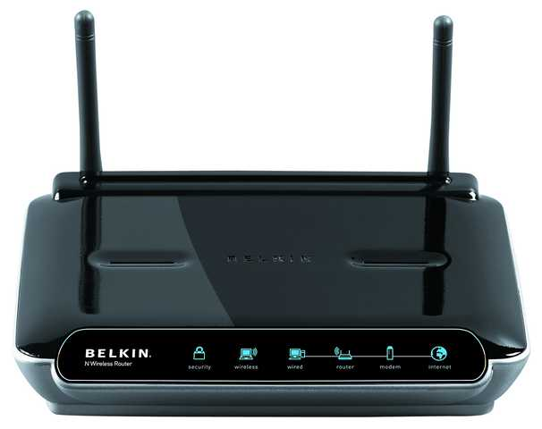


Slide 3

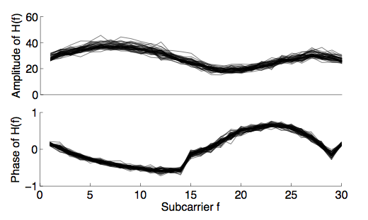
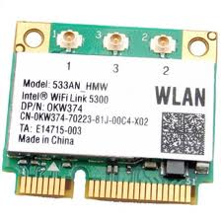
Fingerprinting Wireless Channel
802.11 a/g/n implements OFDM
Wideband channel divided into subcarriers
Intel 5300 card exports frequency response per subcarrier
1 2 3 4 5 6 7 8 9 10 39 48
Frequency subcarriers

Slide 4
Is WiFi Channel Amenable to Localization?
Two key hypotheses need to hold:
Temporal
Channel responses at a given location may vary over time
However, variations must exhibit a pattern – a signature
1.
2.
Spatial
Channel responses at different locations need to be different

Slide 5
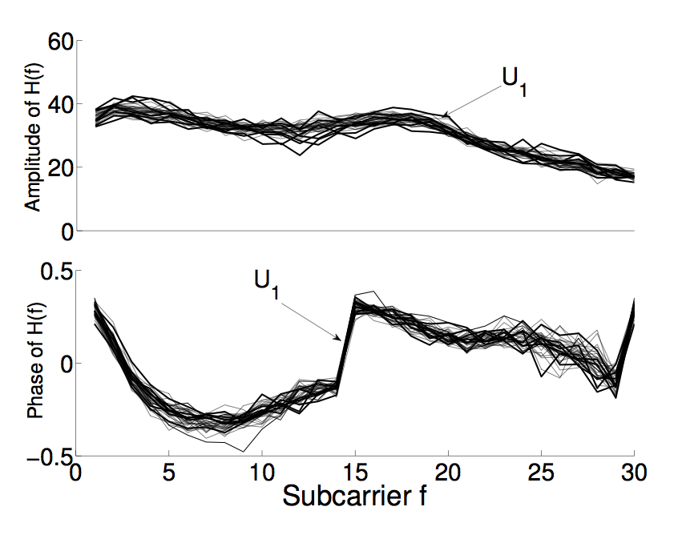
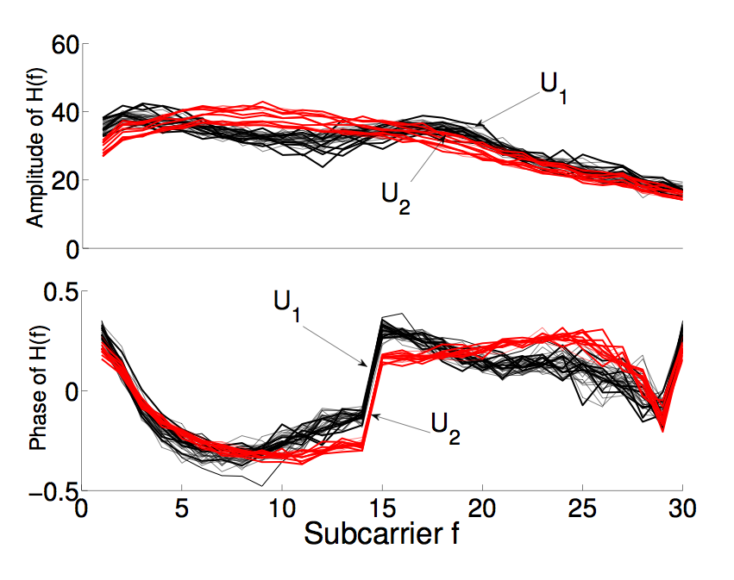
Variation over Time
Measured channel response at different times
Using Intel cards
cluster1
cluster2
cluster1
cluster2
Observe: Frequency responses often clustered at a location
But not necessarily one cluster per location

Slide 6
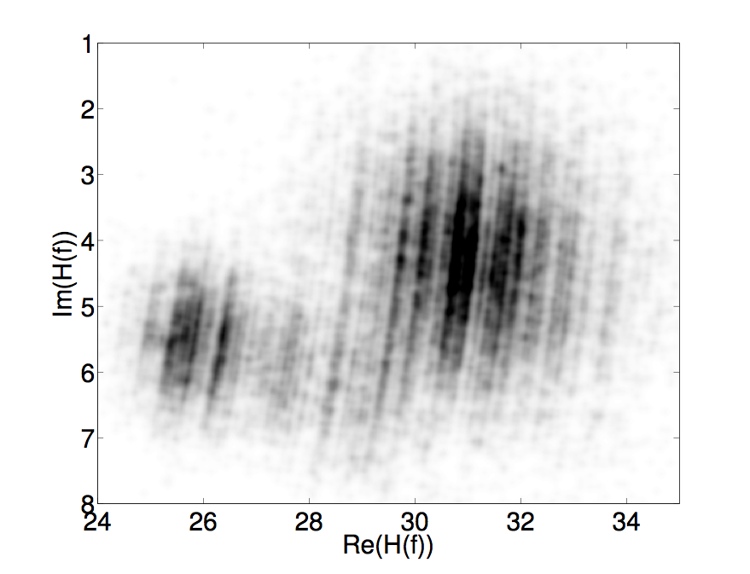
Variation over Time
Measured channel response at different times
Using Intel cards
2 clusters with different
mean and variance
cluster1
cluster2
cluster1
cluster2
But not necessarily one cluster per location

Slide 7
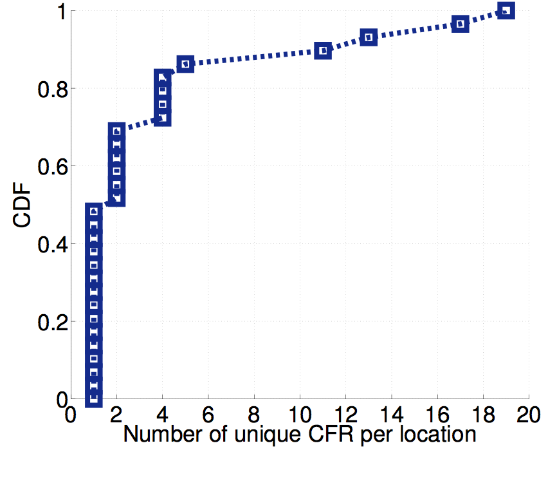
How Many Clusters per Location?
Do all 19 clusters occur
with same frequency?
Unique clusters per location

Slide 8
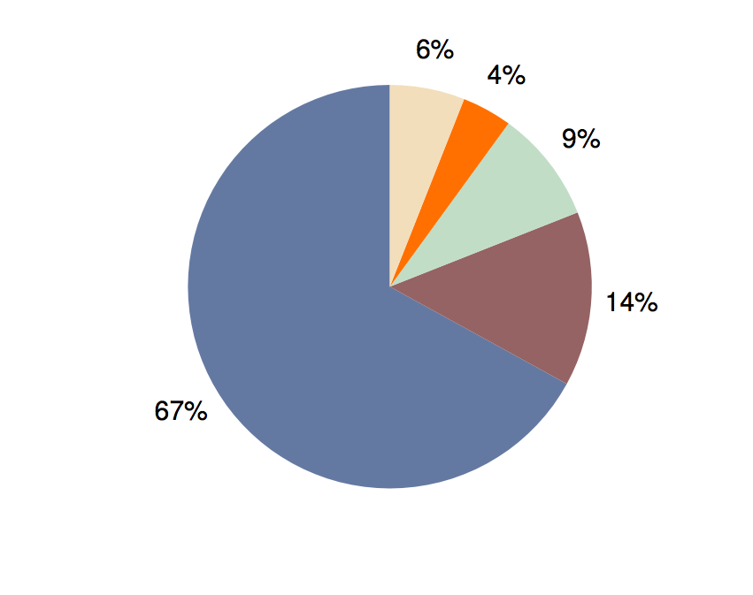
Cluster Occurrence Frequency
Others
4th
3rd
2nd
most
Most
frequent
cluster
Unique clusters per location
3 to 4 clusters heavily dominate, need to learn these signatures

Slide 9
Is WiFi Channel Amenable to Localization?
Temporal
Channel responses at a given location may vary over time
However, variations must exhibit a pattern – a signature
1.
Clusters with different
mean and variance
Location Signature
2.
Spatial
Channel responses at different locations need to be different

Slide 10
What is the Size of a Location?
Localization granularity depends on size
RSSI changes in orders of several meters (hence, unsuitable)

Slide 11
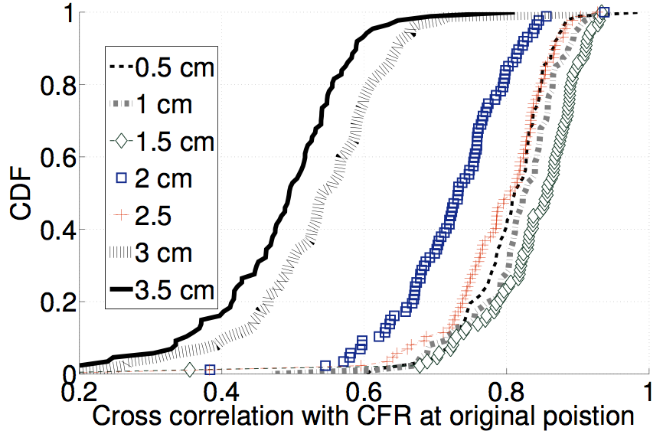
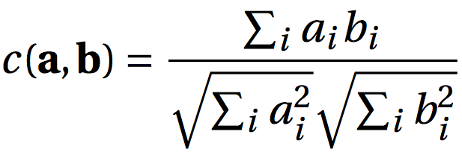
What is the Size of a Location?
Localization granularity depends on size
RSSI changes in orders of several meters (hence, unsuitable)
3 cm apart
2 cm apart
Cross correlation with signature at reference location
Channel response changes every 2-3cm
Define “location” as 2cm x 2cm area, call them pixels

Slide 12
But …
Will all pixels have unique signatures?
>
Max ( )
Self
Similarity
Cross
Similarity
Pixel 1
Pixel 2
Im (H(f))
Pixel 3
Real (H(f))

Slide 13
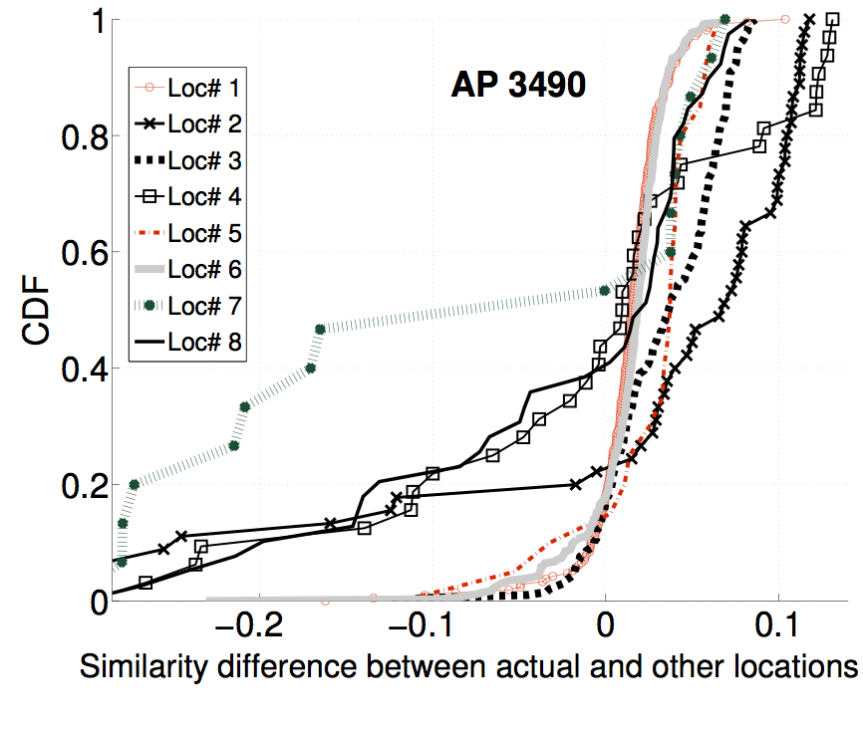
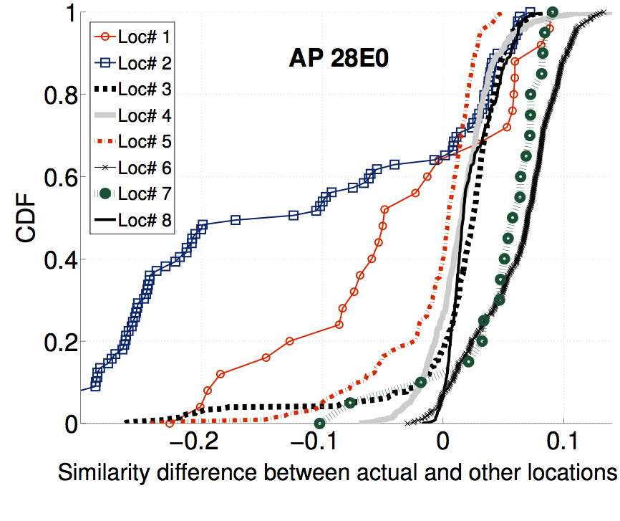
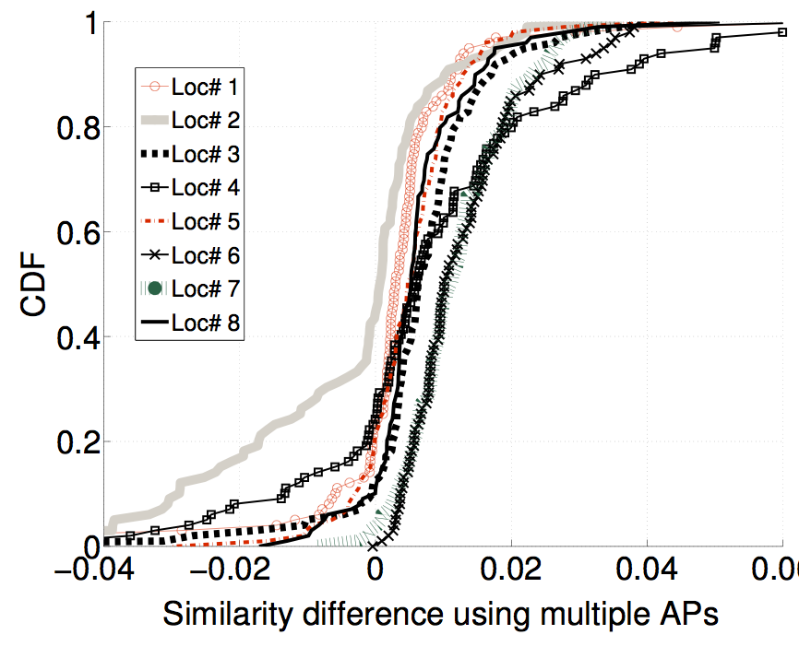
For correct pixel localization:
>
Max ( )
0
Self
Similarity
-
Cross
Similarity
AP1
AP2
AP1 and AP2
Self – Max (Cross)
Self – Max (Cross)
Self – Max (Cross)
67% pixel accuracy even with multiple APs

Slide 14
67% accuracy inadequate …
can we improve accuracy?
Opportunity:
Humans exhibit natural (micro) movements
Likely to hit several nearby pixels
Combine pixel fingerprints into super-fingerprint

Slide 15
From Pixels to Spots
2cm
Pixel
Spot
Combine pixel fingerprints from a 1m x 1m box.
Intuition: low probability that a set of pixels
will all match well with an incorrect spot

Slide 16

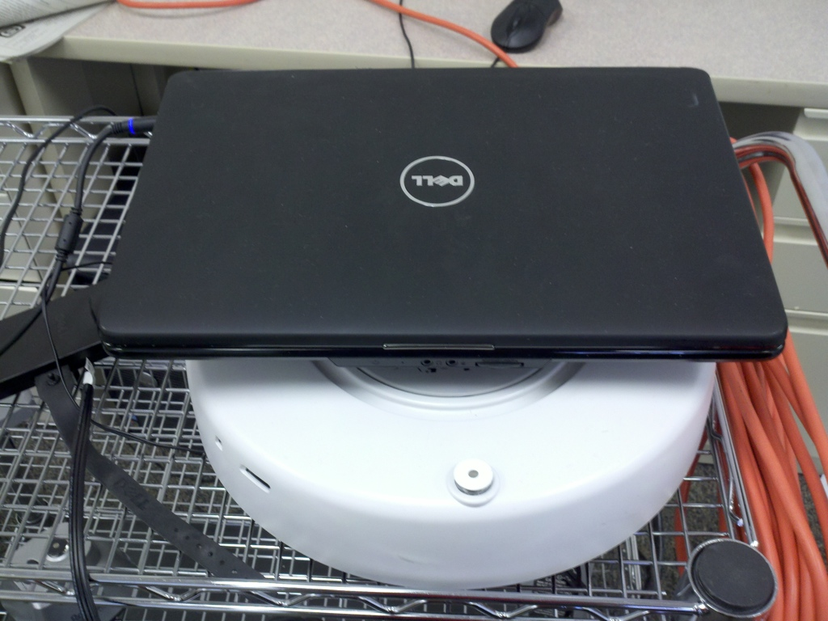
PinLoc Evaluation
Evaluated PinLoc (with existing building WiFi) at:
Duke museum
ECE building
Café (during lunch)
Roomba calibrates
4m each spot
Testing next day
Compare with Horus (best RSSI based scheme)

Slide 17
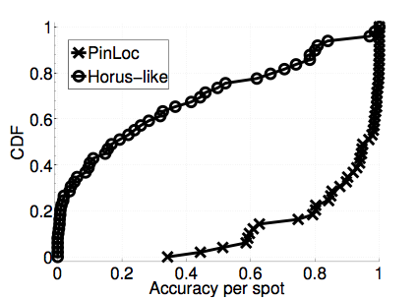
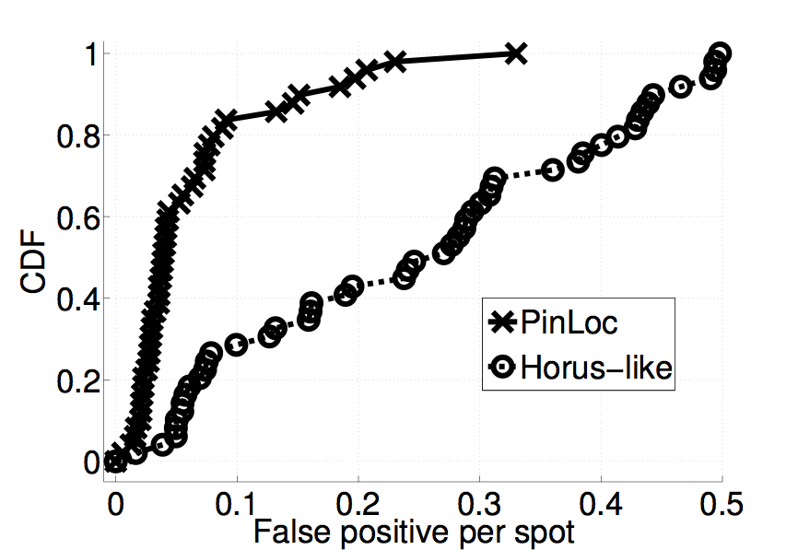
Performance
90% mean accuracy, 6% false positives
WiFi RSSI is not rich enough, performs poorly - 20% accuracy
Accuracy per spot
False positive per spot

