Slide 1
Smartphone Positioning Systems material from UIUC, Prof. Romit Roy Choudhury

Slide 2
Motivation
Sudden growth in smartphone industry
Localization technology caught unprepared
Industry viewing location as “address” for content delivery

Slide 3
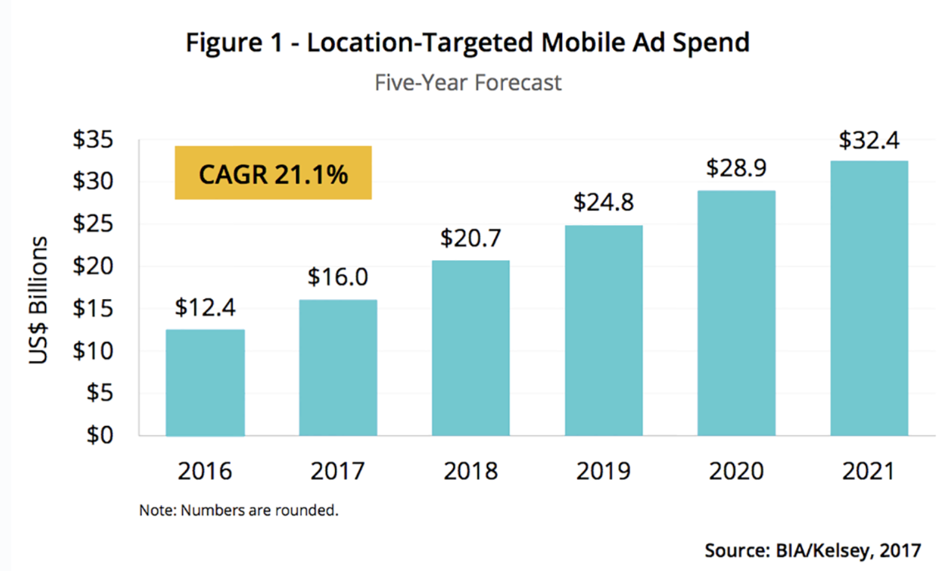
Motivation
Sudden growth in smartphone industry
Localization technology caught unprepared
Industry viewing location as “address” for content delivery
Localization based advertising dollars grew from $12 billion in 2016 to $32 billion in 2021, climbing to 45 percent of overall mobile ad revenue by 2020, reports local marketing and analyst firm BIA Kelsey

Slide 4
Isn’t today’s technology,
such as GPS, adequate?

Slide 5




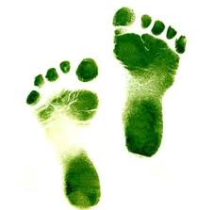
Apps
Information about paintings in museums
Targeted ads in Starbucks, Wal-mart
Access files only from this room
Walking directions in shopping malls
Reminders when passing a library

Slide 6
Apps
Information about paintings in museums
Targeted ads in Starbucks, Wal-mart
Access files only from this room
Walking directions in shopping malls
Reminders when passing a library
.
.
Information about visible objects (augmented reality)

Slide 7

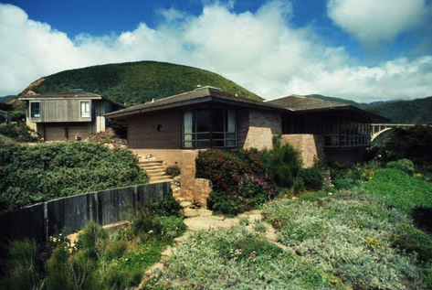

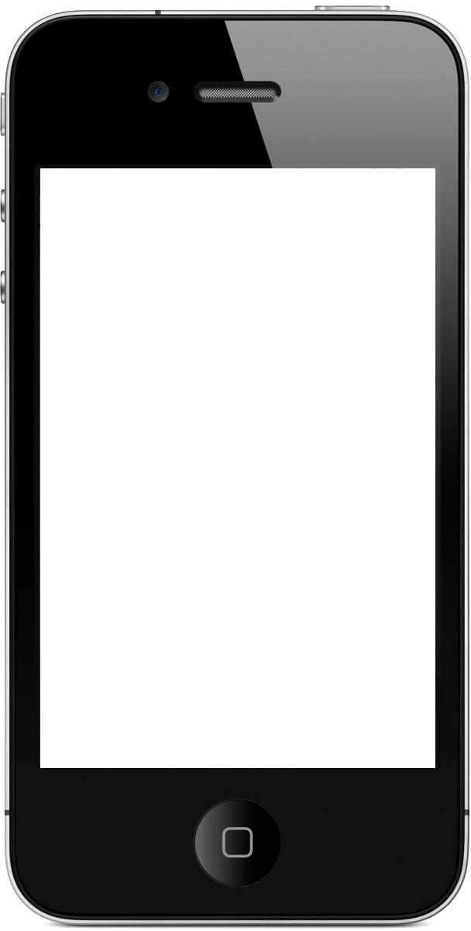
$7.8M
I wonder how much it costs to live there!
207 Coast Road

Slide 8


Enabling Technology
Apps
Localization

Slide 9
Enabling Technology
Apps
Localization
1. Outdoor Continuous
2. Indoor Semantic
3. High Precision Indoor
4. Object localization

Slide 10
Enabling Technology
Constraints
Accuracy
Energy
Calibration
Infrastructure
Apps
Localization
1. Outdoor Continuous
2. Indoor Semantic
3. High Precision Indoor
4. Object localization

Slide 11
Enabling Technology
Constraints
Accuracy
Energy
Calibration
Infrastructure
Apps
Localization
1. Outdoor Continuous
2. Indoor Semantic
3. High Precision Indoor
4. Object localization
Software
Hardware
GPS
WiFi
Inertial / Mag. Sensors
Camera
Mic.

Slide 12
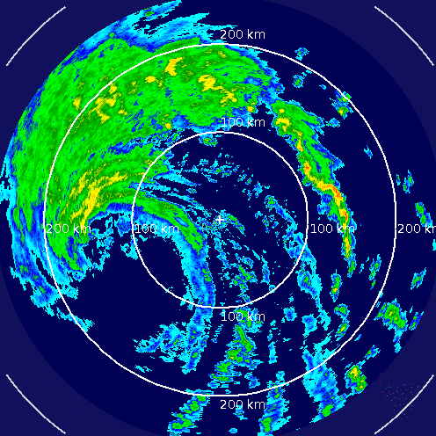
RADAR: An In-Building RF-based User Location and Tracking System

Slide 13
The Idea

Slide 14
Overview
Main Goal:
Locate/Track users INSIDE a building
Method:
Recording/Processing signal strength
Overlapping Coverage → triangulation
Motivation:
Location aware services/applications

Slide 15
Previous Work
Focused on IR
Limited range
Does not allow for traditional transmitting of data (aka limited to just locating people)
Scales poorly
Installation/maintenance limitations
Authors argue that RF solves problems above (range, scalability, deployment, maintenance)

Slide 16
Methodology

Slide 17
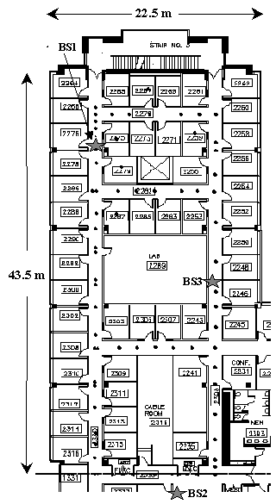
Building Floor Layout
Figure 1: Floor Layout
Figure Notation
Black Dots = locations where empirical signal strength info was collected
Large Stars = Base Stations (BS)
Orientation – North (up); East (right)
Ranges
Open along hallways w/ base stations (200m)
Closes elsewhere (25m)
Base stations overlap in parts and cover the entire floor

Slide 18
Key Idea
Use signal information
Training Phase
Construct/validate models for signal propagation
Real-Time Phase
Infer location of user

Slide 19
Data Collection Process for training
Synchronize clocks on mobile host (MH) & BS
MH broadcasts UDP packets
BS records SS at (t, x, y, d)
Time stamp (t); direction user is facing (d); location (x,y)
If off-line, user indicates location by clicking map on floor
Signal strength varies w/i a single location based on d
SS in each of the 4 d’s at 70 (x,y)

Slide 20
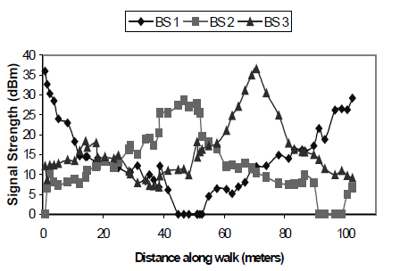
Signal Strength
Why?
Need accurate SS to help determine location
How?
Stronger signal = closer to BS
Modeling (see next slide)
Figure 2: Signal strength recorded at the BS as the user walks around the floor.

Slide 21
Model 1: Experimental

Slide 22
The Empirical Method
Empirical
Use the data points gathered from training phase to construct search space for NNSS
Nearest Neighbor (NNSS)
User sends SS and t
Search previous data for (x,y,d) that corresponds
assumes user is stationary

Slide 23
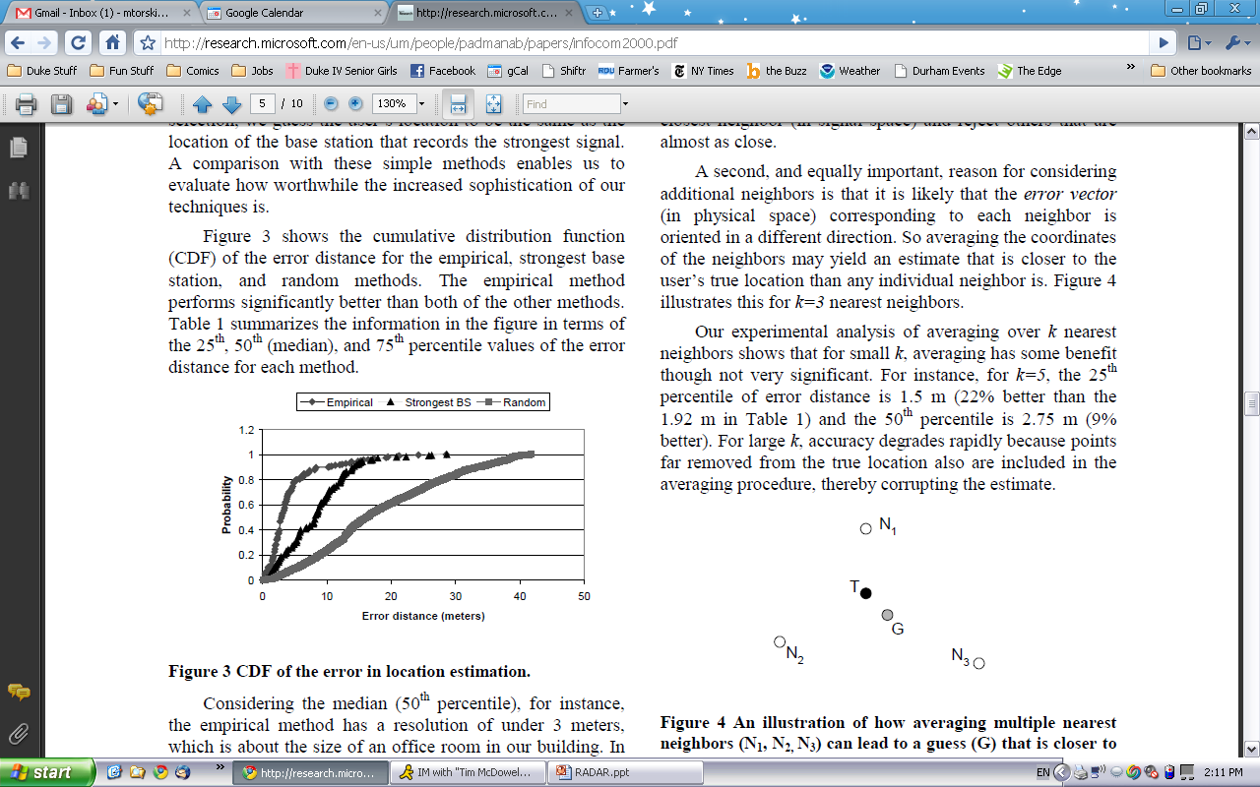
Location Estimate Error
Figure 3: CDF of error distance for different location methods

Slide 24
Multiple Nearest Neighbors
Do not limit to just nearest data point (neighbor)
Expand to k neighbors
May not work well
Next closest “neighbors” may be same (x,y) but different d
Small k → <2m change
Big k → bad estimate
If ignore d, could work for small k, but still not significant enough
Figure 4: Example of how multiple nearest neighbors can be more accurate (k=3)

Slide 25
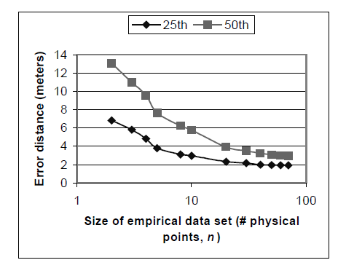
Number of Data Points
Accuracy of 40 points ~= that of 70 points
Also better if points are uniformly distributed
Figure 6: Error Distance as a function of data points
x-axis scaled logarithmically

Slide 26
Mobile User Tracking
4 SS samples/second
Sliding window of 10 samples to compute mean SS
19% worse than that of stationary

Slide 27
Limitations of Empirical Method
Long time to gather all the empirical data
1 floor*= (70 locations) · (4 directions) · (20 samples)
No one wants to collect all that data for a whole office building
If BS moves, have to recollect all the data
~=*1000 square meters

Slide 28
Model 2: Radio Propagation (theoretical)

Slide 29
The Radio Propagation Method
Create a search space for NNSS (to be used in the same way as before)
Reduce dependency on empirical data
How?
Model of indoor signal propagation
Compute (theoretically) SS data (similar to empirical) for locations (x,y) spaced uniformly along the floor
Performance of method dependent of accuracy of model

Slide 30
Challenges to Creating Model
Have to account for free-space loss / loss due to obstructions
Multipath Phenomenon
Signal arrives at user through multiple paths
Depends on layout of building, construction material, number/type of objects in the building
Each building is different
If a wall (etc) moves, has to be recalculated

Slide 31
Chosen Model
Floor Attenuation Factor propagation models
Accommodates different building layouts
Accounts for large-scale path loss
Adaptations
Do not care about attenuation due to floors
Instead focus on walls
Esp. between transmitter and receiver
Wall Attenuation Factor (WAF)
Testing “suggests that the entire system can be relocation to a different part of the building, but the same parameter values can be used” (p 9)

Slide 32
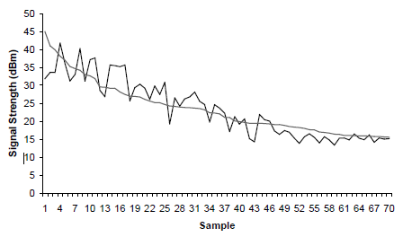
Propagation Model v. Empirical
Not as good as empirical
Better than Strongest BS and Random Methods
Figure 9: Predicted verses measured signal strength

Slide 33
Final Thoughts

