Slide 1
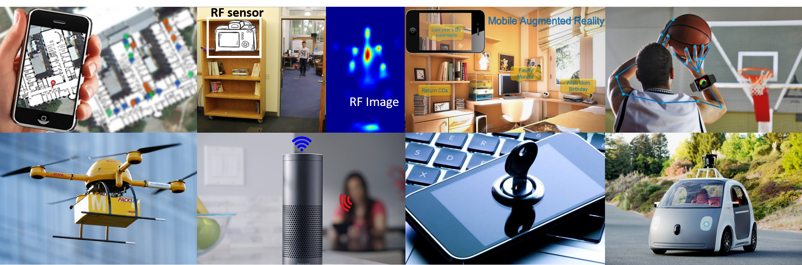
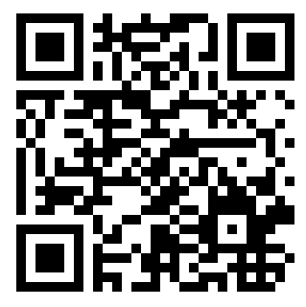
CSE/EE 597: Wireless and Mobile Sensing in the age of IoT
Course Description: This course introduces students to state-of-the-art research on Internet of Things (IoT), with a focus on wireless networking and mobile sensing. Topics include:
  GPS and localization
  Gesture and emotion sensing
  Smart Environments: Drones, sports, and vehicular analytics
  Acoustics sensing and communication
  Robotic wireless networks
  Augmented and virtual reality
  Security and privacy: sensor data leakage and inference
  Batteryless networking for IoT
Powerful and popular analytical techniques from linear algebra, signal processing, and machine-learning relevant to the applications will be discussed. Examples techniques are Trilateration, 3D Dead Reckoning, Orientation tracking, HMM, Viterbi Decoding, Doppler, Maximum Likelihood. Overall, the course would help students to develop skills to create novel applications from wireless and mobile sensor data, and apply mathematical concepts to real world problems through a semester long project.
Prerequisites: Basic familiarity with probability, linear algebra, programming is expected. However, the course is mostly self-contained with introductory materials on math basics, and signal processing. An android tutorial may be presented. Android/iOS experience is a plus, but not required.
Grading: Paper reviews (15%), Class presentation (10%), Midterm (25%), Project (50%)
Time and location: Tuesday and Thursday 4:35 to 5:50pm, Sackett B 108
Office hours: Tuesday and Thursday - after class
Instructor: Mahanth Gowda (mahanth.gowda@psu.edu)

