Slide 1

Anomaly detection using Deep Learning
to positively empower enterprise with the INSIGHTS needed to win
https://github.com/shawnmccarthy/anomalydetection
https://github.com/shawnmccarthy/anomalydetection/projects/1

Slide 2

Agenda
1. |  | Big Picture | 05:00
2. |  | Problem Statement | 05:00
3. |  | Schedule | 05:00

Slide 3
Big Picture Anomaly detection
Problem
>
Finding patterns that do not adhere to what is considered normal
Business could lose millions of dollars due to abnormal events (e.g. data breach, identity theft)
Account take over of your bank or retirement accounts
Water line breaks
Flight delay
The Solution
>
Explore Boltzmann machines, LSTM, and TCN models to detect anomalies in a broad range of business use cases (credit card, market data)
Survey memresitive hardware architecture advances
Survey evolutionary architecture approach to Neural Networks

Slide 4
Traditional methods of anomaly detection
Data science / Statistics – Supervised
Isolation Forest – Unsupervised anomaly detection
One-Class Support Vector Machine (SVM) – Semi-supervised
Local Outlier
Notes:
- Data Science – regression models we can look at past data and use it to predict future target – linear regression for example, xgboost classifiers
Isolation forest – collection of individual tree structures that recursively partition the datset; data set is split randomly – anomalies generally form shortest path from the root than the normal data points
-The Local Outlier Factor (LOF) algorithm finds outliers by measuring the local deviations to a given data point. The algorithm is based on a concept of local point density. The density is described by distance to the k-nearest neighbors.
- One Class SVN- well suited for novelty detection – train on normal data and then use that to detect anomalies

Slide 5
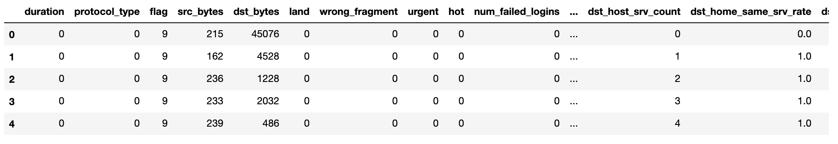
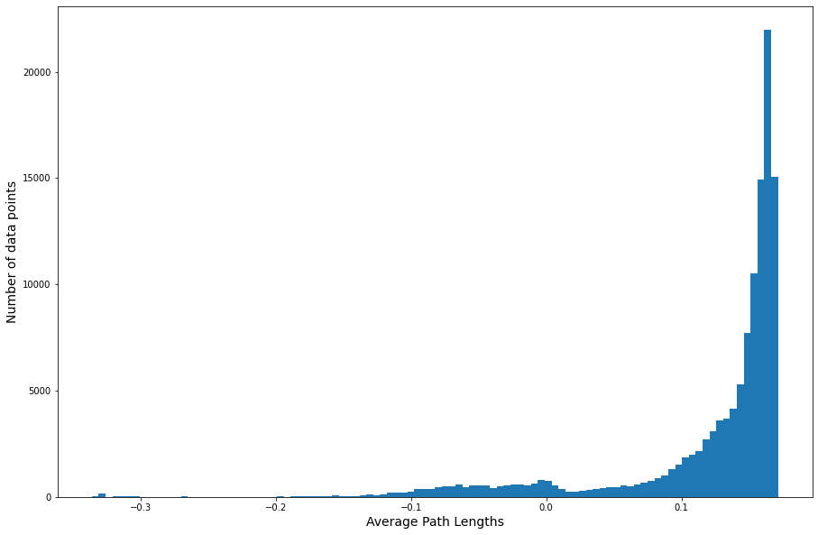
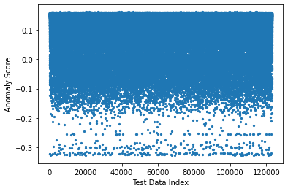
Isolated Forest
Anomalous data (shorter paths)
Data: kddcup.data.gz
Goal: Identify “Bad” connections in a network trace
Good for multidimensional data (here we have 41 columns)
100 trees in forest
Notes:
isolates anomalies using binary trees
Isolation forest works on the principle of the decision tree algorithm. It isolates the outliers by randomly selecting a feature from the given set of features and then randomly selecting a split value between the maximum and minimum values of the selected feature
It is a tree-based algorithm, built around the theory of decision trees and random forests. When presented with a dataset, the algorithm splits the data into two parts based on a random threshold value. This process continues recursively until each data point is isolated
The algorithm has a linear time complexity with a low constant and a low memory requirement

Slide 6

Schedule
Week | Topic | Output
1 | Traditional methods of Anomaly detection Chapters 1-2 | Schedule
2/3 | Boltzmann Machine | Anomaly detection Credit Card data www.Kaggle.com/mlg-ulb/creditcardfraud/version/3
4/5 | LSTM Models | Anomaly detection data Stock Macro and Sector data
6/7 | TCN Models | Anomaly detection data Credit Card Data
8/9/10 | Deep Learning Classifiers with memrisitive networks Memrisitve LSTM Architectures (Chapter 12) Survey of Memresisive Techniques Deep Learning with Darwin: Evolutionary Synthesis of Deep Neural Networks https://link.springer.com/article/10.1007/s11063-017-9733-0#:~:text=These%20experimental%20results%20show%20that,networks%2C%20and%20thus%20a%20promising DarwiNN: Efficient Distributed Neuroevolution under Communication Constraints · https://dl.acm.org/doi/pdf/10.1145/3377929.3390007?casa_token=vFygoCv-G4wAAAAA:qSG1hisR3p4xckobQhVxfHX7sZ9tfLdqvBVdkI8Hdgb9T7RN4wdYvBHFWf47RRAOVZ7a8n5fMI8 | Survey Presentation
Notes:
Boltzmann Machine – Special type of bidirectional neural network comprised of only hidden nodes and input nodes, designed to learn probability distribution of a dataset - what is unqiie is that every node is interconnected (e.g. hidden layer is connected to each other)
LSTM – Recurrent neural network attempts to model time or sequence dependent data; builds on RNN adding a memory component to propagate learned data at time T to the future
TCN – One dimensional convolutional layers – these are ausal no information from future is leaked into the past – because of this parallel computing

Slide 7
Schedule
Week | Topic | Output
11/12/13 | Using Deep Learning and Evolutionary Algorithms for Time Series Forecasting · https://www.lume.ufrgs.br/bitstream/handle/10183/189125/001086994.pdf?isAllowed=y&sequence=1 Time Series Forecasting using Evolutionary Neural Network · https://citeseerx.ist.psu.edu/viewdoc/download?doi=10.1.1.402.5337&rep=rep1&type=pdf | Survey Presentation
14 | Fall Break
15/16 | Final Proposal for Ongoing Research | Final Presentation Ongoing Research Topic

Slide 8
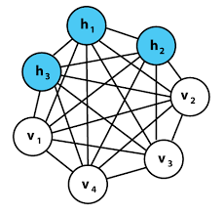
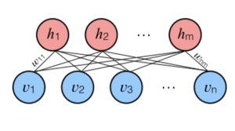
Restricted Boltzmann machine
Unsupervised
Automatically extract meaningful features
Use only the inputs for learning
RBM are unidirectional probabilistic graphical models containing a layer of observable variables and a single layer of latent variables
Restricted because no connection between variables in observed or between latent
Notes:
In a nutshell, the goal of the learning process is to find a set of weights that will minimize the energy. However, the Boltzmann machine’s architecture is resource-demanding. Since every neuron is connected to every other neuron, calculations can take a long time. That is why Restricted Boltzmann Machines (RBM) came into the picture.
A generative unsupervised models, which involve learning a probability distribution from an original dataset and using it to make inferences about never-before-seen data
The Restricted Boltzmann machines are one alternative concept to standard networks that open a door to another interesting chapter in deep learning – the deep belief networks. Their simple yet powerful concept has already proved to be a great tool. It is used in many recommendation systems, Netflix movie recommendations being just one example
We have a visible layer of neurons that receives input data which is multiplied by some weights and added to a bias value at the hidden layer neuron to generate output. Then the output value generated at the hidden layer neuron will become a new input which is then multiplied with the same weights and then bias of the visible layer will be added to regenerate input. This process is called reconstruction or backward pass. Then the regenerated input will be compared with the original input if it matches or not. This process will keep on happening until the regenerated input is aligned with the original input
Look like Generative Adversarial Networks have almost replaced RBMs; RBMs are good at Handling unlabeled data and extract important features from the input.

Slide 9
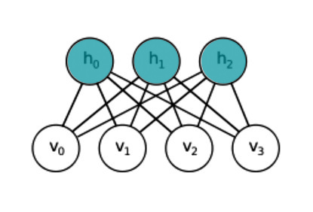

Energy function for RBM
where ai is the bias of the visible neuron i that is in state vi, bj is a bias of the hidden vector j that is in state hj and wij is the weight of the connection between neuron i and j
Notes:
Energy-Based Models (EBMs) They determine dependencies between variables by associating a scalar value to the complete system – Energy.

Slide 10
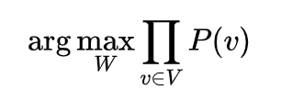
Training
Restricted Boltzmann machine are trained to maximize the product of probabilities assigned to a training set
We are maximizing the joint probability of every possible visible node with respect to the weights
Notes:
It learns from input, what are the possible connections between all these parameters, how do they influence each other and therefore it becomes a machine that represent our system in its normal state
Reconstruction is different from regression or classification in that it estimates the probability distribution of the original input instead of associating a continuous/discrete value to an input example. This means it is trying to guess multiple values at the same time. This is known as generative learning as opposed to discriminative learning that happens in a classification problem (mapping input to labels).
We can use this Boltzmann Machine to monitor our system

Slide 11
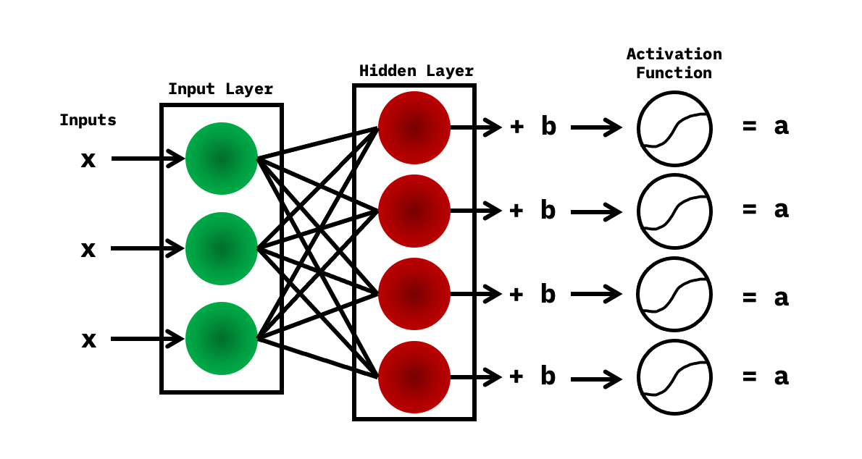
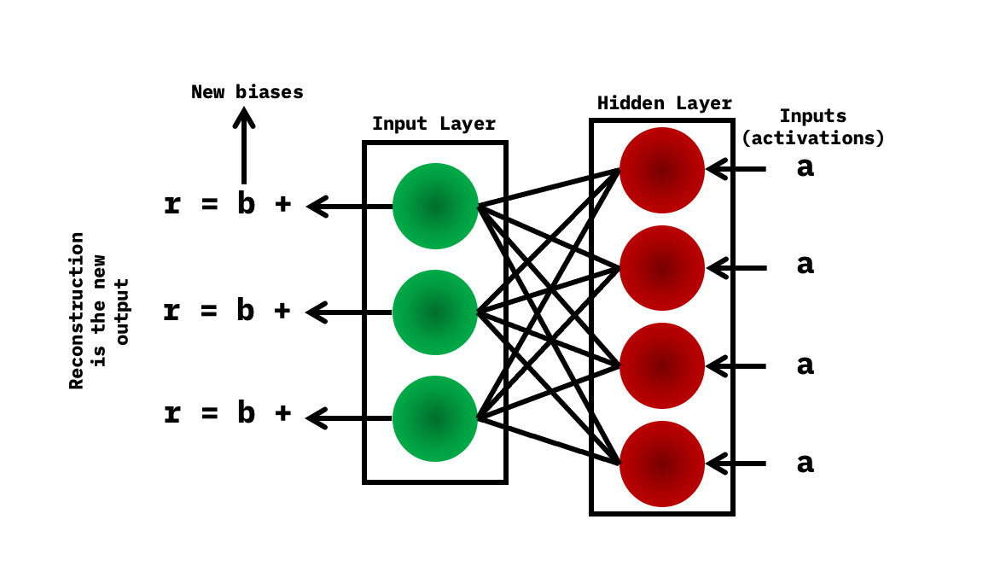
Two Steps
The inputs are taken into the input layer, multiplied by the weights, and added to the bias. After this, it goes through the activation function (sigmoid)
In reconstruction, you have the activations, which are the inputs at this point and are then passed to the hidden layer and then to the input later. After this, new biases are obtained, and the reconstruction is the new output
Notes:
Multiple inputs are considered to be the first step when training the neural network. The inputs are taken into the input layer, multiplied by the weights, and added to the bias. After this, it goes through the activation function (sigmoid), and the outputs decide whether the hidden state gets activated.
The weights in the neural network are in a matrix, where the number of input nodes is the number of rows, and the number of hidden nodes is the number of columns. The primary hidden node obtains the vector multiplication of the inputs, and is multiplied by the first column of weights before the corresponding bias term is added to it.

Slide 12
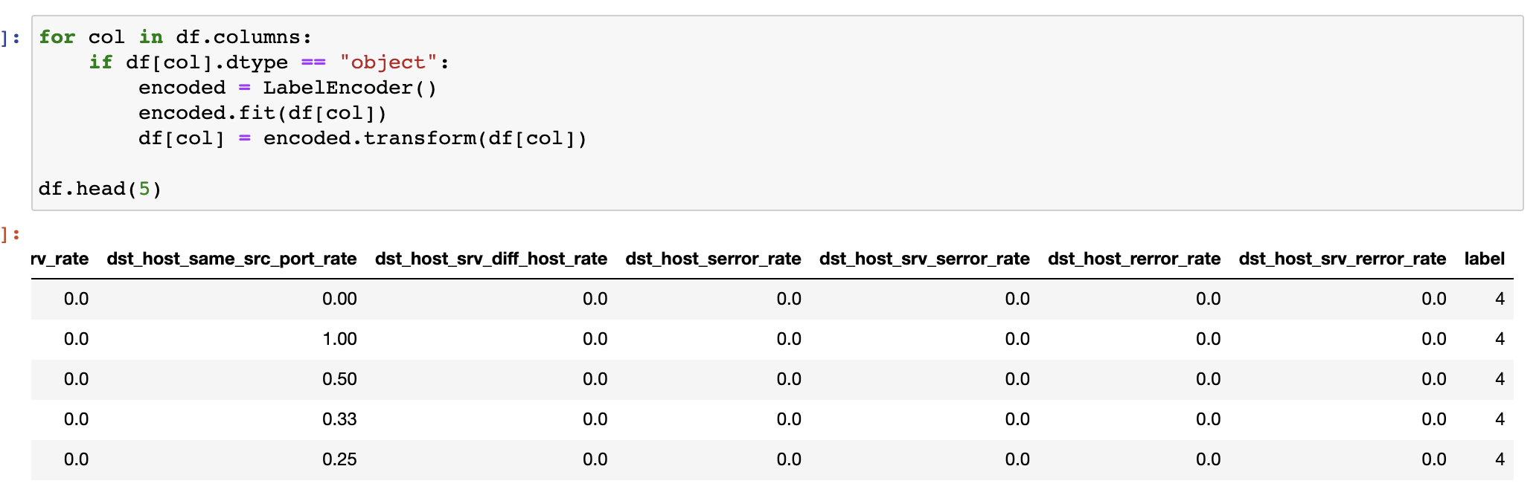
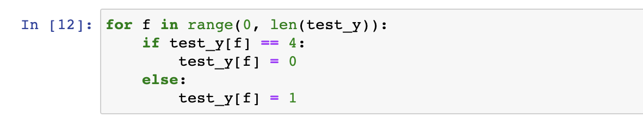
Data Cleaning: KDD

Slide 13
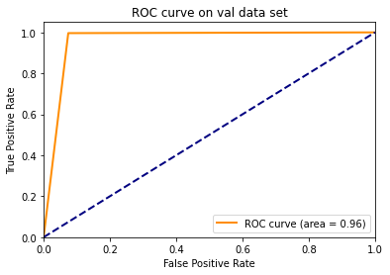
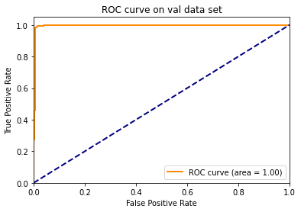
Comparison to traditional methods
Isolation Forrest
Restricted Boltzmann

Slide 14
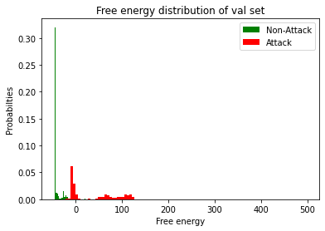
KDD
Clear separation between attack and non-attack HTTP packets

Slide 15
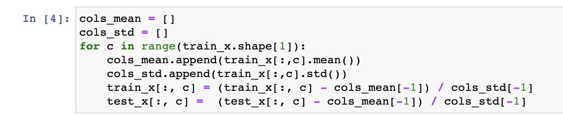
Data Cleaning: Credit Card
Time and Amount are the main ones

Slide 16
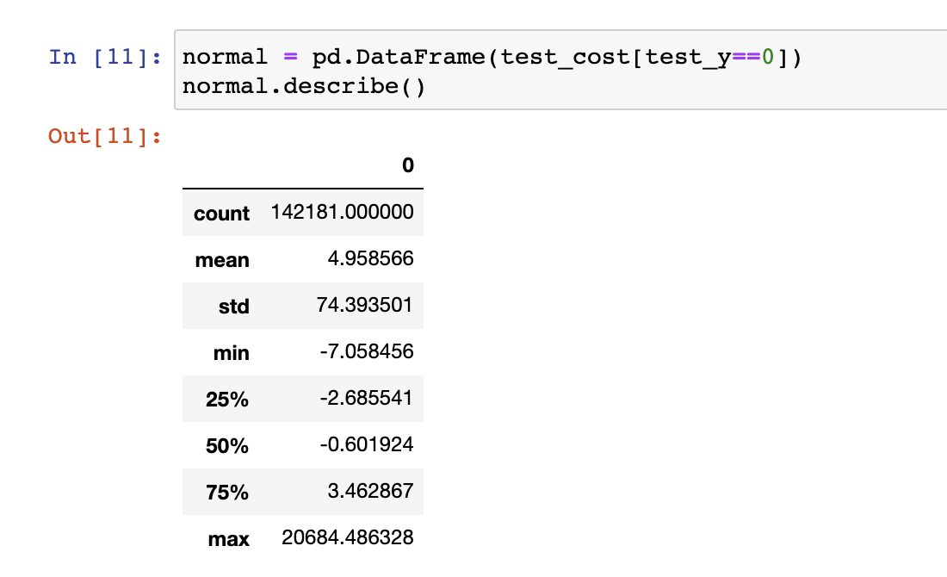
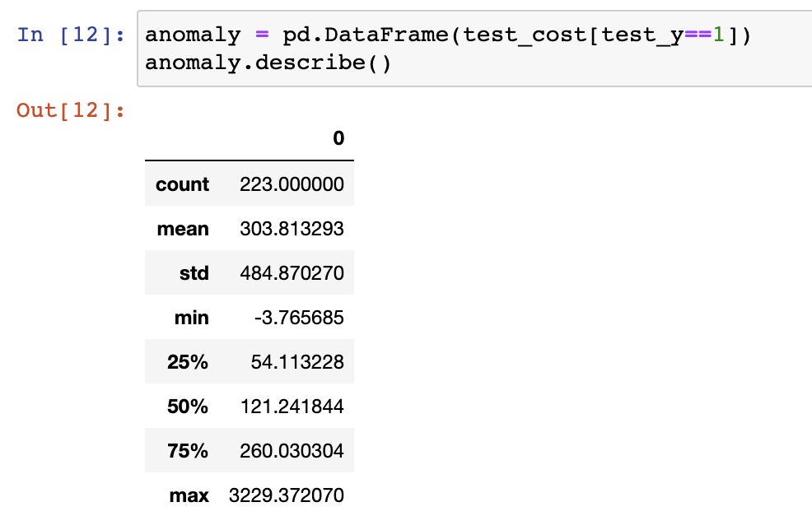
Credit Card data
Normal data right skewed
Most Anomalies below 500

Slide 17
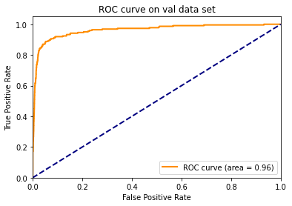
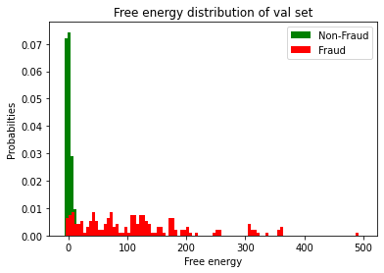
Credit Card data

Slide 18
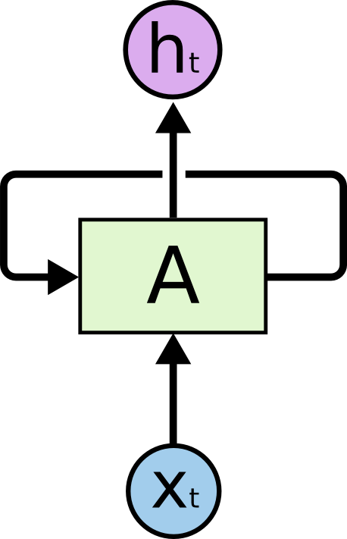
RNN
In the diagram, an element of neural network, A, receives input Xt and outputs a value Ht.
A loop allows information to be passed from one step of the network to the next.
Notes:
One of the appeals of RNNs is the idea that they might be able to connect previous information to the present task, such as using previous video frames might inform the understanding of the present frame

Slide 19
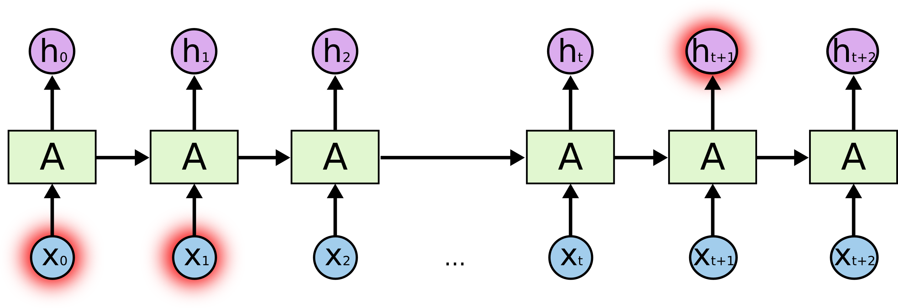
Problem with Long Gaps
Long Context - I grew up in France… I speak fluent French
Unfortunately, as that gap grows, RNNs become unable to learn to connect the information

Slide 20
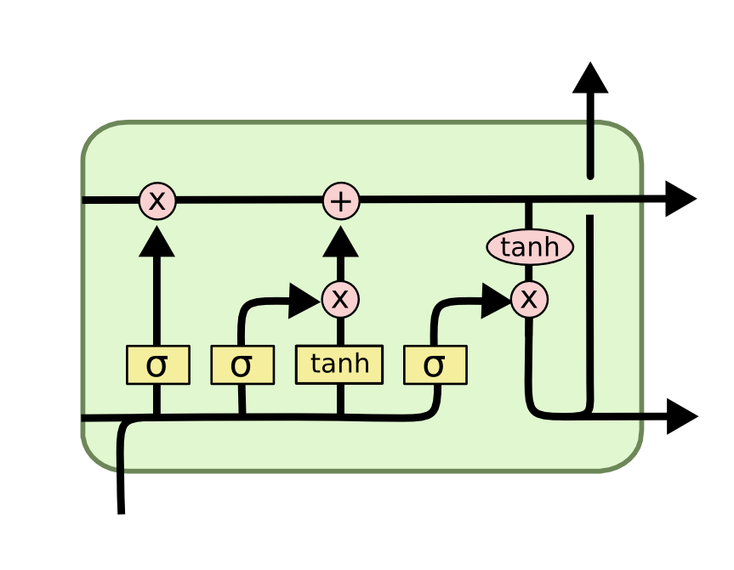
LSTM
LSTMs are a type of RNN that remember information over long periods of time
Capable for long periods
LSTMs are explicitly designed to avoid the long-term dependency problem

Slide 21
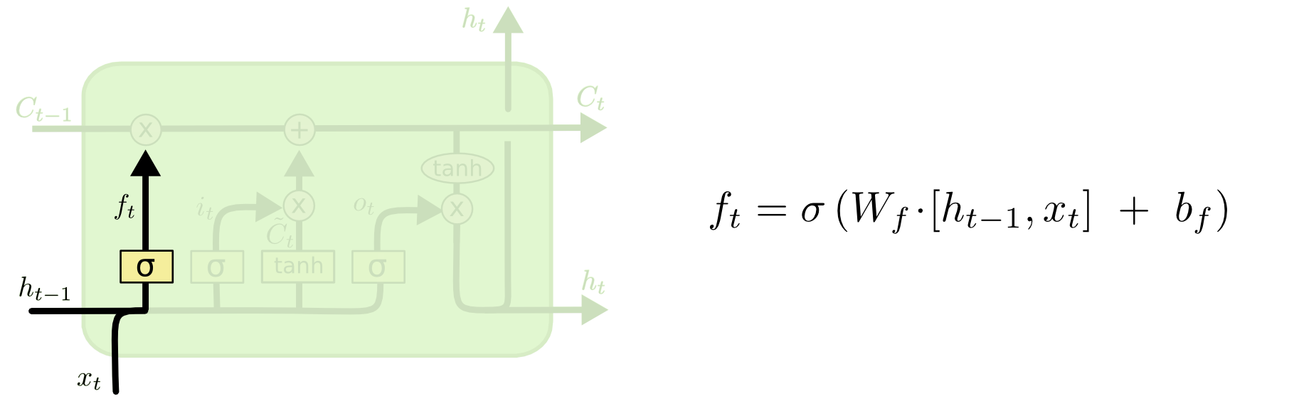
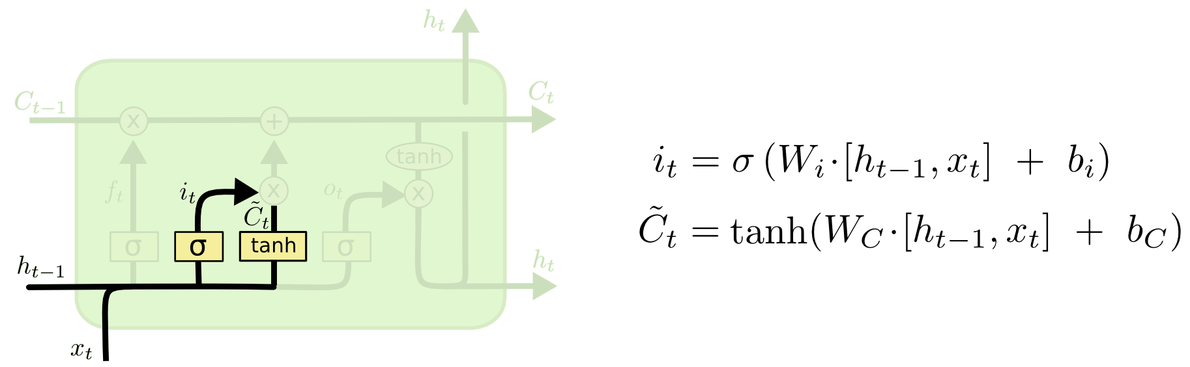
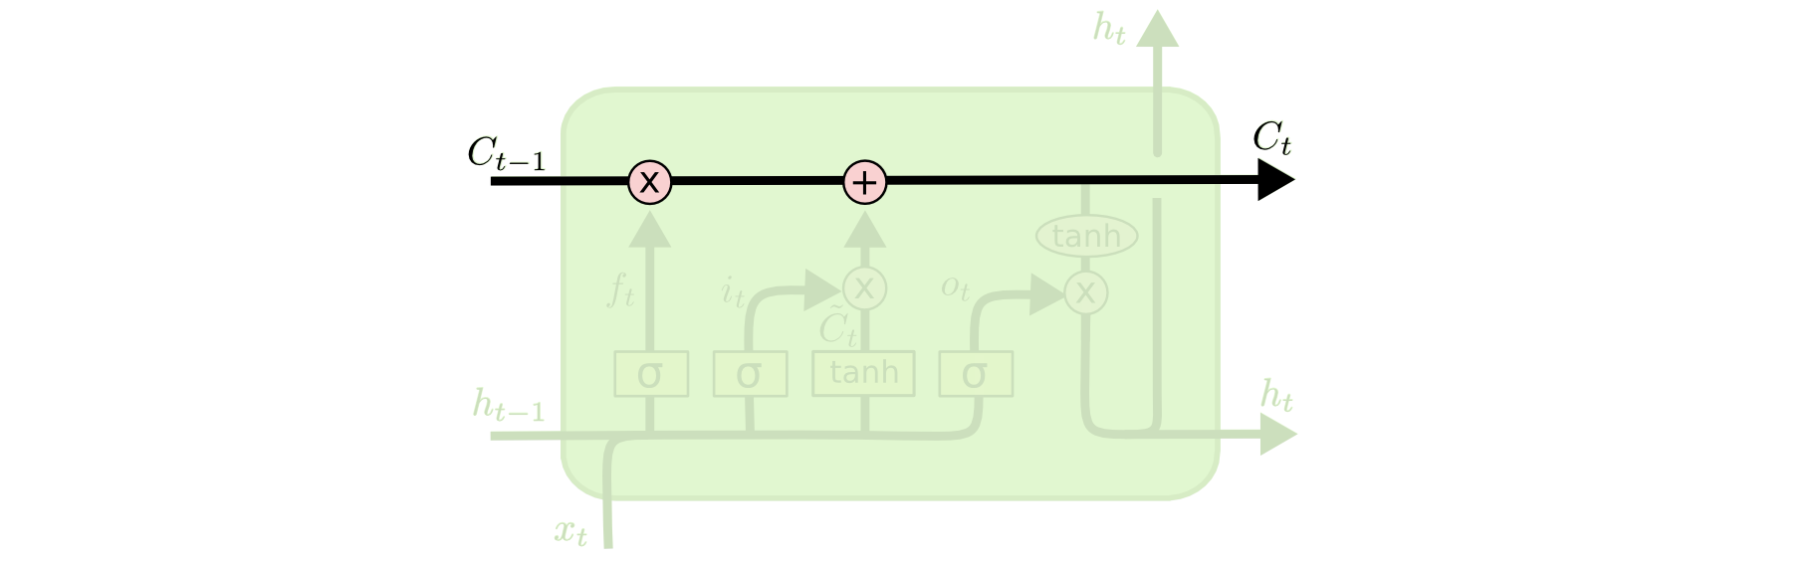
Ability to add or remove data
1. Decide what to forget (sigmoid layer)
2. Decide what to new information (sigmoid / tanh)
Notes:
It looks at ht−1ht−1 and xtxt, and outputs a number between 00 and 11 for each number in the cell state Ct−1Ct−1. A 11 represents “completely keep this” while a 00 represents “completely get rid of this.”
The next step is to decide what new information we’re going to store in the cell state. This has two parts. First, a sigmoid layer called the “input gate layer” decides which values we’ll update. Next, a tanh layer creates a vector of new candidate values, C̃ tC~t, that could be added to the state. In the next step, we’ll combine these two to create an update to the state.

Slide 22
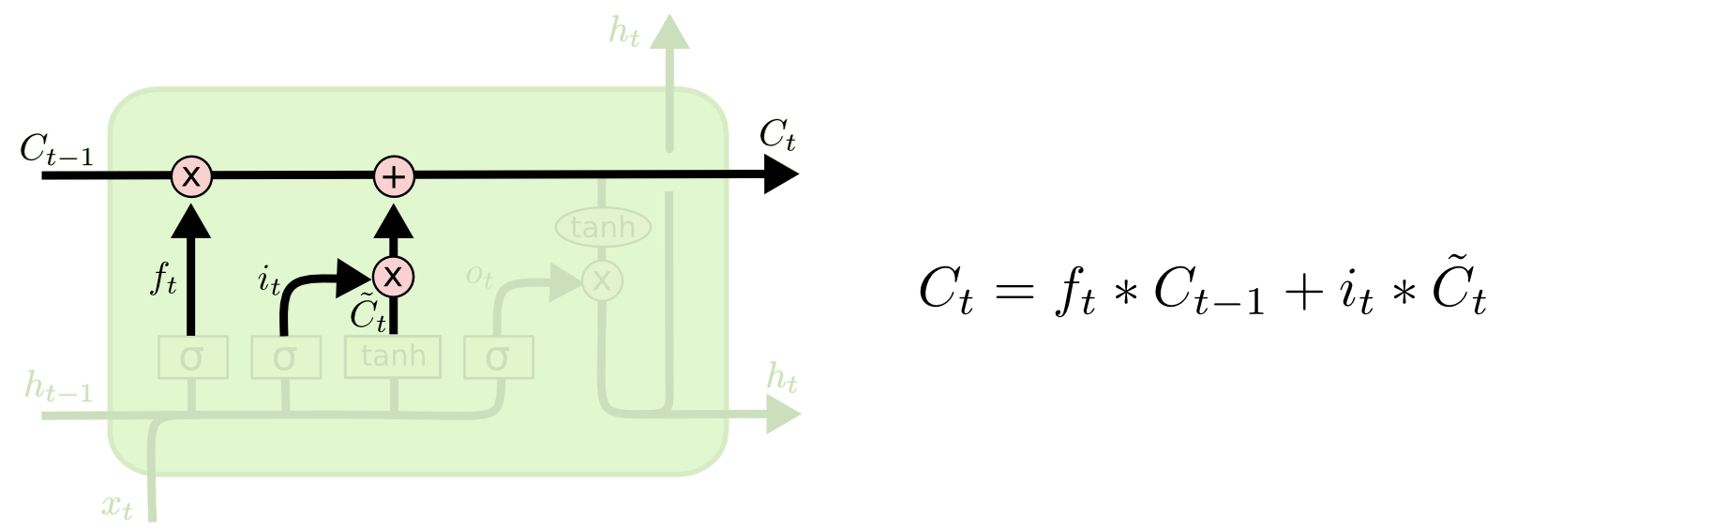
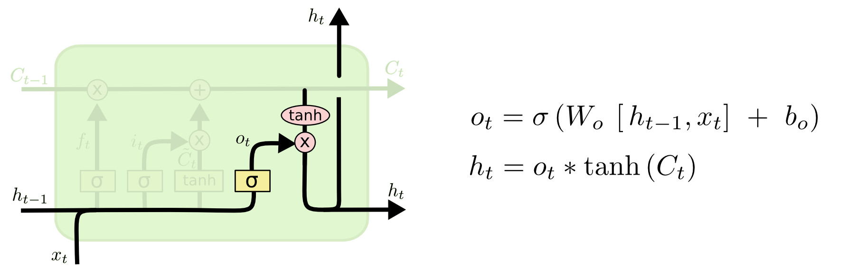
Update state Output
3. Update old cell state to new cell state
4. Output
Notes:
It’s now time to update the old cell state, Ct−1Ct−1, into the new cell state CtCt. The previous steps already decided what to do, we just need to actually do it.
Finally, we need to decide what we’re going to output. This output will be based on our cell state, but will be a filtered version

Slide 23
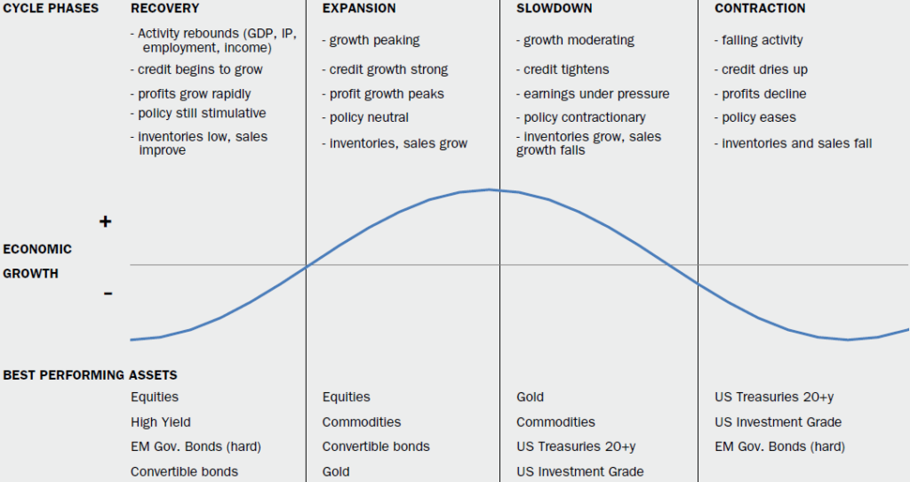
Problem statement prediction
Our approach seeks to identify shifting economic phase and provide a framework for making asset allocation decisions according to the probability that asset may outperform or underperform.
In intermediate-term how is asset performance driven by interest rates and inflation?
Can we determine sector performance based on the business cycle (early, mid, late, recession)?
Can we manage extrapolation bias (too much emphasis on recent price movements)?
Can we improve accuracy of phase identification?
Notes:
Over the intermediate term, asset performance is often driven largely by cyclical factors tied to the state of the economy—such as corporate earnings, interest rates, and inflation. The business cycle, which encompasses the cyclical fluctuations in an economy over many months or a few years, can therefore be a critical determinant of asset market returns and the relative performance of various asset classes.
Specifically, there are 4 distinct phases of a typical business cycle (see chart below):
Early-cycle phase: Generally a sharp recovery from recession, marked by an inflection from negative to positive growth in economic activity (e.g., gross domestic product, industrial production), then an accelerating growth rate. Credit conditions stop tightening amid easy monetary policy, creating a healthy environment for rapid margin expansion and profit growth. Business inventories are low, while sales growth improves significantly.
Mid-cycle phase: Typically the longest phase of the business cycle. The mid cycle is characterized by a positive but more moderate rate of growth than that experienced during the early-cycle phase. Economic activity gathers momentum, credit growth becomes strong, and profitability is healthy against an accommodative—though increasingly neutral— monetary policy backdrop. Inventories and sales grow, reaching equilibrium relative to each other.
Late-cycle phase: Often coincides with peak economic activity, implying that the rate of growth remains positive but slows. A typical late-cycle phase may be characterized as an overheating stage for the economy when capacity becomes constrained, which leads to rising inflationary pressures. While rates of inflation are not always high, rising inflationary pressures and a tight labor market tend to crimp profit margins and lead to tighter monetary policy.
Recession phase: Features a contraction in economic activity. Corporate profits decline and credit is scarce. Monetary policy becomes more accommodative and inventories gradually fall despite low sales levels, setting up for the next recovery.

Slide 24
Dataset – Federal reserve
Oil | Inflation | CPI | Dollar Index | GDP | Unemployment | Business Cycle
Table that shows all macro, all sector and broad asset classes
Crude Oil (https://fred.stlouisfed.org/series/DCOILWTICO) – 1986 - 2021
Dollars per barrel
Inflation (https://fred.stlouisfed.org/series/T10YIE) -2003 .- 2021
The latest value implies what market participants expect inflation to be in the next 10 years, on average
CPI (https://fred.stlouisfed.org/series/CPIAUCSL) - 1947 – 2021
A measure of the average monthly change in the price for goods and services paid by urban consumers between any two time periods. It can also represent the buying habits of urban consumer
Trade Weighted Dollar Index (https://fred.stlouisfed.org/series/DTWEXAFEGS) – 2006 – 2021
A measure of the US dollar to other world currencies
Real Gross Domestic Product (https://fred.stlouisfed.org/series/A191RL1Q225SBEA) – 1947 - 2021
Gross domestic product (GDP) is the value of the goods and services produced by the nation's economy less the value of the goods and services used up in production
Unemployment (https://fred.stlouisfed.org/series/UNRATE) – 1948 – 2021
The unemployment rate represents the number of unemployed as a percentage of the labor force
Recession Data (https://fred.stlouisfed.org/series/USREC) – 1854 – 2021
This time series is an interpretation of US Business Cycle Expansions and Contractions data provided by The National Bureau of Economic Research
Notes:
Key takeaways
The business cycle reflects the aggregate fluctuations of economic activity, which can be a critical determinant of asset performance over the intermediate term.
Changes in key economic indicators have historically provided a fairly reliable guide to recognizing the business cycle's 4 distinct phases—early, mid, late, and recession.
Our approach seeks to identify the shifting economic phases, providing a framework for making asset allocation decisions according to the probability that assets may outperform or underperform.
For example, the early cycle phase is typically characterized by a sharp economic recovery and the outperformance of equities and other economically sensitive assets.
This approach may be incorporated into an asset allocation framework to take advantage of cyclical performance that may deviate from longer-term asset returns.
A business cycle approach to asset allocation can add value as part of an intermediate-term investment strategy.

Slide 25
Sector data – Yahoo time series
Adding ETF sector data will provide insights on confirming the ETFs that perform better during a business cycle
https://finance.yahoo.com/etfs/
ETF | Sector
XLE (Energy Select) | Energy
GDX (Gold) | Gold Miners
XLB | Materials
DIA | Industrials
XLY | Consumer Discretionary
XLP | Consumer Staples
XLV | Health Care
XLF | Financials
XLK | Technology
IYZ | Telecommunication
XLU | Utilities
VNQ | Real estate
SPY | S&P 500

Slide 26
Data Shaping Complete Combined datasets only from 2004
Data is in timeseries for daily, monthly and quarterly so a combined dataset will need to be shaped into a daily time series across all dimensions (see macro and sector combined datasets)
Macro Economics
1986 – Current: OIL
2003 – Current: Inflation
1947 – Current: CPI
2006 – Current: Dollar Index
1947 – Current: GDP
1948 – Current: Unemployment
1854 – Current: Recession
Sector ETFS
1998 – Current
Energy
Materials
Industrial
Consumer Discretionary
Consumer Staples
Health
Financials
Technology
Utilities
2000 – Current: Telecommunications
2004 – Current: Real Estate
2006 – Current: Gold
*Data contains at least 2 business cycles for analysis

Slide 27
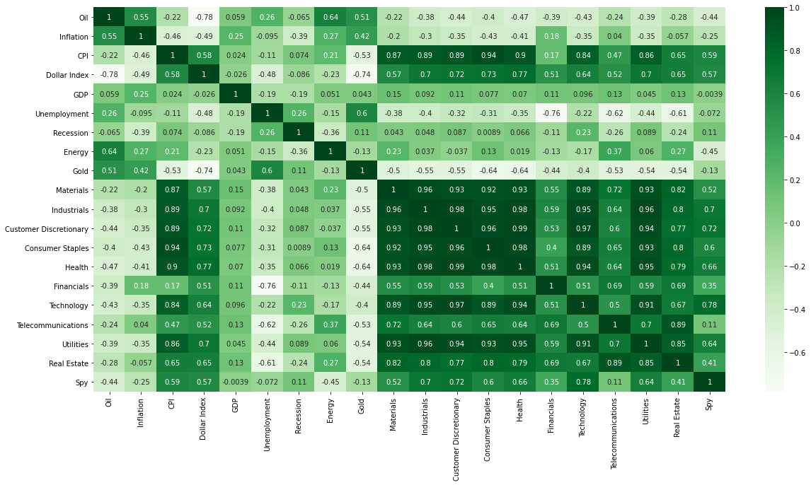
methods
Correlation
Customer Discretionary - Health (98%)
Customer Discretionary - Industrials (98%)
Industrials - Health (97%)
Technology - Customer Discretionary (97%)
Material - Dollar Index (56%)
Methods
LSTM
TCN
Notes:
First the data was explored from the combined data sources. First step in understanding the data is looking at the correlation.
Looking at these correlations we see the following top correlation between both Macro and Sector based ETFs:
Customer Discretionary Health 0.985486
Industrials 0.984891
Industrials Health 0.977034
With industrials, customer discretionary and health we look at plot data to see the relationship.

Slide 28
Lessons Learned Last time
Sector | Expand Before Peak | Peak | Contraction After Peak | Trough | Expansion After Trough
Real-estate | + | - | - | - | +
Technology | + | + | - | - | +
Industrials | + | + | - | - | +
Oil | - | + | + | - | -
Consumer | + | + | - | + | +
The biggest surprise in this analysis is the explainable AI features that drive importance of the business cycle over the last two cycles. This shows that the indicators of CPI, Technology, Real-estate, Industrials and Oil as being good indicators of overall analysis of the business cycle.
Notes:
A business cycle approach to asset allocation can add additional insights as part of a intermediate to longer term strategy. Although each business cycle is different, this analysis suggests that there is a cyclical pattern in the economy and performance in asset categories in the macro and sector do show some correlation.
The biggest surprise in this analysis is the explainable AI features that drive importance of the business cycle over the last two cycles. This shows that the indicators of CPI, Technology, Real-estate, Industrials and Oil as being good indicators of overall analysis of the business cycle.
Indicator
Description
CPI (Macro) Consumer price index measure changes in the price level of a weighted average market basket of consumer goods and services purchases by households
Technology (Sector) Price and yield performance of publicly traded equity securities of companies in the technology select sector index.
Real estate (Sector) Price and yield performance of publicly traded equity securities of companies that purchase office building, hotels and other real property.
Industrials (Sector) Tracks the stocks of some of the largest companies in the US economy; large CAP US equities (e.g. MSFT, BA, HD, AMGN, UNH, DIS, JNJ)
Oil (Macro) Crude oil prices
When combined with the analysis we see the relative performance therefore having business cycle insights can provide insights into more economically sensitive sectors as related to more defensively oriented sectors.
Early – expand before peak - Sectors that typically benefit most from low interest rates—such as consumer discretionary, financials, and real estate which we also see in our analysis
Peak – during this phase the technology stocks
Contraction shows that Oil and by proxy energy stocks to do
Recession shows that consumer staples tend to do better – where revenues are tied to basic needs
Expansion after trough matches the expand before peak
Economic researchers (Ibbotson et al.) state that economic factors influence asset prices, however there is still research required to determine the best way to incorporate economic factors into asset allocation approaches. The impact of the pandemic entered the US into a contraction after peak cycle that was not influenced by other economic factors. There is debate whether we should have eliminated that period from the analysis however it still provides valuable insights to the impact on sector and macro indicators. Today the problem with business cycle analysis is research centers such as NBER are not timely in their analysis (their last announcement of recession was a full 12 months after the fact). Leveraging the full AI model with the 12 data sources continues to predict that we are still in the contraction after peak phase of the business cycle. We believe with a disciplined business cycle approach that we can better predict the natural phases of the economy and better analyze the underlying factors and trends across various time horizons through the use of both macro and sector data sources.

Slide 29
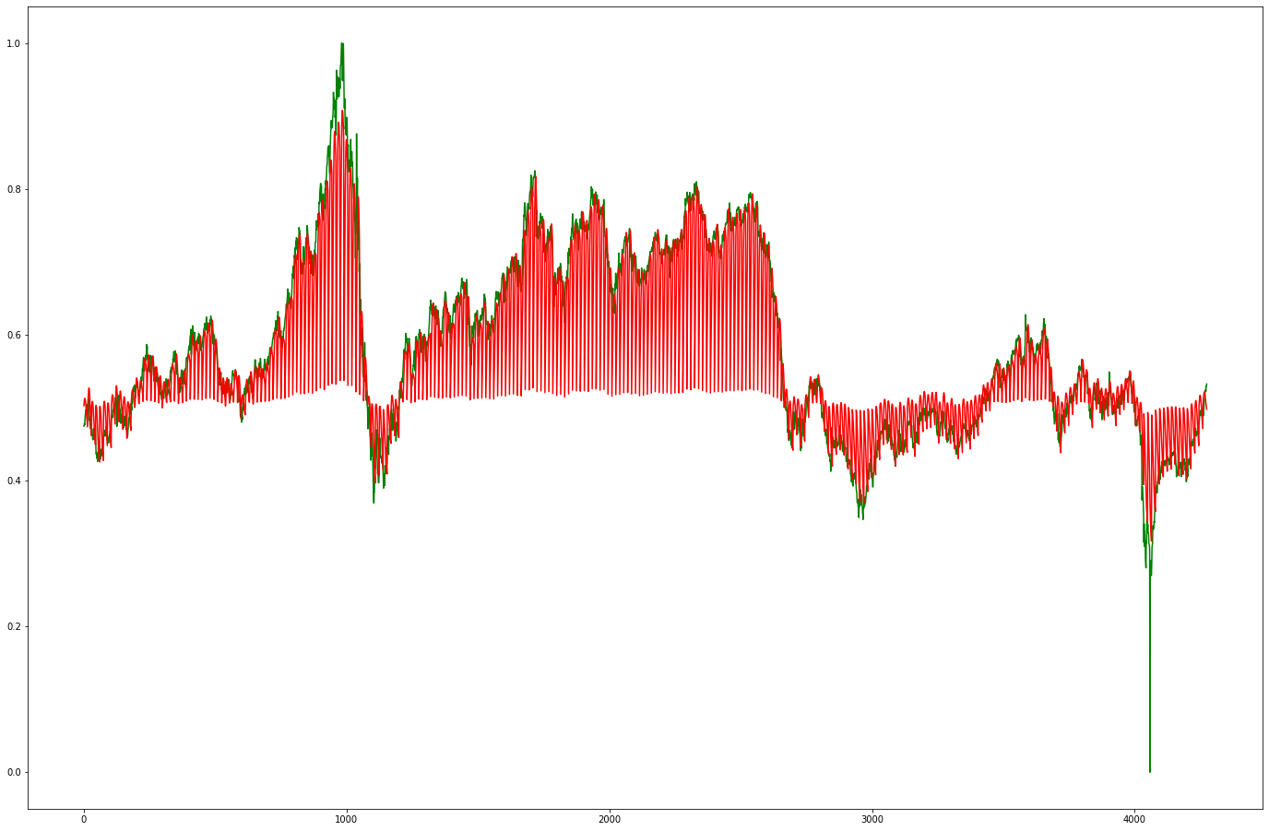
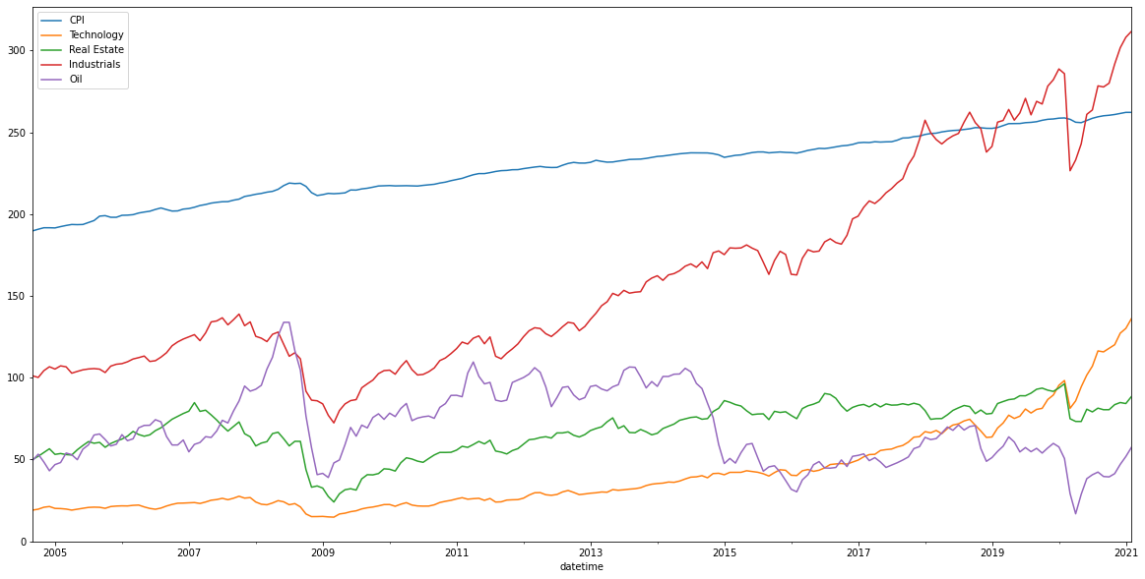
LSTM - Oil
testing_dataset: (285, 15, 1) testing_pred: (285, 15, 1) testing_dataset: (4275, 1) testing_pred: (4275, 1) (4275, 1) Test RMSE: 0.063
Key Insight: Top 5 features tied to business Cycle include CPI, Technology, Real-estate, Industrials and Oil.

Slide 30
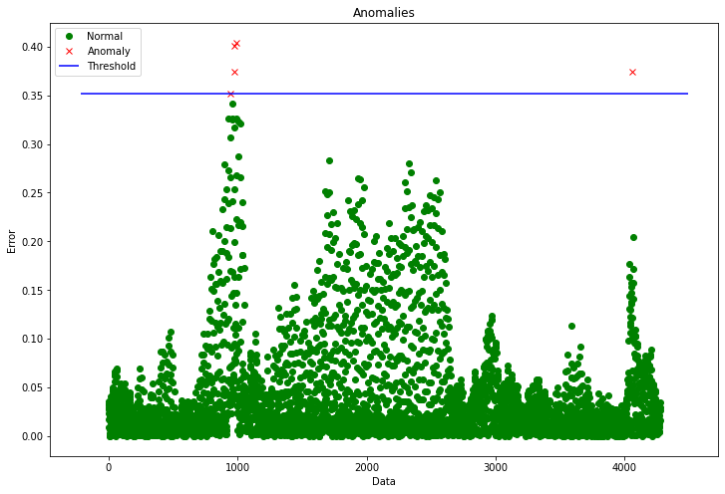
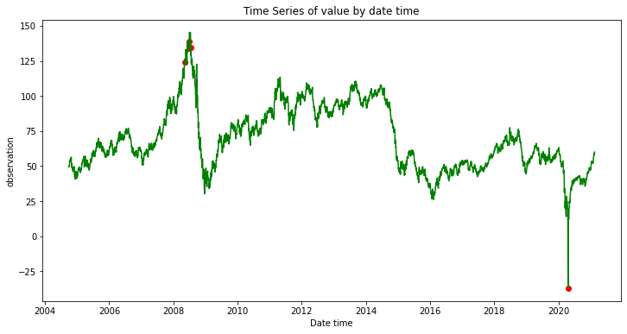
Not great thresholds - oil
RMSE: 0.063

Slide 31
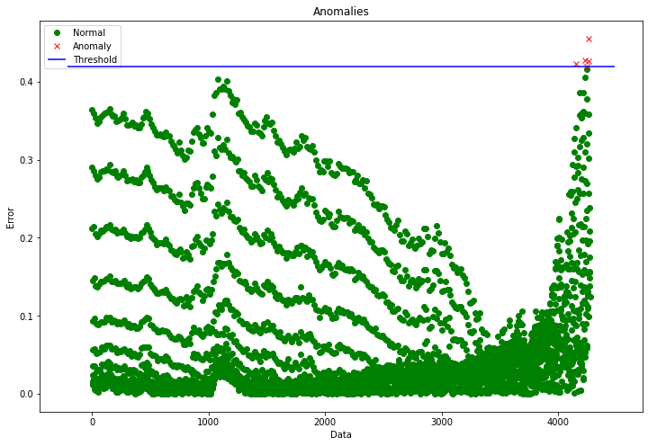
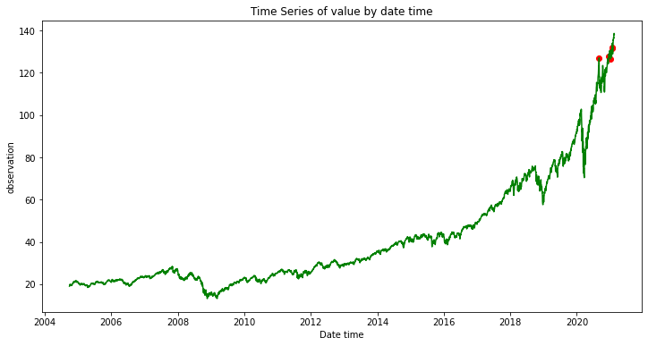
Not great thresholds - Technology
Test RMSE: 0.112

Slide 32
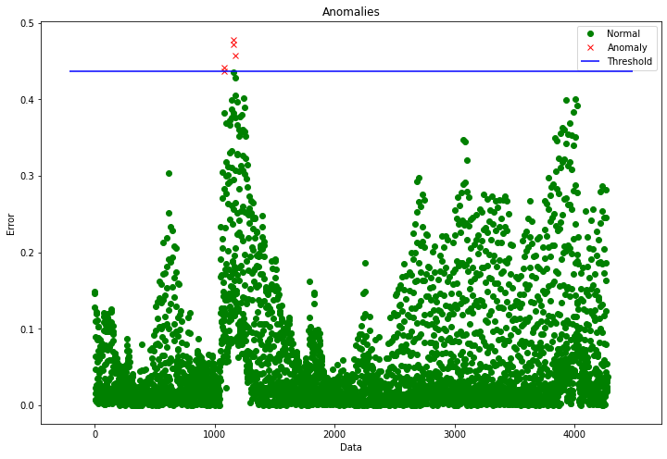
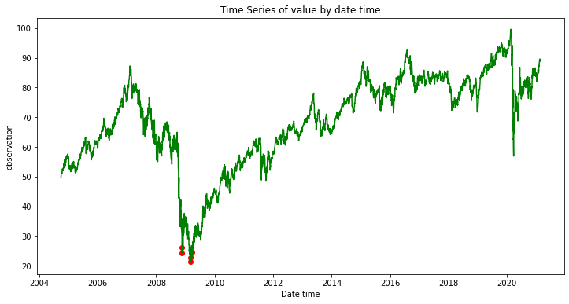
Not great thresholds – Real estate
Test RMSE: 0.094

Slide 33
What's Next Week 6: TCN Models research
TCN networks applied to anomaly detection
https://github.com/shawnmccarthy/anomalydetection/projects/1

Slide 34
Appendix
Charts

