Slide 1

Anomaly detection using Deep Learning
to positively empower enterprise with the INSIGHTS needed to win
https://github.com/shawnmccarthy/anomalydetection
https://github.com/shawnmccarthy/anomalydetection/projects/1

Slide 2

Agenda
1. |  | Big Picture | 05:00
2. |  | Problem Statement | 05:00
3. |  | Schedule | 05:00

Slide 3
Big Picture Anomaly detection
Problem
>
Finding patterns that do not adhere to what is considered normal
Business could lose millions of dollars due to abnormal events (e.g. data breach, identity theft)
Account take over of your bank or retirement accounts
Water line breaks
Flight delay
The Solution
>
Explore Boltzmann machines, LSTM, and TCN models to detect anomalies in a broad range of business use cases (credit card, market data)
Survey memresitive hardware architecture advances
Survey evolutionary architecture approach to Neural Networks

Slide 4
Traditional methods of anomaly detection
Data science / Statistics – Supervised
Isolation Forest – Unsupervised anomaly detection
One-Class Support Vector Machine (SVM) – Semi-supervised
Local Outlier
Notes:
- Data Science – regression models we can look at past data and use it to predict future target – linear regression for example, xgboost classifiers
Isolation forest – collection of individual tree structures that recursively partition the datset; data set is split randomly – anomalies generally form shortest path from the root than the normal data points
-The Local Outlier Factor (LOF) algorithm finds outliers by measuring the local deviations to a given data point. The algorithm is based on a concept of local point density. The density is described by distance to the k-nearest neighbors.
- One Class SVN- well suited for novelty detection – train on normal data and then use that to detect anomalies

Slide 5
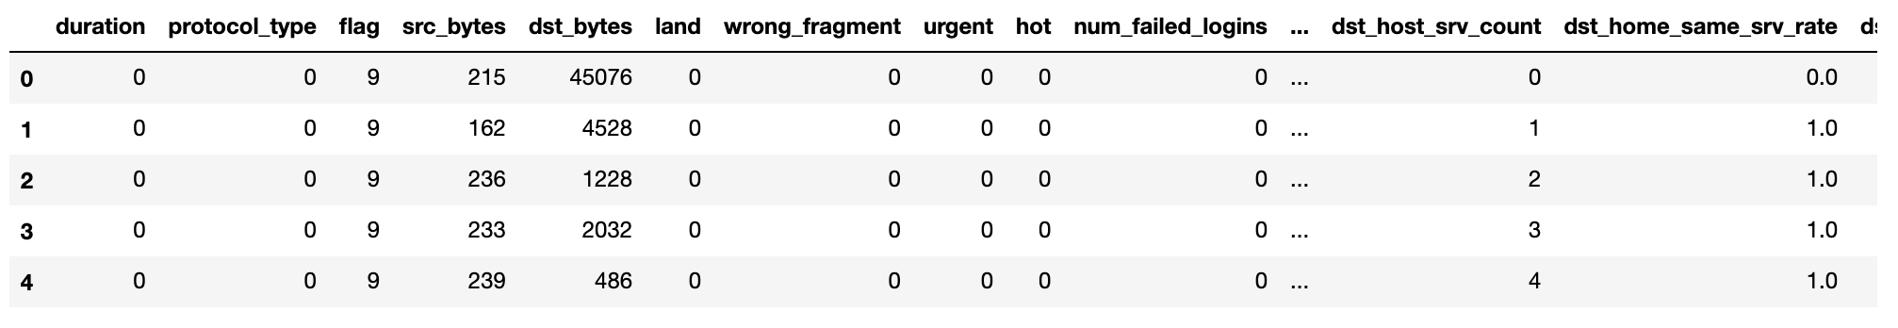
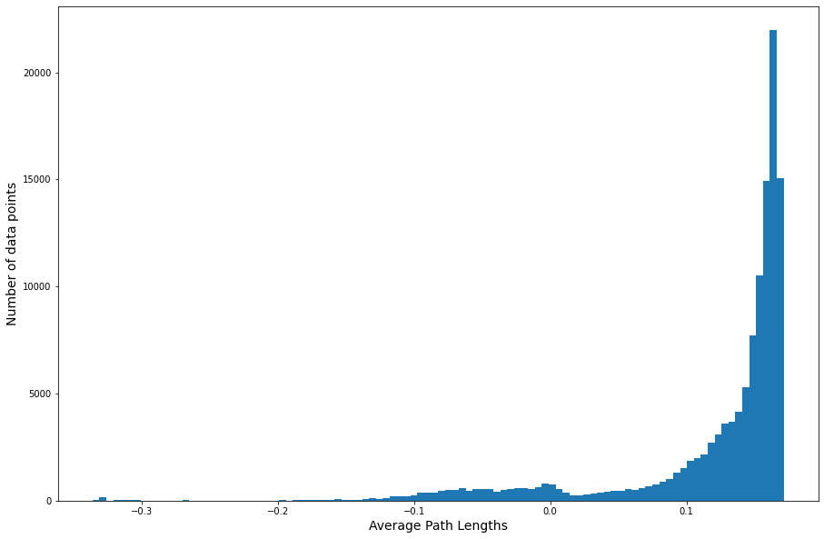
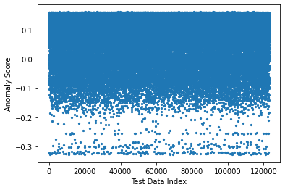
Isolated Forest
Anomalous data (shorter paths)
Data: kddcup.data.gz
Goal: Identify “Bad” connections in a network trace
Good for multidimensional data (here we have 41 columns)
100 trees in forest
Notes:
isolates anomalies using binary trees
Isolation forest works on the principle of the decision tree algorithm. It isolates the outliers by randomly selecting a feature from the given set of features and then randomly selecting a split value between the maximum and minimum values of the selected feature
It is a tree-based algorithm, built around the theory of decision trees and random forests. When presented with a dataset, the algorithm splits the data into two parts based on a random threshold value. This process continues recursively until each data point is isolated
The algorithm has a linear time complexity with a low constant and a low memory requirement

Slide 6

Schedule
Week | Topic | Output
1 | Traditional methods of Anomaly detection Chapters 1-2 | Schedule
2/3 | Boltzmann Machine | Anomaly detection Credit Card data www.Kaggle.com/mlg-ulb/creditcardfraud/version/3
4/5 | LSTM Models | Anomaly detection data Stock Macro and Sector data
6/7 | TCN Models | Anomaly detection data Credit Card Data
8/9/10 | Deep Learning Classifiers with memrisitive networks Memrisitve LSTM Architectures (Chapter 12) Survey of Memresisive Techniques Deep Learning with Darwin: Evolutionary Synthesis of Deep Neural Networks https://link.springer.com/article/10.1007/s11063-017-9733-0#:~:text=These%20experimental%20results%20show%20that,networks%2C%20and%20thus%20a%20promising DarwiNN: Efficient Distributed Neuroevolution under Communication Constraints · https://dl.acm.org/doi/pdf/10.1145/3377929.3390007?casa_token=vFygoCv-G4wAAAAA:qSG1hisR3p4xckobQhVxfHX7sZ9tfLdqvBVdkI8Hdgb9T7RN4wdYvBHFWf47RRAOVZ7a8n5fMI8 | Survey Presentation
Notes:
Boltzmann Machine – Special type of bidirectional neural network comprised of only hidden nodes and input nodes, designed to learn probability distribution of a dataset - what is unqiie is that every node is interconnected (e.g. hidden layer is connected to each other)
LSTM – Recurrent neural network attempts to model time or sequence dependent data; builds on RNN adding a memory component to propagate learned data at time T to the future
TCN – One dimensional convolutional layers – these are ausal no information from future is leaked into the past – because of this parallel computing

Slide 7
Schedule
Week | Topic | Output
11/12/13 | Using Deep Learning and Evolutionary Algorithms for Time Series Forecasting · https://www.lume.ufrgs.br/bitstream/handle/10183/189125/001086994.pdf?isAllowed=y&sequence=1 Time Series Forecasting using Evolutionary Neural Network · https://citeseerx.ist.psu.edu/viewdoc/download?doi=10.1.1.402.5337&rep=rep1&type=pdf | Survey Presentation
14 | Fall Break
15/16 | Final Proposal for Ongoing Research | Final Presentation Ongoing Research Topic

Slide 8
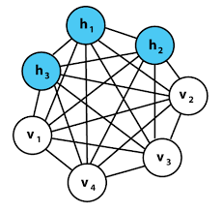
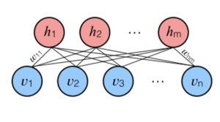
Restricted Boltzmann machine
Unsupervised
Automatically extract meaningful features
Use only the inputs for learning
RBM are unidirectional probabilistic graphical models containing a layer of observable variables and a single layer of latent variables
Restricted because no connection between variables in observed or between latent
Notes:
In a nutshell, the goal of the learning process is to find a set of weights that will minimize the energy. However, the Boltzmann machine’s architecture is resource-demanding. Since every neuron is connected to every other neuron, calculations can take a long time. That is why Restricted Boltzmann Machines (RBM) came into the picture.
A generative unsupervised models, which involve learning a probability distribution from an original dataset and using it to make inferences about never-before-seen data
The Restricted Boltzmann machines are one alternative concept to standard networks that open a door to another interesting chapter in deep learning – the deep belief networks. Their simple yet powerful concept has already proved to be a great tool. It is used in many recommendation systems, Netflix movie recommendations being just one example
We have a visible layer of neurons that receives input data which is multiplied by some weights and added to a bias value at the hidden layer neuron to generate output. Then the output value generated at the hidden layer neuron will become a new input which is then multiplied with the same weights and then bias of the visible layer will be added to regenerate input. This process is called reconstruction or backward pass. Then the regenerated input will be compared with the original input if it matches or not. This process will keep on happening until the regenerated input is aligned with the original input
Look like Generative Adversarial Networks have almost replaced RBMs; RBMs are good at Handling unlabeled data and extract important features from the input.

Slide 9
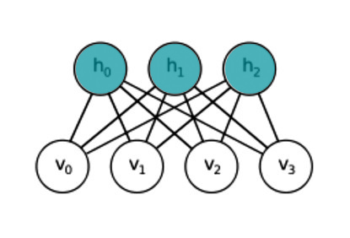

Energy function for RBM
where ai is the bias of the visible neuron i that is in state vi, bj is a bias of the hidden vector j that is in state hj and wij is the weight of the connection between neuron i and j
Notes:
Energy-Based Models (EBMs) They determine dependencies between variables by associating a scalar value to the complete system – Energy.

Slide 10
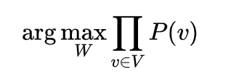
Training
Restricted Boltzmann machine are trained to maximize the product of probabilities assigned to a training set
We are maximizing the joint probability of every possible visible node with respect to the weights
Notes:
It learns from input, what are the possible connections between all these parameters, how do they influence each other and therefore it becomes a machine that represent our system in its normal state
Reconstruction is different from regression or classification in that it estimates the probability distribution of the original input instead of associating a continuous/discrete value to an input example. This means it is trying to guess multiple values at the same time. This is known as generative learning as opposed to discriminative learning that happens in a classification problem (mapping input to labels).
We can use this Boltzmann Machine to monitor our system

Slide 11
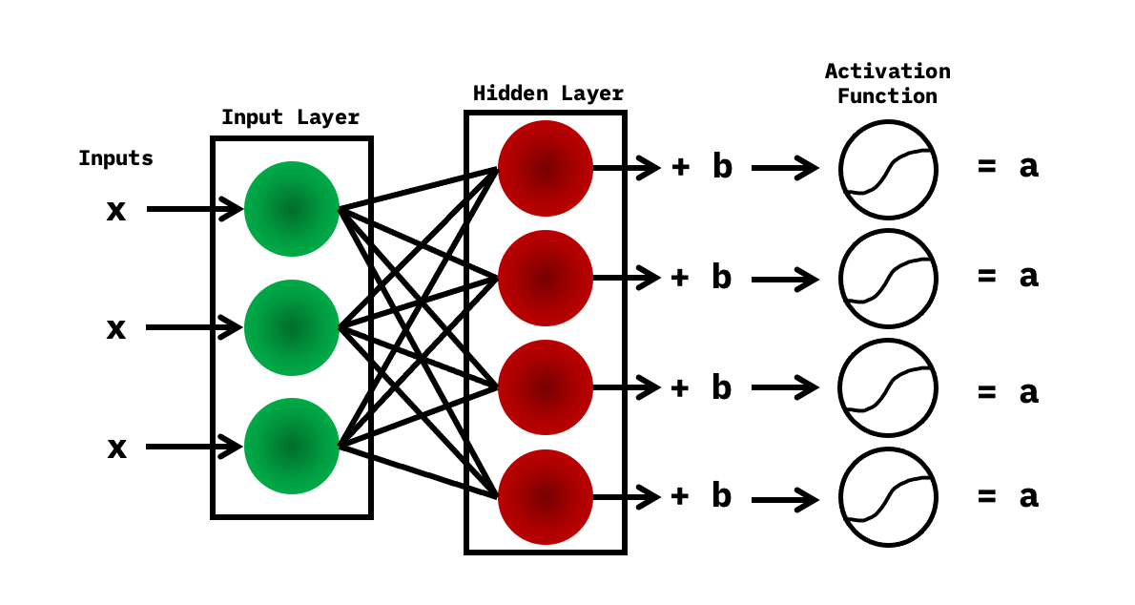
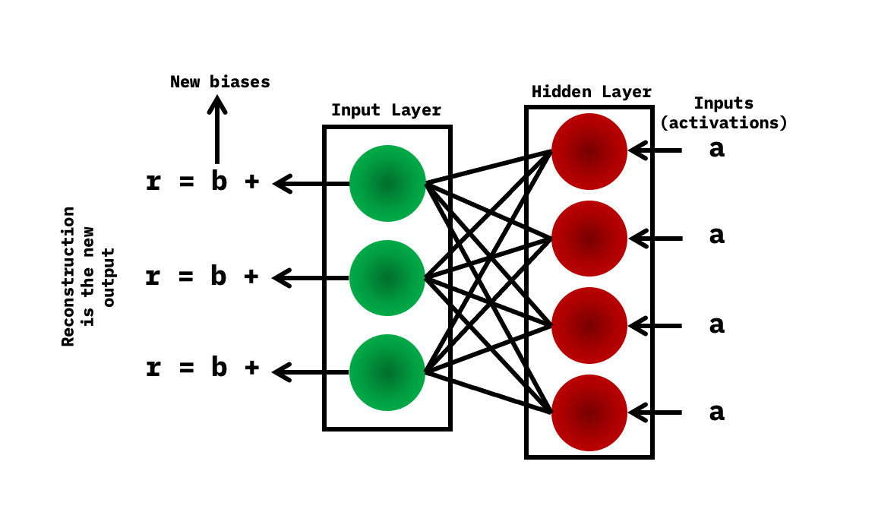
Two Steps
The inputs are taken into the input layer, multiplied by the weights, and added to the bias. After this, it goes through the activation function (sigmoid)
In reconstruction, you have the activations, which are the inputs at this point and are then passed to the hidden layer and then to the input later. After this, new biases are obtained, and the reconstruction is the new output
Notes:
Multiple inputs are considered to be the first step when training the neural network. The inputs are taken into the input layer, multiplied by the weights, and added to the bias. After this, it goes through the activation function (sigmoid), and the outputs decide whether the hidden state gets activated.
The weights in the neural network are in a matrix, where the number of input nodes is the number of rows, and the number of hidden nodes is the number of columns. The primary hidden node obtains the vector multiplication of the inputs, and is multiplied by the first column of weights before the corresponding bias term is added to it.

Slide 12
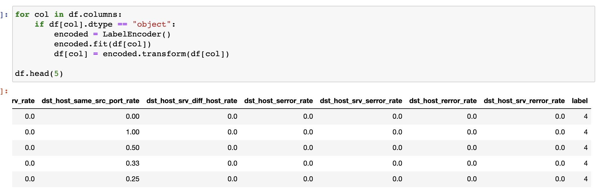
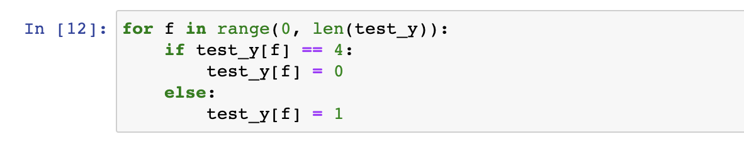
Data Cleaning: KDD

Slide 13
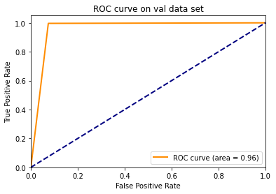
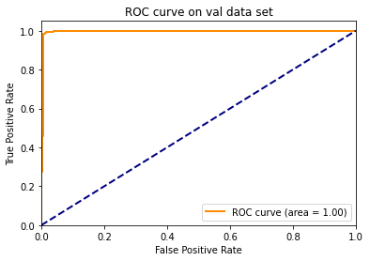
Comparison to traditional methods
Isolation Forrest
Restricted Boltzmann

Slide 14
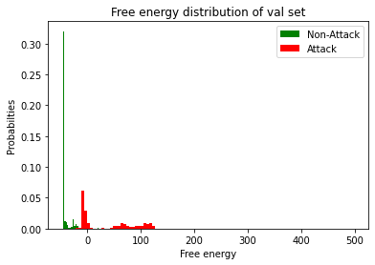
KDD
Clear separation between attack and non-attack HTTP packets

Slide 15
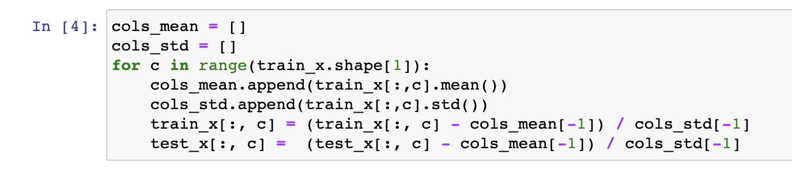
Data Cleaning: Credit Card
Time and Amount are the main ones

Slide 16
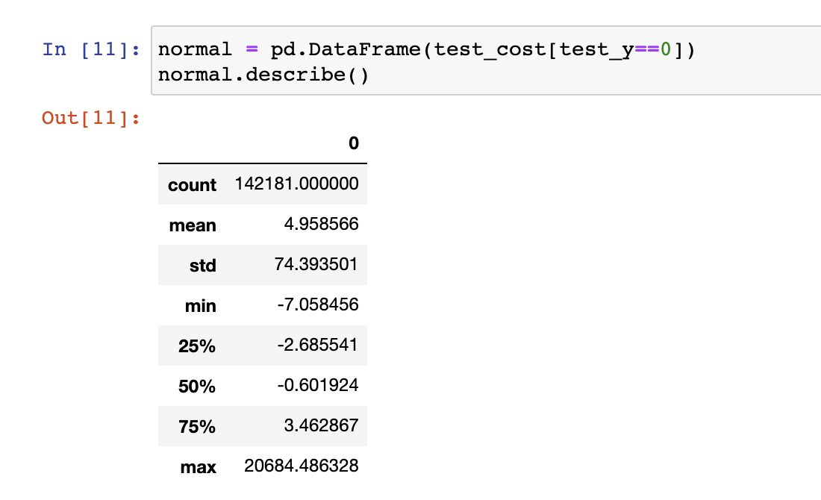
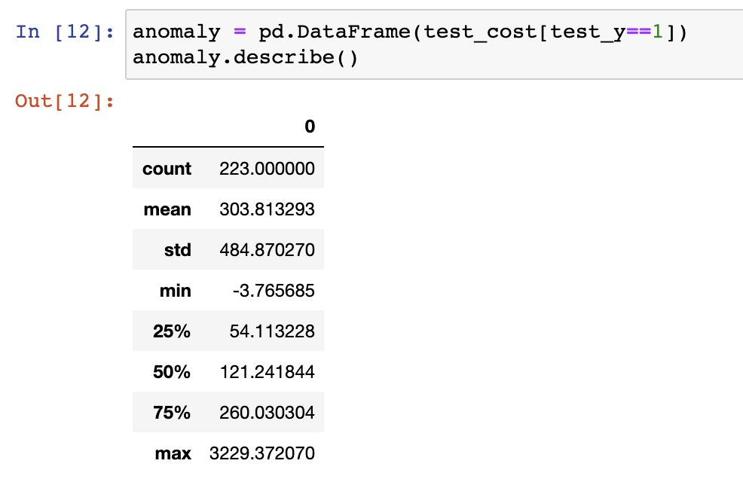
Credit Card data
Normal data right skewed
Most Anomalies below 500

Slide 17
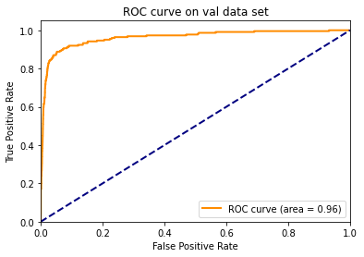
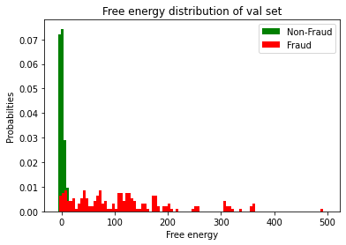
Credit Card data

Slide 18
What's Next Week 4: LSTM Models
Sequence and time series analysis
What is RNN
What is LSTM

Slide 19
Appendix
Charts

