Slide 1
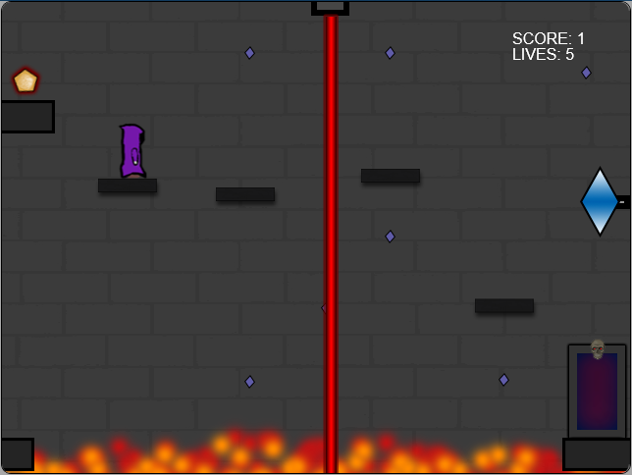

ARCANE

Slide 2
Overview
Platformer style
The player controls a Wizard trying to save the world from certain Doom at the hands of the evil, mysterious old God, Navzar.
Got the idea from my desire to make a platformer and my fondness of wizards

Slide 3
PLANNING
Started with only the core idea of a wizard platformer
Designed most of the levels and assets on Photoshop before writing any code
Playing my own game after each major changes prompted me to add elements of difficulty to the levels that were too easy

Slide 4
Instructions
Controls
[W][A][S][D] for movement and jumping
[SHIFT] to attack
Mouse to navigate the menus
Scoring
Collecting small gems scattered throughout the levels
Finishing the game with extra lives left

Slide 5
DEMONSTRATION
http://shawnmcla-comp397-finalproject-arcane.azurewebsites.net/

Slide 6
Lessons learned
Simple physics can be hard
Creating everything (Graphical assets, audio and code) is time consuming
Plan more!

Slide 7
Future Possibilities
More levels
Smart AI enemies
Levels not restricted to the boundaries of the screen (2D Camera)

