Slide 1
End of Term Web Archive Dataset: Longitudinal Web Archive of .GOV and .MIL Domains
Mark Phillips, Kristy Phillips, and Sawood Alam
JCDL
June 27, 2023

Slide 2
Background

Slide 3
End of Term Web Archive
Collaborative web archiving activity in the United States since 2008
Goal to document the transition in the Executive Branch of the Federal web before and after each election cycle
Serves as a longitudinal snapshot of Federal .gov and public .mil web every four years
Partners volunteer time, crawling, and storage resources for the project
Public access provided by the Internet Archives’ Wayback Machine
https://eotarchive.org

Slide 4
EOT Crawling Partners
 | 2008 | 2012 | 2016 | 2020
Archive Team (AT) |  |  | Crawl
California Digital Library (CDL) | Crawl
Internet Archive (IA) | Crawl | Crawl | Crawl | Crawl
Library of Congress (LOC) | Crawl | Crawl | Crawl
University of North Texas (UNT) | Crawl | Crawl | Crawl | Crawl

Slide 5
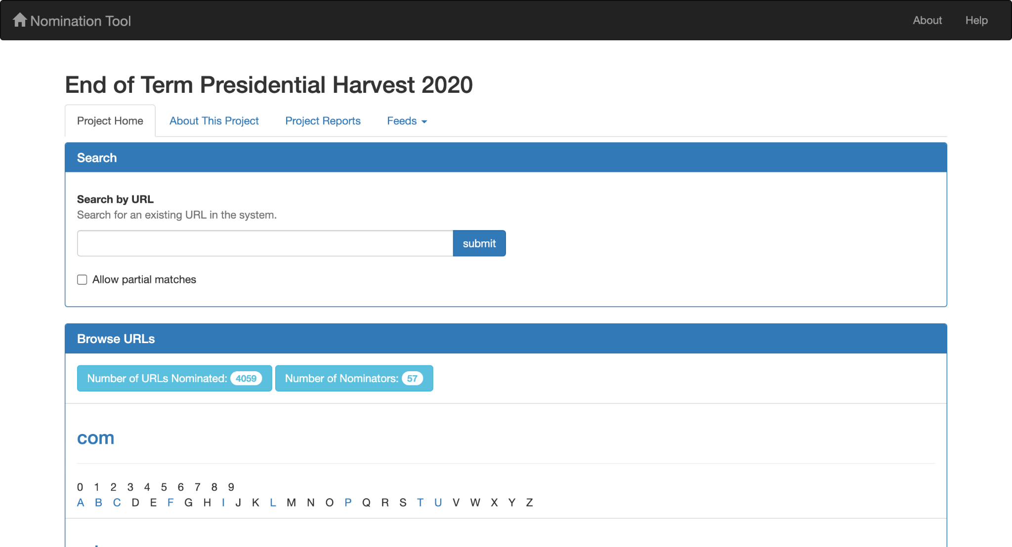
https://digital2.library.unt.edu/nomination/

Slide 6
EOT to AWS

Slide 7
Goals of the Project
Project began in Fall 2021
Provide greater access to the End of Term datasets
2008, 2012, 2016, 2020
Focused on computational consumption of the collection
Currently challenging because of size, access, storage issues
Encourage reuse and research with the EOT data
Position dataset so that we can learn more about our process
Provide a canonical dataset for each crawl for reference numbers like size, URLs, counts

Slide 8
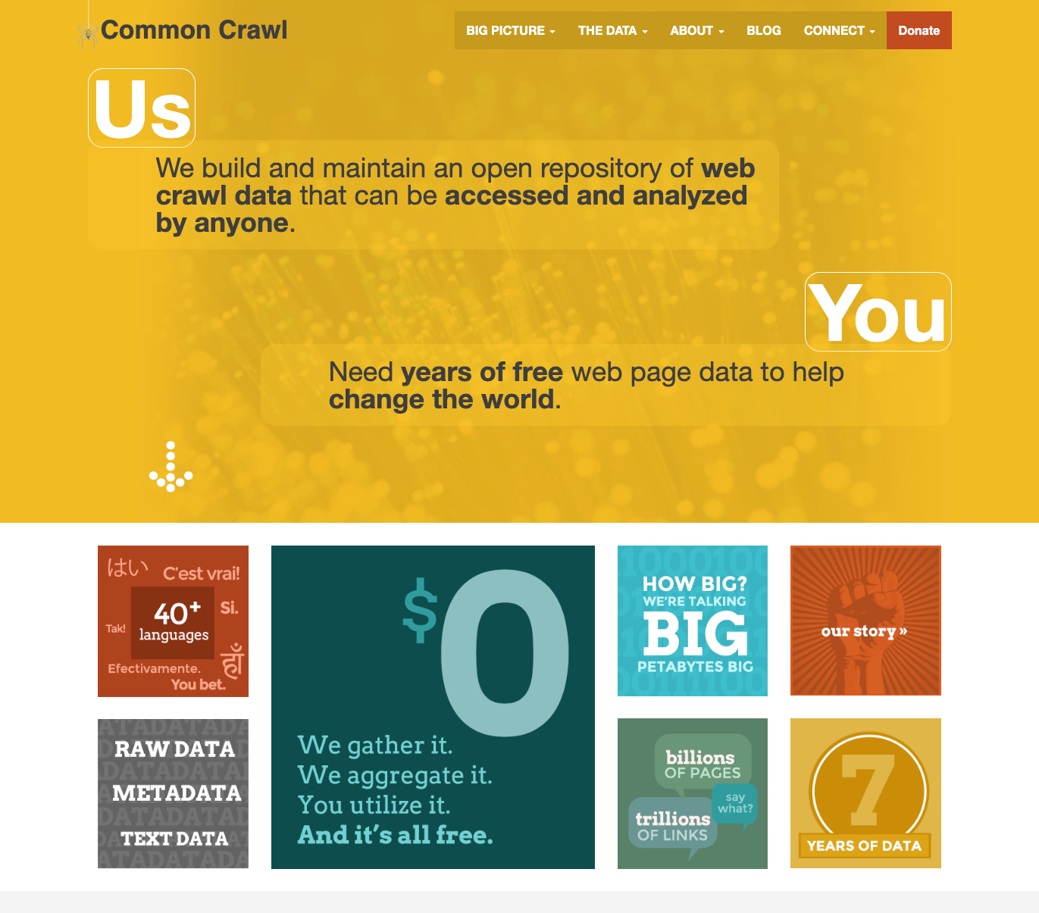
Common Crawl
https://commoncrawl.org
“Common Crawl is a 501(c)(3) non-profit organization dedicated to providing a copy of the internet to internet researchers, companies and individuals at no cost for the purpose of research and analysis.”
Monthly large (~300TB) crawls of the web
Uses Nutch for crawling
Stores data in WARC files
Openly shares their data via AWS Open Data Sponsorship Program
Notes:
https://commoncrawl.org

Slide 9
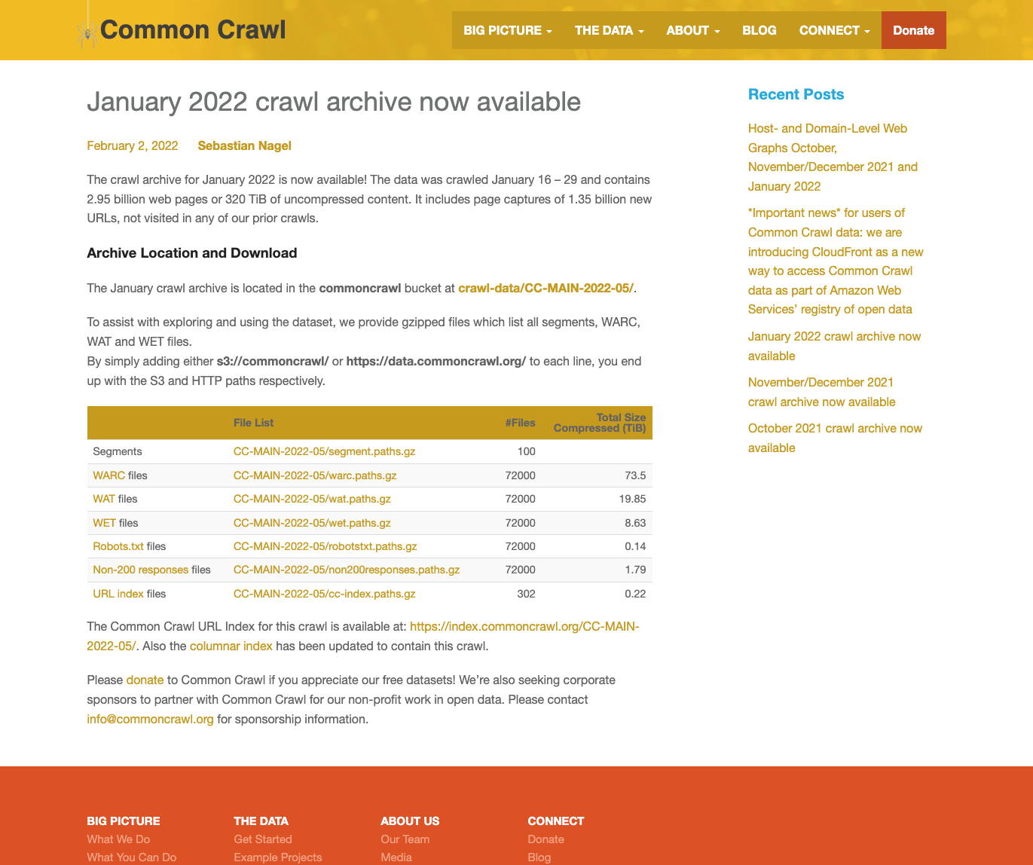
Common Crawl Data
WARC files - content of crawls
WAT - Extracted metadata from WARC files
WET - Extracted text from WARC files
(WAT and WET limited to HTML and TXT)
CDX Index - ZipNum format
Parquet Index - based on CDX Index

Slide 10
Why Common Crawl Data Structure
Existing tools can be used for generation of derivatives
Well documented tools built around working with large datasets
Leverage existing Common Crawl community who are heavy users of those datasets
Reuse documentation about formats, code, processes that exist for Common Crawl
Great starting point until we have a strong reason to deviate

Slide 11
Common Crawl Structure in Amazon S3
commoncrawl
└── crawl-data
├── CC-MAIN-2021-43
├── CC-MAIN-2021-49
└── CC-MAIN-2022-05
└── segments
├── 1642320306335.77
└── 1642320306346.64
├── crawldiagnostics
├── robotstxt
├── warc
├── wat
└── wet

Slide 12
EOT Mapping to Common Crawl Structure
EOT-2008 Segment Examples
crawl-data/EOT-2008/segments/CDL-000/
crawl-data/EOT-2008/segments/CDL-001/
crawl-data/EOT-2008/segments/CDL-002/
crawl-data/EOT-2008/segments/IA-000/
crawl-data/EOT-2008/segments/IA-001/
EOT-2008 Segment Sub-Folders
crawl-data/EOT-2008/segments/CDL-000/cdx/
crawl-data/EOT-2008/segments/CDL-000/warc/
crawl-data/EOT-2008/segments/CDL-000/wat/
crawl-data/EOT-2008/segments/CDL-000/wet/
EOT Indexes (Zipnum)
eot-index/collections/EOT-2008/indexes/
eot-index/collections/EOT-2012/indexes/
eot-index/collections/EOT-2016/indexes/
eot-index/collections/EOT-2020/indexes/
EOT Indexes (Parquet)
eot-index/table/eot-main/warc/crawl=EOT-2008/
eot-index/table/eot-main/warc/crawl=EOT-2012/
eot-index/table/eot-main/warc/crawl=EOT-2016/
eot-index/table/eot-main/warc/crawl=EOT-2020/

Slide 13
EOT Structure in Amazon S3
eotarchive
└── crawl-data
├── EOT-2008
├── EOT-2012
└── EOT-2016
└── segments
├── AT-000
└── IA-000
├── cdx
├── meta
├── warc
├── wat
└── wet

Slide 14
WARC Metadata Sidecars
Python tool for content-based characterization of WARC files.
https://github.com/unt-libraries/warc-metadata-sidecar
Language identification - Compact Language Detector 2 (CLD2)
Format Identification - Fido & pymagic
Encoding Identification - chardet
Soft404 detection - soft-404
Writes output to WARC Metadata record.

Slide 15
Example WARC Metadata Sidecar Record
WARC/1.0
WARC-Date: 2012-10-26T21:59:42Z
WARC-Concurrent-ID: <urn:uuid:da5927b0-4efb-469b-a885-04c7347a0dc6>
WARC-Type: metadata
WARC-Record-ID: <urn:uuid:757626b2-c1fd-4430-abd0-545cdee7cefc>
WARC-Target-URI: http://140.194.76.129/publications/eng-pamphlets/index.html
WARC-Payload-Digest: sha1:SUYN7XTFAOFZ7RB6PQSUDVXZV6DPKAS3
WARC-Block-Digest: sha1:SUYN7XTFAOFZ7RB6PQSUDVXZV6DPKAS3
Content-Type: application/warc-fields
Content-Length: 308
Identified-Payload-Type: {"fido": "text/html", "python-magic": "text/html"}
Preservation-Identifier: fmt/99
Charset-Detected: {"encoding": "ascii", "confidence": 1.0}
Languages-cld2: {"reliable": true, "text-bytes": 16199, "languages": [{"name": "ENGLISH", "code": "en", "text-covered": 99, "score": 878.0}]}

Slide 16
Datasets to date
Crawl | WARC Files | WARC Size | WAT Size | WET Size | CDX Size | META Size
EOT-2004 | 58,977 | 7TB | 108GB | 18MB | 6GB | 36GB
EOT-2008 | 125,704 | 15TB | 447GB | 108GB | 9GB | 68GB
EOT-2012 | 78,509 | 41TB | 885GB | 217GB | 12GB | 82GB
EOT-2016 | 194,683 | 139TB | 2TB | 331GB | 25GB | 178GB
EOT-2020 | 239,811 | 266TB | 9TB | 3TB | 84GB | 713GB
Total | 638,707 | 468TB | 12TB | 4TB | 136GB | 1TB

Slide 17
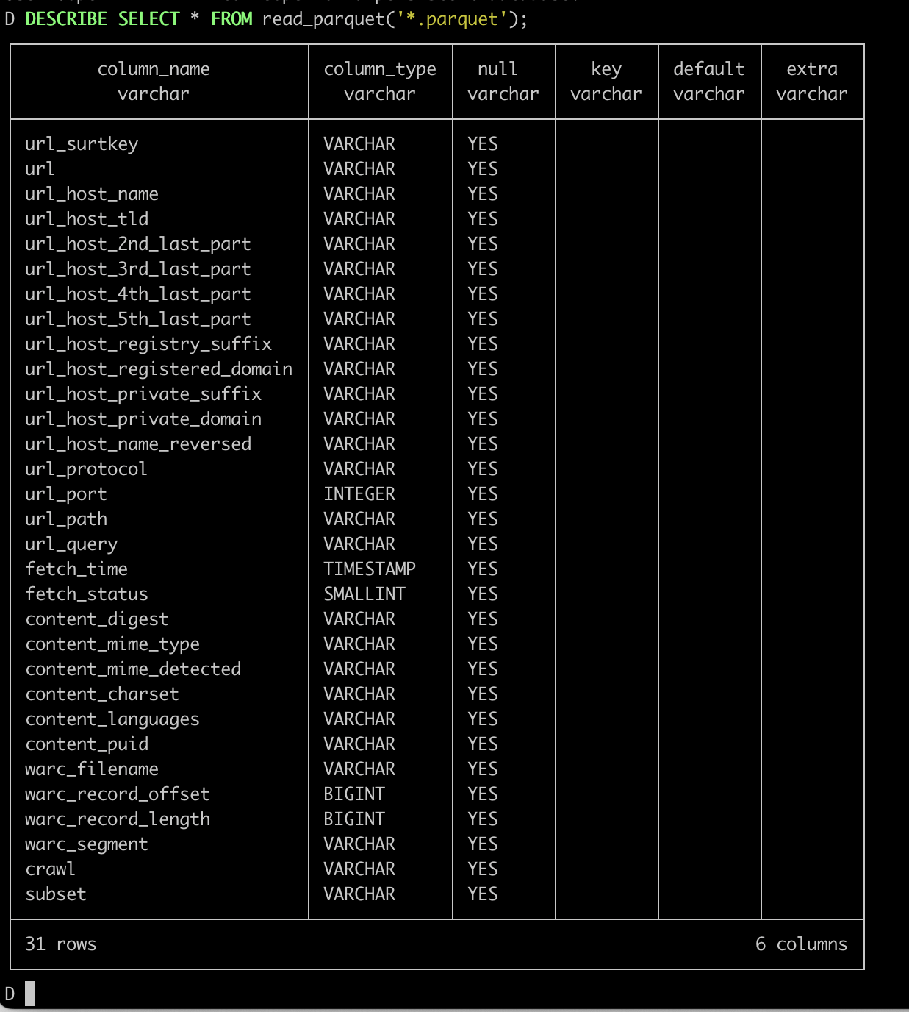
Tools Used
Small 5-node Local Hadoop Cluster (250TB) & mrjob
WAT/WET
https://github.com/commoncrawl/ia-web-commons
https://github.com/commoncrawl/ia-hadoop-tools
CDXJ
https://github.com/webrecorder/cdxj-indexer
WARC Metadata Sidecar
https://github.com/unt-libraries/warc-metadata-sidecar
Zipnum
https://github.com/commoncrawl/webarchive-indexing
Parquet
https://github.com/commoncrawl/cc-index-table

Slide 18
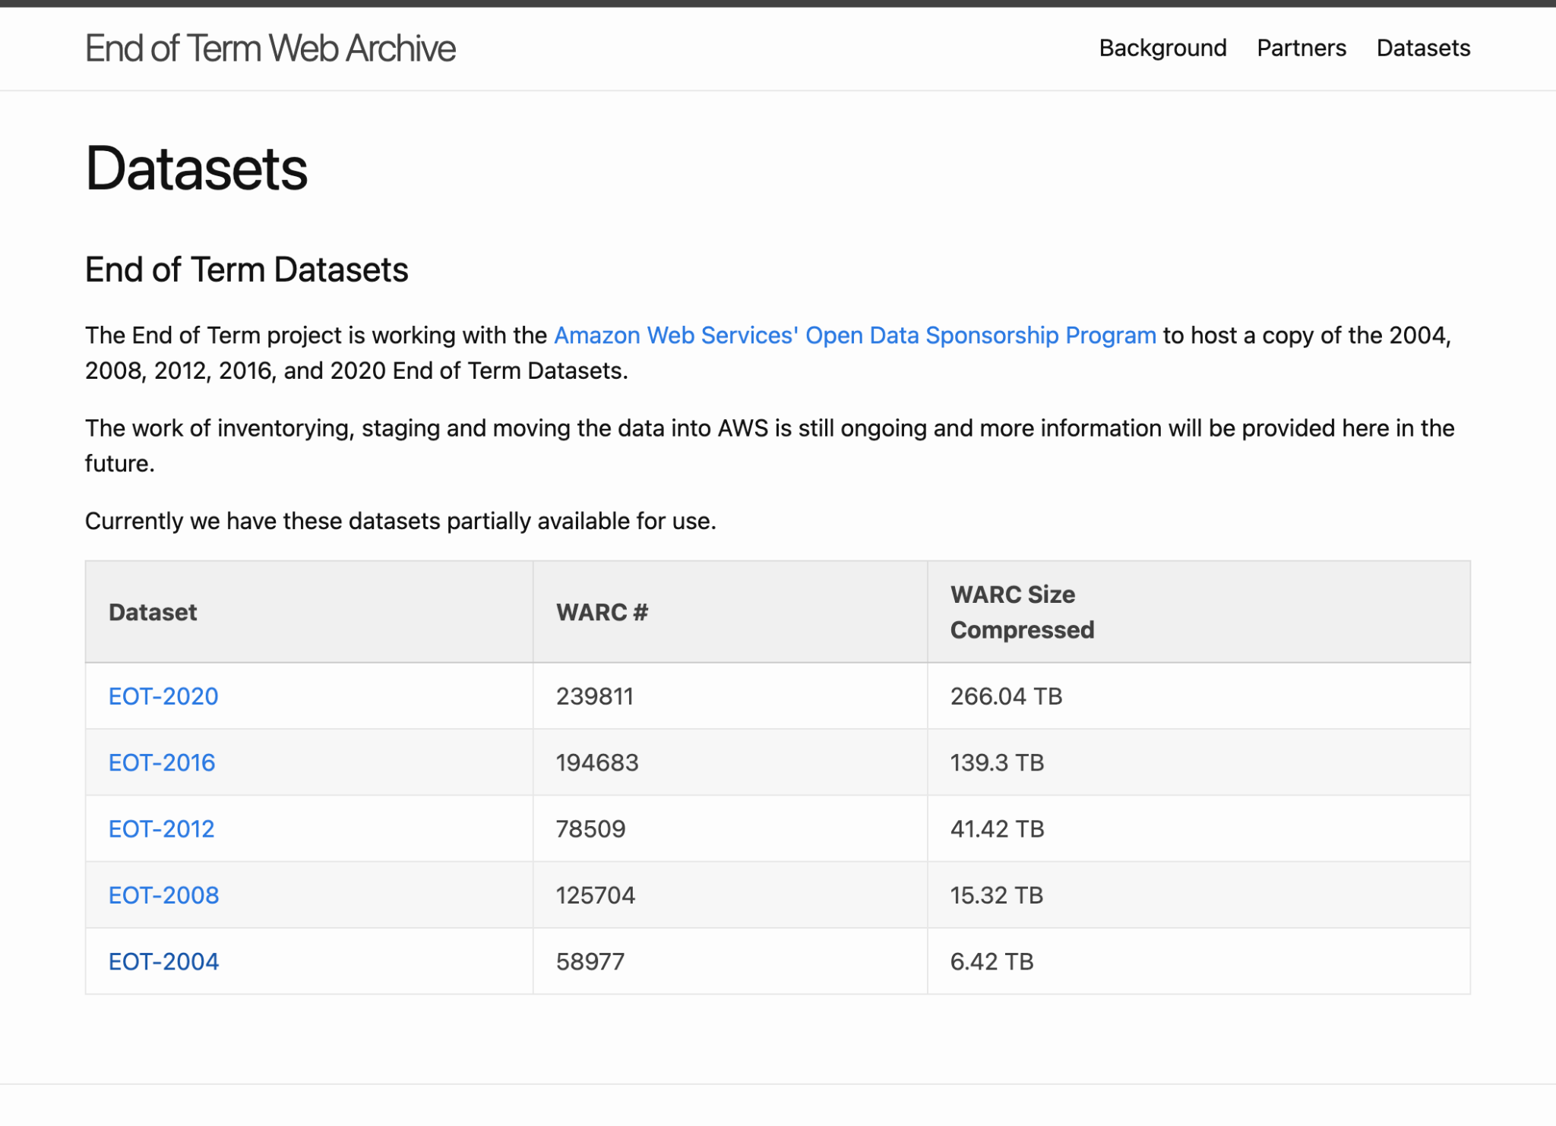
Where to get the datasets
https://eotarchive.org/data/

Slide 19
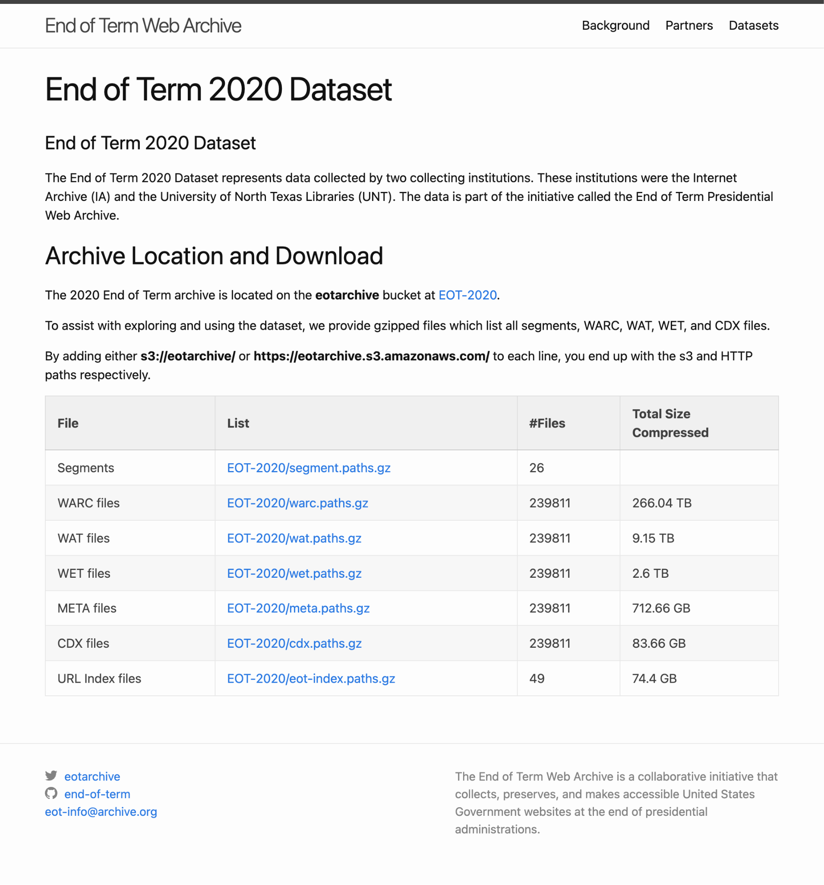
Dataset Overview
Download with HTTP or S3
Path files contain full paths to each file in dataset.
Download path files and then iterate over all lines in file to retrieve full dataset
Take the parts you need
If you have questions reach out.
mark.phillips@unt.edu
sawood@archive.org

