Slide 1
Community Detection And Clustering in Graphs
Vaibhav Mallya
EECS 767
D. Radev

Slide 2
Agenda
Agenda
Basic Definitions
Girvan-Newman Algorithm
Donetti-Munoz Spectral Method
Karypis-Kumar Multi-level Partitioning
Graclus
GraphClust

Slide 3
Definitions
Complex networks: Study of representations of interactions between real-world entities
Borrows heavily from classical graph theory
Vertices, nodes, entities connected by links, edges, connections

Slide 4
Definitions (cont.)
Community: One of many (possibly overlapping) subgraphs
Has strong internal node-node connections
Weaker external connections
Community detection algorithms stress high internal connectivity and low external connectivity with a given community
Cluster: See community

Slide 5
Definitions (cont.)
Practical applications of clustering, community detection
Simplifies visualization, analysis on complex graphs
Search engines – Categorization
Clusty.com was an early one, is still around
Social networks - Useful for tracking group dynamics
Neural networks - Tracks functional units
Food webs - helps isolate co-dependent groups of organisms

Slide 6
Girvan-Newman Algorithm
Published by Michelle Girvan and Mark Newman in 2002
Helped rekindle recent interest in community detection
Iteratively finds community boundaries
Hierarchical divisive algorithm

Slide 7
Girvan-Newman Algorithm
Calculate edge-betweenness for all edges
Remove the edge with highest betweenness
Recalculate betweenness
Repeat until all edges are removed, or modularity function is optimized (depending on variation)

Slide 8
Girvan-Newman Algorithm
Quality Function: Objective measure of how good community divisions are
Girvan-Newman Modularity is most popular quality function
Premise: Random graph has no communities
Create a null model of the original graph – similar to actual graph, but without communities.
May involve, f.ex randomly rewiring certain nodes while maintaining their degree
Hereafter referred to simply as “modularity”

Slide 9
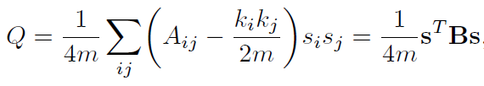
Girvan-Newman Algorithm
Modularity equation
(Obviously, we can try and optimize this function directly; there are other approaches that do this)

Slide 10
Girvan-Newman Algorithm
Vertex Betweenness Centrality
First proposed by Freeman
Classical vertex importance measure on a network
Defined as the total number of shortest paths that pass through each vertex on the network
There is a possible ambiguity with this definition

Slide 11
Girvan-Newman Algorithm
See it?
B
A
E
C
D

Slide 12
Girvan-Newman Algorithm
To resolve:
We’re actually calculating all-shortest paths between two paths
There are N paths between any two vertices
Each path gets a weight equal to 1/N
B
A
E
C
D

Slide 13
Girvan-Newman Algorithm
Vertex betweenness of C:
D-B +0.5
E-B +0.5
C-B +1
A-B +1
= 2
B
A
E
C
D

Slide 14
Girvan-Newman Algorithm
Edge betweenness centrality
G-N’s generalization of vertex betweenness
Number of shortest paths that pass through a given edge
“If there is more than one shortest path between a pair of vertices, each path is given equal weight such that the total weight of all the paths is unity”

Slide 15
Girvan-Newman Algorithm
Edge Betweenness example - EA
D-B +0.5
E-B +0.5
E-A +0.5
= 1.5
B
A
E
C
D

Slide 16
Girvan-Newman Algorithm
Algorithm for all-edge betweenness
Choose two vertices
Calculate all shortest paths between these two vertices
Place every path encountered into a set
Iterate over the set
Increment the betweenness of every path by 1 / size of the set
Repeat for every pair of vertices

Slide 17
Girvan-Newman Algorithm
Intuitively, why should this work? Analogy:
Network of N nodes: nodes are towns, edges are roads
Place N-1 cars on each node; each one to a town
Each road gets a point when a car drives on it
Remove the highest ranked road – interstate highway
Repeat the process
First we’ll remove all interstates (leaving state roads)
Then state roads will be removed, leaving county roads, then suburban roads, etc
After we each set of levels, we get a more fine-grained division of communities

Slide 18
Girvan-Newman Complexity
Original definition for undirected graphs
More on possible directed generalizations later
O(mn), or O(n^2) on sparse graph

Slide 19
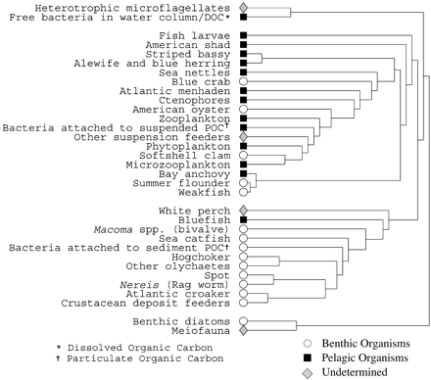
Girvan-Newman Output
Chesapeake Bay Food Web

Slide 20
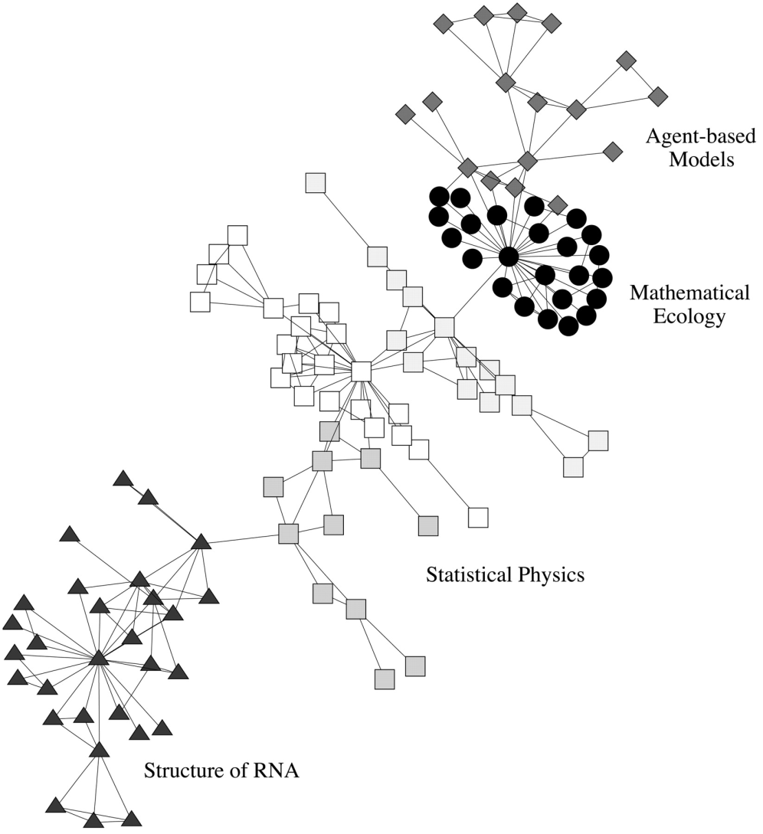
Girvan-Newman Output
Santa Fe Institute Collaboration Network

Slide 21
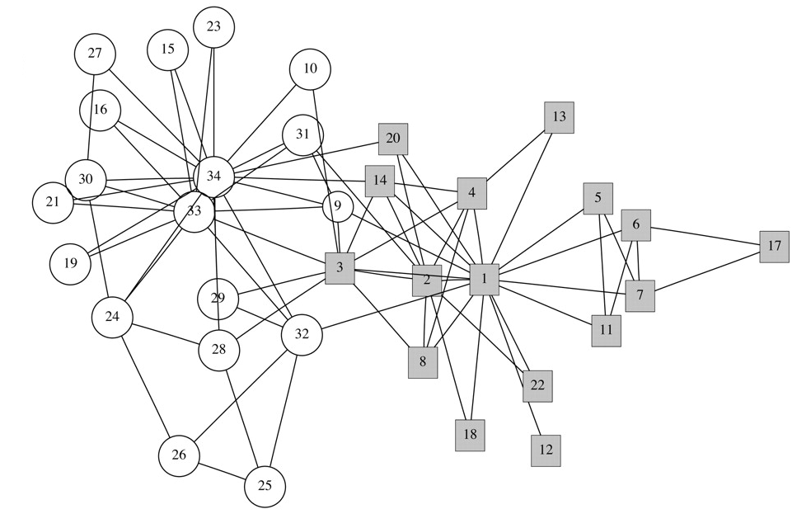
Girvan-Newman Output
Zachary’s Karate Club

Slide 22
Donetti-Munoz Spectral Method
Based on eigenvectors of the Laplacian matrix
“Elegant insight”
For any two nodes A and B, these eigenvector components will be very close
Convert into coordinates: points in an M-dimensional metric space
M corresponds to number of eigenvectors used
Then we can apply standard clustering techniques
Manhattan distance, angle distance, etc
Apply basic hierarchical clustering methods after conversion; merge connected cluster pairs

Slide 23
Donetti-Munoz Spectral Method
Laplacian Matrix (aka Kirchhoff matrix) “L”
Encodes topological information
Symmetric N x N
Each diagonal “i” corresponds to degree of vertex “i“
Other elements = -1 edge exists between row and column, 0 otherwise
Useful properties

Slide 24
Donetti-Munoz Spectral Method
Example Laplacian
 | A | B | C | D | E
A | 2 | -1 | 0 | 0 | -1
B | -1 | 2 | -1 | 0 | 0
C | 0 | -1 | 2 | 0 | -1
D | 0 | 0 | 0 | 1 | -1
E | -1 | 0 | -1 | -1 | 3
B
A
E
C
D

Slide 25
Donetti-Munoz Spectral Method
Calculation of Laplacian’s eigenvectors is bottleneck
Use Lanczos method to determine best ones
Runtime: O(Number of edges / (difference between two smallest eigenvalues) )

Slide 26
Donetti-Munoz Spectral Method
Lanczos Method
Iterative algorithm for approximating eigenvalues of a square matrix
Improves on power-law method – retain intermediate eigenvalues
Generates tri-diagonal matrix whose eigenvectors are calculated cheaply
Must balance round-off errors, which accumulate – numerical stability is complicated but manageable

Slide 27
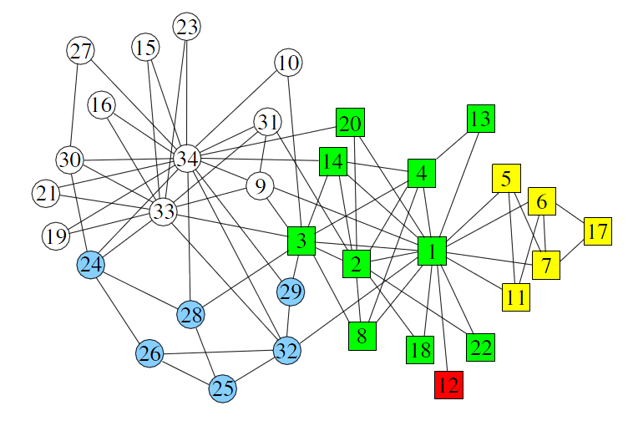
Donetti-Munoz Spectral Method
Applied to Zachary’s Karate Club Network
Circles/squares = original, colors = additional

Slide 28
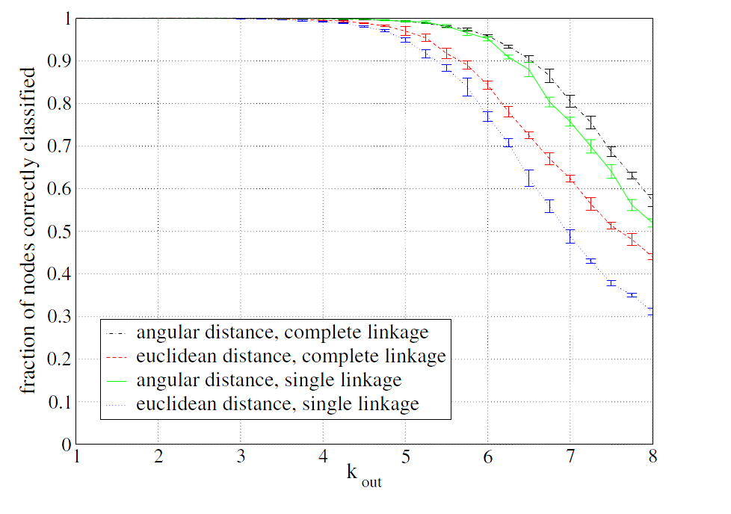
Donetti-Munoz Spectral Method
Applied to computer-generated random graphs

Slide 29
Karypis-Kumar Multi-level Partitioning
Example of multi-level partitioning scheme
Coarsen: Reduce graph in some meaningful way, collapsing vertices and edges
Partition: Calculate good partition
Uncoarsen: Obtain something resembling the original graph, with partitions intact.
Key advantage of such schemes is speed
Partitions tend to be of slightly worse quality
But the algorithm is significantly faster

Slide 30
Karypis-Kumar Multi-level Partitioning
Karypis-Kumar based their algorithm on Hendrickson-Leland collapsing approach
Heavy Edge Matching for partitioning
Improved Kernigan-Lin for partition refining
Coarsen: Collapse a pair of adjacent vertices
Creates multinode of the vertices
They use “maximal matchings” to include maximum possible number of collapsed edges
Partition: Compute a high-quality bisection
Cut the graph in a meaningful way
KL, SB, GGP, GGGP

Slide 31
Karypis-Kumar Multi-level Partitioning
Uncoarsening: Expand the smaller graph back into the original via boundary KL method
The graph is uncoarsened in stages
At each stage, the partition is corrected

Slide 32
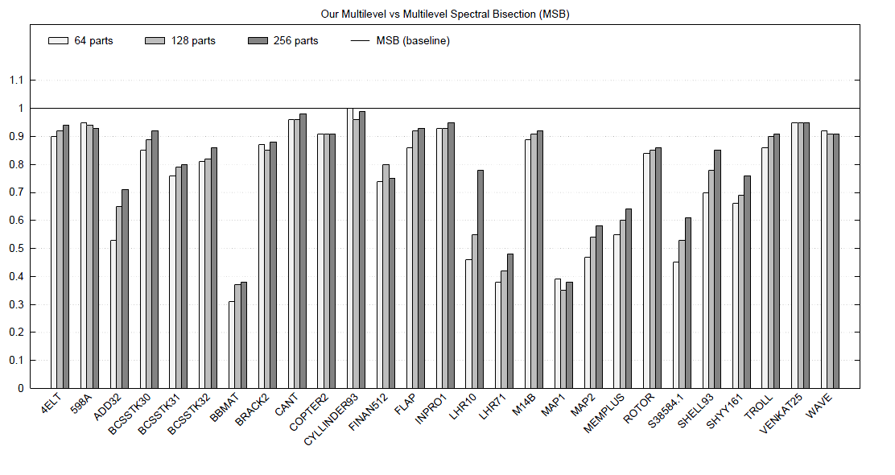
Karypis-Kumar Multi-level Partitioning
The graph that shows their algorithm is better
Compared to MS Bisection algorithm.

Slide 33
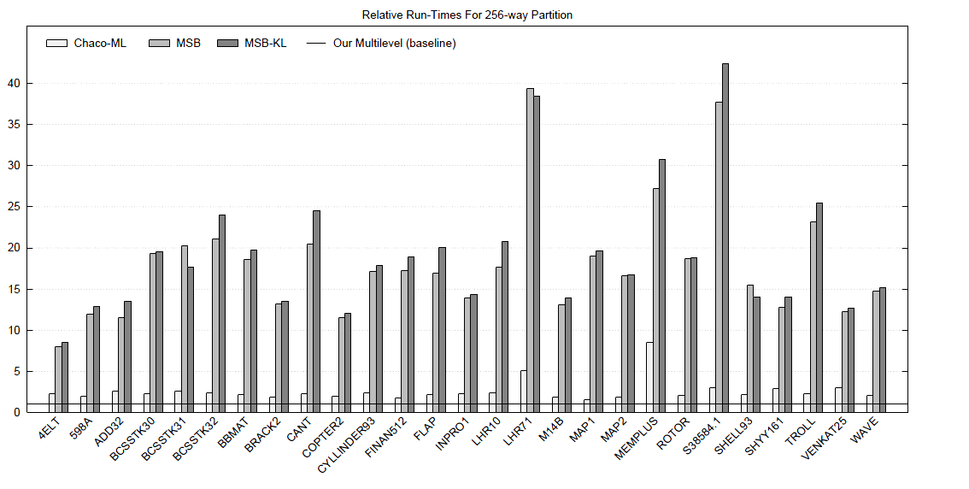
Karypis-Kumar Multi-level Partitioning
Another graph showing their algorithm is better

Slide 34
Graclus
Software for calculating partitions, clusters
Uses novel algorithms developed at UT Austin
Avoids use of eigenvector-based schemes
Eigenvectors are Expensive to compute
Key idea: Finding graph clusters equivalent to maximizing weighted kernel k-means objective function

Slide 35
Graclus
Like Karypis-Kumar, multi-level
Coarsening: Yu-Shi algorithm, a kind of spectral method

Slide 36
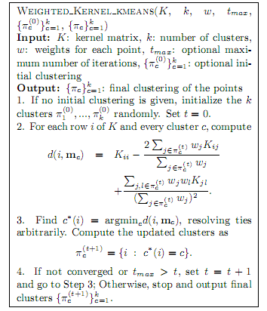
Graclus
Refinement

Slide 37

Graclus
Refinement – Objectives, Kernel Matrix to use

Slide 38
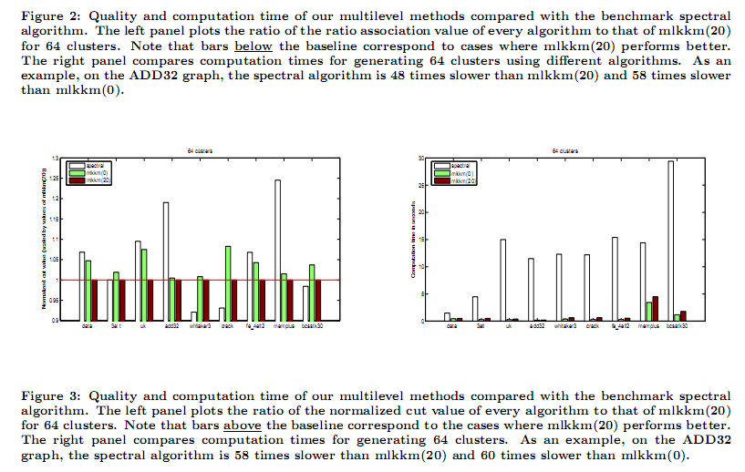
Graclus

Slide 39
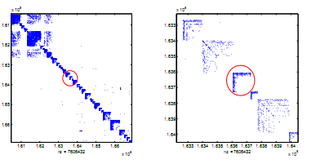
Graclus
Harry Potter

Slide 40
GraphClust
Shasha et al, primarily from NYU
“Clusters graphs based on topology”
Clusters a *set* of graphs
Clusters a graph based on four dimensions:
Substructure definition
Graph type
Distance Metric
Number of Clusters
16 algorithms; each dimension has 1 option.

Slide 41
GraphClust
For each graph
Record the number of times each substructure is present
Construct a vector of non-negative integers
Use the provided distance metric (inner dot product or Euclidean distance) to cluster the graph.
Intended to work on *database* of graphs, potentially thousands of them or more
Algorithm is supposed to be fast
Can optionally use SVD for added speed

Slide 42
List of Sources
A fast and high quality multilevel scheme for partitioning irregular graphs G. Karypis and V. Kumar, 1998
Community structure in social and biological networks (Girvan-Newman, 2002) http://www.pnas.org/content/99/12/7821
A Fast Kernel-based Multilevel Algorithm for Graph Clustering, I. Dhillon, Y. Guan, and B, Kulis, 2005 http://www.acm.org/sigs/sigkdd/kdd2005/index.html

Slide 43
List of Sources (cont.)
Modularity and community structure in networks (Newman, 2006)
Community Detection Algorithms: A comparative analysis by Lancichinetti and Fortunato, 2009
Community detection in graphs by Fortunato, 2009

