Slide 1
Zero-Knowledge Demo
Shawn Ong

Slide 2
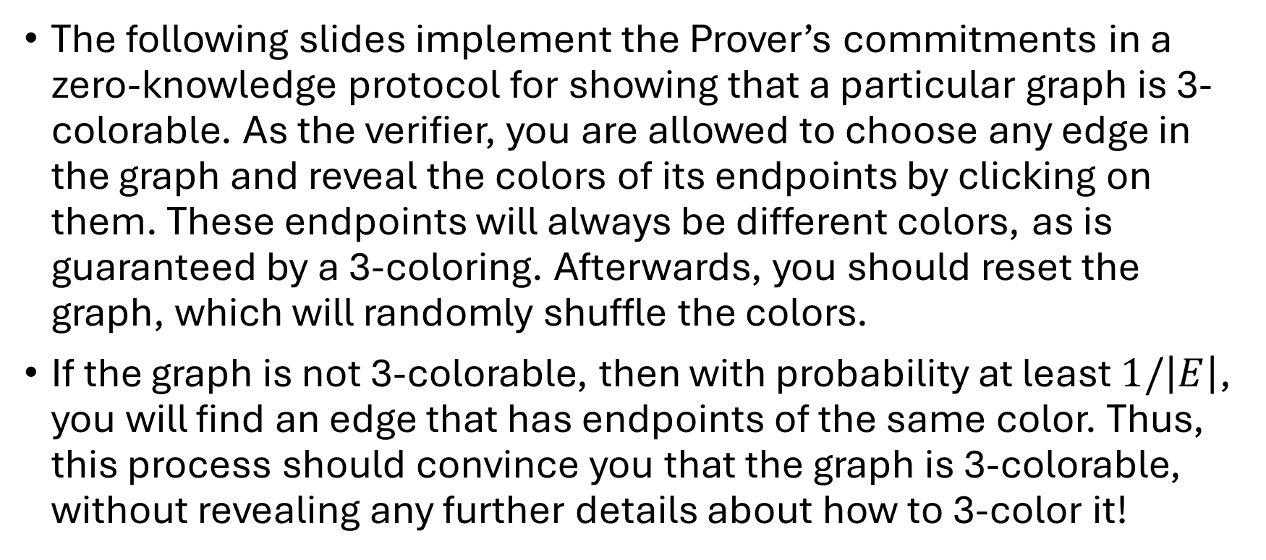
Directions
The following slides implement the Prover’s commitments in a zero-knowledge protocol for showing that a particular graph is 3-colorable. As the verifier, you are allowed to choose any edge in the graph and reveal the colors of its endpoints by clicking on them. These endpoints will always be different colors, as is guaranteed by a 3-coloring. Afterwards, you should reset the graph, which will randomly shuffle the colors.
If the graph is not 3-colorable, then with probability at least $1/\left|E\right|$, you will find an edge that has endpoints of the same color. Thus, this process should convince you that the graph is 3-colorable, without revealing any further details about how to 3-color it!

Slide 3
Reset
24
1
2
23
3
Reveal the colors of any edge’s endpoints by clicking the vertices to verify that they differ. To move on to the next iteration, reset the graph by clicking the above reset button.
22
4
21
5
20
6
19
7
18
8
17
9
16
10
15
11
14
13
12

Slide 4
Reset
24
1
2
23
3
Reveal the colors of any edge’s endpoints by clicking the vertices to verify that they differ. To move on to the next iteration, reset the graph by clicking the above reset button.
22
4
21
5
20
6
19
7
18
8
17
9
16
10
15
11
14
13
12

Slide 5
Reset
24
1
2
23
3
Reveal the colors of any edge’s endpoints by clicking the vertices to verify that they differ. To move on to the next iteration, reset the graph by clicking the above reset button.
22
4
21
5
20
6
19
7
18
8
17
9
16
10
15
11
14
13
12

Slide 6
Reset
24
1
2
23
3
Reveal the colors of any edge’s endpoints by clicking the vertices to verify that they differ. To move on to the next iteration, reset the graph by clicking the above reset button.
22
4
21
5
20
6
19
7
18
8
17
9
16
10
15
11
14
13
12

Slide 7
Reset
24
1
2
23
3
Reveal the colors of any edge’s endpoints by clicking the vertices to verify that they differ. To move on to the next iteration, reset the graph by clicking the above reset button.
22
4
21
5
20
6
19
7
18
8
17
9
16
10
15
11
14
13
12

Slide 8
Reset
24
1
2
23
3
Reveal the colors of any edge’s endpoints by clicking the vertices to verify that they differ. To move on to the next iteration, reset the graph by clicking the above reset button.
22
4
21
5
20
6
19
7
18
8
17
9
16
10
15
11
14
13
12

