Slide 1
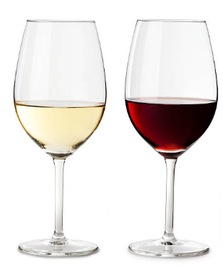
Wine Quality Project
Cagla Keles and Shawn Oyer
6/7/2024

Slide 2
Intro and Overall Goals
This project seeks to unravel the complex relationships between the physicochemical properties of wine and its perceived quality.
Utilizing comprehensive datasets from the UCI Machine Learning Repository and Kaggle, this research focuses on red and white variants of the Portuguese "Vinho Verde" wine, catalogued from the 2009 vintage.
Goal 1: Predicting Sweetness of Wine (Sweet vs Dry)
Created new classification based on Residual Sugar
Goal 2: Predicting Wine Body (Light-bodied vs Full-bodied)
Created new classification based on Alcohol
Goal 3: Predicting Quality of Wine (Good vs Bad)
Created new classification based on Quality
Goal 4: Identifying Best Predictive Features for Wine Quality
Used all features to predict Quality

Slide 3
The Dataset and Pre-Processing
The datasets contain detailed assessments of 1,599 red and 4,898 white wine samples, each evaluated by wine experts whose sensory ratings provide a robust basis for our analysis.
The sensory data was created using the median of at least 3 evaluations made by wine experts and each expert graded the wine quality between 0 (very bad) and 10 (excellent).
Physicochemical properties includes acidity levels, sugar content, alcohol percentage, density, pH, chloride, sulfate and sulfur dioxide levels, allowing for a comprehensive exploration of their impact on wine quality.
Pre-processing
Handling missing values: Imputation where appropriate, or removal of records if the missing data was too sparse or deemed non-random.
Outlier detection and treatment: By using statistical methods such as Z scoring, we identified and removed anomalous values.
Data normalization: We checked for normalization using D’Agostino-Pearson Normality Test and improved skewness using Yeo-Johnson Transformation distribution to have a uniform scale without distorting differences in the ranges of values or losing information.
Encoding categorical variables: Categorical descriptors of taste such as "sweet" or "dry" were converted into binary formats, facilitating their use in various classification models.
Reducing Dimensionality: We determined Multicollinearity using Variance Inflation Factor (VIF) to determine if the independent variables were redundant and could potentially be dropped to reduce dimensionality, however, it was determined that there were no high VIF scores so every column was retained.

Slide 4
Models/Algorithms Used
Random Forest Classifier
Random Forest builds multiple decision trees and merges them together to get a more accurate and stable prediction. It is great for classification and regression tasks, providing insights into feature importance and robustness against overfitting.
XGBoost (Extreme Gradient Boosting) Classifier
XGBoost is an optimized distributed gradient boosting library that is designed to be highly efficient, flexible, and portable. It excels in performance and speed across many areas of machine learning and is particularly effective in handling large and complex datasets.
Gradient Boosting Classifier
Gradient Boosting constructs models sequentially, with each new model correcting errors made by the previous ones, using gradient descent to minimize loss. It's excellent in handling various types of data and effective in improving predictions iteratively, especially for structured data.
Linear Regression
A linear regression model describes the relationship between a dependent variable, y, and one or more independent variables, X. The dependent variable is also called the response variable. Independent variables are also called explanatory or predictor variables.
Decision Tree Regressor
A decision tree is a non-parametric supervised learning algorithm, which is utilized for both classification and regression tasks. It has a hierarchical, tree structure, which consists of a root node, branches, internal nodes and leaf nodes.

Slide 5
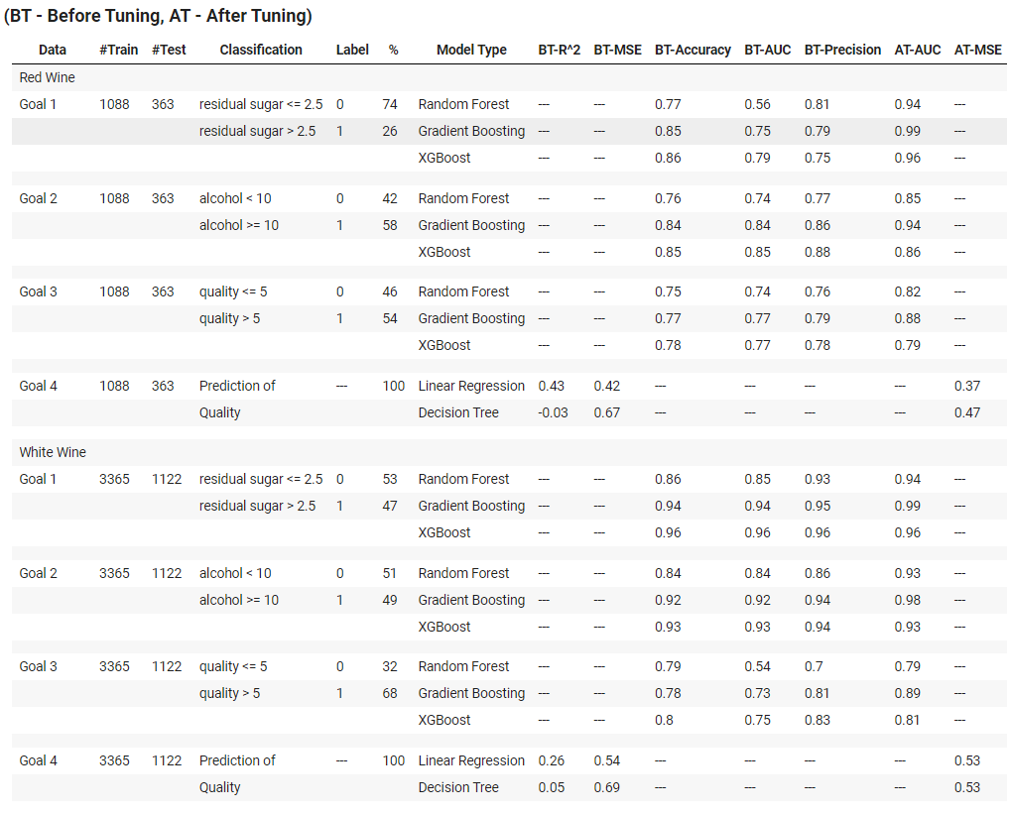
Models/Algorithms Evaluations

Slide 6
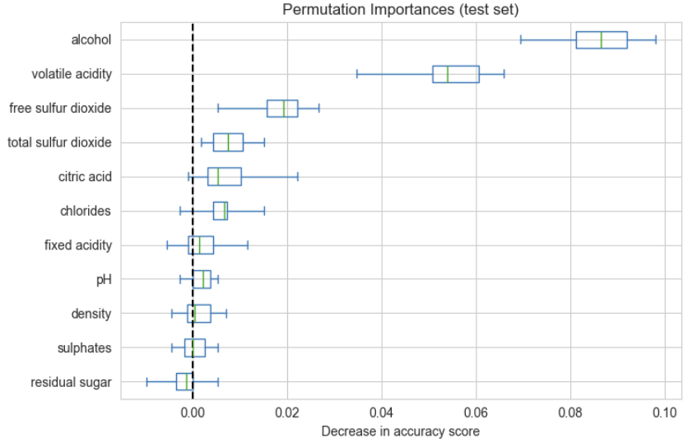
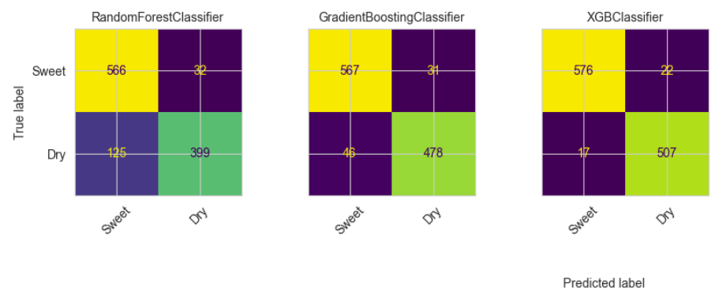
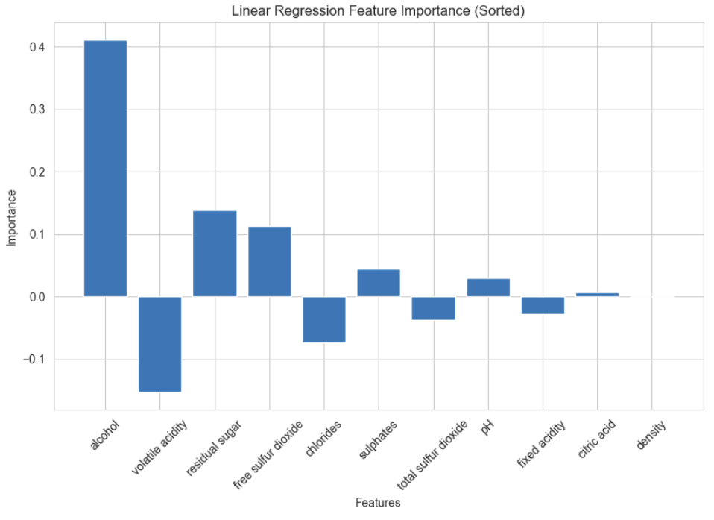
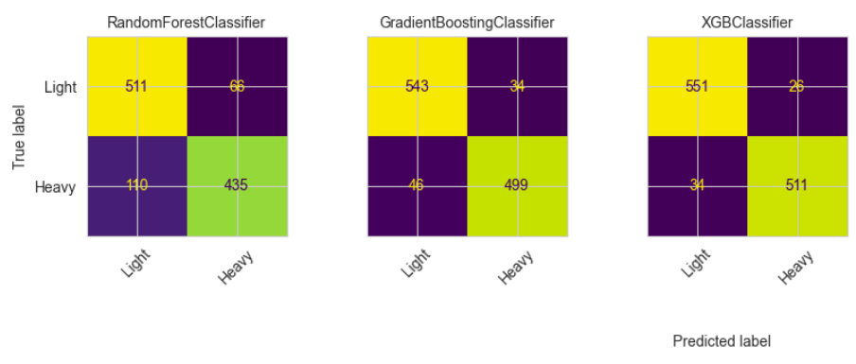
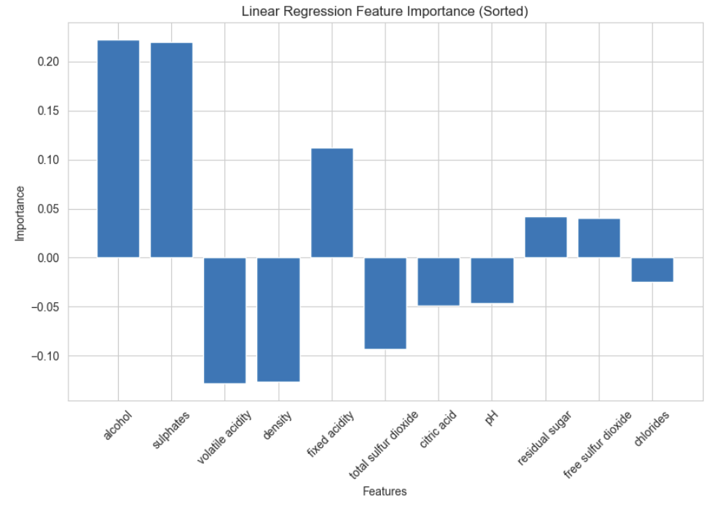
Models/Algorithms Evaluations
Goal 3
Goal 1
Goal 2
White Wine
Red Wine
Goal 4

Slide 7
Models/Algorithms Discussion and Performance
Goal 1: Predicting Sweetness of Wine
For both red and white wines, the Random Forest (RF), Gradient Boosting (GB), and XGBoost (XGB) classifiers were initially overfitted. After parameter adjustments, GB outperformed other models, particularly in AUC, which reaching 99% in both wine types post-tuning. Key predictive features for sweetness included density, alcohol, and various sulfur metrics, which differed slightly between red and white wines.
Goal 2: Predicting Wine Body (Light-bodied vs Full-bodied)
Similar to Goal 1, RF and XGB exhibited overfitting initially. Post-tuning, GB provided the highest AUC, with notable improvements, achieving 88% for red wines and 98% for white wines. Predictive features of a wine's body included density, residual sugar, and sulphates, with some differences in predictive features between red and white wines, such as the reliance on total sulphates for red wines and fixed chlorides for white wines.
Goal 3: Predicting Quality of Wine (Good vs Bad)
Once again, RF and XGB showed initial overfitting, which was mitigated through model tuning. GB achieved the highest AUC scores post-tuning, with 88% for red wines and 89% for white wines. Alcohol level emerged as the most significant predictor of quality across both wine types, alongside other features like sulphates and volatile acidity.
Goal 4: Identifying Best Predictive Features for Wine Quality
Linear Regression (LR) and Decision Tree Regressor (DT) were used to identify predictive features. Before tuning, LR had higher R^2 scores indicating that it explained variability in wine quality better than DT, and it also had lower MSE scores suggesting more accurate predictions. After model parameter tuning, improvements were noted in the MSE values, underscoring the effectiveness of the tuning process. Key features identified included alcohol, sulphates, and volatile acidity. Interestingly, there were distinctions between the features important for red and white wines, and density was found to have no bearing on wine quality at all.

Slide 8
Conclusion, Limitations and Future Work
Across all goals, GB consistently outperformed other models post-tuning, particularly in terms of AUC. Alcohol was consistently a critical predictor across different classifications (sweetness, body, quality) as well as the leading predictor in wine quality.. The results underline the effectiveness of parameter tuning in enhancing model performance and reducing overfitting, as well as the importance of specific physicochemical features in predicting different aspects of wine.
Limitations:
The study faces limitations such as model overfitting, particularly with Random Forest and XGBoost, and potential data imbalances in quality ratings, which might skew predictions. Additionally, the reliance solely on physicochemical properties and expert ratings could limit the model's comprehensiveness and introduce subjectivity.
Future work:
Future work could enhance robustness by incorporating diverse features like climatic conditions and soil types, applying advanced machine learning models, and using more rigorous cross-validation techniques. Expanding the study to include various types of wines and implementing techniques to address data imbalance could also improve model generalization and predictive accuracy, making the findings more applicable.

Slide 9
Team Members and Workload Distribution
Cagla Keles
Skills/Experience: Java and Python, Carbon neutral building design, Artificial Intelligence, Research
Contributions:
Goals 1-2, Presentation, Report
Shawn Oyer
Skills/Experience: Python, SQL, GIS, Data analytics, Quality control
Contributions:
Goals 3-4, README, Data Dictionary, Report

Slide 10
Resources Used
Johnson, Philip, and John Burgee. “Predicting Wine Quality project.” Wikipedia, the free encyclopedia, https://www.kaggle.com/code/rielumboh/predicting-wine-quality-project. Accessed 3 June 2024.
P. Cortez, A. Cerdeira, F. Almeida, T. Matos and J. Reis. Modeling wine preferences by data mining from physicochemical properties. In Decision Support Systems, Elsevier, 2009, 47(4):547-553. ISSN: 0167-9236.
Dataset Links:
https://archive.ics.uci.edu/dataset/186/wine+quality
https://www.kaggle.com/datasets/uciml/red-wine-quality-cortez-et-al-2009

