Slide 1
High Performance Machines- Asia Pacific and PRC Region

Slide 2
Agenda
1
Objective of the project
2
Evaluation of the current policy
3
Policy Improvement using Markov Decision Process
4
Suggestions

Slide 3
Objective
Objective
Current Policy
Optimal Policy
Suggestions
1. Early and efficient issue resolution plays a key role in reducing costs and driving customer satisfaction
2. Lenovo can select from three different service actions to resolve an issue
3. Based on history, each service action has a different likelihood of solving a particular issue
The likelihood of a service action leading to a resolution
For a given issue, which service action would lead to a quick and cost efficient issue resolution?
Background
Uncertainties
Key
Question

Slide 4
Evaluation of the current policy

Slide 5
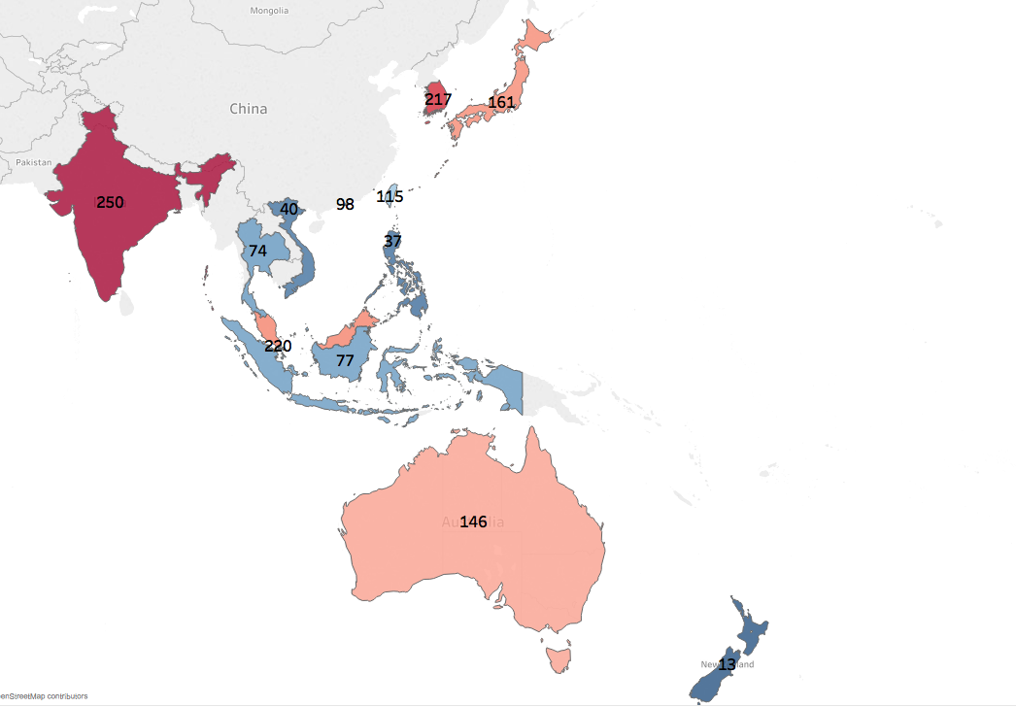
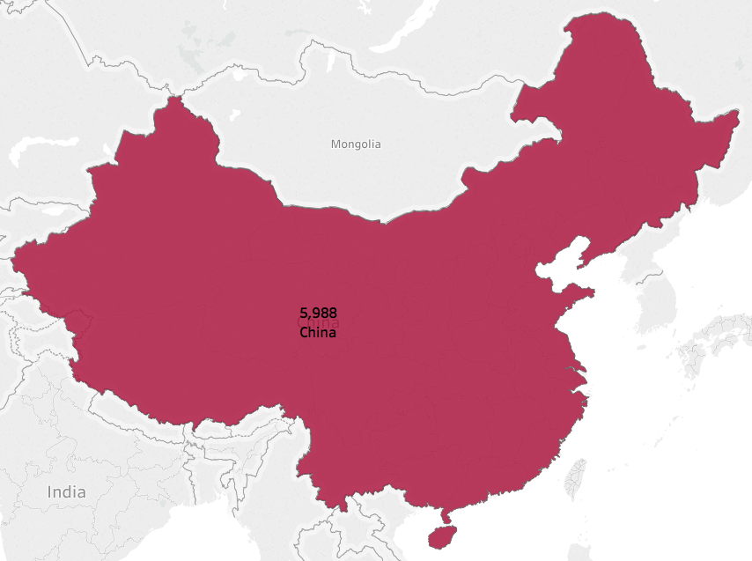
In the past year, ~6k and 1.6k High Performance machine issues were resolved in the PRC and Asia Pacific region
Objective
Current Policy
Optimal Policy
Suggestions
Asia Pacific Region
PRC Region

Slide 6





Asia Pacific vs PRC Comparison
Objective
Current Policy
Optimal Policy
Suggestions
Asia Pacific
PRC
Number of issues resolved
Number of issues resolved
1.6k
6k
Avg # of days to issue resolution
Avg # of days to issue resolution
2.6
1.7
% of L3 escalations
% of L3 escalations
5.9%
0.7%
# of service actions per issue
# of service actions per issue
1.6
1.2
1st service action resolution %
1st service action resolution%
71%
84%

Slide 7
Process for categorizing Asia Pacific and PRC issues
Objective
Current Policy
Optimal Policy
Suggestions
Issue arrives
Issue solved by 1 Service Action
Perform Service Action
Any Service Action in next 30 days?
Yes
‘>1’ Service Action category
Issue solved by >1 Service Action
No
1 Service Action category

Slide 8
In Asia Pacific region, 45% of the issues resolved in 1 service action are through NPRA
Objective
Current Policy
Optimal Policy
Suggestions

Slide 9
In Asia Pacific region, for issues solved by more than 1 service action, 83% of the unsuccessful actions* are SSR
Objective
Current Policy
Optimal Policy
Suggestions
*As the number of steps increase, the % of SSR which do not lead to a resolution increases. This could be because of the following reasons
In the current data, multiple parts had to be replaced which are captured as multiple SSR steps
Lack of clarity about whether these multiple steps contributed to the overall resolution of the issue

Slide 10
Policy Improvement using Markov Decision Process

Slide 11
Objective
Current Policy
Optimal Policy
Suggestions
There are 5 key components for a Markov Decision Process
State Space
Action Space
Markov Decision Process
Transition Probabilities
Epoch
Reward Matrix

Slide 12
Objective
Current Policy
Optimal Policy
Suggestions
There are 5 key components for a Markov Decision Process
State Space
States indicate the available information about an issue at given point in time
States were defined as a combination of the machine status (Broken, Fixed) along with the previous action performed for the issue
List of States are B-NA, B-FOP, B-CRU, B-NPRA, B-ONS, F-FOP, F-CRU, F-NPRA, F-ONS, F-L3
Actions available at each state
 | L1/L2 | SSR | L3 escalation | Do Nothing
B - NA | ✓ | ✓ | ✓ | ✓
B - FOP | ✓ | ✓ | ✓ | ✓
B - CRU | ✓ | ✓ | ✓ | ✓
B - NPRA | ✓ | ✓ | ✓ | ✓
B - ONS | ✓ | ✓ | ✓ | ✓
F - FOP | ✘ | ✘ | ✘ | ✓
F - CRU | ✘ | ✘ | ✘ | ✓
F - NPRA | ✘ | ✘ | ✘ | ✓
F - ONS | ✘ | ✘ | ✘ | ✓
F - L3 | ✘ | ✘ | ✘ | ✓
Action Space
Actions are the decisions taken by Lenovo to resolve an issue
List of possible actions include L1/L2, SSR, L3 escalation, Do Nothing
Future States of the machine are impacted by the action chosen

Slide 13
Objective
Current Policy
Optimal Policy
Suggestions
There are 5 key components for a Markov Decision Process
Epoch
Sample Transition Probability Matrix
Epoch indicates all the moments where the status of the machine is recorded and a potential action can be initiated
For this MDP, epoch has been defined as 1/4th of a day
 | B-NA | B-FOP | B-CRU | B-NPRA | B-ONS | F-FOP | F-CRU | F-NPRA | F-ONS | F-L3
B - NA | 0 | 0.05 | 0.01 | 0.07 | 0.15 | 0.20 | 0.05 | 0.32 | 0.14 | 0.00
B - FOP | 0 | 0.15 | 0.03 | 0.07 | 0.11 | 0.28 | 0.04 | 0.19 | 0.07 | 0.07
B - CRU | 0 | 0.00 | 0.12 | 0.16 | 0.08 | 0.36 | 0.20 | 0.00 | 0.00 | 0.08
B - NPRA | 0 | 0.02 | 0.00 | 0.15 | 0.19 | 0.07 | 0.01 | 0.23 | 0.13 | 0.21
B - ONS | 0 | 0.03 | 0.00 | 0.04 | 0.49 | 0.01 | 0.00 | 0.05 | 0.30 | 0.09
F - FOP | 0 | 0 | 0 | 0 | 0 | 1 | 0 | 0 | 0 | 0
F - CRU | 0 | 0 | 0 | 0 | 0 | 0 | 1 | 0 | 0 | 0
F - NPRA | 0 | 0 | 0 | 0 | 0 | 0 | 0 | 1 | 0 | 0
F - ONS | 0 | 0 | 0 | 0 | 0 | 0 | 0 | 0 | 1 | 0
F - L3 | 0 | 0 | 0 | 0 | 0 | 0 | 0 | 0 | 0 | 1
TransitionMatrix
Transition Matrix represents the probability of moving from one state to another under a given action
The matrix is calculated based on the transitions seen historically
Reward
Matrix
Reward matrix provides the expected cost of taking an action in a particular state
For e.g., Costs associated with a L3 escalation is much higher than for L1/L2 or SSR service action
On average, there is a 20% chance that a machine in B – NA state will move to F-FOP state

Slide 14
Objective
Current Policy
Optimal Policy
Suggestions
For PRC, the optimal policy for a broken machine is to perform an L1/L2 action except for B-CRU state for M24/M27 machines
PRC Region – M23/M26
PRC Region – M24/M27
 | L1/L2 | SSR | L3 escalation | Do Nothing
B - NA | ✓
B - FOP | ✓
B - CRU | ✓
B - NPRA | ✓
B - ONS | ✓
F - FOP |  |  |  | ✓
F - CRU |  |  |  | ✓
F - NPRA |  |  |  | ✓
F - ONS |  |  |  | ✓
F - L3 |  |  |  | ✓
 | L1/L2 | SSR | L3 escalation | Do Nothing
B - NA | ✓
B - FOP | ✓
B - CRU |  | ✓
B - NPRA | ✓
B - ONS | ✓
F - FOP |  |  |  | ✓
F - CRU |  |  |  | ✓
F - NPRA |  |  |  | ✓
F - ONS |  |  |  | ✓
F - L3 |  |  |  | ✓

Slide 15
Objective
Current Policy
Optimal Policy
Suggestions
For Asia Pacific, the optimal policy for a broken machine is to perform an L1/L2 action
Asia Pacific Region
Sensitivity Analysis
 | L1/L2 | SSR | L3 escalation | Do Nothing
B - NA | ✓
B - FOP | ✓
B - CRU | ✓
B - NPRA | ✓
B - ONS | ✓
F - FOP |  |  |  | ✓
F - CRU |  |  |  | ✓
F - NPRA |  |  |  | ✓
F - ONS |  |  |  | ✓
F - L3 |  |  |  | ✓
Following are the metrics that we changed to analyze the robustness of the policy
Service Cost associated with FOP, ONS and L3: Variation of 30% did not yield a change in policy
Transition Probabilities associated with service actions: Variation of 20% did not yield a change in policy

Slide 16
Suggestions
Objective
Current Policy
Optimal Policy
Suggestions
1
Information about whether a service action helped resolve an issue – This will help us better estimate the Markov Decision Process parameters like cost and transition probability matrices
2
Initial data gathered by the L1 associate about the issue – This will help us eliminate service actions which are not suitable for resolving the issue

Slide 17
Appendix

Slide 18
Assumptions
1
All claims for a machine received in 30 days after the first claim, were considered to be implemented for the same issue. If no service action was performed within 30 days of the last service action implemented, the machine is considered to be fixed
2
For the claims which were escalated to L3, L3 was considered to be the last service action leading to a fixed machine
3
For the claims on which multiple service actions were attempted, only the last service action attempted was considered the successful service action which fixed the machine.
4
Service actions of same type performed on a single day were considered to be different records. For instance, if ONS was attempted twice on the same day, it was considered as two separate onsite visits.

Slide 19
In PRC region, for issues solved by more than 1 service action, 71% of the unsuccessful actions* are SSR
As the number of steps increase, the % of SSR which do not lead to a resolution increases. This could be because of the following reasons
Multiple parts had to be replaced
Lack of clarity about whether a service action contributed to the overall resolution

Slide 20
Distribution of Successful Service Actions for Major Machines in PRC
M23 and M26 have similar distribution and M24 and M27 have similar distribution

Slide 21
Distribution of Issues resolved in Asia Pacific Region by Machine Type

Slide 22
Distribution of Issues resolved in PRC Region by Machine Type

Slide 23
Evolution of machines by Region using Markov Chain

Slide 24
MDP Transition Probabilities and Reward Matrix - PRC
L1/L2 Action
L3 Action
SSR Action
DN Action
Reward Matrix
Penalty of $2 is levied if the service action fails to fix the machine
Penalty of $4 is levied if there is no action taken in the epoch
Cost of other actions are derived from historical trend of cost of actions

Slide 25
Regression Model to predict the next Service Action
Takes care of wear and tear of machine over the years
Tracks behavior of different machines and their response to service action in past
Age of the machine
Machine Type
# SB replaced before this claim
Frequency of machine needing an SSR action in past
Track nature of customers and variation of company policies across countries
Country Code
Service Action Prediction Model
Frequency of machine having complicated part
# Processor replaced before this claim
Times machine required representative visit
# SSR service actions
# of L3 resolutions to track if any major repairing in the past
# prior escalations to L3
# L1/L2 service actions
Times issue could be solved with L1/L2
Forward step-wise selection was used to build the Logistic Regression Model
Accuracy of ~67% was achieved in forecasting the next service action for a machine
Accuracy can be improved significantly by using the initial information collected by L1 associate about the issue

