Slide 1
Connect-Games
Shawn Salm
Professor DURGA SURESH-MENON
Capstone (comp 7500)
April 16th, 2018

Slide 2
Need for Connect-Games
Currently, online and mobile games exist that allow one to play such games against other people from around the world or against a computer at different levels of difficulty.
Playing against live opponents however, can be problematic in that each person has different schedules as well as different amounts of time in which they can devote to the game.
Playing a computer solves the asynchronous problem that one has when playing against a live opponent, however also may feel mechanical to engage with and unsatisfying when winning.

Slide 3
How Connect-Games Addresses these Problems
Connect-Games allows one to teach a computer student how to win at games such as Tic Tac Toe or Connect Four simply as playing as an opponent.
The user will can see the computer student’s progress as it plays against other user’s taught computer students.
In this way, one will get the convenience of playing against a computer while at the same time, the satisfaction of a computer student winning against another user’s computer student.

Slide 4


How Connect-Games Works
Connect-Games is made up of a C# program to perform the logic of the system and a SQL Server database to hold the results of the games played as well as the users’ information such as their username and password.
The program is able to manage games that play on a two-dimensional board in which the winner connects n-number of their pieces in a row such as Tic Tac Toe or Connect Four.
This required that the games are broken down into simple sequences with the allowed behavior of a player being able to be interchangeable as well as the rules for winning a game.
Each game’s sequence of moves is stored allowing the computer student to learn by using winning sequences as a model in determining their next move.
The game is hosted on the cloud platform Azure with the user interface being a simple combination of ASP.NET MVC with an HTML/JavaScript front end.

Slide 5
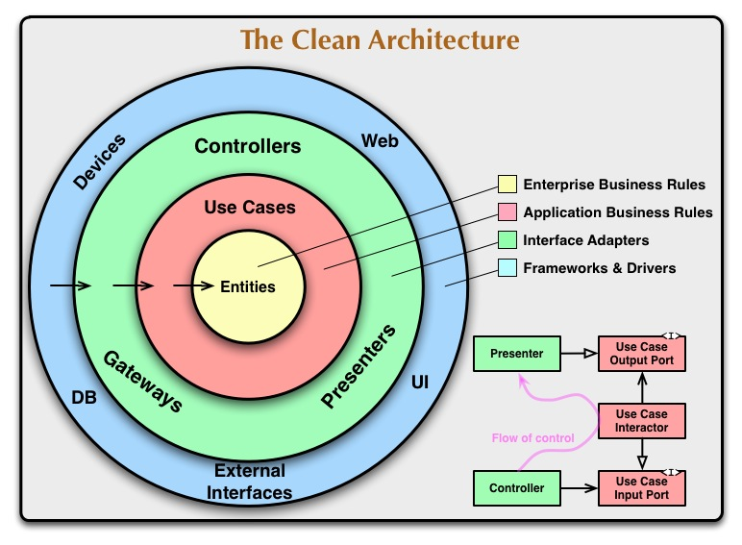
Architecture Based on
https://8thlight.com/blog/uncle-bob/2012/08/13/the-clean-architecture.html

Slide 6
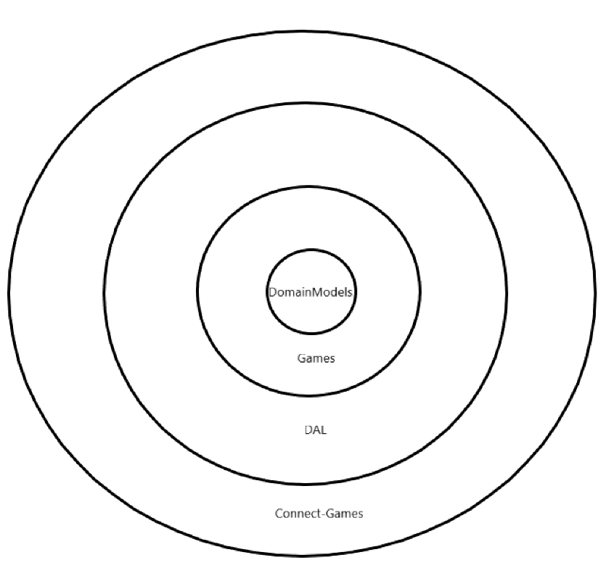
Architecture
Components: Connect-Games.DomainModels, Connect-Games.Games, Connect-Games.DAL, and ConnectGames

Slide 7
Design of Domain.Model Component
The classes and interfaces contained in the Connect-Games.DomainModels make up the core design of Connect-Games and depends on no frameworks or components other than the .NET Core framework 2.0 in which it is written in.
The style is a program to an interface style where as much as possible classes work with abstractions or interfaces. This allows for framework independent, testable, UI independent, and database independent design and code.

Slide 8
Design of Domain.Model Component
The Connect-Games.DomainModels can be broken up into four main areas of functionality: move behaviors, rules, AI, and game.
The move behaviors and rules allow for a mixing and matching of available moves and the rules that govern a game. Therefore, more games than Connect Four and Tic-Tac-Toe can be created simply by creating new types of move behaviors and rules, for example, 3D-Tic-Tac-Toe or new game never played before could be invented.

Slide 9
Design of Domain.Model Component
The AI section of the component allows for the computer student to learn to play a game. It is also designed using interfaces that allow for different machine learning algorithms to be used in place of the simple default version.
Finally, the games section has classes that model a game engine and provide the functionality for a match between to AI computer players. Each of these classes can be reused or replaced simply by providing a different implementation for the given interfaces.

Slide 10
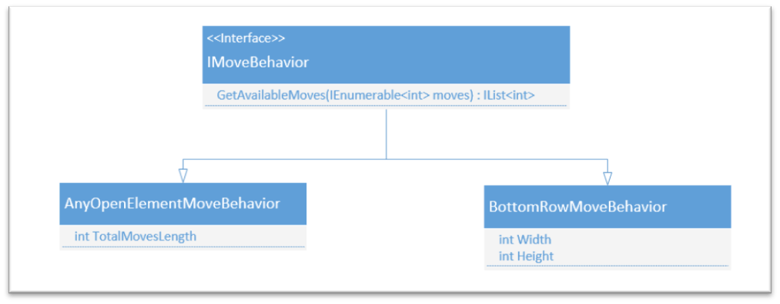
Move Behaviors

Slide 11
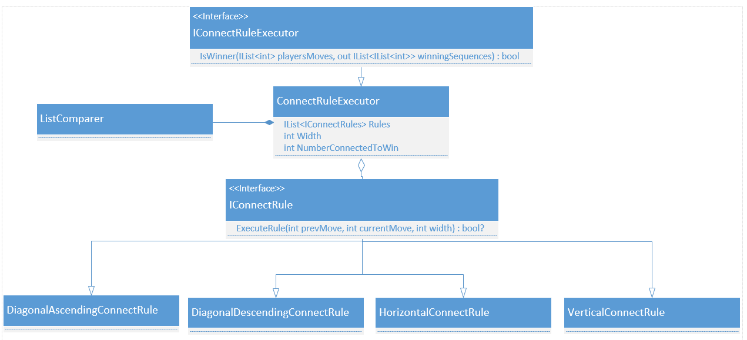
Rules

Slide 12
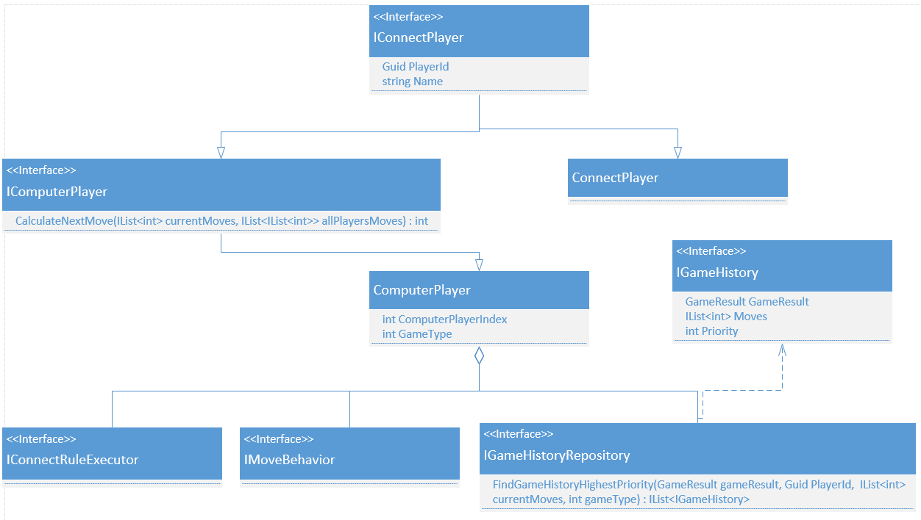
AI

Slide 13
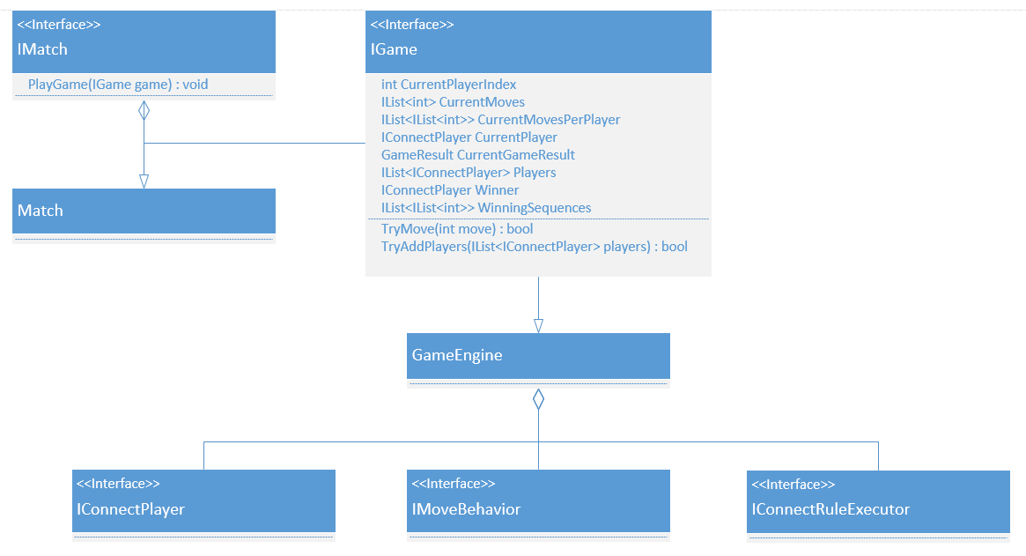
Game Engine

Slide 14
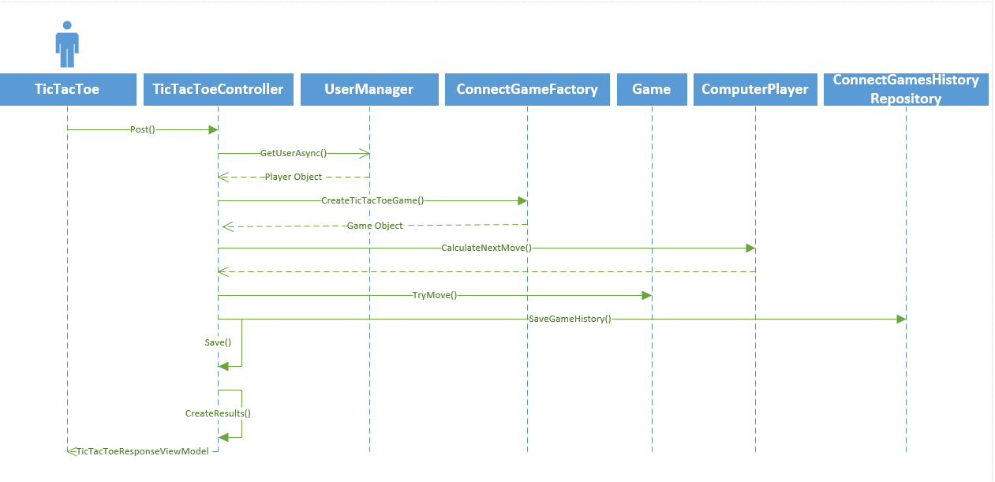
User Trains Computer Student at Tic-Tac-Toe

Slide 15
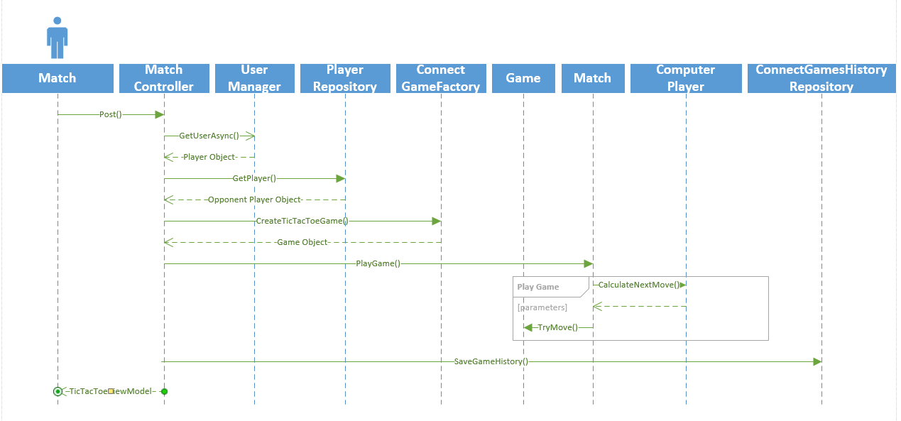
User Sets Match Between Computer Students

Slide 16
Default Algorithm for the Computer Student to Pick its next Move
The computer tests to see if any of its available moves will win the game. If so, that will be the computer’s move.
The computer tests to see if any of the available moves will cause it to loss the game. If so, the computer will block the opponent from winning by making that move.
The computer checks to see if the current sequence of moves equals a sequence of moves so far in which the player won by retrieving records from the GameHistory records where it has played the game. If there is more than one sequence, then a random one is selected. If the computer finds that, based on its game history records, that it is current playing a sequence in which it will lose, then the computer if it is able to, will try a different move than the one in which it lost before.
Finally, if none of the above steps caused the computer to make a move, then a random move is selected from the available list of valid moves.

Slide 17
Connect-Games
demo

Slide 18
Connect-Games
Thank you for watching!

