Slide 1
A Deep Reinforcement Learning Framework for the Financial Portfolio Management Problem
Zhengyao Jiang
Dixing Xu
Department of Computer Sciences and Software Engineering
Jinjun Liang
Department of Mathematical Sciences
Xi’an Jiaotong-Liverpool University
Suzhou, SU 215123, P. R. China
Presented by: Shawn Anderson

Slide 2
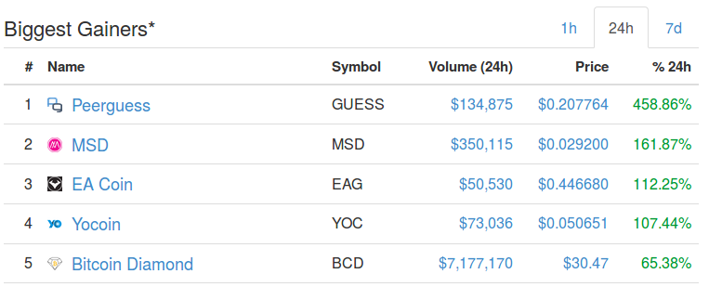
Can we build a machine to trade our Bitcoin for us?!
Cryptocurrency prices are unprecedented.
The Market cap is now over 450 Billion Dollars
[1] https://coinmarketcap.com/gainers-losers/

Slide 3
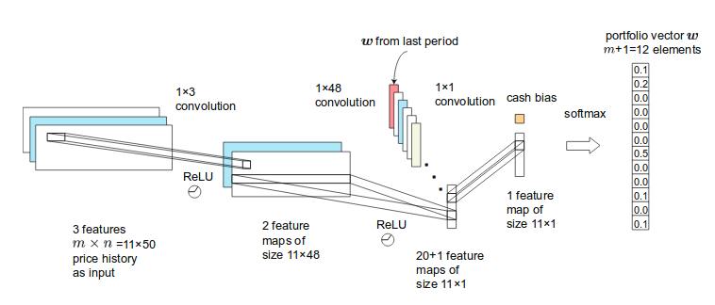
Yes we can!
The Portfolio Vector w_{t}
The Price Tensor X_{t}
W_{t-1}
Deep Reinforcement Learning

Slide 4
Outline
Cryptocurrencies and Markets
The Portfolio Management Problem
Reinforcement Learning as a Portfolio Manager
Mini-machine Network Topology
Results and Future Work

Slide 5
Outline
Cryptocurrencies and Markets
The Portfolio Management Problem
Reinforcement Learning as a Portfolio Manager
Mini-machine Network Topology
Results and Future Work

Slide 6
Cryptocurrencies and Markets
Cryptocurrencies are tradeable, digital assets that can represent value and be traded on an open market.
Cryptocurrency exchanges are websites that serve as open marketplaces where users can trade cryptocurrencies for other cryptocurrencies or fiat currencies.

Slide 7

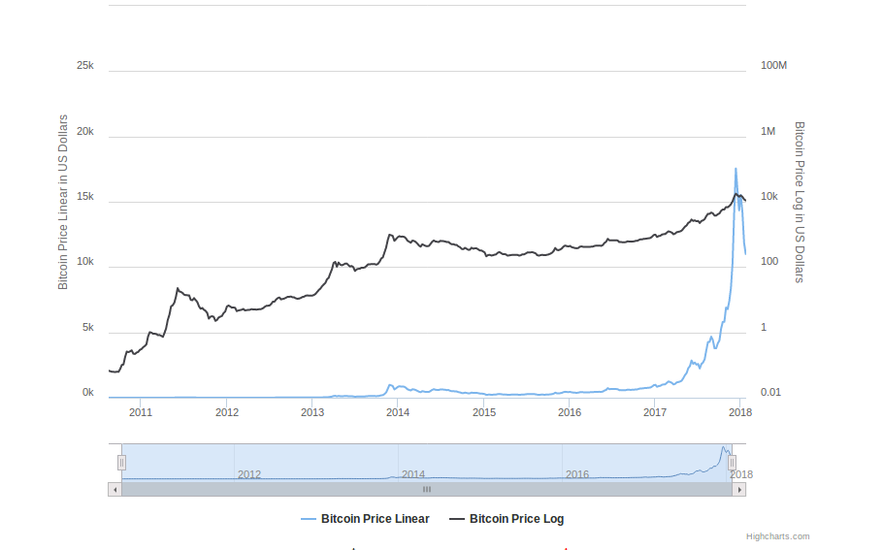
What is Cryptocurrency?
Bitcoin Price 2011-2018
January 3rd 2009 First Bitcoins mined by Satoshi Nakamoto
Bitcoin is a public ledger
There will only ever be 21 million Bitcoin, creating scarcity
Now there are over 1000 ‘altcoins’
Cryptocurrencies are referred to as ‘coins’
Price of one Bitcoin in USD from 2011-2018.
Blue: Price, Black: Log Price
[2] https://www.buybitcoinworldwide.com/price/
Notes:
Bitcoin is a public ledger. That is, it’s simply a list of transactions between private keys.
The ledger is broken up into blocks. Every 10 minutes a new block is appended to the ledger.
Miners compete to add the new block to the ledger.
The successful miner adds a special transaction to the block which credits 25 coins to her private key.

Slide 8
Why Cryptocurrency Markets?
poloniex.com
Open 24/7
Free API access to trading and data
High price movement and volatility
Decentralization and Openness
A gif of the ‘Markets’ view on poloniex.com,
A Cryptocurrency Exchange
[3] poloniex.com

Slide 9
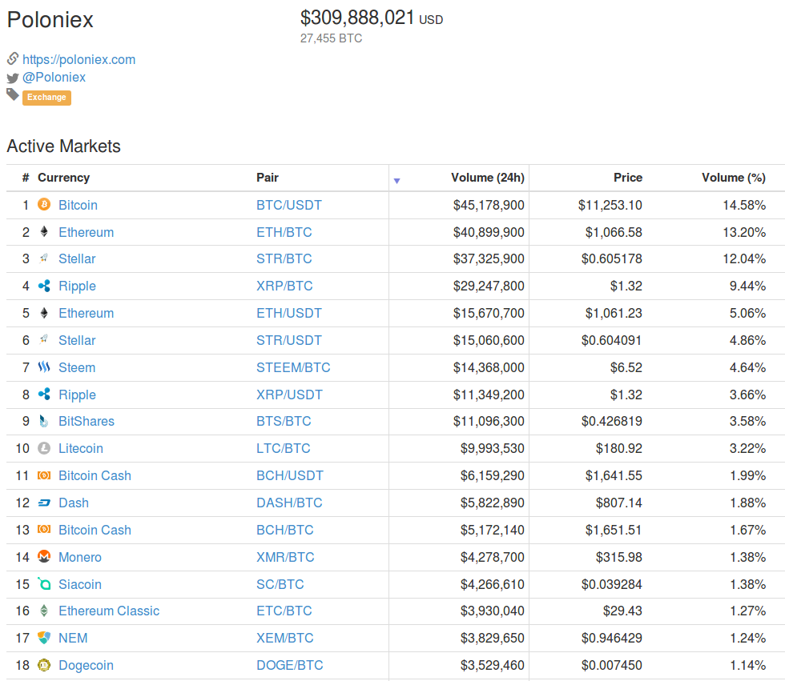
Market Assumptions and Asset Selection
Zero Slippage
If we see a trade, then we can
execute it.
Zero Market Impact
Our buys and sells do not
effect market prices.
Poloniex Trade Pairs by Volume
Poloniex Trade Pairs Ranked by Trade Volume (Top 4)
[3] https://coinmarketcap.com/exchanges/poloniex/

Slide 10
Outline
Cryptocurrencies and Markets
The Portfolio Management Problem
Reinforcement Learning as a Portfolio Manager
Mini-machine Network Topology
Results and Future Work

Slide 11
The Portfolio Management Problem
Given a portfolio of assets, periodically redistribute the portfolio in order to maximize gains over each period.

Slide 12


Managing Our Portfolio
m: Number of Assets
T: Length of time period
t: Time step counter
Assets
w_{t-1}
v_{t-1}
w_{t}
v_{t}
w_{t+1}
v_{t+1}
Price Vector
50%
1
30%
1
35%
1
40%
0.5
50%
0.4
40%
0.8
10%
0.3
20%
0.6
25%
0.7
Portfolio Vector
w_{t}: Portfolio Vector
v_{t}: Price Vector

Slide 13

The Relative Price Vector
w_{t-1}
v_{t-1}
w_{t}
v_{t}
w_{t+1}
v_{t+1}
50%
1
30%
1
35%
1
40%
0.5
50%
0.4
40%
0.8
10%
0.3
20%
0.6
25%
0.7
y_{t}
y_{t+1}
1
1
Relative Price Vector
0.8
2
2
1.17
w_{t}: Portfolio Vector
v_{t}: Price Vector
y_{t}: Relative Price Vector

Slide 14

The Rate of Return
w_{t-1}
w_{t}
w_{t+1}
50%
30%
35%
40%
50%
40%
10%
20%
25%
⍴_{t} 0.02
⍴_{t} 0.534
y_{t}
y_{t+1}
Rate of Return
1
1
0.8
2
2
1.17
w_{t}: Portfolio Vector
y_{t}: Relative Price Vector
⍴_{t}: Rate of Return

Slide 15
The Portfolio Value
w_{t-1}
w_{t}
w_{t+1}
50%
30%
35%
40%
50%
40%
10%
20%
25%
⍴_{t} 0.02
⍴_{t} 0.534
y_{t}
y_{t+1}
1
1
Portfolio
Value
2
0.8
2
1.17
w_{t}: Portfolio Vector
y_{t}: Relative Price Vector
⍴_{t}: Rate of Return
p_{t}: Portfolio Value
p_{t-1} $10.00
p_{t} $10.20
p_{t +1} $15.65

Slide 16
Logarithmic Rate of Return
w_{t-1}
w_{t}
w_{t+1}
50%
30%
35%
40%
50%
40%
10%
20%
25%
r_{t} 0.02
r_{t} 0.43
y_{t}
y_{t+1}
Log Rate of Return
1
1
0.8
2
2
1.17
w_{t}: Portfolio Vector
y_{t}: Relative Price Vector
r_{t}: Log Rate of Return
p_{t}: Portfolio Value
p_{t-1} $10.00
p_{t} $10.20
p_{t +1} $15.65
Notes:
There are two ways you can see it:
Predict y_{t}
Produce w_{t-1} such that (w_{t-1} . y_{t}) is maximized

Slide 17

Maximize Final Portfolio Value
w_{t-1}
w_{t}
w_{t+1}
50%
30%
35%
40%
50%
40%
10%
20%
25%
r_{t} 0.02
r_{t} 0.43
y_{t}
y_{t+1}
1
1
0.8
2
2
1.17
w_{t}: Portfolio Vector
y_{t}: Relative Price Vector
r_{t}: Log Rate of Return
p_{t}: Portfolio Value
p_{t-1} $10.00
p_{t} $10.20
p_{t +1} $15.65
Notes:
There are two ways you can see it:
Predict y_{t}
Produce w_{t-1} such that (w_{t-1} . y_{t}) is maximized

Slide 18
Outline
Cryptocurrencies and Markets
The Portfolio Management Problem
Reinforcement Learning as a Portfolio Manager
Mini-machine Network Topology
Results and Future Work

Slide 19
System Overview
The Portfolio Vector w_{t}
The Price Tensor X_{t}
W_{t-1}
Deep Reinforcement Learning

Slide 20
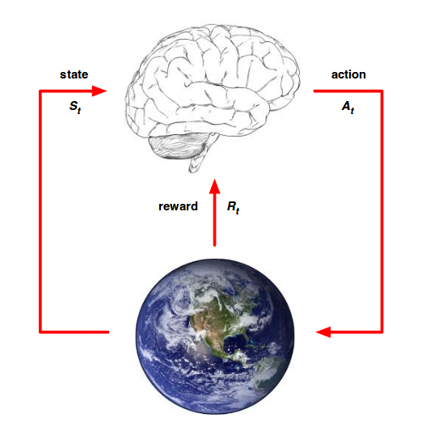
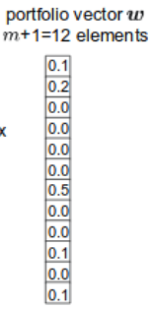
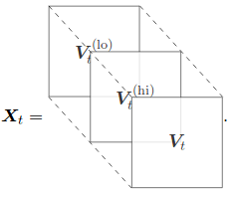
Reinforcement Learning as a Portfolio Manager
Agent
r_{t}
w_{t-1}
w_{t}
w_{t}: Portfolio Vector
X_{t}: Price Tensor
r_{t}: Rate of Return
Environment
[3] Silver, David. Retrieved from: http://www0.cs.ucl.ac.uk/staff/d.silver/web/Teaching_files/intro_RL.pdf
Notes:
The agent and the environment
Environment is all assets in the market, and the expectations of all participants
Efficient Market Hypothesis - All information about assets is reflected in the price itself. (Technical analysis)
Asset Preselection
Periodic Feature Extraction
History cut-off
External state: X_{t}, Internal State: w_{t-1}
Portfolio Value is not considered as internal state due to assumption 2

Slide 21
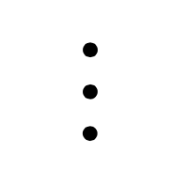

The Price Tensor
w_{t}
v^{(lo)}_{t-50}
v^{(lo)}_{t-49}
v^{(lo)}_{t-2}
v^{(lo)}_{t-1}
f number of features
31%
1
0.7
0.7
1.1
v^{(hi)}_{t-50}
v^{(hi)}_{t-49}
v^{(hi)}_{t-2}
v^{(hi)}_{t-1}
26%
0.5
0.6
0.7
0.9
1.2
1.1
1.1
1.1
v_{t-50}
v_{t-49}
v_{t-2}
v_{t-1}
1.8
1.4
1.1
1
41%
0.6
0.6
1.1
0.7
0.9
0.8
0.9
1.1
m
number of
non-cash
assets
2.1
1.4
1.1
1
2%
0.6
0.6
0.7
0.9
2
1.4
1.1
1
w_{t}: Portfolio Vector
X_{t}: Price Tensor
r_{t}: Rate of Return
n historic periods
Notes:
X_{t} of shape (f,m,n)
m is num of non-cash assets
n is number of input periods before t
f is the feature number

Slide 22


Full Exploitation and the Reward Function
Reward function is explicitly expressed
Actions do not impact the environment
All episodic rewards are equally important
Reward Function:
w_{t}: Portfolio Vector
X_{t}: Price Tensor
r_{t}: Rate of Return

Slide 23
Deterministic Policy Gradient
Action is deterministically produced by the policy, given a state
State s_{t} = (X_{t}, w_{t-1})
Action a_{t} = w_{t} = π_{θ}(s_{t})
Objective Function:
w_{t}: Portfolio Vector
X_{t}: Price Tensor
r_{t}: Rate of Return

Slide 24
Policy Networks
The policy network π_{θ} will be constructed using three different deep Neural Networks, CNN, RNN, and LSTM.
Gradient Ascent Update:

Slide 25
Outline
Cryptocurrencies and Markets
The Portfolio Management Problem
Reinforcement Learning as a Portfolio Manager
Mini-machine Network Topology
Results and Future Work

Slide 26
Mini-machine Topology
The nicknamed ‘Mini-machine Topology’ is the combination of three technical achievements made by the authors:
Ensemble of Independent Identical Evaluators (EIIE)
Portfolio Vector Memory (PVM)
Online Stochastic Batch Learning (OSBL)

Slide 27
Ensemble of Identical Independent Evaluators (EIIE)
Input: Price Tensor X_{t}, Previous portfolio vector w_{t-1}
Networks flow independently for each asset, while parameters are shared.
Softmax Layer: Non-negative and sums to unity
Notes:
Training time scales linearly with number of assets

Slide 28

Ensemble of Identical Independent Evaluators (EIIE)
Input: Price Tensor X_{t}, Previous portfolio vector w_{t-1}
Networks flow independently for each asset, while parameters are shared.
Softmax Layer: Non-negative and sums to unity
Portfolio Value of Coin
From W_{t-1}
Price Tensor
48 x 2 hidden layer
Squashed By Softmax
f features
Coin Evaluation
n periods
3 x 2 Conv
W_{t} Coin Value
48 x 2 Conv (x20)
21 x 1 hidden layer
Notes:
Training time scales linearly with number of assets

Slide 29
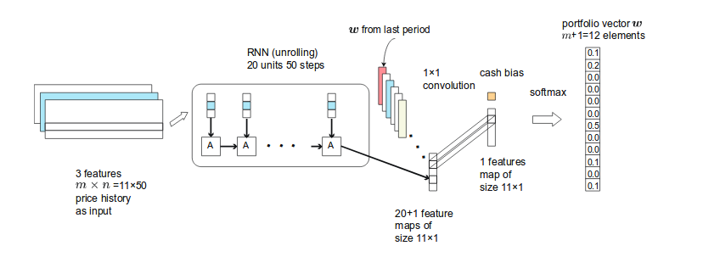
RNN Implementation
EIIE Component can be swapped out for RNN or LSTM

Slide 30
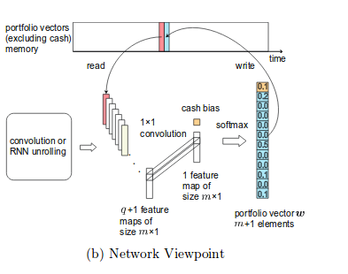
Portfolio Vector Memory (PVM)
To maintain a full record of state history, we require all historic portfolio vectors
State s_{t} = (X_{t}, w_{t-1})

Slide 31

Online Stochastic Batch Learning (OSBL)
We can train on historic data while managing our portfolio in real time!
n_{b}: Size of batches
t_{b}: Randomly selected training period
𝛽: Probability Decay rate
Our batch sample distribution:
Our batch gradient update:
t = 15
0 1 2 3 4 5 6 7 8 9 10 11 12 13 14 15
%3.13 %6.25 %13 %25 %50 0 0 0
P_{𝛽=0.5}(t_{b}), n_{b} = 3:

Slide 32
Mini-machine Topology
This structure allows for incredible performance, few network parameters, linear scaling in number of coins, a convergence of historic portfolio vectors, and efficient online training.

Slide 33
Outline
Cryptocurrencies and Markets
The Portfolio Management Problem
Reinforcement Learning as a Portfolio Manager
Mini-machine Topology
Results and Future Work

Slide 34
Experiments
Cross Validation for hyper parameter tuning
3 Back-Tests to cover different market conditions
Data Purpose | Train (675 days ~ 22 mos) | Test (50 days)
Cross Validation | Jul 2014 - May 2016 | May 2016 - June 2016
Back-Test 1 | Nov 2014 - Sep 2016 | Sept 2016 - Oct 2017
Back-Test 2 | Feb 2015 - Dec 2016 | Dec 2016 - Jan 2017
Back-Test 3 | May 2015 - March 2017 | March 2017 - April 2017

Slide 35



Performance Measures
Accumulative Portfolio Value (fAPV) - Higher is better
Sharpe Ratio (SR) - Higher is better
Maximum Drawdown (MDD) - Lower is better
Notes:
APV - How much did our funds grow?
Sharpe Ratio - Risk adjusted mean return. How does our portfolio perform relative to the risk free asset (Bitcoin)? And how great is its variance relative to the risk free asset?
Maximum Drawdown - What is the greatest sequential loss of our portfolio? Ie. the greatest distance from a peak to a trough

Slide 36
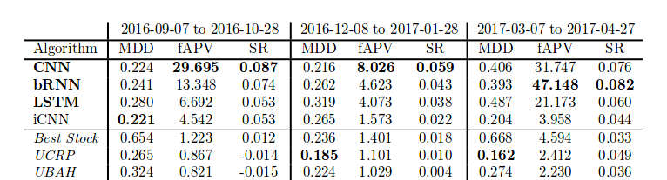
Results
Mini-machine topology dominates fAPV and SR in all three Back-tests
RNN grows Portfolio 47 times in 50 days in Back-test 3!
Back-Test 1 Back-Test 2 Back-Test 3
Work by the Authors
Benchmarks

Slide 37
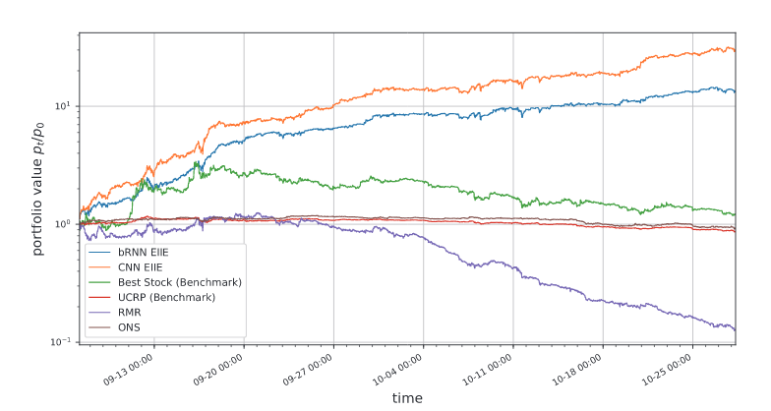
Back Test 1 - Moderate Market Conditions
Sept 2016 - Oct 2017

Slide 38
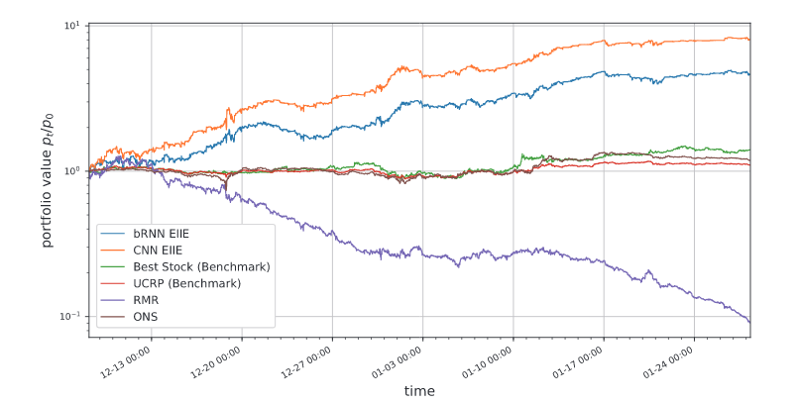
Back Test 2 - Poor Market Conditions
Dec 2016 - Jan 2017

Slide 39
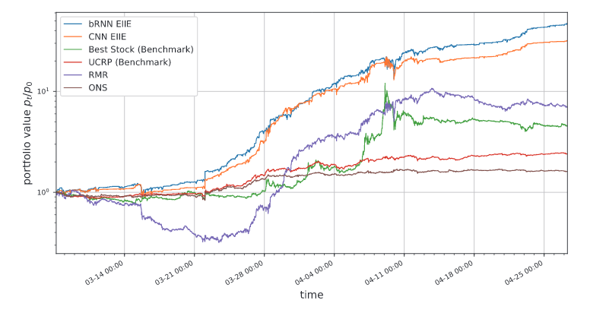
Back Test 3 - Favourable Market Conditions
March 2017 - April 2017

Slide 40
Conclusion
Cryptocurrency markets offer an exciting playground for modern financial strategy exploration
Deterministic Policy Deep Reinforcement Learning offers very promising results in Portfolio Management
Mini-machine topology allows for strong returns, efficient scaling to more coins, and online learning.

Slide 41
Future Work
Forward Testing
Longer Trading Periods
Relaxed Assumptions
Zero market impact (Deterministic Policy -> Stochastic / Value based)
Zero slippage (For Forward Testing)
Architecture Experimentation
More Price Tensor Features
Order book data, volume data
External data (Social media, web scraping)
Multi-Agent System
Distributed parameter search
Inter-agent trading (zero fees!)
More Assets / More Markets (Stock market)

Slide 42
Thank you!
Check out the software! PGPortfolio on GitHub:
https://github.com/ZhengyaoJiang/PGPortfolio

Slide 43
References
[1] coinmarketcap https://coinmarketcap.com/
[2] https://www.buybitcoinworldwide.com/price/
[3] Poloniex https://poloniex.com/
[4] DeepRL for the FPMP https://arxiv.org/pdf/1706.10059.pdf
[5] Reinforcement Learning And Introduction. Richard S. Sutton and Andrew G. Bartohttp://incompleteideas.net/book/bookdraft2018jan1.pdf
[6] Deep Reinforcement Learning. David Silver. http://www0.cs.ucl.ac.uk/staff/d.silver/web/Teaching.html
[7] D Charles, II Kirkpatrick, and Julie R Dahlquist. Technical analysis: The complete resource for financial market technician.ISBN-13, pages 978–0137059447, 2006.

