Slide 1
Disaster Preparedness
CERT Basic Training
Unit 1

Slide 2
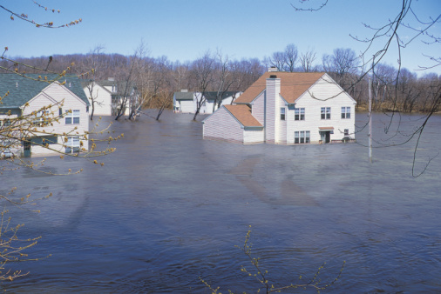
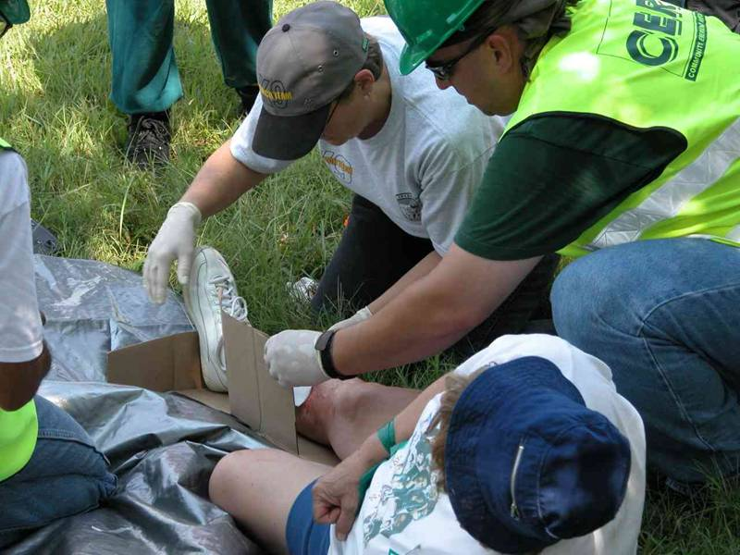
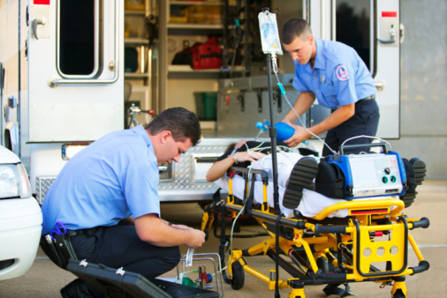
Setting the Stage

Slide 3
Course Preview
Fire safety
Disaster medical operations
Light search and rescue
CERT organization
Disaster psychology
CERT and terrorism
Notes:
2

Slide 4
Unit Objectives
Identify roles and responsibilities for community preparedness
Describe types of hazards that affect community, people, health, and infrastructure
Undertake personal and organizational preparedness actions
Describe functions of CERTs

Slide 5
Community Preparedness: Roles and Responsibilities
Key priority in lessening the impact of disasters
Critical that all community members take steps to prepare
Effective when addresses unique attributes of community and engages whole community

Slide 6
Government
Government has responsibility to:
Develop, test, and refine emergency plans
Ensure emergency responders have adequate skills and resources
Provide services to protect and assist citizens

Slide 7
Emergency Operations Plan
Assigns responsibility to organizations and individuals
Sets forth lines of authority
Describes how people and property will be protected
Identifies personnel, equipment, facilities, supplies, and other resources

Slide 8
Community Leaders
Have a responsibility to participate in community preparedness
Participate on local collaborative planning council
Identify and integrate appropriate resources into government plans
Ensure that facilities, staff, and customers served are prepared

Slide 9
The Public
Learn about community alerts, warnings, and evacuation routes
Take training
Practice skills and personal plans
Network and help others
Give feedback to community
Report suspicious activity
Volunteer

Slide 10
Engaging the Whole Community
Goal of Citizen Corps is to make communities safer, more prepared, and more resilient
Citizen Corps Councils bring government and community leaders together
Councils ensure emergency plans more effectively reflect the community

Slide 11
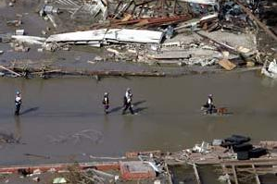
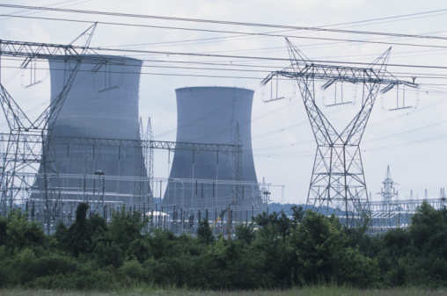
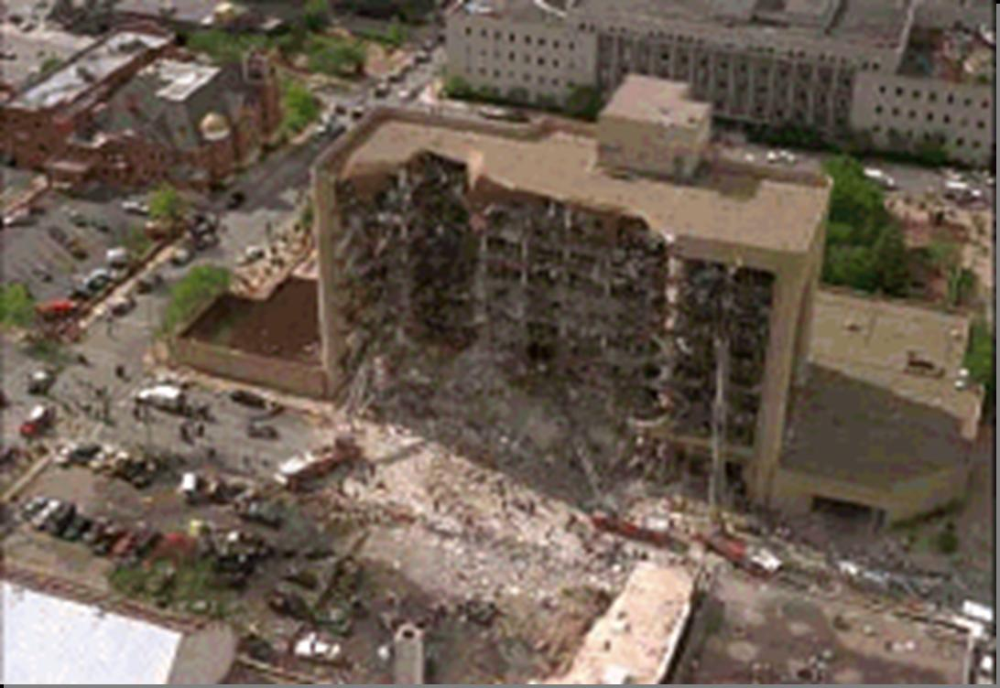
Types of Disaster
Natural
Technological
Intentional

Slide 12
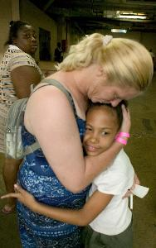
Key Disaster Elements
They are relatively unexpected
Emergency personnel may be overwhelmed
Lives, health, and the environment are endangered

Slide 13
Local Hazard Vulnerability
Identify most common disasters that occur
Identify possible hazards with most severe impact
Consider recent or historical impacts
Identify susceptible locations in the community for specific hazards
Consider what to expect from disruption of services

Slide 14
Results of Damage to Infrastructure
Police: address incidences of grave public safety
Firefighters: suppress major fires
EMS personnel: handle life-threatening injuries
Lower priority needs met in other ways

Slide 15
Hazards Related to Structure Type
You may not have opportunity to select type of structure when a disaster occurs
Engineered buildings have performed well in most types of disasters
Types of damage vary by structure
Differences in hazards and mitigation between single-family homes and multiple-unit dwellings

Slide 16
Hazards from Home Fixtures
Gas line ruptures
Displaced water heaters or ranges
Damage
From falling books, dishes, other cabinet contents
Electric shock or injury
From displaced appliances, office equipment
Fire
From faulty wiring, overloaded plugs, or frayed electric cords

Slide 17
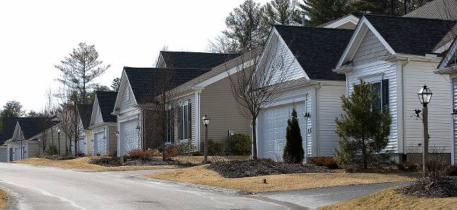
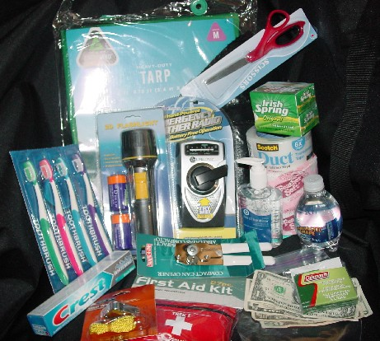

Home and Workplace Preparedness

Slide 18
Preparing for a Disaster
Know local hazards, alerts, warning systems, evacuation routes, and sheltering plans
Consider important elements of disaster preparedness
Address specific needs for yourself and people you know

Slide 19
Protective Actions
Assess situation
Decide to stay or change locations
Critical early decision in disasters
Seek clean air and protect breathing passages
Protect from debris and signal if trapped
Remove contaminants
Practice good hygiene

Slide 20
Sheltering
Shelter in place: sealing a room
Identify internal room
Stay for several hours
Store supplies
Shelter for extended stay
Stay for several days or up to 2 weeks
Store emergency supplies
Mass care or community shelter
Take 3-day disaster kits
Shelters provide most supplies

Slide 21
Develop a Disaster Plan
Where will you meet family members?
Who is your out-of-State “check-in” contact?
Will you have an extended stay? Shelter in place? Evacuate?
How will you escape your home? Workplace? School? Place of worship?
What route (and several alternates) will you use to evacuate your neighborhood?
Do you have transportation?
Did you practice your plan?

Slide 22
Escape Planning
Consider needs of children and individuals with disabilities
Inform all family members or office coworkers of the plan
Run practice escape drills

Slide 23
Preparing for a Disaster
Mitigation is the reduction of loss of life and property by lessening the impact of disasters
Any activity that prevents an emergency or reduces effects of hazards
CERT members should have adequate homeowners coverage
Add flood insurance if in a flood hazard area

Slide 24
Non-structural Hazard Mitigation
Anchor heavy furniture
Secure appliances and office equipment
Install hurricane storm shutters
Childproof cabinet doors
Locate and label gas, electricity, and water shutoffs
Secure water heaters and have flexible gas lines installed

Slide 25
Other Mitigation Measures
Bolt houses to foundations
Install trusses or hurricane straps to reinforce roof
Strap propane tanks and chimneys
Strap mobile homes to their slabs
Raise utilities
Build a safe room

Slide 26
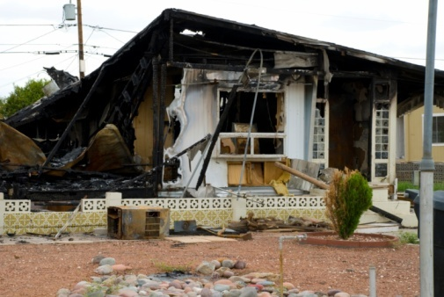
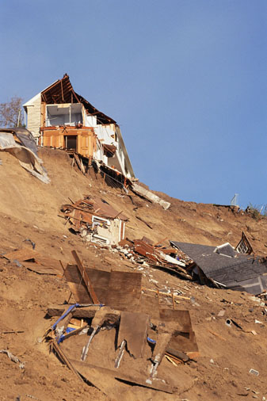
Fortifying Your Home
Different non-structural hazards to fortify against:
Home fires
Landslides or mudslides
Wildfires

Slide 27
Get Involved
Preparedness requires active participation from all
Talk to friends and family about hazards
Ask about emergency planning outside the home
Make sure those in charge have a plan
Training provides skills needed to help others and keep skills current
CERT program provides training, practice, and connection to others
Participate in drills and exercises
Talk to friends and family about volunteering

Slide 28
CERT Disaster Response
Respond in period immediately after a disaster
Assist emergency response personnel when requested
CERT members’ first responsibility is personal and family safety
Respond after a disaster:
Locate and turn off utilities, if safe
Extinguish small fires
Treat injuries
Conduct light search and rescue
Help to relieve survivor stress

Slide 29
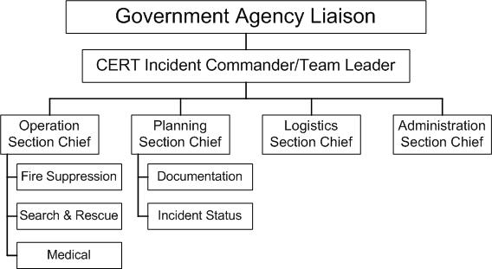
CERT Organization

Slide 30
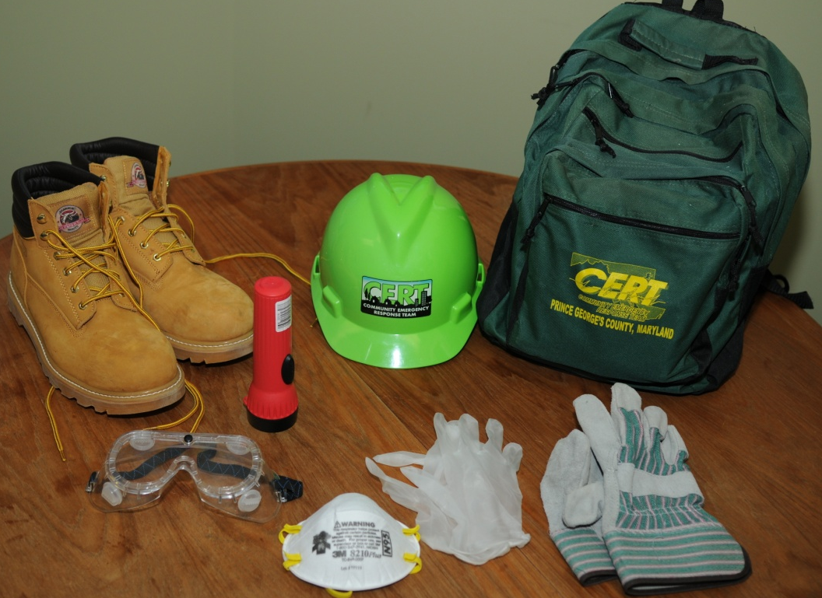
Personal Protective Equipment
Helmet
Goggles
N95 Mask
Gloves (work and non-latex)
Sturdy shoes or work boots

Slide 31
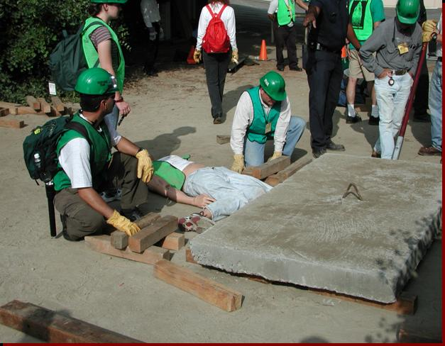
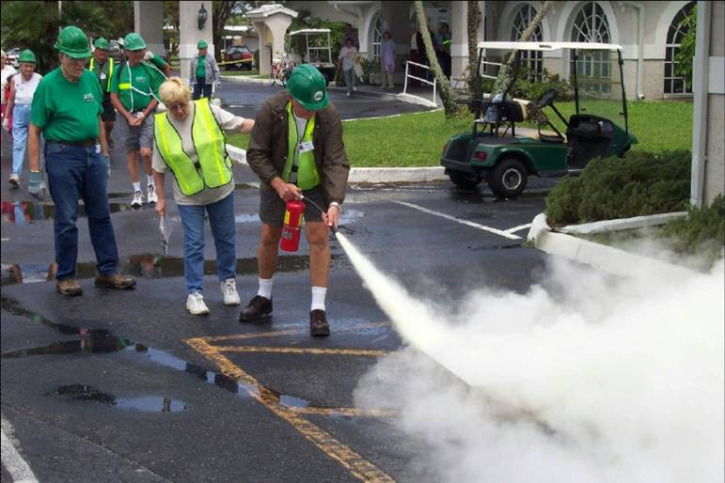
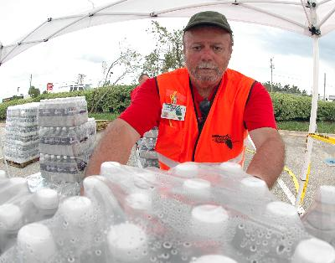
CERT in Action

Slide 32
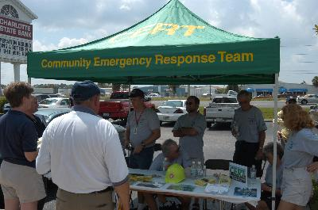
Non-Disaster Roles
Identify and aid neighbors/coworkers who might need assistance
Distribute preparedness materials; do demos
Staff first aid booths at special events
Assist with installation of smoke alarms
Parade route management

Slide 33
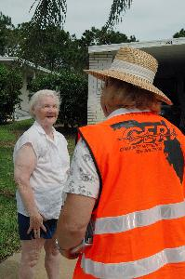
Protection for Disaster Workers
CERT members generally protected by:
“Good Samaritan” laws
Volunteer Protection Act of 1997
Relevant State statutes

Slide 34
Additional Training for CERTs
Advanced first aid
Animal issues in disasters
Automated External Defibrillator (AED) use
Community relations
CPR skills
Debris removal
Donations management
Shelter management
Special needs concerns
Traffic/crowd control
Utilities control
Online courses

Slide 35
Unit Summary
You should now be able to:
Identify roles and responsibilities for community preparedness
Describe types of hazards that affect community, people, health, and infrastructure
Undertake personal and organizational preparedness actions
Describe functions of CERTs

Slide 36
Homework Assignment
Review detailed information for Unit 1
Read unit to be covered in next session
Bring necessary supplies and wear appropriate clothes for next session
Discuss preparedness with family and friends
Assemble supplies in multiple locations
Examine homes for hazards

