Slide 1

Fire Safety and Utility Controls
CERT Basic Training
Unit 2

Slide 2
Unit Objectives
Explain role of CERTs in fire safety
Identify and reduce potential fire and utility risks
Describe CERT sizeup process
Conduct basic sizeup for a fire emergency
Explain basic safety precautions
Identify hazardous materials
Extinguish small fires using a fire extinguisher

Slide 3
Unit Topics
Fire chemistry
Fire and utility hazards in the home, workplace, and neighborhood
CERT sizeup
Fire sizeup considerations
Firefighting resources
Fire suppression safety
Hazardous materials

Slide 4
Role of CERTs
CERTs play very important role in fire safety by:
Extinguishing small fires
Preventing additional fires by removing fuel sources
Shutting off utilities
Assisting with evacuations, when necessary

Slide 5
CERT Priorities
Help in emergencies before professional responders arrive
Rescuer safety is number one priority
Always work with a buddy
Always wear safety equipment
CERT Goal:
Do the greatest good for
the greatest number

Slide 6
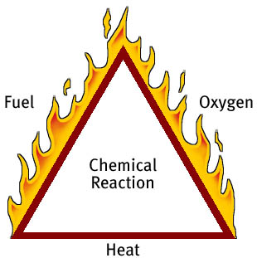
The Fire Triangle
Heat
Fuel
Oxygen

Slide 7
5 Classes of Fire
A: Ordinary combustibles
B: Flammable and combustible liquids
C: Energized electrical equipment
D: Combustible metals
K: Cooking oils

Slide 8
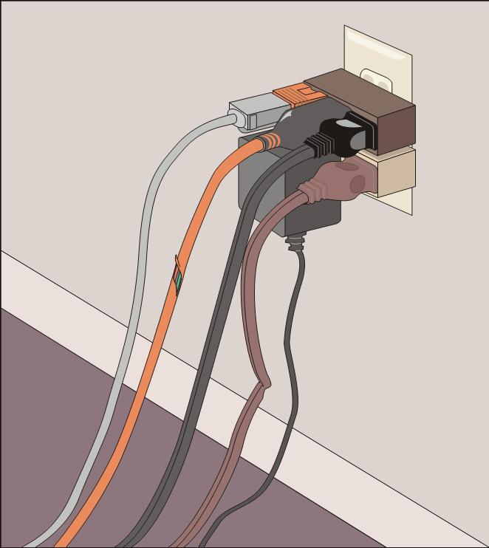
Reducing Electrical Hazards
Avoid the “electrical octopus”
Don’t run cords under carpets
Check for and replace broken or frayed cords
Maintain appliances

Slide 9
Electrical Emergencies
Know where power shutoffs are for:
Appliances
Circuit breakers
Fuses
Post shutoff directions next to all utilities
Know procedures for turning power back on

Slide 10
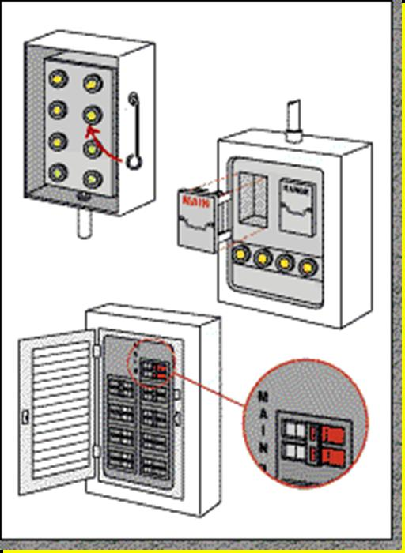
Shutoff Procedures
Fuse box with shutoff
Circuit box with shutoff

Slide 11
Natural Gas Hazards
Asphyxiant
Robs body of oxygen
Explosive
Can easily ignite

Slide 12
Natural Gas Hazard Awareness
Install natural gas detector
Install carbon monoxide detector in home
Test batteries for natural gas and carbon monoxide detectors every month
Change batteries every 6 months
Locate and label gas shutoffs
Have proper non-sparking tool

Slide 13
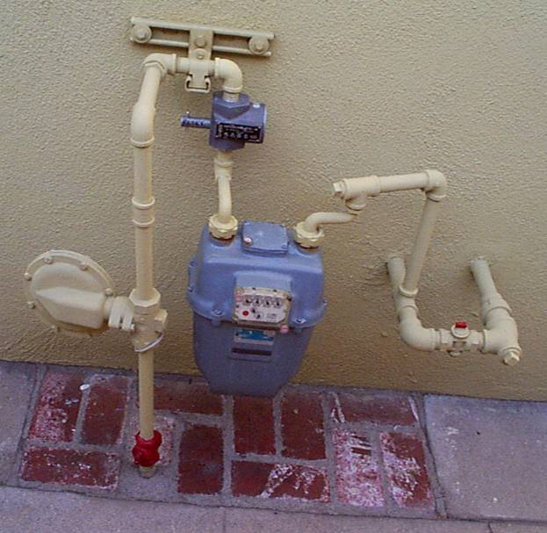
Gas Shutoff
Locate and label gas shutoff valves
If not automatic, know procedures for shutting off gas

Slide 14
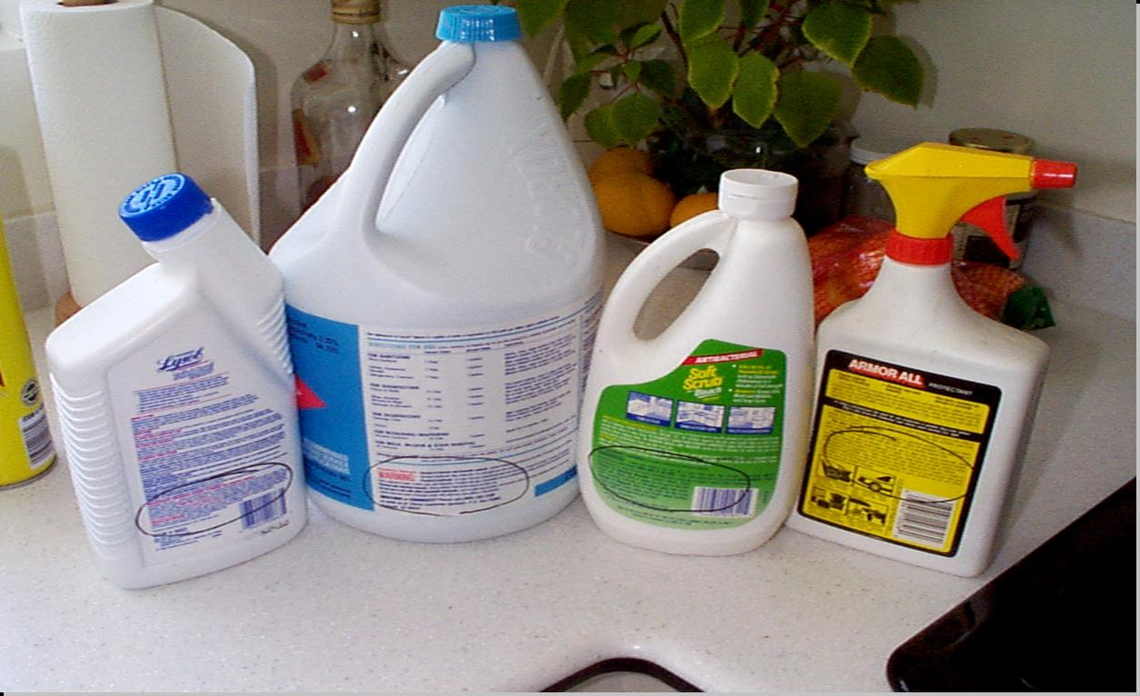
L.I.E.S.
Always read labels
Use L.I.E.S. storage procedures (Limit, Isolate, Eliminate, Separate)

Slide 15
CERT Sizeup
Gather Facts
Assess Damage
Consider Probabilities
Assess Your Situation
Establish Priorities
Make Decisions
Develop Plan of Action
Take Action
Evaluate Progress
REMEMBER: CERT SIZEUP IS A CONTINUAL PROCESS

Slide 16
CERT Fire Sizeup
Helps responders decide:
Whether to attempt to suppress a fire
A plan of action
Answers these questions:
Do my buddy and I have the right equipment?
Are there other hazards?
Is the building structurally damaged?
Can my buddy and I escape?
Can my buddy and I fight the fire safely?
Remember: The safety of individual CERT members is always the top priority

Slide 17
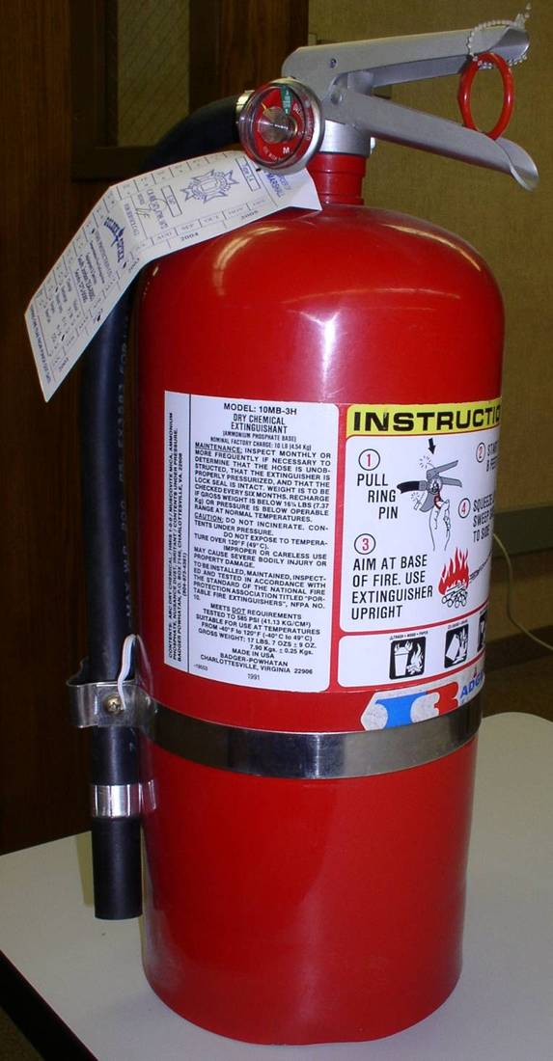
Firefighting Resources
Portable fire extinguishers
Wet standpipes
Confinement
“Creative” resources

Slide 18
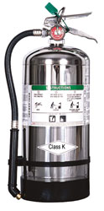
Fire Extinguishers
Water
Dry chemical
Carbon dioxide
Specialized fire extinguisher

Slide 19
Extinguisher Rating/Labeling
Labels show types of fires that extinguisher is used for:
Class A fire ratings: 1A to 40A
Class B fire ratings: 1B to 640B
Higher number on label = greater amount of extinguishing agent

Slide 20
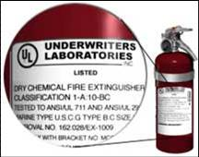
Examples of Labels

Slide 21
P.A.S.S.
Test the extinguisher after pulling the pin

Slide 22
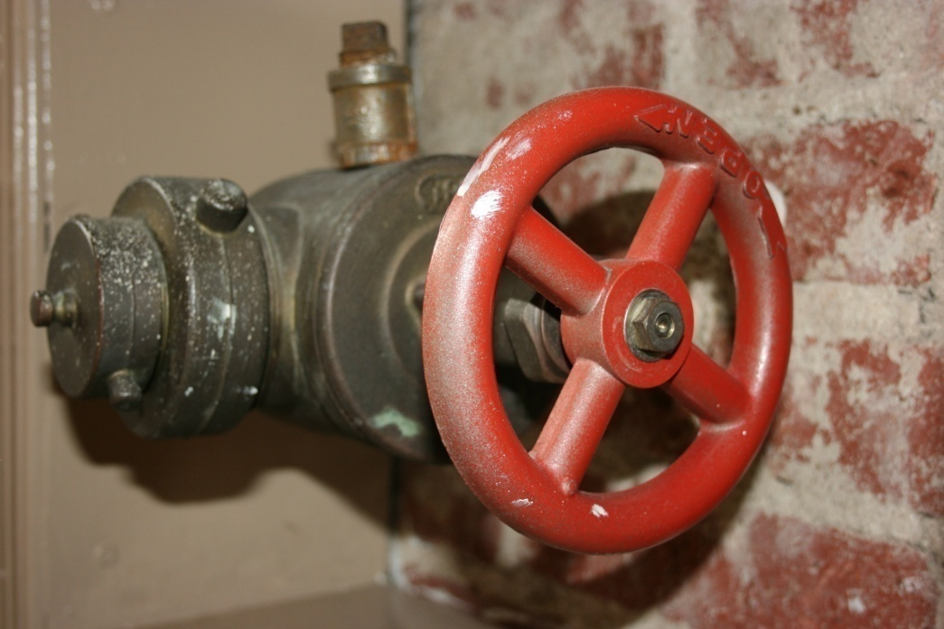
Interior Wet Standpipes
Usually in commercial buildings or apartments
Work in two-person teams when using wet standpipes

Slide 23
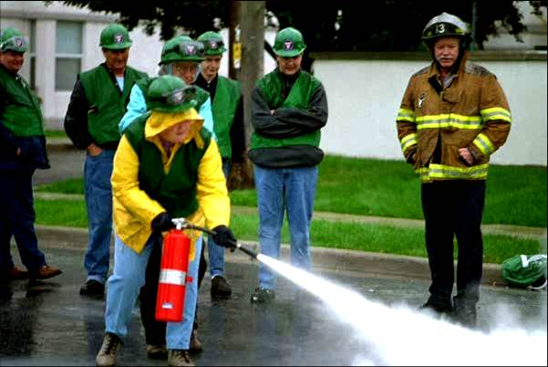
Fire Suppression Safety
Safety of individual CERT members is top priority

Slide 24
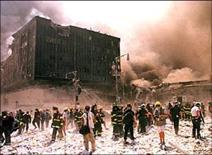
Fire Suppression Don’ts
Don’t get too close
Don’t try to fight a fire alone
Don’t try to suppress large fires
Don’t enter smoke-filled areas

Slide 25
Hazardous Materials
Corrode other materials
Explode or are easily ignited
React strongly with water
Are unstable when exposed to heat or shock
Are otherwise toxic to humans, animals, or the environment through absorption, inhalation, injection, or ingestion

Slide 26
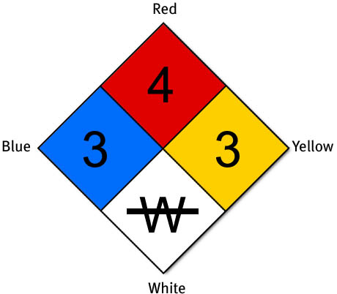
Identifying Stored Hazmats

Slide 27
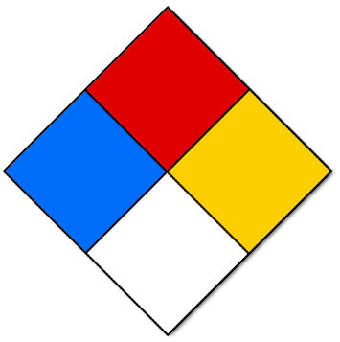
The White Quadrant
NFPA 704 Diamond White Quadrant:
W: Shows unusual reactivity with water
OX: Possesses oxidizing properties

Slide 28

STOP!

Slide 29











Hazmats in Transit
Red &
Orange
Red
White
Red
White
Red &
Blue
Yellow
White
Yellow &
Black &
White
White
White

Slide 30
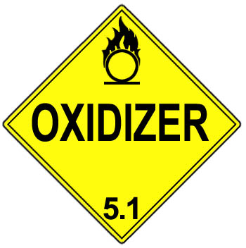
UN and NA Placards
Symbol
Symbol
Chemical
Number
Name
1203
Chemical Class
3
Chemical Class

Slide 31

Greater Than 1?
Remember!
All hazardous material placards are a stop sign for CERTs

Slide 32
Unit Summary
You should know:
Keys to effective fire suppression
CERT sizeup and fire sizeup considerations
Classes of fire and types of fire extinguishers
P.A.S.S.
How to identify hazardous materials
Always follow the safety rules established for CERTs – personal safety comes first!

Slide 33
Homework Assignment
Read unit to be covered in next session
Bring necessary supplies to next session
Wear appropriate clothes to next session

