Slide 1
Disaster Medical Operations — Part 1
CERT Basic Training
Unit 3

Slide 2
CERT Training
Treatment for life-threatening conditions
Airway obstruction, bleeding, shock
Treatment for other, less urgent conditions
Provide greatest good for greatest number by conducting simple triage and rapid treatment

Slide 3
START
STart = Simple Triage
Survivors sorted based on priority of treatment
stART = And Rapid Treatment
Rapid treatment of injuries assessed and prioritized in first phase
Notes:
2

Slide 4
Unit Objectives
Identify “killers”
Apply techniques for opening airway, controlling bleeding, and treating for shock
Conduct triage under simulated disaster conditions

Slide 5
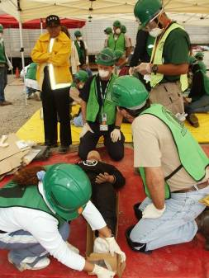
Unit Topics
Treating life threatening injuries
Triage
Notes:
4

Slide 6
Three “Killers”
Emergency medicine “killers”
Airway obstruction
Bleeding
Shock
First priority of medical operations:
Open airway
Control excessive bleeding
Treat for shock

Slide 7
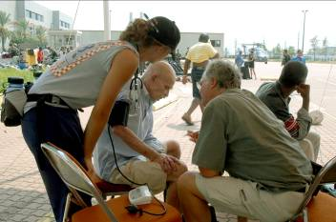
How to Approach a Survivor
Be sure survivor can see you
Identify yourself
Your name and name of your organization
Request permission to treat, if possible
Respect cultural differences

Slide 8
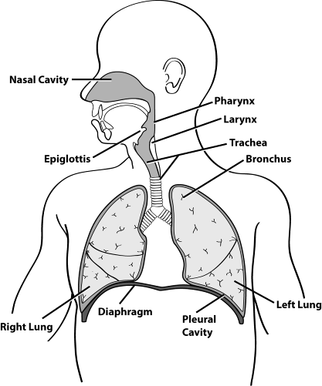
Open the Airway

Slide 9
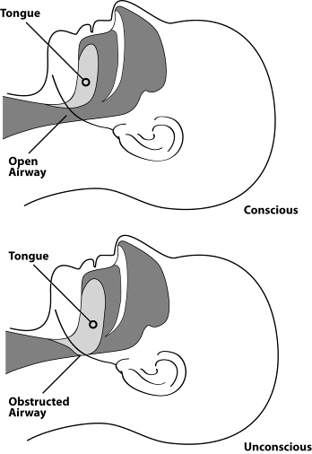
Open vs. Obstructed Airway

Slide 10
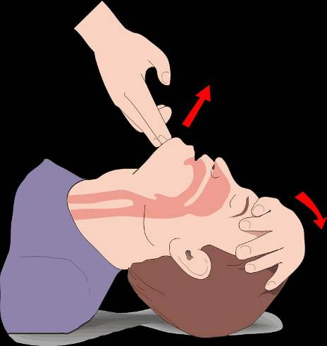
Head-Tilt/Chin-Lift Method

Slide 11
Types of Bleeding - 1
Arterial bleeding
Bleeding from artery spurts
Venous bleeding
Bleeding from vein flows
Capillary bleeding
Bleeding from capillaries oozes
Notes:
10

Slide 12
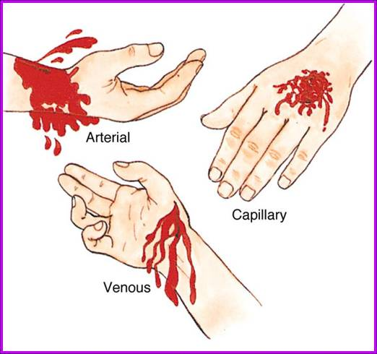
Types of Bleeding - 2
Notes:
11

Slide 13
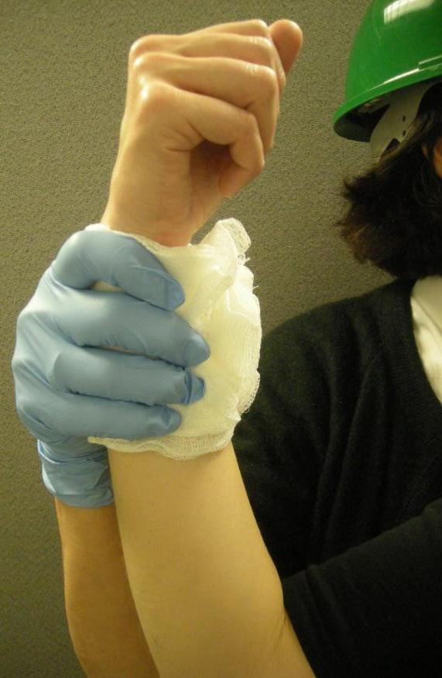
Control Bleeding
3 main methods for controlling bleeding:
Direct pressure
Elevation
Pressure points
Notes:
12

Slide 14
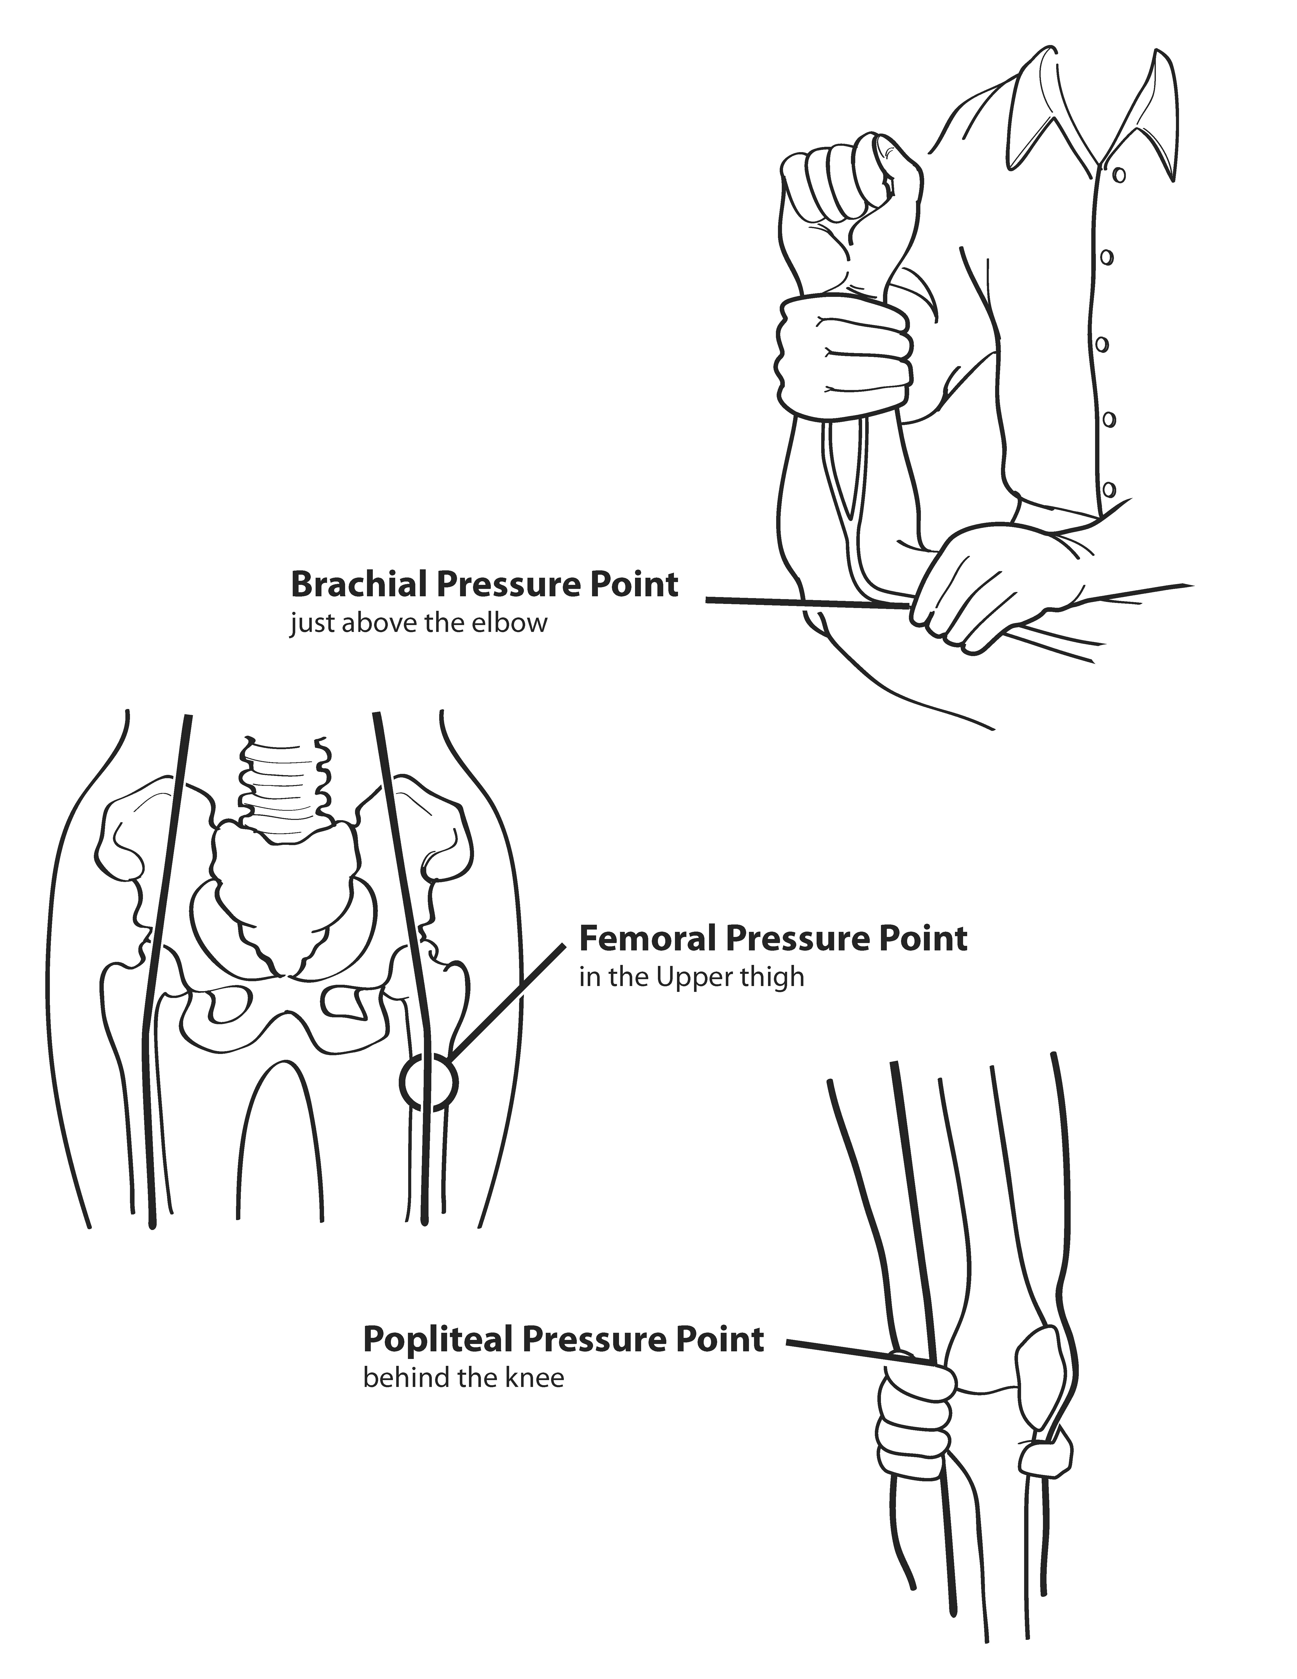
Pressure Points
Notes:
13

Slide 15
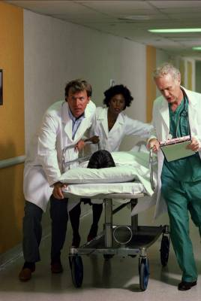
Shock
Result of ineffective circulation of blood
Remaining in shock will lead to death of:
Cells
Tissues
Entire organs

Slide 16
Recognizing Shock
Main signs of shock
Rapid and shallow breathing
Capillary refill of greater than 2 seconds
Failure to follow simple commands, such as “Squeeze my hand”
Symptoms of shock are easily missed… pay careful attention to your patient!
Notes:
15

Slide 17

Responding to Mass Casualty Event
Have a plan
Follow that plan
Document your actions throughout

Slide 18
CERT Sizeup
Gather Facts
Assess Damage
Consider Probabilities
Assess Your Situation
Establish Priorities
Make Decisions
Develop Plan of Action
Take Action
Evaluate Progress
REMEMBER: CERT SIZEUP IS A CONTINUAL PROCESS
Notes:
17

Slide 19
What Is Triage?
Process for managing mass casualty event
Survivors are evaluated
Survivors are sorted by urgency of treatment needed
Survivors are set up for immediate or delayed treatment

Slide 20
Triage
Immediate (I): Survivor has life-threatening injuries (airway, bleeding, or shock)
Delayed (D): Injuries do not jeopardize survivor’s life; treatment can be delayed
Minor (M): Walking wounded and generally ambulatory
Dead (DEAD): No respiration after two attempts to open airway

Slide 21
Rescuer Safety During Triage
If hazmat or terrorist event is suspected, CERT members DO NOT respond
Evacuate as safely as possible
ALWAYS wear PPE:
Helmet
Goggles
N95 mask
Work gloves
Sturdy shoes or boots
Non-latex exam gloves

Slide 22
Triage Process
Step 1: Stop, Look, Listen, and Think
Step 2: Conduct voice triage
Step 3: Start where you stand; follow systematic route
Step 4: Evaluate each survivor and tag
Step 5: Treat “I” survivors immediately
Step 6: Document triage results

Slide 23
Step 4: Triage Evaluation
Check airway and breathing
Check circulation and bleeding
Check mental status

Slide 24
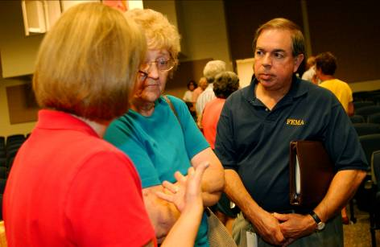
Triage Pitfalls
No team plan, organization, or goal
Indecisive leadership
Too much focus on one injury
Treatment (rather than triage) performed

Slide 25
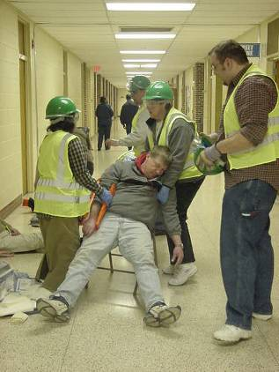
Unit Summary
You should now be able to:
Identify 3 “killers”
Apply techniques for opening the airway, controlling bleeding, and treating for shock
Conduct triage under simulated disaster conditions

Slide 26
Homework Assignment
Read unit to be covered in next session
Bring necessary supplies for the next session
Wear appropriate clothes for the next session

