Slide 1


Disaster Medical Operations — Part 2
CERT Basic Training
Unit 4

Slide 2
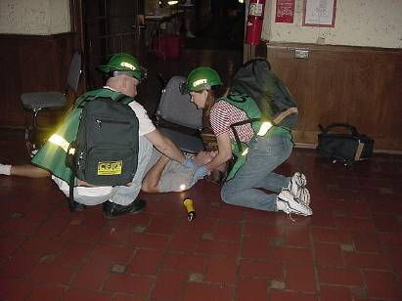
Unit 3 Review
3 “Killers”
Airway obstruction
Excessive bleeding
Shock

Slide 3
CERT Sizeup
Gather Facts
Assess Damage
Consider Probabilities
Assess Your Situation
Establish Priorities
Make Decisions
Develop Plan of Action
Take Action
Evaluate Progress
REMEMBER: CERT SIZEUP IS A CONTINUAL PROCESS
Notes:
2

Slide 4
Unit Objectives
Take appropriate sanitation measures to help protect public health
Perform head-to-toe patient assessments
Establish a treatment area
Apply splints to suspected fractures and sprains
Employ basic treatments for other injuries
Notes:
3

Slide 5
Unit Topics
Public Health Considerations
Functions of Disaster Medical Operations
Establishing Medical Treatment Areas
Conducting Head-to-Toe Assessments
Treating Burns
Wound Care
Treating Fractures, Dislocations, Sprains, and Strains
Nasal Injuries
Treating Cold-Related Injuries
Treating Heat-Related Injuries
Bites and Stings
Notes:
4

Slide 6
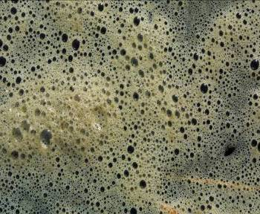
Public Health Considerations
Maintaining proper hygiene
Maintaining proper sanitation
Purifying water (if necessary)
Preventing spread of disease

Slide 7
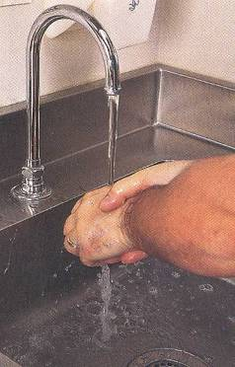
Maintaining Hygiene
Wash hands frequently
Or use alcohol-based hand sanitizer
Wear non-latex exam gloves
Wear N95 mask and goggles
Keep dressings sterile
Avoid contact with body fluids
“If it is warm, wet, and not yours, don’t touch it!”

Slide 8
Maintain Sanitation
Control disposal of bacterial sources
Put waste products in plastic bags
Tie off bags and mark them as medical waste
Bury human waste

Slide 9
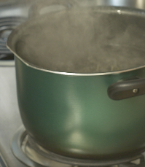
Water Sanitation Methods
Boil water for 1 minute
Water purification tablets
Non-perfumed liquid bleach
8 drops/gal of water
16 drops/gal if water is cloudy
Let stand for 30 minutes before use

Slide 10
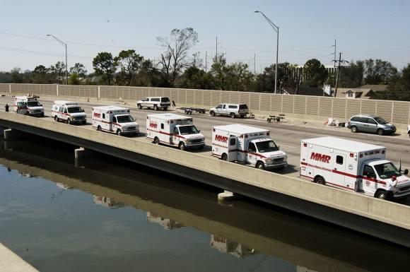
Functions of Disaster Medical Operations
Triage
Treatment
Transport
Morgue
Supply

Slide 11
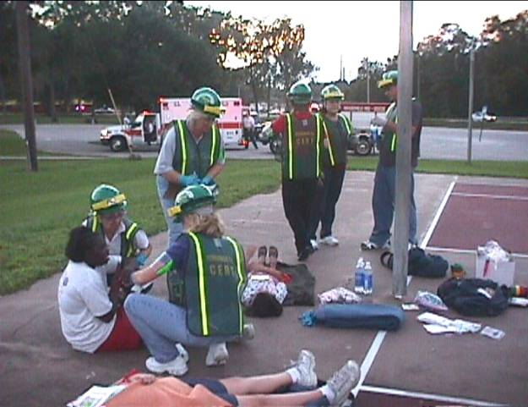
Establish a Medical Treatment Area
Select site and set up treatment area as soon as injured survivors are confirmed
When determining best location(s) for treatment area, consider:
Safety of rescuers and survivors
Most effective use of resources

Slide 12
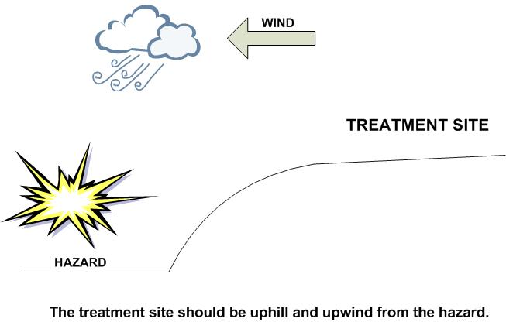
Treatment Area Site Selection
The site selected should be:
In a safe area, free of hazards and debris
Upwind, uphill, and upstream (if possible) from hazard zone(s)
Accessible by transportation vehicles
Expandable
Notes:
11

Slide 13
Most Effective Use of CERT Resources
To help meet the challenge of limited resources, CERT may need to establish:
Decentralized medical treatment location (more than one location)
Centralized medical treatment location (one location)
Notes:
12

Slide 14
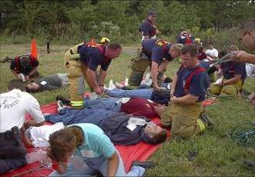
Treatment Area Layout
Four treatment areas:
“I” for Immediate care
“D” for Delayed care
“M” for Minor injuries/walking wounded
“DEAD” for the morgue

Slide 15
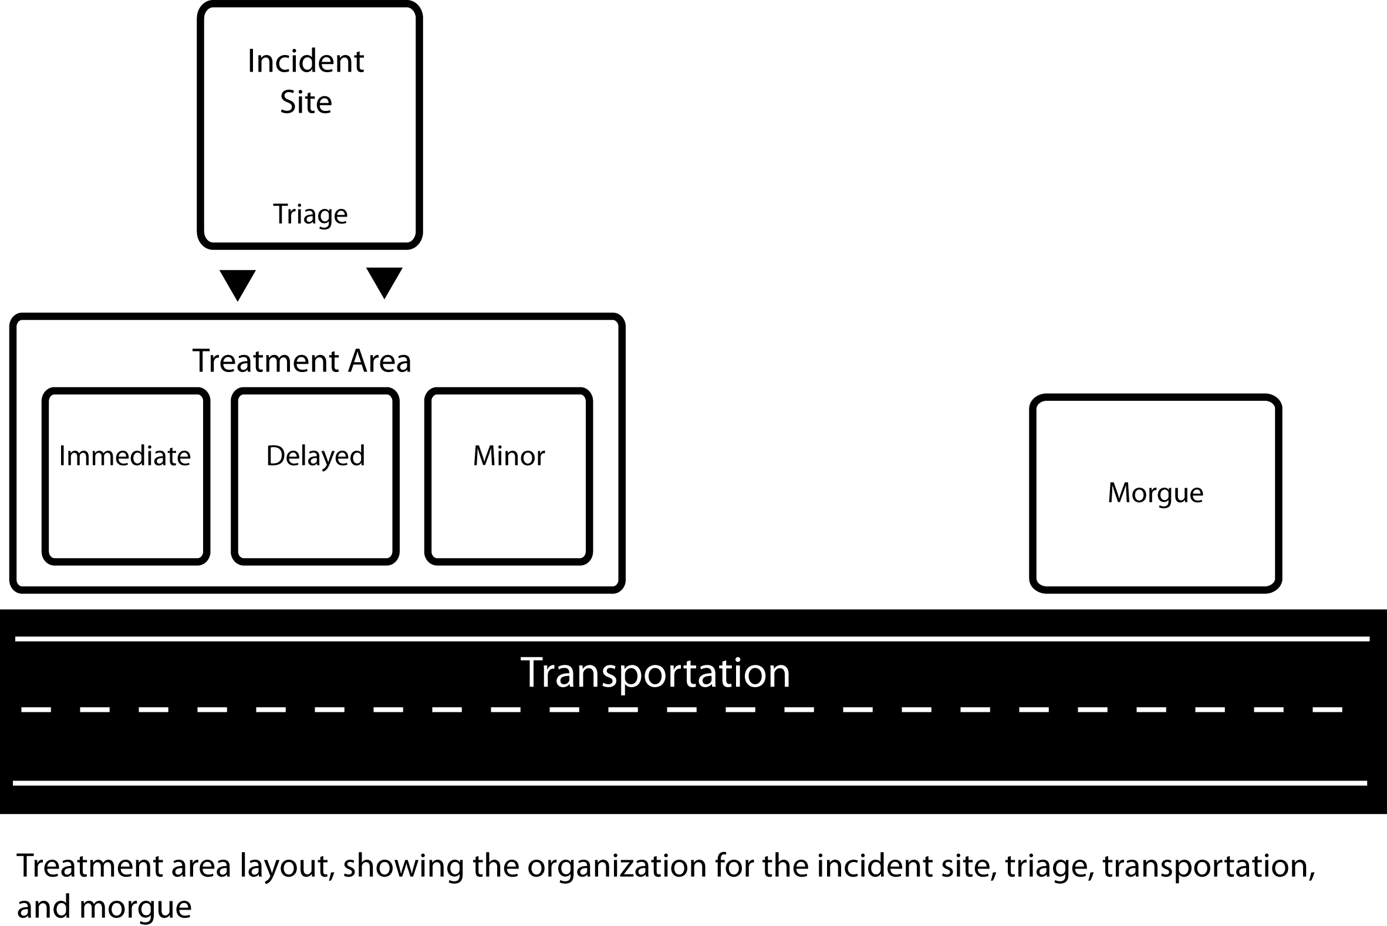
Treatment Area Layout
Notes:
14

Slide 16

Treatment Area Organization
Assign treatment leader to each treatment area
Document thoroughly
Available identifying information
Description (age, sex, body build, estimated height)
Clothing
Injuries
Treatment
Transfer location

Slide 17
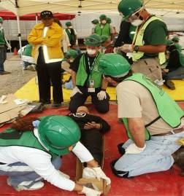
Head-to-Toe Assessment
Objectives of head-to-toe assessment:
Determine extent of injuries
Determine type of treatment needed
Document injuries

Slide 18
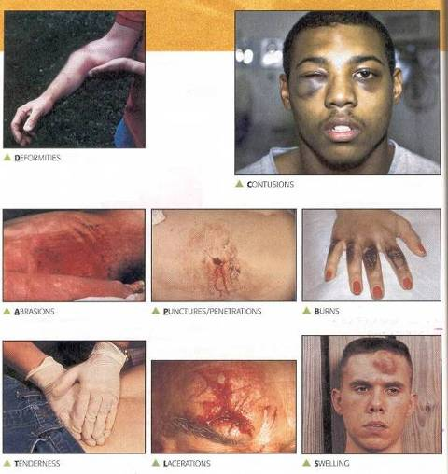
DCAP-BTLS
Deformities
Contusions
Abrasions
Punctures
Burns
Tenderness
Lacerations
Swelling
Notes:
17

Slide 19
Where and When
Light damage: assess in place
Moderate damage: move to treatment area first
Assess and tag everyone
Both verbal and hands on

Slide 20
Conducting Head-to-Toe Assessment
Pay careful attention
Look, listen, and feel
Check own hands for patient bleeding
If you suspect a spinal injury in unconscious survivors, treat accordingly
Check PMS in all extremities
Look for medical identification

Slide 21
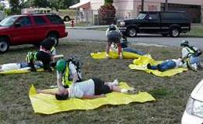
Order of Assessment
Head
Neck
Shoulders
Chest
Arms
Abdomen
Pelvis
Legs

Slide 22
Closed-Head, Neck, Spinal Injuries
Do no harm
Minimize movement of head and neck
Keep spine in straight line
Stabilize head

Slide 23
Treating Burns
Conduct thorough sizeup
Treat with first aid
Cool burned area
Cover with sterile cloth to reduce risk of infection

Slide 24
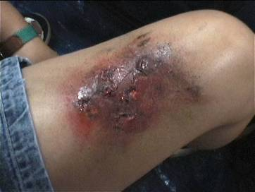
Burn Severity
Factors that affect burn severity:
Temperature of burning agent
Period of time survivor exposed
Area of body affected
Size of area burned
Depth of burn

Slide 25
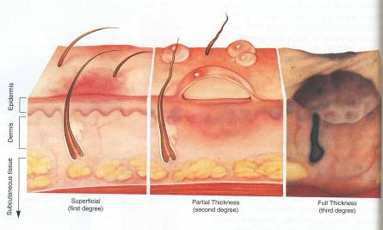
Burn Classifications
Superficial: epidermis
Partial Thickness: dermis and epidermis
Full Thickness: subcutaneous layer and all layers above

Slide 26
Burn Treatment: DOs
When treating a burn survivor, DO:
Cool skin or clothing if they are still hot
Cover burn loosely with dry, sterile dressings to keep air out, reduce pain, and prevent infection
Elevate burned extremities
Notes:
25

Slide 27
Burn Treatment: DON’Ts
When treating a burn survivor, DO NOT:
Use ice
Apply antiseptics, ointments, or other remedies
Remove shreds of tissue, break blisters, or remove adhered particles of clothing
Notes:
26

Slide 28

Treatment for Chemical Burns
Remove cause of burn + affected clothing/jewelry
If irritant is dry, gently brush away as much as possible
Always brush away from eyes, survivor, and you
Flush with lots of cool running water
Apply cool, wet compress to relieve pain
Cover wound loosely with dry, sterile or clean dressing
Treat for shock if appropriate

Slide 29
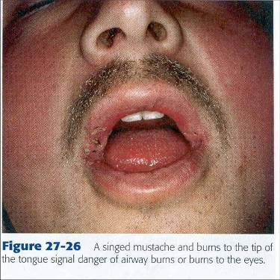
Inhalation Burns Signs and Symptoms
Sudden loss of consciousness
Evidence of respiratory distress or upper airway obstruction
Soot around mouth or nose
Singed facial hair
Burns around face or neck
Notes:
28

Slide 30
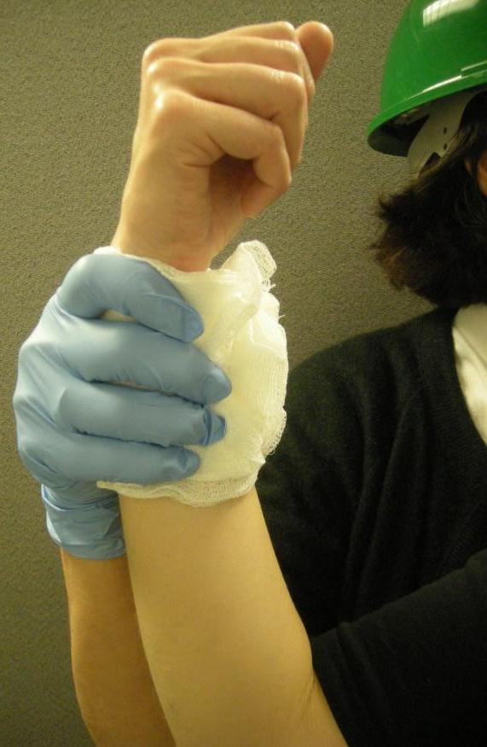
Wound Care
Control bleeding
Clean wound
Apply dressing and bandage
Notes:
29

Slide 31
Cleaning and Bandaging Wounds
Clean by irrigating with clean, room temperature water
NEVER use hydrogen peroxide
Irrigate but do not scrub
Apply dressing and bandage
Dressing applied directly to wound
Bandage holds dressing in place

Slide 32
Rules of Dressing
If active bleeding:
Redress OVER existing dressing
If no active bleeding:
Remove bandage and dressing to flush wound
Check for infection every 4-6 hours

Slide 33
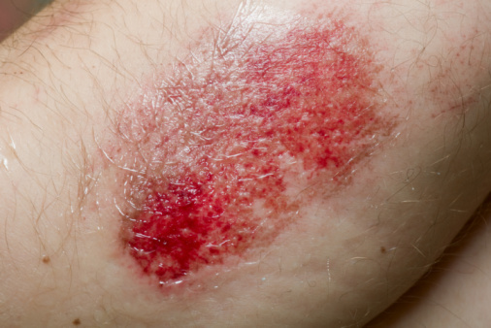
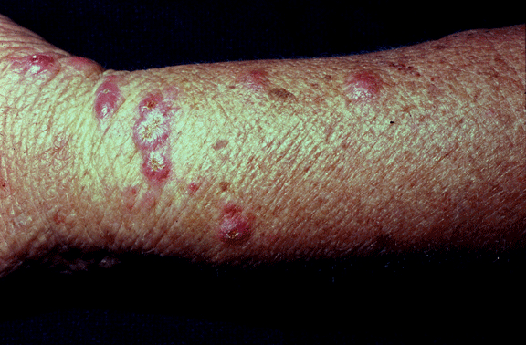
Signs of Infection
Signs of possible infection
Swelling around wound site
Discoloration
Discharge from wound
Red striations from wound site
Notes:
32

Slide 34
Amputations
Control bleeding; treat shock
If amputated body part is found:
Save tissue parts, wrapped in clean material and placed in plastic bag
Keep tissue parts cool, but NOT directly on ice
Keep severed part with survivor
Notes:
33

Slide 35
Impaled Objects
When foreign object is impaled in patient’s body:
Immobilize affected body part
Do not attempt to move or remove
Try to control bleeding at entrance wound
Clean and dress wound, making sure to stabilize impaled object
Notes:
34

Slide 36
Fractures, Dislocations, Sprains, Strains
Immobilize injury and joints immediately above and below injury site
If uncertain of injury type, treat as fracture

Slide 37
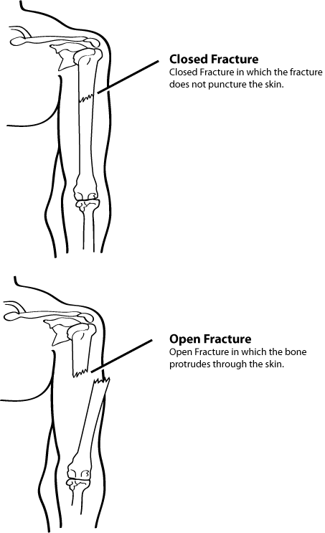
Types of Fractures
Notes:
36

Slide 38
Treating Open Fractures
Do not draw exposed bone ends back into tissue
Do not irrigate wound
Cover wound with sterile dressing
Splint fracture without disturbing wound
Place moist dressing over bone end
Notes:
37

Slide 39
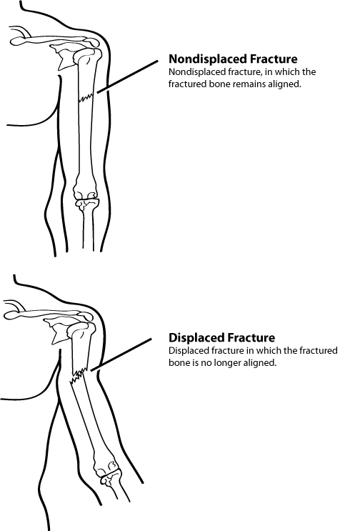
Displaced and Nondisplaced Fractures
Notes:
38

Slide 40
Dislocations
Dislocation is injury to ligaments around joint
So severe that it permits separation of bone from its normal position in joint
Treatment
Immobilize; do NOT relocate
Check PMS before and after splinting/ immobilization

Slide 41
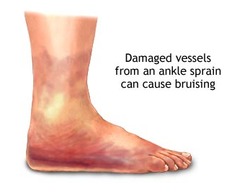
Signs of Sprain
Tenderness at site
Swelling and bruising
Restricted use or loss of use
Notes:
40

Slide 42
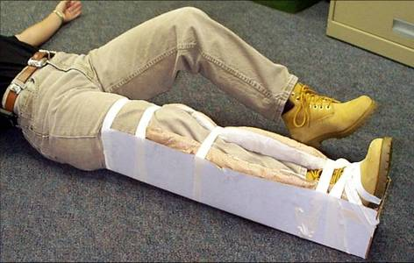
Splinting
Notes:
41

Slide 43
Splinting Guidelines
Support injured area above and below injury
Assess PMS in extremity
Splint injury in position that you find it
Don’t try to realign bones or joints
Fill voids to stabilize and immobilize
Immobilize above and below injury
After splinting, reassess PMS
Notes:
42

Slide 44
Nasal Injuries
Causes
Blunt force to nose
Skull fracture
Nontrauma conditions, e.g., sinus infections, high blood pressure, and bleeding disorders
Cautions
Large blood loss from nosebleed can lead to shock
Actual blood loss may not be evident because survivor will swallow some amount of blood

Slide 45
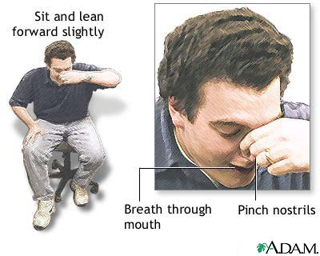
Treatment of Nasal Injuries
Control nasal bleeding:
Pinch nostrils or put pressure on upper lip under nose
Have survivor sit with head forward, NOT back
Ensure that airway remains open
Keep survivor calm
Notes:
44

Slide 46
Cold-Related Injuries
Hypothermia :
Occurs when body’s temperature drops below normal
Frostbite:
Occurs when extreme cold shuts down blood flow to extremities, causing tissue death
Notes:
45

Slide 47
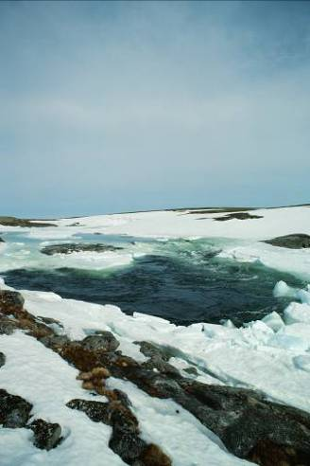
Symptoms of Hypothermia
Body temperature of 95° F or lower
Redness or blueness of skin
Numbness and shivering
Slurred speech
Unpredictable behavior
Listlessness
Notes:
46

Slide 48
Hypothermia Treatment
Remove wet clothing
Wrap survivor in blanket
Protect survivor from weather
Provide food and drink to conscious survivors
Do not attempt to massage to warm body
Place unconscious survivor in recovery position
Place survivor in warm bath
Notes:
47

Slide 49
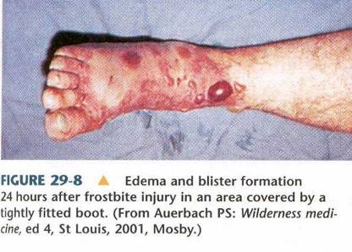
Symptoms of Frostbite
Skin discoloration
Burning or tingling sensation
Partial or complete numbness
Notes:
48

Slide 50
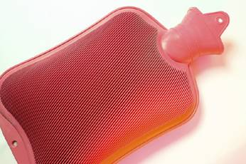
Frostbite Treatment
Immerse injured area in warm (NOT hot) water
Warm slowly!
Do NOT allow part to re-freeze
Do NOT attempt to use massage
Wrap affected body parts in dry, sterile dressing
Notes:
49

Slide 51
Heat-Related Injuries
Heat cramps:
Muscle spasms brought on by over-exertion in extreme heat
Heat exhaustion:
Occurs when exercising or working in extreme heat results in loss of body fluids
Heat stroke:
Survivor’s temperature control system shuts down
Body temperature rises so high that brain damage and death may result
Notes:
50

Slide 52
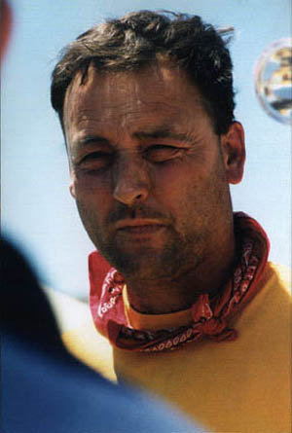
Symptoms of Heat Exhaustion
Cool, moist, pale or flushed skin
Heavy sweating
Headache
Nausea or vomiting
Dizziness
Exhaustion

Slide 53
Symptoms of Heat Stroke
Hot, red skin
Lack of perspiration
Changes in consciousness
Rapid, weak pulse and rapid, shallow breathing

Slide 54
Treatment of Heat-Related Injuries
Remove from heat to cool environment
Cool body slowly
Have the survivor drink water, SLOWLY
No food or drink if survivor is experiencing vomiting, cramping, or is losing consciousness
Notes:
53

Slide 55
Treatment for Bites/Stings
If bite or sting is suspected, and situation is non-emergency:
Remove stinger if still present by scraping edge of credit card or other stiff, straight-edged object across stinger
Wash site thoroughly with soap and water
Place ice on site for 10 minutes on and 10 minutes off
Notes:
54

Slide 56
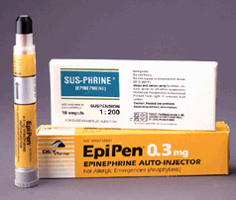
Anaphylaxis
Check airway and breathing
Calm individual
Remove constrictive clothing and jewelry
Find and help administer survivor’s Epi-pen
Watch for signs of shock and treat appropriately
Notes:
55

Slide 57
Unit Summary
Public health concerns related to sanitation, hygiene, and water purification
Organization of disaster medical operations
Establishing treatment areas
Conducting head-to-toe assessments
Treating wounds, fractures, sprains, and other common injuries
Notes:
56

Slide 58
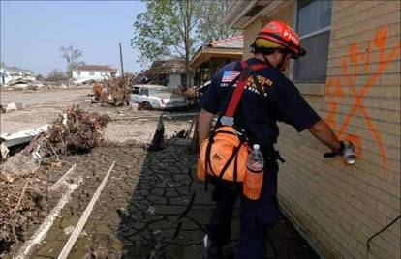
Homework Assignment
Read unit to be covered in next session
Bring necessary supplies for next session
Wear appropriate clothes for next session
Practice complete head-to-toe assessment on friend or family member
Notes:
57

