Slide 1
CERT Organization
CERT Basic Training
Unit 6

Slide 2
Unit Objectives
Describe the CERT structure
Identify how CERTs interrelate with ICS
Explain documentation requirements

Slide 3
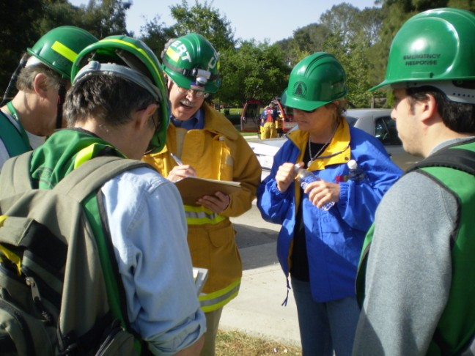
Unit Topics
CERT Organization
Mobilization
Documentation
Notes:
2

Slide 4
Principles of On-scene Management
Maintain the safety of disaster workers
Provide clear leadership and organizational structure
Improve effectiveness of rescue efforts

Slide 5
CERT On-scene Management
Well-defined management structure
Manageable span of control
Common terminology
Effective communication
Consolidated action plans
Comprehensive resource management
Accountability

Slide 6
Objectives for On-scene Management
Identify scope of incident
Determine overall strategy
Deploy resources
Document actions and results

Slide 7
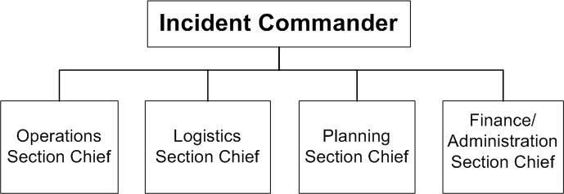
Incident Command System
Notes:
6

Slide 8
CERT Operations
Command structure
CERT Incident Commander/Team Leader (IC/TL)
Command Post
Expanded structure as needed
Notes:
7

Slide 9
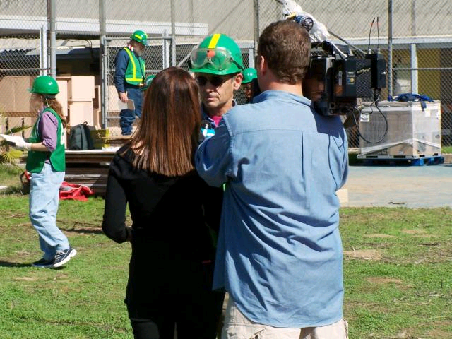
Dealing with the Media
Refer media inquiries to CERT IC/TL
Do not let media inhibit CERT goals
Be careful about information released
Notes:
8

Slide 10
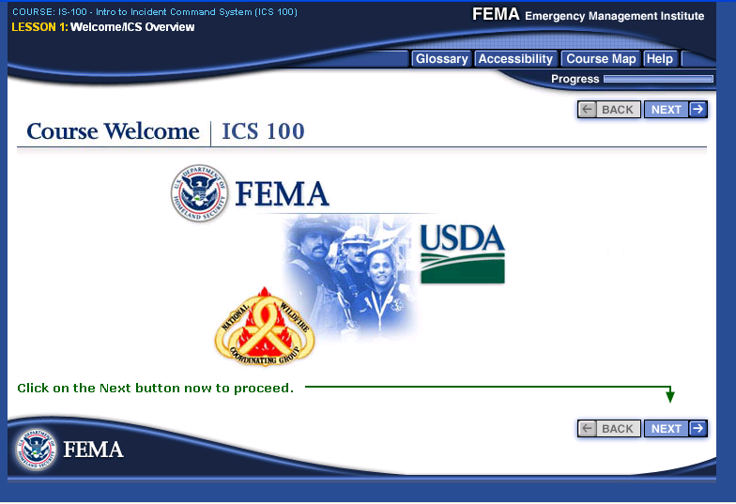
NIMS Compliance
Ability to work together
IS-100.a: Introduction to ICS
IS-700.b: Introduction to NIMS
http://training.fema.gov/IS/NIMS.asp
Notes:
9

Slide 11
CERT Mobilization
CERTs take care of themselves, their families, their homes, their neighbors
Proceed to predesignated staging area
IC/TL is established, organizes the group
IC/TL prioritizes actions
Organization is flexible and evolves based on new information
Notes:
10

Slide 12
Rescuer Safety
Rescuer safety is first priority
Heavy damage = No rescue
Moderate damage = Locate, triage, evacuate
Light damage = Locate, triage, continue sizeup, and document
Notes:
11

Slide 13
Documentation
Section Chiefs
Provide Command Post with information
Command Post
Documents situation status
Incident locations
Access routes
Identified hazards
Support locations
Notes:
12

Slide 14
Documentation
Write
it down!
Notes:
13

Slide 15
Documentation Forms
Damage Assessment
Personnel Resources Sign-In
Incident/Assignment Tracking Log
Briefing Assignment
Survivor Treatment Area Record
Communications Log
Equipment Inventory
General Message
Notes:
14

Slide 16
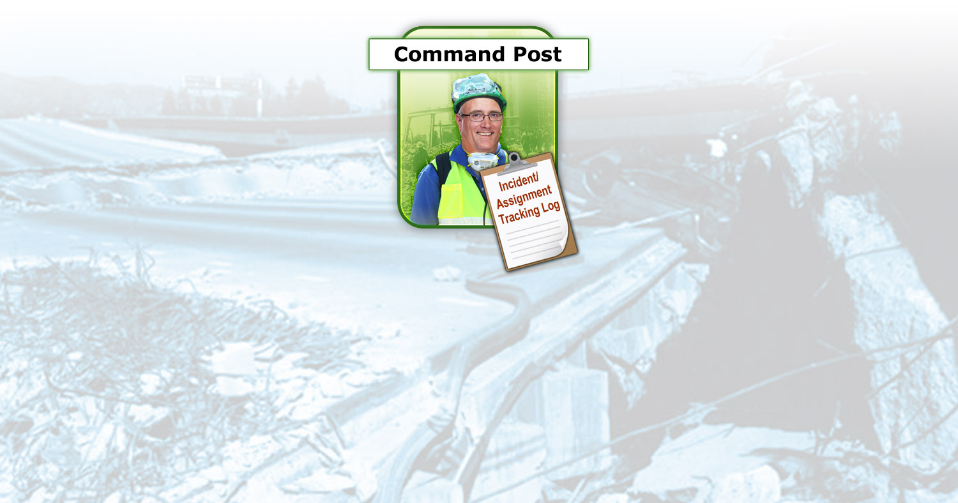
Documentation Flow
Notes:
15

Slide 17
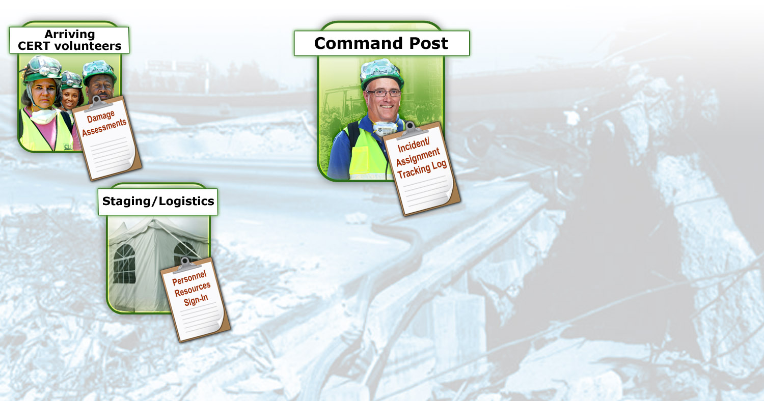
Documentation Flow
Notes:
16

Slide 18
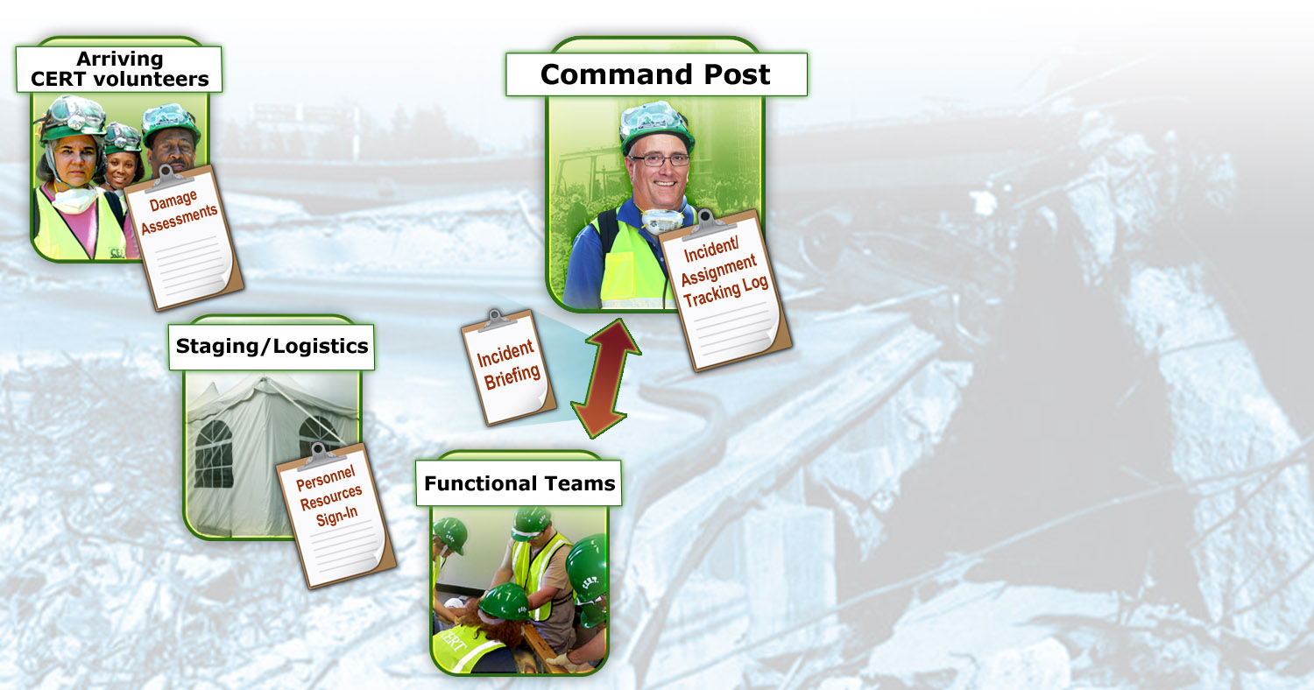
Documentation Flow
Notes:
17

Slide 19
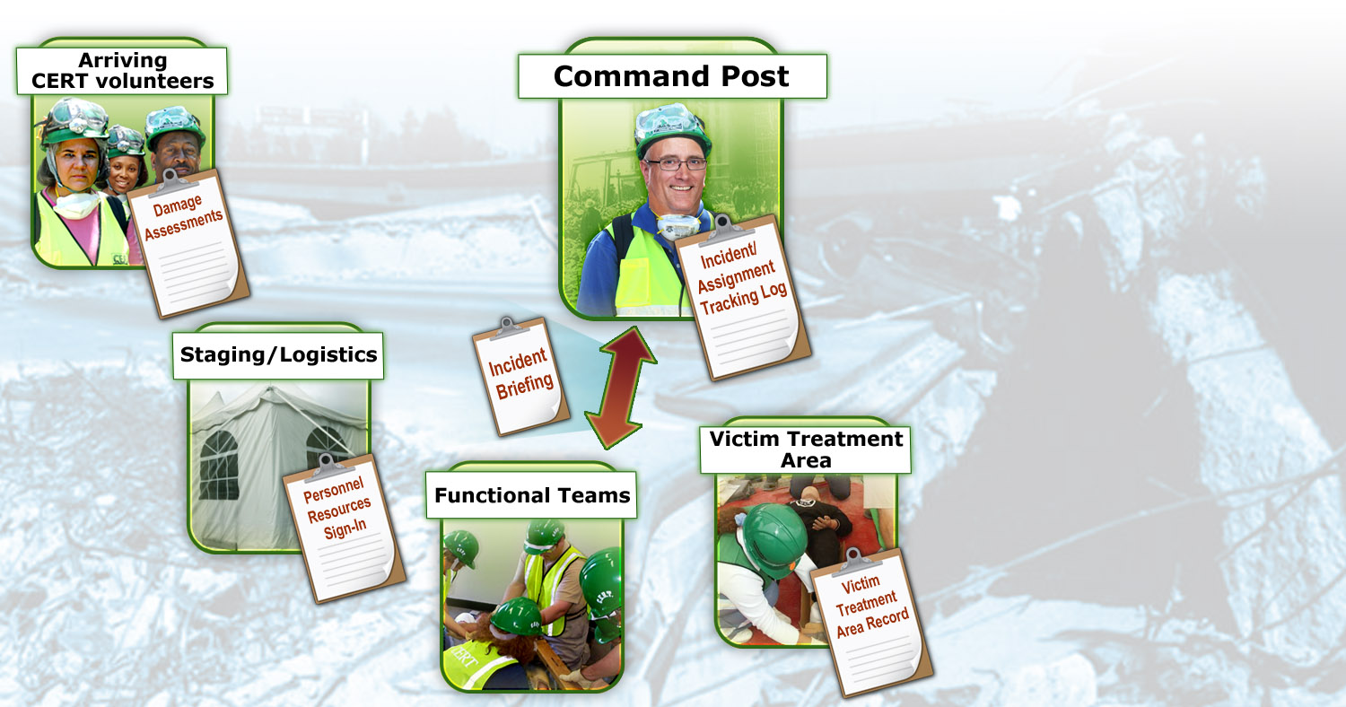
Documentation Flow
Notes:
18

Slide 20
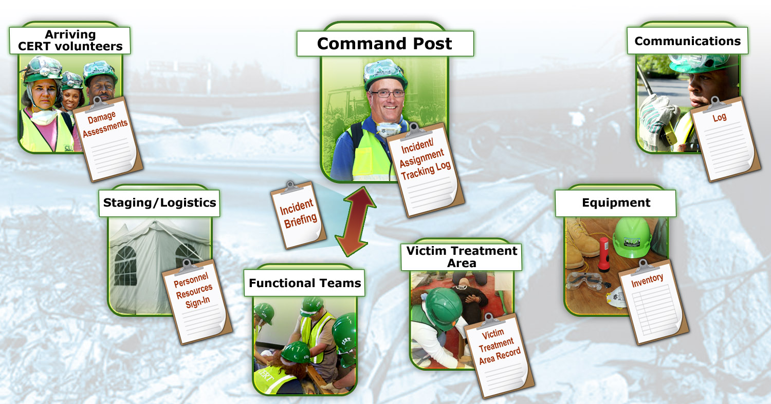
Documentation Flow
Notes:
19

Slide 21
Unit Summary
ICS provides flexible means of organization
“Is it safe to attempt the rescue?”
Document and communicate information to all CERT levels
Provide Command Post with ongoing information about damage assessment, group status, and needs
Command Post documents and tracks situation status
Notes:
20

Slide 22
Homework Assignment
Read unit to be covered in next session
Bring necessary supplies to next session
Wear appropriate clothes to next session
Notes:
21

