Slide 1

Disaster Psychology
CERT Basic Training
Unit 7

Slide 2
Unit Objectives
Describe disaster and post-disaster emotional environment for survivors and rescuers
Describe steps rescuers can take to relieve their own stress and that of other survivors

Slide 3
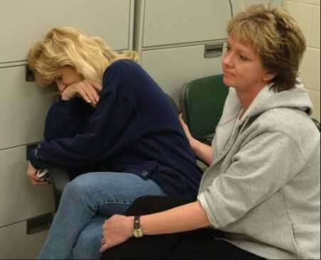
Unit Topics
Disaster Trauma
Team Well-Being
Working with Survivors’ Trauma

Slide 4
Psychological Trauma
Your own personal losses
Working in your neighborhood
Assisting neighbors, friends, coworkers who have also been injured
Not feeling safe and secure

Slide 5
Psychological Symptoms of Trauma
Irritability or anger
Self-blame or blaming others
Isolation and withdrawal
Fear of recurrence
Feeling stunned, numb, overwhelmed
Feeling helpless
Mood swings
Sadness, depression, grief
Denial
Concentration and memory problems
Relationship problems/marital discord

Slide 6
Physiological Symptoms of Trauma
Loss of appetite
Headaches or chest pain
Diarrhea, stomach pain, or nausea
Hyperactivity
Increase in drug consumption
Nightmares
Insomnia
Fatigue

Slide 7
Team Well-Being
Actions can be taken before, during, and after an incident to help manage emotional impact of disaster response work
Knowing possible psychological and physiological symptoms of disaster trauma helps manage impact
Learn to manage stress
CERT members for themselves
CERT leaders during response

Slide 8
How You Reduce Stress
Get enough sleep
Exercise regularly
Eat a balanced diet
Balance work, play, and rest
Allow yourself to receive as well as give
Connect with others
Use spiritual resources

Slide 9
Take Care of Yourself
Be aware of trauma that can follow a disaster
Explain to family members and friends what you need:
Listen when you want to talk
Don’t force you to talk

Slide 10
How Team Leaders Reduce Stress
Brief CERT personnel beforehand
Remember CERT is a team
Rest and regroup
Take breaks away
Eat properly, stay hydrated
Arrange for debriefing
Rotate teams and duties
Phase out workers gradually

Slide 11
Critical Incident Stress Debriefing
1. Introductions and description
2. Review of factual material
3. Sharing of initial thoughts and feelings
4. Sharing of emotional reactions to incident
5. Instruction about normal stress reactions
6. Review of symptoms
7. Closing and further needs assessment

Slide 12
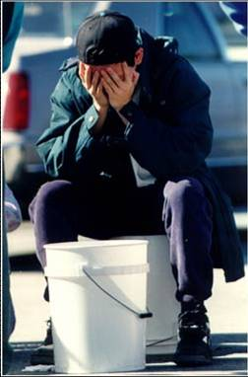
Phases of a Crisis
Impact
Inventory
Rescue
Recovery

Slide 13
Traumatic Crisis
Actual or potential death
Serious injury
Destruction
Loss of contact with family or close friends

Slide 14
Effects of Traumatic Stress
Cognitive functioning
Physical health
Interpersonal relationships

Slide 15
Mediating Factors
Prior experience with a similar event
Intensity of disruption
Individual feelings about event
Emotional strength of individual
Length of time since event

Slide 16
Stabilizing Survivors
Assess survivors for injury or shock
Get uninjured people to help
Provide support by:
Listening
Empathizing
Help survivors connect with natural support systems

Slide 17
How to Be an Empathetic Listener
Put yourself in the speaker’s shoes
Listen for meaning, not just words
Pay attention to nonverbal communication
Paraphrase the speaker

Slide 18
Avoid Saying…
“I understand”
“Don’t feel bad”
“You’re strong” or “You’ll get through this”
“Don’t cry”
“It’s God’s will”
“It could be worse”
“At least you still have…”
“Everything will be okay”

Slide 19
Managing the Death Scene
Cover the body; treat it with respect
Move the body to temporary morgue
Follow local laws and protocols
Talk with local authorities

Slide 20
Informing Family/Friends of a Death
Separate the family member(s) or friend(s)
Have the person(s) sit down
Make eye contact
“I’m sorry, but your family member has died. I am so sorry.”
Let the family and friends grieve

Slide 21
Unit Summary
Rescues may be unpleasant or uncomfortable
Psychological and physiological symptoms of trauma
Take steps to reduce stress
CISD is one intervention
Four emotional phases of a disaster
Stress affects cognition, health, and interactions
Stabilize individuals
Be an empathetic listener

Slide 22
Homework Assignment
Read unit to be covered in next session
Bring necessary supplies to next session
Wear appropriate clothes to next session

