Slide 1

Terrorism and CERT
CERT Basic Training
Unit 8

Slide 2
Unit Objectives
Define terrorism
Identify potential targets in the community
Identify the eight signs of terrorism
Identify CERT operating procedures for a terrorist incident
Describe the actions to take following a suspected terrorist incident

Slide 3
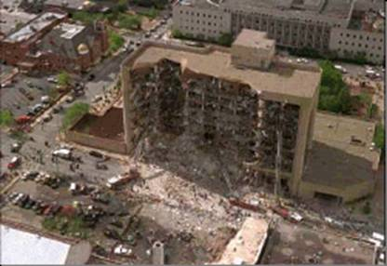
Unit Topics
What Is Terrorism?
Terrorist Targets
Terrorist Weapons
CBRNE Indicators
Preparing at Home, Work, and in Your Neighborhood
CERTs and Terrorist Incidents

Slide 4
What Is Terrorism?
The unlawful use of force or violence against persons or property to intimidate or coerce a government, the civilian population, or any segment thereof, in furtherance of political or social objectives

Slide 5
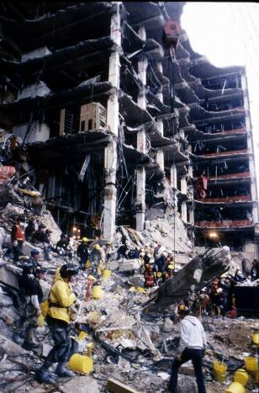
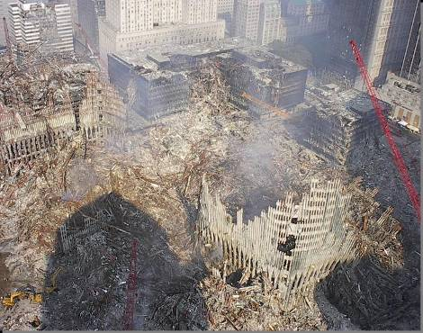
Terrorism in the Past

Slide 6
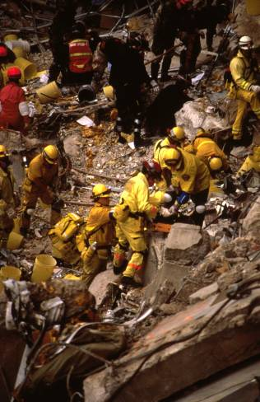
Terrorist Goals
Mass casualties
Loss of critical resources
Disruption of vital services
Disruption of the economy
Heightened fear

Slide 7
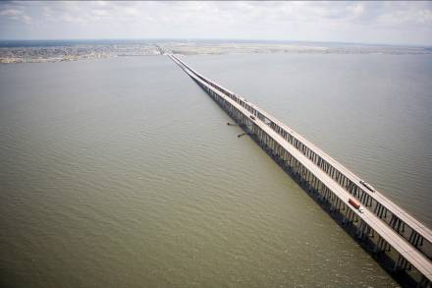
Terrorist Targets
Seats of government
Key industries
Bridges, subways, tunnels, and other key transportation facilities
Water supplies and utilities

Slide 8
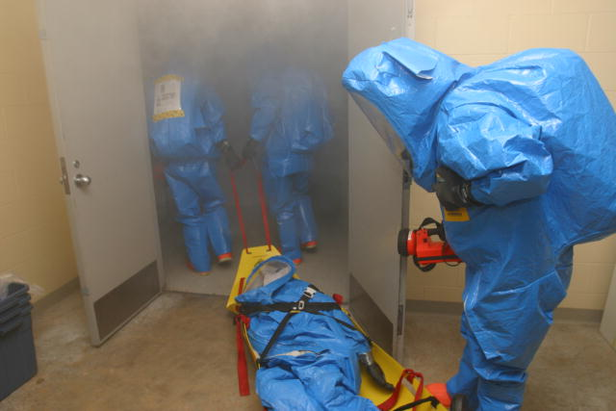
Terrorist Weapons
1. Chemical
2. Biological
3. Radiological
4. Nuclear
5. High-yield Explosives

Slide 9
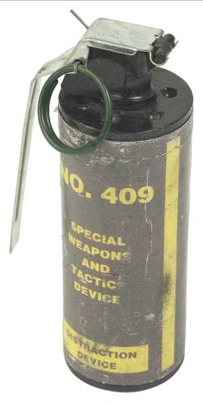
Chemical Weapons
Blister agents
Blood agents
Choking agents
Nerve agents
Riot-control agents

Slide 10
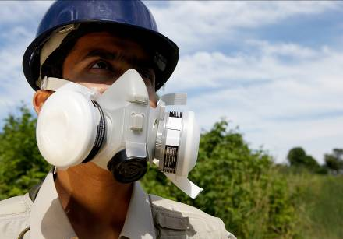
Biological Weapons
Routes of exposure:
Inhalation
Ingestion
Absorption

Slide 11
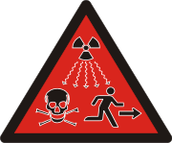
Radiological Weapons
Considered a higher threat because components are easy to obtain

Slide 12
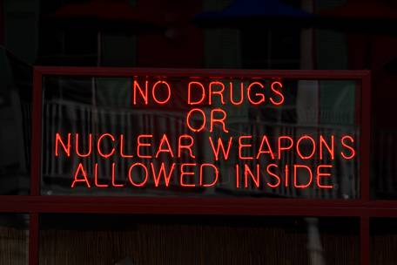
Nuclear Weapons
Derives destructive force from nuclear reaction
Affected area is larger as contaminated objects spread
Potential for casualties extends beyond initial attack
Long-term effects difficult to monitor and track

Slide 13
High-Yield Explosives
Weapon of choice for terrorists
Used in 80% of attacks
Military munitions: grenades, mortars, surface-to-air missiles
Newer explosives called improvised explosive devices or IEDs
Any device created in an improvised manner used to destroy, disfigure, distract, or harass

Slide 14
Assessing the Risk
Types of terrorist weapons in order of greatest risk (least to greatest):
Nuclear
Chemical
Radiological
Biological
High-yield explosives

Slide 15
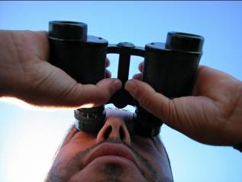
Eight Signs of Terrorism
Surveillance
Elicitation
Tests of security
Funding
Acquiring supplies
Impersonation or suspicious people
Rehearsals and dry runs
Deployment

Slide 16
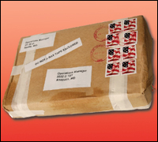
Attack Has Occurred or Is Underway
Vapor clouds or mists
Unscheduled spraying
Materials or equipment unusual for the area
Unusual odors or tastes
Out of place and unattended packages
Leaking packages

Slide 17
See CBRNE Indicators?
If you observe any indications of a terrorist incident you should:
Not touch it
Move away from object or area
Report it to authorities immediately

Slide 18
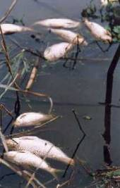
Physical Signs of Chemical-Biological Attack
Sick or dead animals, fish, or birds
Large number of persons seeking medical attention
Multiple survivors exhibiting similar symptoms
Multiple casualties without obvious signs of trauma

Slide 19
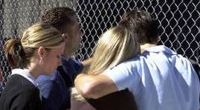
Preparing at Home, Work, Neighborhood
Personal and family safety is first priority!
CERT members are NOT equipped or trained to respond to terrorist incidents
Terrorism incident scenes are also crime scenes

Slide 20
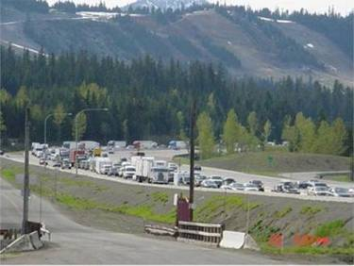
Prepare for Terrorist Activity
CBRNE events are survivable
Preparing for terrorist incidents similar to preparing for natural hazards
Review Unit 1 guidelines
Certain actions more relevant to CBRNE

Slide 21
Shelter-in-Place Procedures
Shut off ventilation systems
Go to your shelter-in-place room
Use precut plastic sheeting to cover air openings
Tape sheeting over doors, windows, vents
Use duct tape to seal other areas
Listen to a battery-powered radio
Ventilate room once contaminants are gone

Slide 22
Protection from Radioactive Fallout
Go deep inside a building (distance/shielding)
Stay inside (time)
Stay tuned

Slide 23
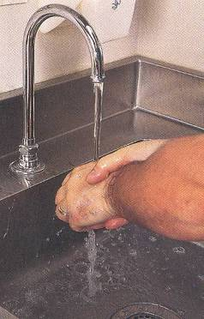
Basic Decontamination Procedures
Leave the contaminated area
Take decontamination action
Remove everything
Wash hands
Flush the entire body
Blot dry
Report for decontamination
Food safety

Slide 24
Treating Others
First priority for a CERT member is personal safety
Take self-protective measures only
Do not attempt to treat survivors in contaminated area
Tell survivors about decontamination procedures

Slide 25
What Professional Responders Will Do
Follow sizeup steps:
What is going on
How bad the situation is and how much worse it could get
What measures can be taken to control the incident safely
What resources will be needed

Slide 26
Unit Summary
Terrorists attack to:
Intimidate the government or the civilian population
Further their objectives
Their goals are to:
Create mass casualties
Disrupt critical resources, vital services, and the economy
Cause fear

Slide 27
Unit Summary (cont’d)
Terrorist Weapons
1. Chemical
2. Biological
3. Radiological
4. Nuclear
5. High-yield Explosives

Slide 28
Unit Summary (cont’d)
CERT Protocol for Terrorist Incidents
Terrorist incidents are a stop sign!
Do not proceed if you suspect terrorist activity
Simple guidelines:
Do not touch
Move away from object or area
Report it to authorities immediately

Slide 29
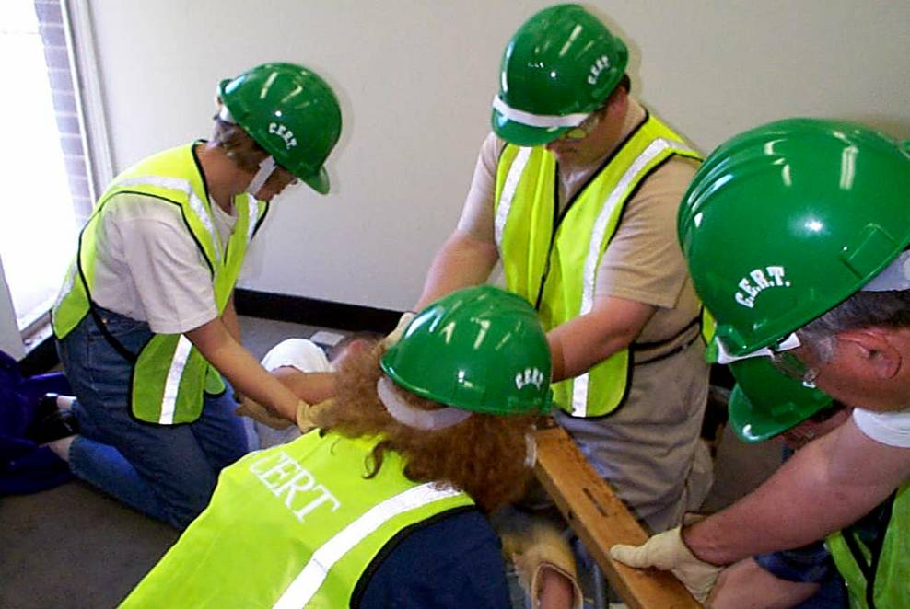
Homework Assignment
Review the materials from the previous units
Wear appropriate clothing for disaster simulation exercise

