Slide 1
Fun with Json
Shawn Weisfeld
shawn@shawnweisfeld.com
http://www.shawnweisfeld.com

Slide 2








About Me
Founder of UserGroup.tv
Lead Organizer Dallas GiveCamp
Sr. Developer & Architect at DRN Data
C#.NET Microsoft Most Valuable Professional
Adjunct Professor at Florida Institute of Technology

Slide 3


Watch User Group presentations
for FREE online!
http://www.UserGroup.tv
We know you cannot make it to every User Group meeting,
that is why we post them online for you!
Miss a User Group meeting?
Forget something that you learned?
Want to see content from a User Group not in your area?
Want to share with a buddy?
Presentations from the thought leaders on the topic.
New Content added all the time!
All the topics you care about
Including:
Agile
C#
Entity Framework
HTML5
MEF
MVC
Silverlight
XAML
jQuery
For new content announcements
@UserGroupTV

Slide 4
What we will cover
Creating Json Services in .NET:
MVC Controller
ASP.NET WebAPI
Json to POCO with json2csharp.com
Consuming Json Services
javascript in the browser with jQuery
RestSharp
JSON.NET

Slide 5
What is Json?

Slide 6

Not this Jason…

Slide 7

Not Jason Statham either…

Slide 8

Defiantly not Jason Preistley …

Slide 9
What is Json
JavaScript Object Notation, is a text-based open standard designed for human-readable data interchange. It is derived from the JavaScript scripting language for representing simple data structures and associative arrays, called objects. Despite its relationship to JavaScript, it is language-independent, with parsers available for many languages.

Slide 10
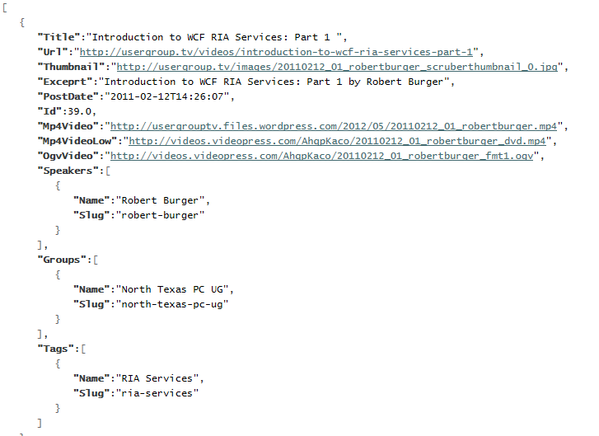
Json Example
http://services.usergroup.tv/api/post

Slide 11
Demo: Create Json with an MVC Controller

Slide 12
Steps:
Create Action on a controller
Get data
Wrap in JsonResult Object
Set behavior to AllowGet
Return JsonResult Object

Slide 13
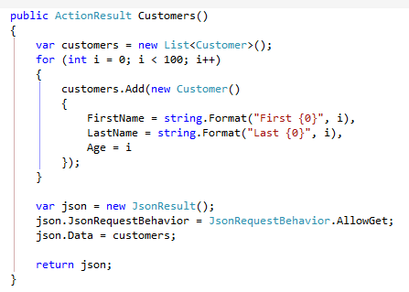
The goods:

Slide 14
Demo: Create Json with ASP.NET WebAPI

Slide 15

Steps:
Add nuget package for ASP.NET WebAPI
Add API Route to Global.asax
Add Controller that inherits from ApiController
Create Get Action that returns data

Slide 16
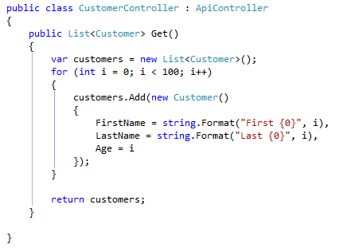
The goods:

Slide 17
Demo: Consume with jQuery

Slide 18
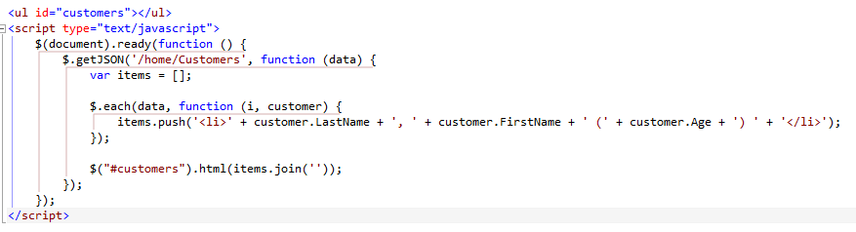
The goods:

Slide 19
Demo: Consume with RestSharp

Slide 20
http://json2csharp.com/
http://www.asp.net/vnext/overview/fall-2012-update

Slide 21

The goods:

Slide 22
Demo: Consume with Json.NET

Slide 23

The goods:

Slide 24
What we saw
Creating Json Services in .NET:
MVC Controller
ASP.NET WebAPI
Json to POCO with json2csharp.com
Consuming Json Services
javascript in the browser with jQuery
RestSharp
JSON.NET

Slide 25

Thank You!
Rate My Talk & Download Slides + Code!
http://speakerrate.com/weisfels
Contact Information
shawn@shawnweisfeld.com
http://www.shawnweisfeld.com
@shawnweisfeld

