Slide 1



Please help us!
Thank our Sponsors:

Slide 2

Redis for the .NET Developer
Shawn Weisfeld
shawn@shawnweisfeld.com
http://www.shawnweisfeld.com

Slide 3







About Me
Founder of UserGroup.tv
Application Development Manager at Microsoft
Adjunct Professor at Florida Institute of Technology

Slide 4


Watch User Group presentations for FREE online!
All the topics you care about
Including:
Agile
C#
Entity Framework
HTML5
MVC
Silverlight
XAML
jQuery
and Much More!
Miss a User Group meeting?
Forget something that you learned?
Want to see content from a User Group not in your area?
Want to share with a buddy?
We know you cannot make it to every User Group meeting,
that is why we post them online for you!
We now have over 300 presentations online
That is over 60 GB of video
New Content added all the time!
Presentations from the thought leaders on the topic.
For new content announcements
@UserGroupTV
http://www.UserGroup.tv

Slide 5
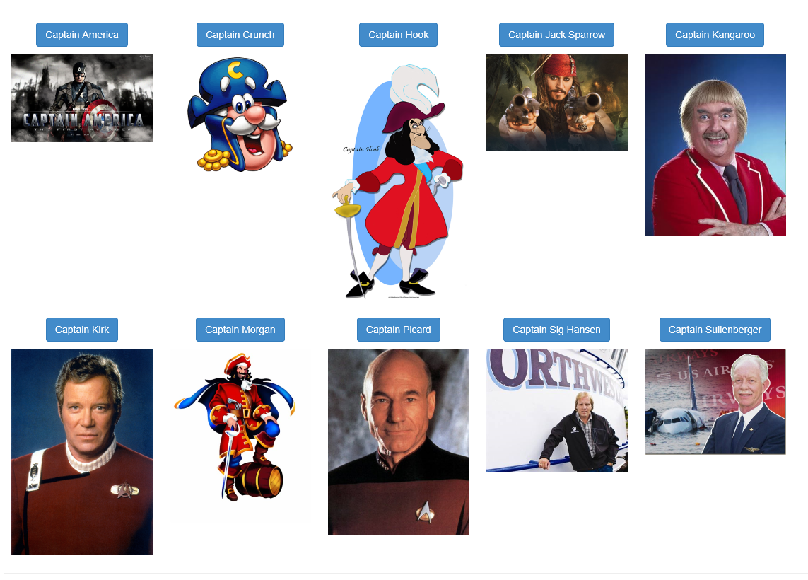
Which Captain should reign supreme?
Vote Now! Captain Smackdown
http://captainsmackdown.azurewebsites.net

Slide 6
What is Redis?
Redis is an open source, BSD licensed, advanced key-value cache and store. It is often referred to as a data structure server since keys can contain strings, hashes, lists, sets, sorted sets, bitmaps and hyperloglogs.
You can run atomic operations on these types, like appending to a string; incrementing the value in a hash; pushing an element to a list; computing set intersection, union and difference; or getting the member with highest ranking in a sorted set.

Slide 7
What is Redis?
In order to achieve its outstanding performance, Redis works with an in-memory dataset. Depending on your use case, you can persist it either by dumping the dataset to disk every once in a while, or by appending each command to a log.
Redis also supports trivial-to-setup master-slave asynchronous replication, with very fast non-blocking first synchronization, auto-reconnection with partial resynchronization on net split.

Slide 8
Features of Redis
Transactions
Pub/Sub
Lua scripting
Keys with a limited time-to-live
LRU eviction for keys
Automatic failover

Slide 9
What do you need:
2 things:
Redis Server
Redis Client

Slide 10

Redis Server
Original POSIX version on redis.io
Windows Version by MSOpenTech
Azure:
http://azure.microsoft.com/en-us/documentation/articles/cache-dotnet-how-to-use-azure-redis-cache
Preview Portal only: https://portal.azure.com
GitHub: https://github.com/MSOpenTech/redis
NuGet:

Slide 11
Redis as a Service on Azure
250 MB to 26 GB
With or without Replication
Includes Azure Metrics and Alerts
More Info:
http://azure.microsoft.com/blog/2014/06/04/lap-around-azure-redis-cache-preview/

Slide 12
Redis Clients
Redis-cli.exe
Desktop Manager
http://redisdesktop.com/
C# StackExchange
https://github.com/StackExchange/StackExchange.Redis
More at
http://redis.io/clients

Slide 13
Redis data types
String
Lists: collections of string elements sorted according to the order of insertion. They are basically linked lists.
Sets: collections of unique, unsorted string elements.
Sorted sets, similar to Sets but where every string element is associated to a floating number value, called score. The elements are always taken sorted by their score, so unlike Sets it is possible to retrieve range of elements (for example you may ask: give me the top 10, or the bottom 10).

Slide 14
Redis data types
Hashes, which are maps composed of fields associated with values. Both the field and the value are strings. This are very similar to Ruby or Python hashes.
Bit arrays (or simply bitmaps): it is possible, usign special commands, to handle String values like array of bits: you can set and clear individual bits, count all the bits set to 1, find the first set or unset bit, and so forth.

Slide 15
Redis data types
HyperLogLogs: this is a probabilistic data structure which is used in order to estimate the cardinality of a set.

Slide 16
Goodies
Redis SessionState Provider
Uses StackExchange client internally
http://msdn.microsoft.com/en-us/library/azure/dn690522.aspx
Coming soon one backed by Azure Table Storage
Redis as a black plane for SignalR
http://www.asp.net/signalr/overview/signalr-20/performance-and-scaling/scaleout-with-redis

Slide 17
Resources
Redis Website
http://redis.io
Interactive Tutorial
http://try.redis.io
MSOpenTech Redis Blog
http://msopentech.com/opentech-projects/redis/
Channel 9: A look around the Redis Cache Preview with Saurabh Pant
http://channel9.msdn.com/Shows/Web+Camps+TV/A-look-around-the-Redis-Cache-Preview-with-Saurabh-Pant

Slide 18
Thank you! Your Feedback is Important
Rate My Talk & Download Slides + Code!
http://tinyurl.com/RateShawn
Contact Information
Email: shawn@shawnweisfeld.com
Blog: http://www.shawnweisfeld.com
Twitter: @shawnweisfeld

Slide 19
Please Complete An Evaluation Form Your input is important!
You can access Evaluation Forms at:
http://TulsaTechFest.com
Fill them out!
You can win additional prizes!
Like a $50 Best Buy Gift Card!!
Winner drawn – Midnight, Sun Aug 17th!

Slide 20
Please help us!
Thank our Sponsors:

Slide 21

© 2014 Microsoft Corporation. All rights reserved. Microsoft, Windows, Windows Vista and other product names are or may be registered trademarks and/or trademarks in the U.S. and/or other countries.
The information herein is for informational purposes only and represents the current view of Microsoft Corporation as of the date of this presentation. Because Microsoft must respond to changing market conditions, it should not be interpreted to be a commitment on the part of Microsoft, and Microsoft cannot guarantee the accuracy of any information provided after the date of this presentation. MICROSOFT MAKES NO WARRANTIES, EXPRESS, IMPLIED OR STATUTORY, AS TO THE INFORMATION IN THIS PRESENTATION.

