Slide 1
Semantic Logging Application Block (SLAB)
Shawn Weisfeld
shawn@shawnweisfeld.com
@shawnweisfeld

Slide 2



Welcome to Houston TechFest
Thank you for being a part of the 8th Annual Houston TechFest!
Please turn off all electronic devices or set them to vibrate.
If you must take a phone call, please do so in the lobby so as not to disturb others.
Thanks to our Diamond Sponsors:

Slide 3
Key objectives
Why is consuming logs so difficult?
How can the EventSource class make logging better?
How can the Semantic Logging Application Block help me get there?
Notes:
This is not a talk for Windows Store apps! This is for the .NET Framework (desktop/server).

Slide 4

Logs are a hassle to deal with
No real structure.
What’s in there? (Especially tough if you didn’t create them.)
Sheer number of files and types of logs is overwhelming.
Image credit: Casey Konstantín
bit.ly/126NvV7

Slide 5
We (P&P and Microsoft) are on a mission
Changing the way people think about logging.
Logging cannot be just a checkmark of doing something.
You have to think about consumption and purpose.
Allow appropriate decisions to be made at appropriate time, explicitly separating:
WHAT to log.
HOW to log it.
WHERE to log.

Slide 6
Technologies at play
Event Tracing for Windows (ETW)
Native to Windows platform
EventSource class
New in .NET Framework 4.5
Great performance & OK diagnostic tooling
Historically hard to publish events
Meant to ease authoring experience
Extensible but supports ETW-only out of the box
Semantic Logging Application Block (SLAB)
Provides several destinations for events published with EventSource
Additional tooling support for authoring events
Does not require any knowledge in ETW

Slide 7
Why SLAB
Structured Logging
Move logging out of Process

Slide 8
Structured Logging
Make it easier to read logs
Write messages via .NET EventSource Class
No external dependencies to write messages
New in .NET 4.5 (supported in .NET 3.5 & .NET 4.0 via Nuget Package)

Slide 9
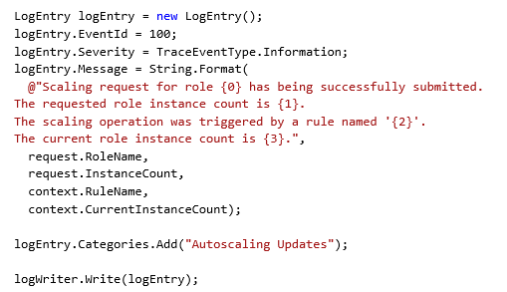
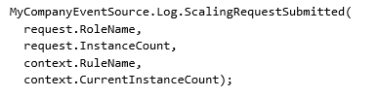
Writing Messages to:
Unstructured Logging
Structured Logging

Slide 10
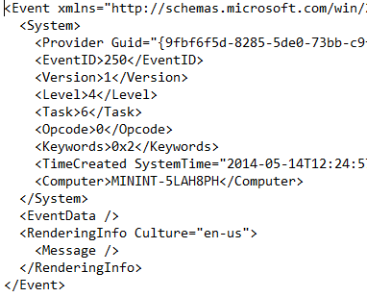
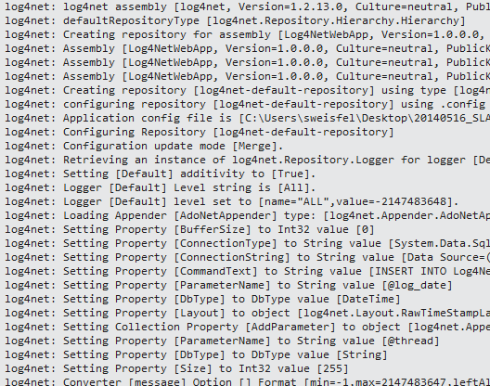
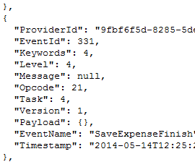
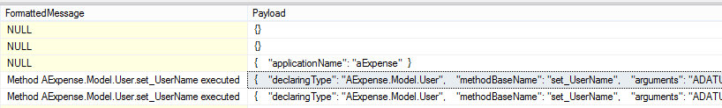
Reading Messages from:
Unstructured Logging
Structured Logging

Slide 11
Demo – Hello SLAB

Slide 12
Hello SLAB
How to write an event from your app
How to write an event from the global.asax
What the event source looks like
Attaching listeners in code

Slide 13
Built in Event Sinks & Formatters
Several sinks/destinations:
Windows Azure Table.
SQL Database.
Flat file.
Rolling flat file.
Console.
Formatters (for text-based sinks):
JSON.
XML.
Natural (plain-text).

Slide 14
Move logging out of Process
Built on top of Event Tracing for Windows (ETW)
Remove cost of writing messages to another process
Remove risk of writing messages to another process
Ability to alter logging without touching the app
Allows for message capture even if app crashes
Ability to log multiple applications on the same machine
Hosted as a Windows Service or Console

Slide 15
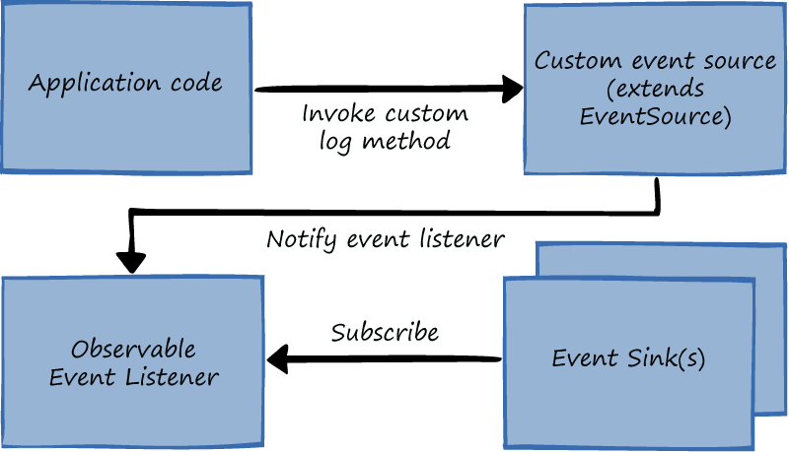
In Process

Slide 16
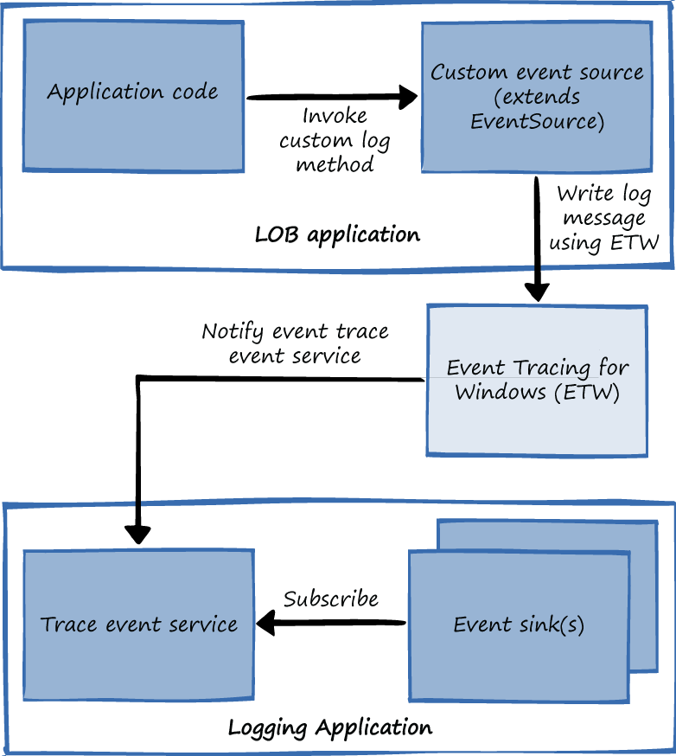
Out of Process

Slide 17
Demo – Out of Process

Slide 18
SLAB Validation
Checks for
Event ID mismatch
Argument order
Methods that take more then just simple types

Slide 19
Demo – SLAB Validation

Slide 20
Advanced EventSource
Writing Complex types
Write a helper method that strips the object for logging, add the NonEvent Attribute
Keywords
Allow technique to filter what events get written to the log
Makes searching logs easier
Tasks & OpCodes
Allows for additional metadata to be added to the log
Version
Flags logged events making resilient to schema changes

Slide 21
EventSource Performance
Don’t write on disabled events
Write using non – “Params” overload
Pass enums as ints

Slide 22
PerfView
Consume ETW events via external tools
PerfView is a performance-analysis tool that helps isolate CPU- and memory-related performance issues.
http://www.microsoft.com/en-us/download/details.aspx?id=28567

Slide 23
Using SLAB in 3 easy steps
Create an EventSource class to describe what you want to log
Call your EventSource class from your code
If “In Process” - Add an Event listener to capture your messages to the appropriate Event Sink

Slide 24
More Info
SLAB CodePlex site
http://slab.codeplex.com/
Creating Structured and Meaningful Logs with Semantic Logging
Julian Dominguez, Build 2013
http://channel9.msdn.com/Events/Build/2013/3-336
Introducing Semantic Logging
Grigori Melnik
http://channel9.msdn.com/posts/Introducing-Semantic-Logging

Slide 25
More Info
Announcing the EventSource NuGet Package – Write to the Windows Event Log
http://blogs.msdn.com/b/dotnet/archive/2013/08/09/announcing-the-eventsource-nuget-package-write-to-the-windows-event-log.aspx
SLAB - Reactive Event Sourcing
http://www.shujaat.net/2013/08/slab-reactive-event-sourcing.html
Event listener is IObservable.
Event sinks are IObservers.
Can leverage Reactive Extensions (Rx) to filter, pre-process or transform the event stream before it’s persisted.

Slide 26
More Info
Semantic Logging Application Block (SLAB)
http://convective.wordpress.com/2013/08/12/semantic-logging-application-block-slab/
Semantic Logging Application Block (SLAB) 1.1
https://slab.codeplex.com/wikipage?title=ActivityTracingAndSampling
Adds support for ActivityId and RelatedActivityId allowing you to correlate events between separate log messages
SLAB on MSDN
http://msdn.microsoft.com/en-us/library/dn440729(v=pandp.60).aspx
Sample Code and PDF book

Slide 27
More Info
EventSorce: Everything you ever wanted to know
http://view.officeapps.live.com/op/view.aspx?src=http%3A%2F%2Fblogs.msdn.com%2Fcfs-filesystemfile.ashx%2F__key%2Fcommunityserver-components-postattachments%2F00-10-44-08-22%2F_5F00_EventSourceUsersGuide.docx

Slide 28

© 2014 Microsoft Corporation. All rights reserved. Microsoft, Windows, Windows Vista and other product names are or may be registered trademarks and/or trademarks in the U.S. and/or other countries.
The information herein is for informational purposes only and represents the current view of Microsoft Corporation as of the date of this presentation. Because Microsoft must respond to changing market conditions, it should not be interpreted to be a commitment on the part of Microsoft, and Microsoft cannot guarantee the accuracy of any information provided after the date of this presentation. MICROSOFT MAKES NO WARRANTIES, EXPRESS, IMPLIED OR STATUTORY, AS TO THE INFORMATION IN THIS PRESENTATION.

Slide 29
Thank you! Your Feedback is Important
Rate My Talk & Download Slides + Code!
http://tinyurl.com/RateShawn
Contact Information
Email: shawn@shawnweisfeld.com
Blog: http://www.shawnweisfeld.com
Twitter: @shawnweisfeld

Slide 30

Please Leave Feedback During Q&A
If you leave session feedback and provide contact information in the survey, you will be qualified for a prize
Scan the QR Code to the right or go to http://bit.ly/1p13f3n

Slide 31





















Thanks to all our Sponsors!

