Slide 1
SQL Server Data Tools
Shawn Weisfeld
shawn@shawnweisfeld.com
http://www.shawnweisfeld.com

Slide 2







About Me
Founder of UserGroup.tv
Application Development Manager at Microsoft
Adjunct Professor at Florida Institute of Technology

Slide 3


Watch User Group presentations for FREE online!
All the topics you care about
Including:
Agile
C#
Entity Framework
HTML5
MVC
Silverlight
XAML
jQuery
and Much More!
Miss a User Group meeting?
Forget something that you learned?
Want to see content from a User Group not in your area?
Want to share with a buddy?
We know you cannot make it to every User Group meeting,
that is why we post them online for you!
We now have over 400 presentations online
That is over 60 GB of video
New Content added all the time!
Presentations from the thought leaders on the topic.
For new content announcements
@UserGroupTV
http://www.UserGroup.tv

Slide 4
Agenda
SQL Server Data Tools 101
Using SQL Server Data Tools without a project
Using SQL Server Data Tools Projects

Slide 5
SQL Server Data Tools 101

Slide 6
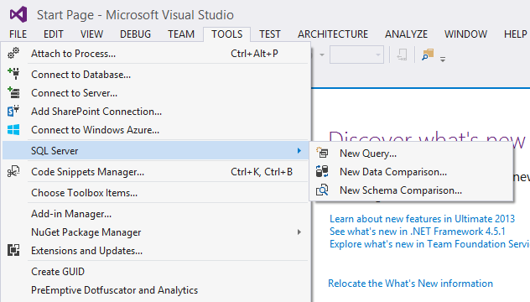
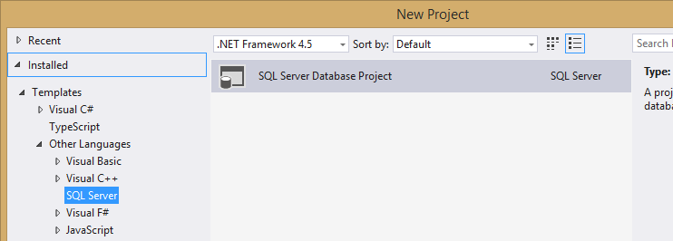
What are they?
...provides an integrated environment for database developers to carry out all their database design work for any SQL Server platform within Visual Studio.

Slide 7
How do I get them?
Visual Studio Editions
Ultimate, Premium & Pro
Updated via “Extensions and Updates”

Slide 8
Why should I use them?
Databases are inherently stateful
Focus is on ALTER instead of CREATE
Dependencies complicate scripts
Errors are often found only when scripts are executed
Synchronizing application and database versions
Database development often not integrated in to application life cycle management and processes
Targeting different SQL Server and SQL Azure versions

Slide 9
Imperative Database Development
Describes the changes that we want to make
Risks
What happens if we forget to apply one of the changes?
What happens if we apply the changes in the wrong order?
How to we “version” the database with the application?
What is the “truth” for the DB schema?

Slide 10
Imperative Example
-- version 1
CREATE TABLE dbo.Auction
(
id INT NOT NULL,
name VARCHAR(25) NOT NULL,
start DATETIME NULL,
len INT NULL
)
-- version 2
ALTER TABLE dbo.Auction
WITH CHECK ADD CONSTRAINT Au_PK
-- version 3
ALTER TABLE dbo.Auction
WITH CHECK
ADD CONSTRAINT Au_SK UNIQUE (name)

Slide 11
Imperative bakes knowledge into scripts
The state of the target system:
Presence of objects, dependencies, unbinding, rebinding
Required ordering of operations
Cumulative changes need to be serialized
v1→v2→v3→v4→v5 instead of v1→v4→v5
Validating the end-result against expected end-state is hard
No easy way to compare expected vs. actual
Batching or separating multiple changes

Slide 12


What if . . .
We could describe what we wanted and let the tooling figure out how to get us there?

Slide 13
Declarative Database Development
Define what you want in the form of a model
Fill the model using a DSL (domain specific language)
T-SQL
Use the model as the starting point “blueprint” for all operations
Deployment/publish, start by comparing the current state of the target with the required state (blueprint)
Use the resulting difference knowledge to programmatically generate an deployment plan
Use plan to create sequence of (SQL) statements required to make the target state become like the blueprint state

Slide 14
Declarative Example
-- version 1
CREATE TABLE dbo.Auction
(
id INT NOT NULL,
name VARCHAR(25) NOT NULL,
start DATETIME NULL,
len INT NULL
)
-- version 2
CREATE TABLE dbo.Auction
(
id INT NOT NULL PRIMARY KEY,
name VARCHAR(25) NOT NULL,
start DATETIME NULL,
len INT NULL
)
-- version 3
CREATE TABLE dbo.Auction
(
id INT NOT NULL PRIMARY KEY,
name VARCHAR(25) NOT NULL UNIQUE,
start DATETIME NULL,
len INT NULL
)

Slide 15
Declarative Schema Deployment
Source
Schema
Model
Target
Schema
Model
Model Compare
Reverse Engineer
Diff List
Plan
Optimizer
Additional
schema
artifacts
Deploy Plan
Script Generator
Target
DB
Script Executor
Incremental target update

Slide 16
Using SSDT without a project

Slide 17
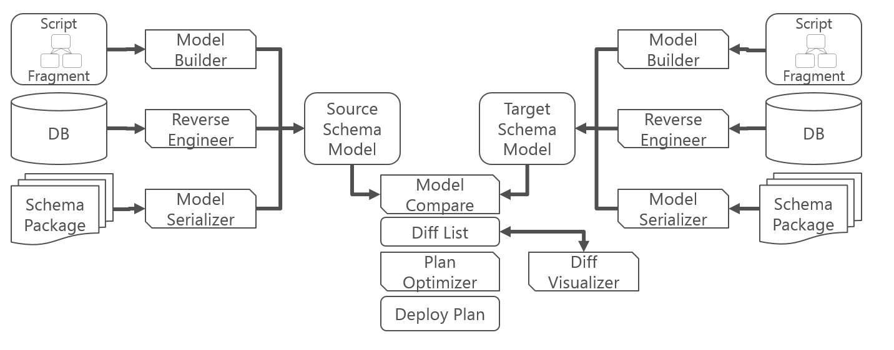
Schema Compare

Slide 18
Data Compare
Source
Target
ID | FirstName | LastName
1 | George | Washington
2 | John | Adams
3 | Thomas | Jefferson
ID | FirstName | LastName
1 | George | Jefferson
2 | John | Adams
4 | Donald | Duck
Add
Modify
ID | FirstName | LastName
4 | Donald | Duck
ID | FirstName | LastName
1 | George | Jefferson
Delete
Unchanged
ID | FirstName | LastName
3 | Thomas | Jefferson
ID | FirstName | LastName
2 | John | Adams

Slide 19
Demo
Schema Compare
Data Compare

Slide 20
Using SSDT Projects

Slide 21
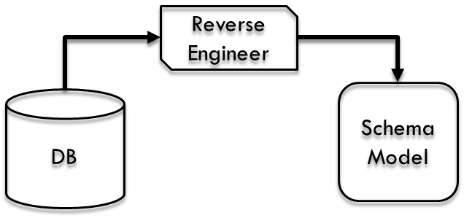
Reverse Engineer from Existing
Reverse Engineering is a special form of model builder, which scripts the content of a source database in the form of SQL scripts (model DSL input format) to construct a model

Slide 22
Demo
Reverse Engineer from Existing
IDE Features
Go To Definition/Find All References/Refactoring
Edition Aware Targeting
Detection of Breaking Schema Changes
Debugging

Slide 23
What is a Data-Tier Application?
Data-Tier Application Component (DAC)
SQL Server database registered as Data-Tier Application Component
DAC is a self contained entity of a database used by an application
Unit of deployment and management
Authored along side your application code
Compiled into a DAC package (DACPAC)
Extracted for existing databases
Database extracted (DACPAC) or exported (BACPAC) into packages
Package is deployable to SQL Server and SQL Azure

Slide 24
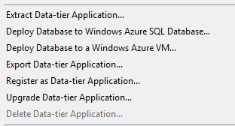
DAC Lifecycle
Develop (VS.NET)
Deploy (SSMS)
Manage (SSMS)
Author DAC
Compile Database Project to DACPAC
Compare and Synchronize Source
Publish DACPAC
Deploy Package
Upgrade Databases
New Databases
Register Database as DAC
Export and Extract Packages
Import Database/ DACPAC
Developer
DBA
DBA/Admin

Slide 25
DACPAC vs BACPAC
A DACPAC is a file that encapsulates the database schema.
Used to migrate schema changes between environments.
A BACPAC is a file that encapsulates the database schema as well as the data stored in the database.
Used to move to a new server
Used to backup a db in an “open” format (json)

Slide 26
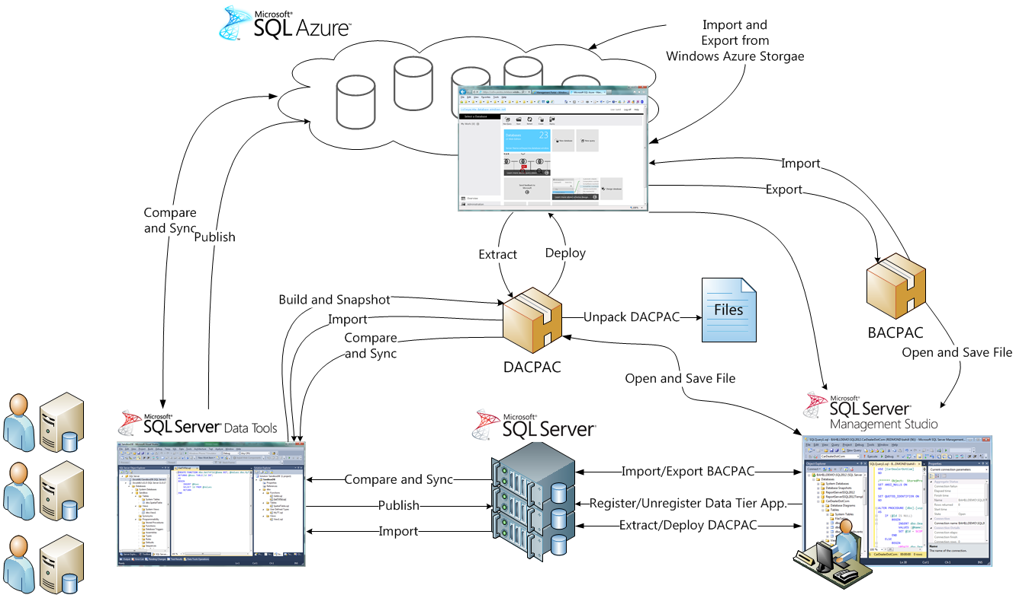

Slide 27
Publishing via TSQL
Push from within VS

Slide 28
Publishing via DACPAC
“msi for db changes”
Push from within VS
Push from SSMS
Push from command line
SqlPackage
MSDeploy

Slide 29
SqlPackage.exe
Common Commands
Extract: Creates a database snapshot (.dacpac) file from a live SQL Server or Windows Azure SQL Database.
Export: Exports a live database - including database schema and user data - from SQL Server or Windows Azure SQL Database to a BACPAC package (.bacpac file).
Import: Imports the schema and table data from a BACPAC package into a new user database in an instance of SQL Server or Windows Azure SQL Database.
Publish: Incrementally updates a database schema to match the schema of a source .dacpac file. If the database does not exist on the server, the publish operation will create it. Otherwise, an existing database will be updated.
Script: Creates a Transact-SQL incremental update script that updates the schema of a target to match the schema of a source
More Info
http://msdn.microsoft.com/en-us/library/hh550080(v=VS.103).aspx

Slide 30
MSDeploy with dbSqlPackage Provider
Common Commands
Extract : Creates a database snapshot (.dacpac) file from a live SQL Server or SQL Azure databases.
Publish : Incrementally updates a database schema to match the schema of a source .dacpac file.
Script : Creates a Transact-SQL script equivalent to the script executed by the Publish Action.
More Info
http://msdn.microsoft.com/en-us/library/hh550081(v=vs.103).aspx

Slide 31
Demo
Publishing via TSQL Diff
Publishing via DACPAC
Detecting Drift with DACPAC

Slide 32
Demo
Management Views
select * from msdb.dbo.sysdac_instances
select * from msdb.dbo.sysdac_history_internal

Slide 33
Thank you! Your Feedback is Important
Rate My Talk & Download Slides + Code!
http://tinyurl.com/RateShawn
Contact Information
Email: shawn@shawnweisfeld.com
Blog: http://www.shawnweisfeld.com
Twitter: @shawnweisfeld

Slide 34
Resources

Slide 35
Links
SQL Server Data Tools Home Page
http://msdn.microsoft.com/en-us/data/tools.aspx
SQL Server Data Tools MSDN
http://msdn.microsoft.com/en-us/library/hh272686(v=vs.103).aspx
Compare Visual Studio Offerings
http://www.visualstudio.com/products/compare-visual-studio-products-vs
SSDT In Older Versions of VS
http://blogs.msdn.com/b/ssdt/archive/2014/01/31/ssdt-and-visual-studio-versions.aspx

Slide 36
Links
Required Permissions for SQL Server Data Tools
http://msdn.microsoft.com/en-us/library/jj889462(v=vs.103).aspx
DAC Support For SQL Server Objects and Versions
http://msdn.microsoft.com/en-us/library/ee210549.aspx

Slide 37
Sample Databases
Northwind and pubs
http://www.microsoft.com/en-us/download/details.aspx?id=23654

Slide 38
Works Cited
SQLBits 2012 SSDT Workshop
http://www.slideshare.net/gdrapers/ssdt-workshop-sql-bits-x-20120329
By Gert Drapers - gert.drapers@microsoft.com

Slide 39

© 2014 Microsoft Corporation. All rights reserved. Microsoft, Windows, Windows Vista and other product names are or may be registered trademarks and/or trademarks in the U.S. and/or other countries.
The information herein is for informational purposes only and represents the current view of Microsoft Corporation as of the date of this presentation. Because Microsoft must respond to changing market conditions, it should not be interpreted to be a commitment on the part of Microsoft, and Microsoft cannot guarantee the accuracy of any information provided after the date of this presentation. MICROSOFT MAKES NO WARRANTIES, EXPRESS, IMPLIED OR STATUTORY, AS TO THE INFORMATION IN THIS PRESENTATION.

