Slide 2
Building Resilient, Scalable Services with Microsoft Azure Service Fabric
2-700
Mark Fussell
Principal Program Manager
Vipul Modi
Principal Software Engineering Manager

Slide 3
Building Resilient, Scalable Services with Microsoft Azure Service Fabric
2-700
Mark Fussell
Principal Program Manager
Vipul Modi
Principal Software Engineering Manager

Slide 4
Agenda
Azure Service Fabric platform
Applications and microservices
Programming models
Scaling

Slide 5
Microsoft Azure Service Fabric A platform for reliable, hyperscale, microservice-based applications
Microservices
High Availability
Data Partitioning
Service Fabric
Health Monitoring
Container Orchestration & lifecycle management
Hybrid Operations
Self-healing
Simple programming models
High Density
Rolling Upgrades
Low Latency
Placement Constraints
Replication & Failover
Stateful services
Fast startup & shutdown
Load balancing
Hyper-Scale
Automated Rollback
Windows
Server
Linux
Windows
Server
Linux
Azure
Hosted Clouds
Windows
Server
Linux
Private Clouds

Slide 6

Service Fabric cluster with microservices
App1
App2

Slide 7
Handling machine failures
App1
App2

Slide 8


What can you build with Service Fabric?
Stateless applications
A service that has state where the state is persisted to external storage, such as Azure databases or Azure storage
e.g. Existing web (ASP.NET) and worker role applications
Stateful applications
Reliability of state through replication and local persistence
Reduces latency
Reduces the complexity and number of components in traditional three tier architecture
Existing apps written with other frameworks
node.js, Java VMs, any EXE

Slide 9
Service Fabric Applications
Applications composed of microservices
Reliable Actors API
Reliable Services API
Service Fabric
Health Monitoring
Container Orchestration & lifecycle management
High Availability
Hybrid Operations
Data Partitioning
Self-healing
Simple programming models
High Density
Rolling Upgrades
Low Latency
Placement Constraints
Replication & Failover
Stateful services
Fast startup & shutdown
Load balancing
Hyper-Scale
Automated Rollback
Azure
Private Clouds

Slide 10
Reliable Actor API
Build reliable stateless and stateful objects with a virtual Actor Programming Model
Suitable for applications with multiple independent units of state and compute
Automatic state management and turn based concurrency (single threaded execution)

Slide 11
DEMO - Reliable Actor API Stateless and stateful counter actors

Slide 12
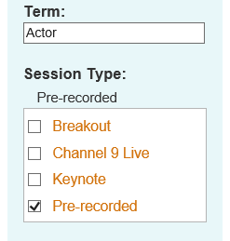
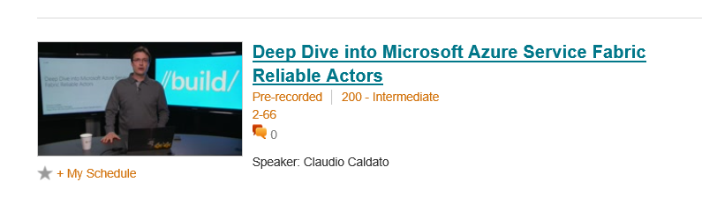
Learn more about Reliable Actors APIs
Watch pre-recorded session
http://channel9.msdn.com/Events/Build/2015/2-66

Slide 13





Defining applications and services
Code
Config
Application Type
Application
Package
Counter
Service type
Unit of
Lifetime
Versioning
Isolation
Counter WebApp type
Counter
Service
Pkg
Counter
WebApp
Pkg

Slide 14
Instantiating an application
app1
app2
Service
Package
A
Service
Package
A
Service
Package
B
Service
Package
B
app3
app4
Service
Package
A
Service
Package
A
Service
Package
B
Service
Package
B
ServiceType is “like” a .NET CLR type (class CounterServiceType)
ApplicationType is “like” a typed Container (CounterAppType : ServiceContainer<TServiceType> where TServiceType is CounterServiceType, ServiceType2
ApplicationInstance is an instance of the ApplicationType and has an unique name “fabric:/CounterApplication”
Each service instance has a unique name in the “namespace” of the application “fabric:/CounterApplication/CounterService”

Slide 15
Reliable Services API
Build stateless services using existing technologies such as ASP.NET
Build stateful services using reliable collections
Manage the concurrency and granularity of state changes using transactions
Communicate with services using the technology of your choice (e.g WebAPI, WCF)

Slide 16
Reliable Collections
Reliable collections make it easy to build stateful services.
Evolution of the .NET collections for the cloud
Collections
Single machine
Single threaded
Concurrent
Collections
Single machine
Multi threaded
Reliable Collections
Multi machine
Replicated (HA)
Persistence (durable)
Asynchronous
Transactional

Slide 17


Reliable Collections
IReliableDictionary<K,V>
IReliableQueue<T>
Atomically update one or more collections using transactions
Changes are replicated and durably stored on multiple replicas
Reads are repeatable within the transaction
Enumerations are snapshot based

Slide 18
DEMO
Reliable Service API Stateless Word count service

Slide 19





Word count service Cloud Service vs Stateful Service Fabric
Cloud Services
Service Fabric
(Stateful)
Reliable Azure Queue
Azure Tables/NoSQL

Slide 20
DEMO
Reliable Service API Stateful Word count service

Slide 21
Service partitioning
Services can be partitioned for scale-out
You can choose your own partitioning scheme
Service partitions are stripped across machine in the cluster
Node 100
Node 101
Node 102
Node 103
Node 104
Node 105
P1
P2
P3
S
S
S
S
S
S
P4
S
S
S
P
S
S

Slide 22




Scale-out and partitioning
Load Balancer

Slide 23
DEMO
Reliable Service API Scale-out stateful word count service

Slide 24
Summary
Built micro-services using Reliable Actors and Reliable Services APIs
Achieved Data Reliability through Reliable Collections and Stateful Actors
Scaled-out using partitioning

Slide 25
Call to Action
Download the Service Fabric developer SDK
http://aka.ms/ServiceFabric
Download the samples from GitHub
http://github.com/Azure/ServiceFabric-Samples
Learn from the tutorials and videos
http://aka.ms/ServiceFabricdocs
Attend other talks
Microsoft Azure Service Fabric Architecture
Deploying and managing services with Microsoft Azure Service Fabric
Provide feedback
http://aka.ms/ServiceFabricforum
http://stackoverflow.com/questions/tagged/azure-service-fabric
Twitter hastag #AzureServiceFabric

Slide 26
Resources
Improve your skills by enrolling in our free cloud development courses at the Microsoft Virtual Academy.
Try Microsoft Azure for free and deploy your first cloud solution in under 5 minutes!
Easily build web and mobile apps for any platform with AzureAppService for free.

